Slide 1

Presentation
Course Code: CSE-4302
Course Title : Computer Graphics and Pattern Recognition Sessional.

Slide 2
Topic: Real-Time Detection and Tracking for Augmented Reality on Mobile Phones
Submitted By
Submitted To
1. Name: Sumaiya Ahmed Susmi ID:2020105810
2. Name: Isfat Ara Hasan Ema ID:20201112010
3. Name: Fatema Zahan Shayla ID:20201159010
Department of Computer Science and Engineering
Name: M. Raihan
Assistant Professor
Department of Computer Science and Engineering
Department of Computer Science and Engineering
North Western University, Khulna.

Slide 3
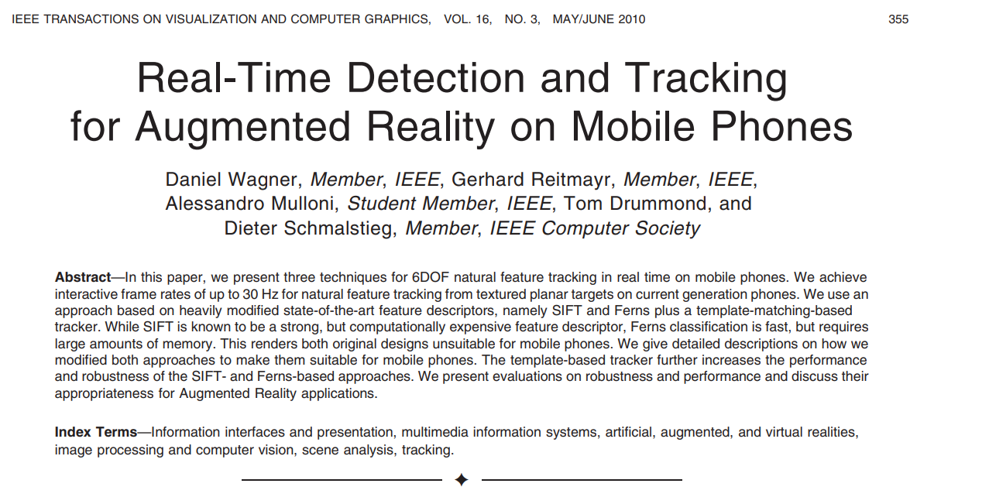

Slide 4
Abstract:
The paper introduces 3 techniques for real-time 6DOF feature tracking on mobiles, achieving up to 30 Hz rates. It modifies SIFT and Ferns, making them mobile-friendly. SIFT is strong but computationally expensive; Ferns is fast but memory-intensive. Authors enhance these with a template-matching tracker, evaluating suitability for Augmented Reality.
1. Introduction:
The paper addresses mobile AR's natural feature tracking challenges, introducing PhonySIFT and PhonyFerns for mobile platforms, along with PatchTracker. This hybrid system achieves efficient 6DOF tracking, surpassing naive methods and is suitable for both mobile phones and advanced platforms. The detailed evaluation offers insights for computer vision-based tracking system developers.

Slide 5
2. Related Work: The paper tackles real-time 6DOF tracking challenges in mobile AR, presenting the sole published system for mobile 6DOF tracking. It categorizes prior work, focusing on SIFT and Ferns for point-based approaches, addressing mobile resource constraints and tracking outsourcing to PCs. The paper briefly mentions early fiducial marker tracking and provides a concise overview of SIFT and Ferns techniques.
3.NATURAL FEATURE MATCHING
The paper outlines a tracking classification method (from reference [14]) learning binary features from image intensity near interest points. At runtime, these features classify interest points without distance measures, optimizing recognition in the original model image. Training involves varied example views, with Ferns handling the large distribution, approximating classification probabilities. The summary is a brief overview without specific mathematical details
North Western University , Khulan.

Slide 6
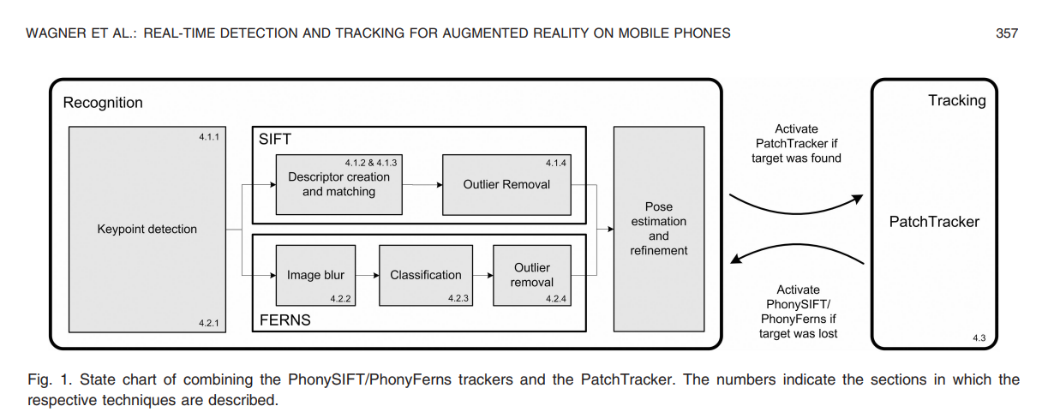
4.MAKING NATURAL FEATURE TRACKING FEASIBLE ON PHONES
The paper enhances SIFT and Ferns for real-time 6DOF tracking on mobiles. PhonySIFT and PhonyFerns, with FAST and Gauss-Newton, enable a four-step pipeline. PhonySIFT, a modified SIFT, and PhonyFerns, an adapted Ferns, are featured. PatchTracker, a keypoint-less, active search tracker, is introduced. Combined tracking uses PhonySIFT/Ferns for initiation, handing over to PatchTracker for robust mobile augmented reality.
North Western University , Khulan.

Slide 7
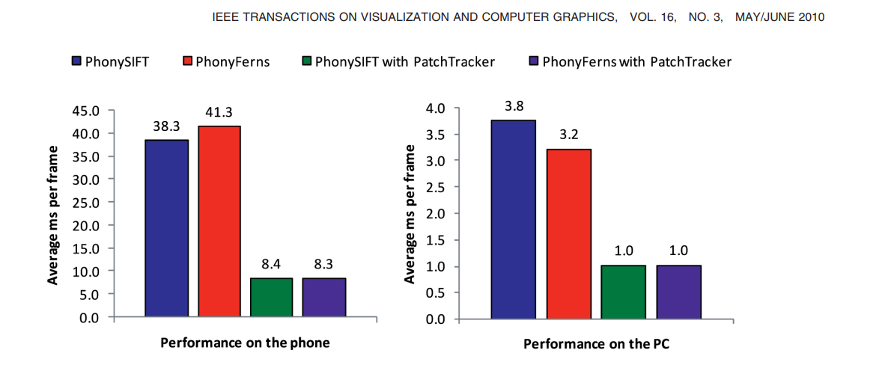
5EVALUATION
The evaluation compared PhonySIFT, PhonyFerns, and their PatchTracker combinations for tracking quality and speed on mobile phones and PCs. Ferns parameters, matching rates, and tracking robustness were assessed across diverse scenarios. The results highlighted the effectiveness of PhonySIFT/PatchTracker for real-time performance in augmented reality on mobile devices, offering insights into each tracker's strengths and weaknesses in various contexts.

Slide 8
6. Conclusion:
In conclusion, our study on real-time mobile phone pose estimation introduced three trackers—comparing SIFT and Ferns. Despite challenges in memory and computational demands, both methods converged with FAST detectors and shared outlier management. PhonyFerns integrated SIFT's regularization, PhonySIFT embraced Ferns' search forest. Combining PhonySIFT, PhonyFerns, and PatchTracker tackled tilt issues. Future advancements, like mobile GPUs, may impact tracking choices. Next steps involve 3D tracking support and addressing homography limitations and self-occlusions.
North Western University , Khulan.

Slide 9
Thank You
North Western University , Khulan.

