Slide 1

Welcome TAMIDER Nursing Room
The spirit to care

Slide 2
Project Name : Doctor Appointment Management
Md Sajib Tamider

Slide 3
Feature Of this Project
Class
Inheritance
Operator overloading
Function overloading
Constructor
Destructor
Exception handling

Slide 4
In a look of this Project:
Class Patient
Void choice()
Void signup()
Void patientList()
Void updateData()
Void doctorList()
Void areaSpeacialized()
Void bookAppointment()
Void existenAppointment()
Class Doctor
Void choice_d()
existenAppointment()
areaSpecialized()
Void signup()
Class Admin
Void choice_a()
areaSpecialized()
Void eraseDocData()
Void erasePatData()

Slide 5
Let’s Introduce the classes and the methods
Class Patient
Void choice() : for choice any kind of method
Void signup() : for signup the data
Void patientList() : to show the previous Patient List
Void updateData() : to update the previous data
Void doctorList() : to show whice doctor we have
Void areaSpeacialized() : to show which doctor we have in your area
Void bookAppointment() : to book an appointment with a doctor
Void existenAppointment() : to show the existential patient whose are take an appointment
Class Doctor : inherit Patient class
Void choice_d() : for choice the methods
Void existenAppointment(): to show the previous patient list
Void signup(): Enter data as a doctor
Void areaSpecialized() : to show whose are specialized in your area
Class Admin : inherit Patient class
Void choce_a() : for choice the methods
Void eraseDocData(): for delete the doctor’s data
Void erasePatientData(): for delete the patient’s data

Slide 6
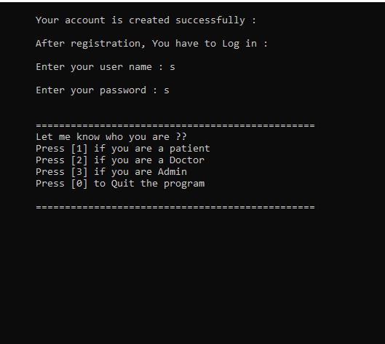
User Interface of the project

Slide 7


