Slide 1
Ensemble
Learning

Slide 2
Ensemble Learning
An ensemble model combines several individual models to produce more accurate predictions than a single model alone.
Bagging VS Boosting VS Stacking
Bagging
Boosting
Stacking
AdaBoost
GradientBoost
XGBoost
CatBoost
Random
Forest

Slide 3
Ensemble Learning
Bagging
Bagging (Bootstrap Aggregating) is a method that trains multiple models on different data samples and combines their predictions to improve accuracy and reduce variance.
Data
NB
DT
RF
Model
Model
Model
Yes
Yes
No
Yes

Slide 4
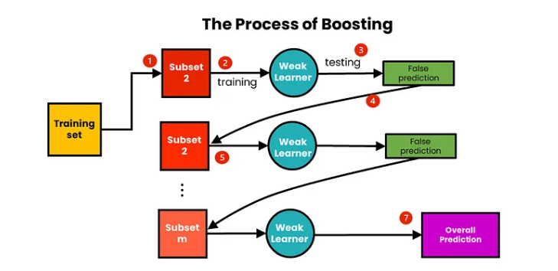
Ensemble Learning
Boosting
Boosting is a technique that trains models sequentially, each focusing on correcting the errors of the previous one. The final prediction is a weighted combination of all models, improving accuracy by reducing bias.

Slide 5
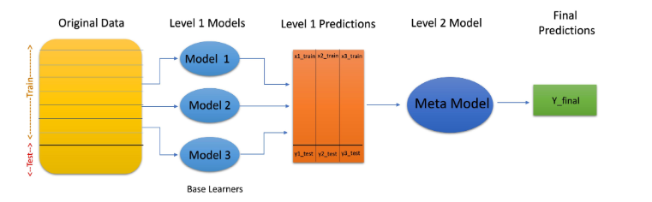
Ensemble Learning
Stacking
Stacking is an ensemble technique that combines predictions from multiple models (base models) using a new model (meta-model) to make the final prediction. The meta-model learns how to best combine the base models' outputs to improve overall performance.

Slide 6
Hyperparameter Optimization
Hyperparameter optimization, or hyperparameter tuning, is the process of identifying the optimal set of hyperparameters for a machine learning model to enhance its performance on a specific task. Unlike parameters learned from the data, hyperparameters are predefined settings that influence the learning algorithm's behavior before the training process begins.
Grid Search: Grid search involves specifying a range of possible hyperparameter values and evaluating the model's performance across all possible combinations within this range. While it can be computationally intensive, grid search thoroughly explores the hyperparameter space.
Random Search: Random search involves sampling hyperparameter values randomly from predefined ranges. It is computationally more efficient than grid search and often yields comparable or even superior results.

Slide 7
Thank you

