Slide 1
Random Forest

Slide 2
Learning Materials
Random Forest
Decision Tree Pruning
Pre-Pruning in Decision Tree
Post-Pruning in Decision Tree
Hyper Parameter Tuning using
Randomized Search CV
Grid Search CV

Slide 3
Random Forest
Random Forest is an ensemble machine learning algorithm that combines multiple decision trees to improve accuracy and prevent overfitting. Each tree in the forest is trained on a random subset of the data, and its predictions are averaged (for regression) or determined by majority vote (for classification). This approach makes Random Forest robust and versatile, often performing well even with complex datasets.
Training Set
Training Sample
Training Sample
Training Sample
Data sample
1
2
n
Decision Tree 1
Decision Tree 2
Decision Tree 3
DT
1
2
n
Test Set
Voting
Prediction

Slide 4
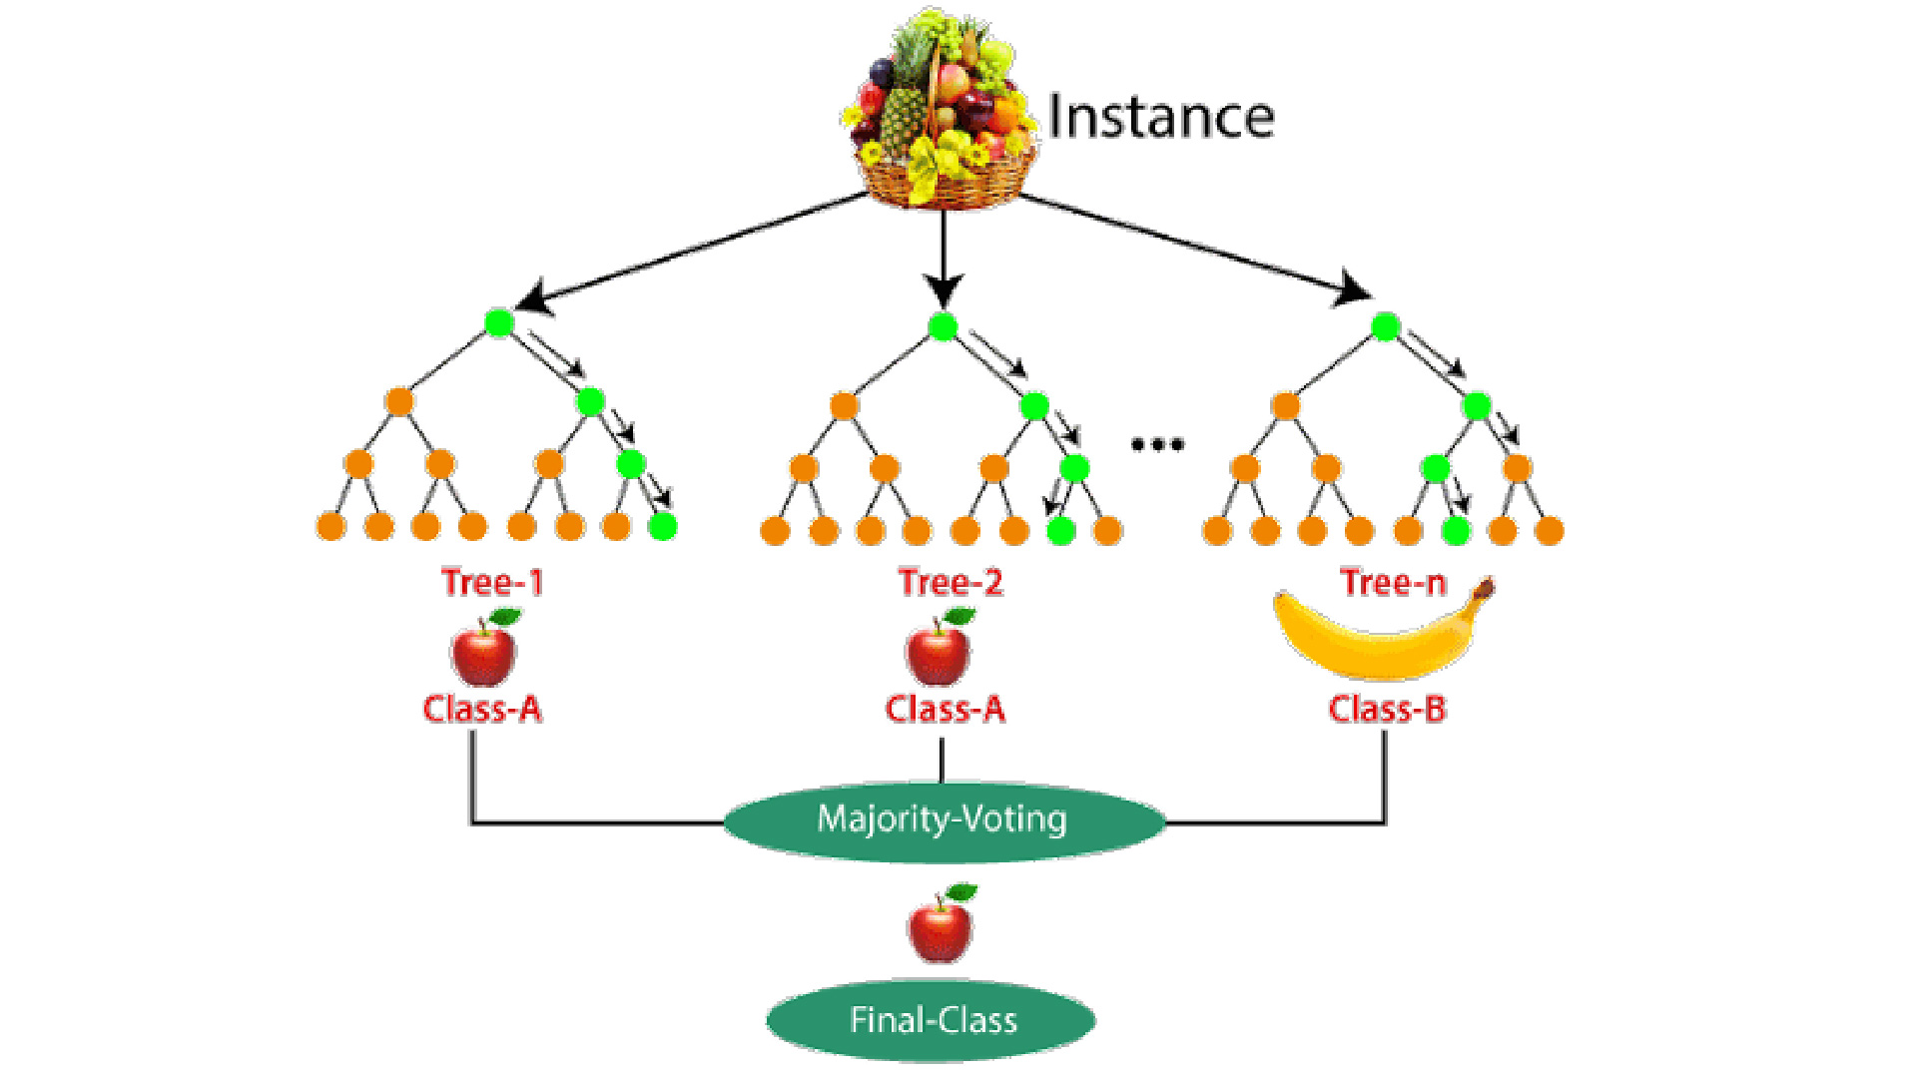
Random Forest
Steps in Random Forest:
Step 1: A random subset of records (n samples) is selected from the dataset, which contains k records.
Step 2: A decision tree is constructed for each of these random samples.
Step 3: Each decision tree produces its own output.
Step 4: The final output is determined by Majority Voting (for classification) or Averaging (for regression).

Slide 5
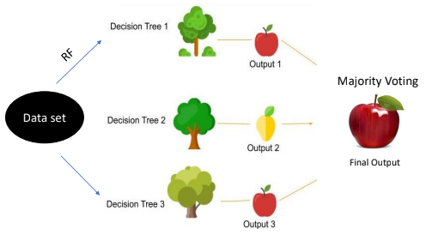
Random Forest
Dataset
Row Sampling
Feature Sampling
RS+FS
RS+FS
Training Sample
Training Sample
Decision Tree 1
Decision Tree 2
Voting
Prediction

Slide 6
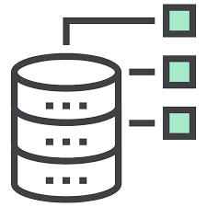
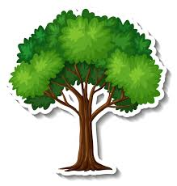
OOB(Out-Of-Bag)
in
Random Forest
SF + SR
Dataset
SF + SR
Train
Test
SF + SR
Train
Valida
Didn’t use as train sample
Count as
validation
data
2/3*n
1/3*n

Slide 7
Performance measure
Classification
Regression
Majority Voting Classifier
Average
OOB(Out-Of-Bag)
The Out-Of-Bag (OOB) score is a measure of prediction accuracy in a Random Forest model. It is an internal method of cross-validation that uses the "out-of-bag" samples to test the model.

Slide 8
Random Forest
Advantages:
High accuracy through ensemble learning.
Resistant to overfitting.
Handles missing data effectively.
Provides feature importance for better insights.
Versatile for both classification and regression tasks.
Dis-advantages:
Complex and difficult to interpret.
Slower predictions with a large number of trees.
Memory-intensive.
Slight increase in bias compared to individual trees.
Requires careful tuning to balance accuracy and speed.

Slide 9
Random Forest
Applications
Healthcare: Predicting patient outcomes.
Finance: Credit scoring and fraud detection.
Marketing: Customer segmentation.
Environmental Science: Weather prediction.
:

Slide 10
Decision Tree Pruning

Slide 11
Neural Network Pruning
Weight Pruning : Removing connections with small weights or setting them
to zero.
Neuron Pruning: Removing entire neurons from the network.
Layer Pruning : Removing entire layers of the neural network.
Decision Tree Pruning
Pre-Pruning: Involves setting a threshold on certain parameters (e.g., maximum depth of the tree, minimum number of samples per leaf) while growing the tree. Tree construction stops when the threshold is reached to prevent the tree from growing too large.
Post-Pruning: Involves growing the tree to its full depth and then removing nodes or branches that do not provide significant predictive power. Pruning decisions are based on metrics like cross-validation accuracy or information gain
Note: For large datasets, pre-pruning is generally recommended over post-pruning.

Slide 12
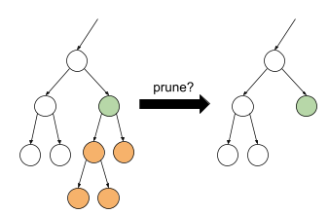
Pruning
Before
After

