Slide 1
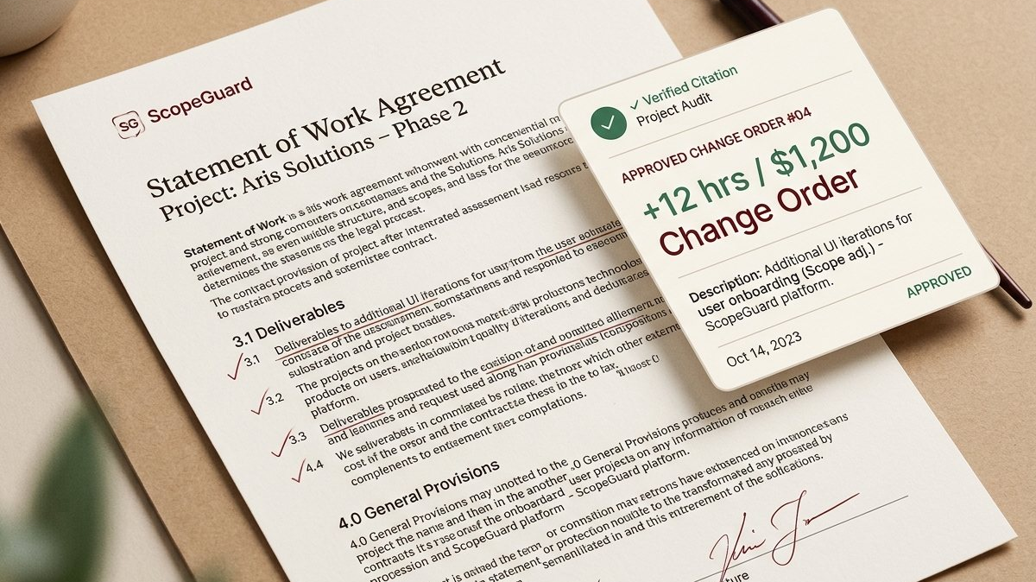
SCOPEGUARD
Evidence-backed change orders for client work
ScopeGuard reads the agreement, verifies the relevant wording, and leaves the pricing and final decision with the person doing the work.
Hackathon product overview
SCOPEGUARD
01
Notes:
Sources: Supplied Devpost Submission — ScopeGuard, Title and Tagline sections. Background visual: project-owned asset public/slides-images/slide-01-hero.jpg.

Slide 2
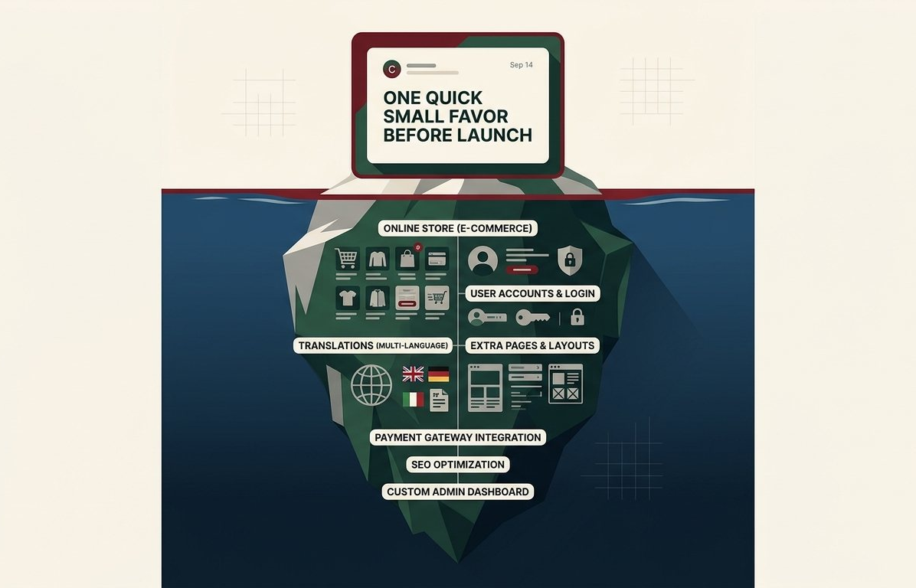
PROBLEM STATEMENT
A small request can hide a large scope change
The moment
"One more small thing before launch"
For freelancers, a good response requires finding the relevant clause in a statement of work, separating facts from assumptions, and preserving a record of what changed.
The risk: a vague request can become an untracked commitment.
SCOPEGUARD
02
Notes:
Sources: Supplied Devpost Submission — ScopeGuard, Inspiration section; supplied README, introduction. Visual: project-owned asset public/slides-images/slide-02-scope-creep-iceberg.jpg.

Slide 3
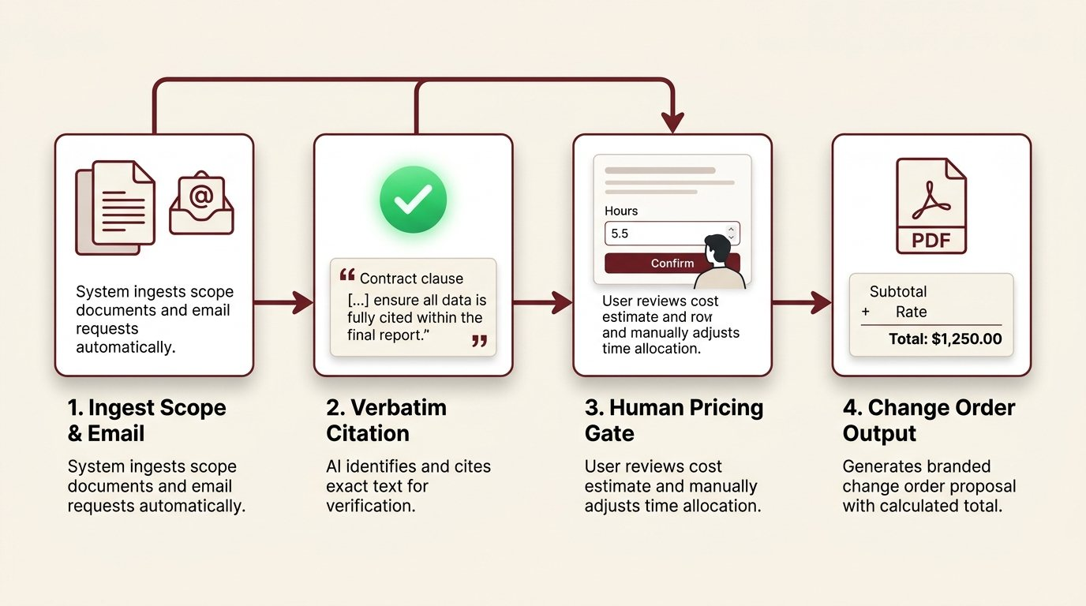
SOLUTION OVERVIEW
A clear path from request to change order
ScopeGuard links the client message to the confirmed scope before anyone discusses price.
1 Ingest the agreement and request
2 Surface verified quotes and an evidence-based label
3 Let the user confirm the decision and enter estimates
4 Render a consistent, frozen change order
SCOPEGUARD
03
Notes:
Sources: Supplied Devpost Submission — ScopeGuard, What it does section; supplied README, workflow overview. Visual: project-owned asset public/slides-images/slide-04-workflow-steps.jpg.

Slide 4
TARGET USERS
Built for client work where scope matters
Freelance web developers
What they need
Need a reliable way to respond when an existing client request changes what the agreement covers.
A factual answer
that points back to
the agreement
Small agencies
ScopeGuard provides evidence and consistency without turning the system into a legal, pricing, or sending authority.
Need a shared record that protects the project team from version drift and accidental commitments.
SCOPEGUARD
04
Notes:
Sources: Supplied README, opening paragraph and 'What ScopeGuard does not do' section; supplied Devpost Submission, Inspiration and What it does sections.

Slide 5
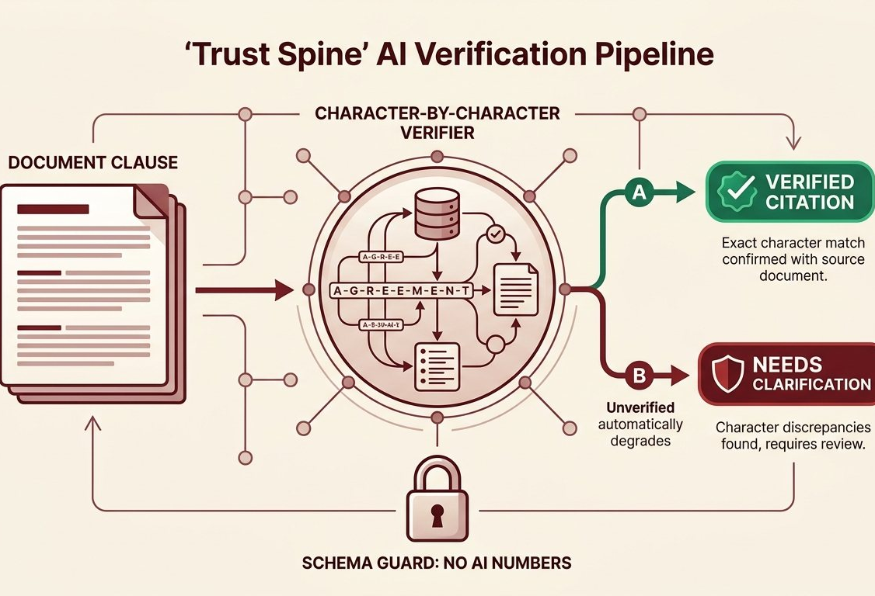
PRODUCT FEATURES
Trust controls shape every output
Verified citations
Quotes must match the source document before the product displays them.
Evidence rules
Unsupported conclusions fall back to a clarification request instead of a stronger claim.
Human pricing gate
The user enters the hours and approves the final version. The AI has no fields for costs or dates.
SCOPEGUARD
05
Notes:
Sources: Supplied README, 'What makes it trustworthy' sections 1–4; supplied Devpost Submission, How we built it section. Visual: project-owned asset public/slides-images/slide-05-trust-spine.jpg.

Slide 6
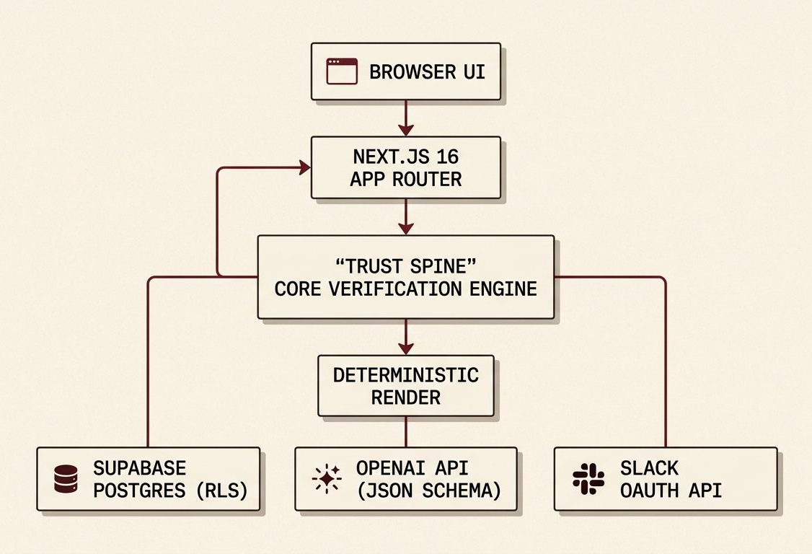
TECHNICAL ARCHITECTURE
A web application with a verification layer at its core
Application layer
Next.js 16 App Router, React 19, TypeScript, and server-rendered UI.
Trust spine
Citation verification, evidence rules, a monetary-claim guard, and deterministic document rendering.
Data and integrations
Supabase Postgres with row-level security, private storage, OpenAI, and per-user Slack OAuth.
SCOPEGUARD
06
Notes:
Sources: Supplied Devpost Submission, How we built it section; supplied README, Architecture section. Visual: project-owned asset public/slides-images/slide-07-architecture.jpg.

Slide 7
AI TECHNOLOGIES USED
Structured model output, bounded by evidence
OpenAI runs three controlled operations
Safety boundaries
Scope extraction
Builds structured scope items from the confirmed source
Request analysis
Compares each client request with supporting evidence
Document drafting
Prepares display-only language that the system checks again
Strict JSON schema
Verbatim quote validation
Evidence-rule downgrades
No AI fields for hours, cost, or dates
SCOPEGUARD
07
Notes:
Sources: Supplied Devpost Submission, How we built it section; supplied README, 'What makes it trustworthy' sections 1–3 and Fixture mode section. No external sources used.

Slide 8
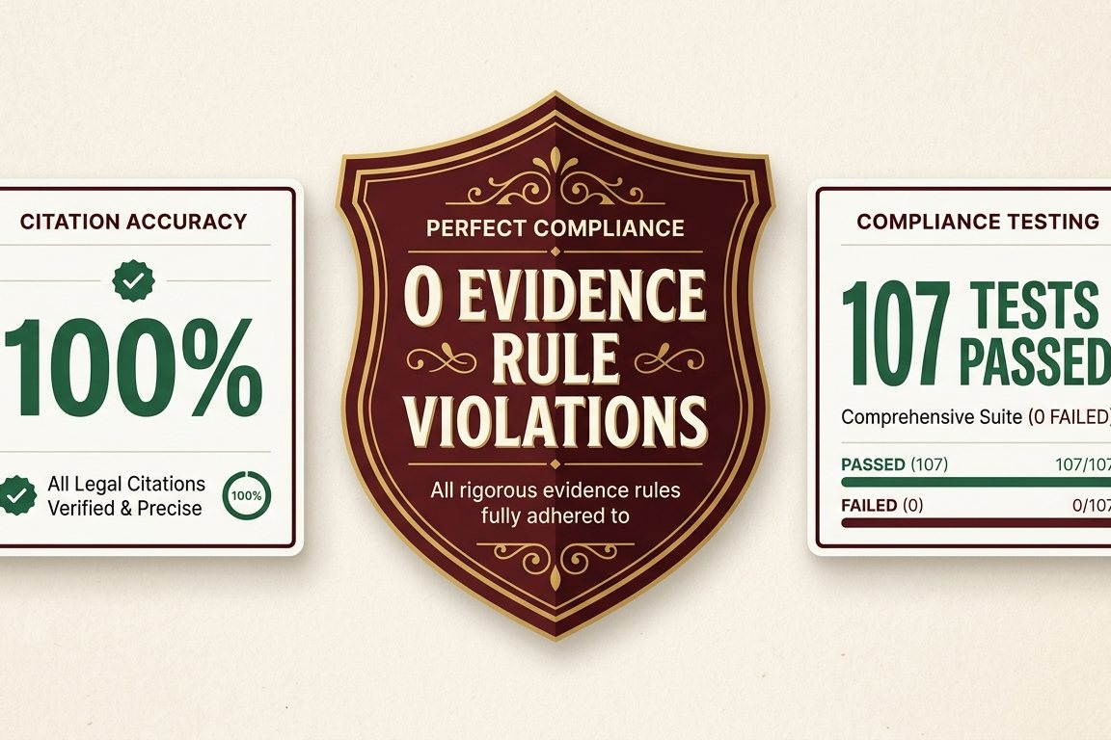
IMPACT AND VALUE PROPOSITION
More defensible scope decisions, with evidence preserved
Evidence over guesswork
Every displayed claim needs a verified quote or the system asks for clarification.
Consistent approved figures
One calculation produces the on-screen total, client reply, PDF, and invoice.
Current fixture-mode evaluation: 100% citation validation and 0 evidence-rule violations.
SCOPEGUARD
08
Notes:
Sources: Supplied README, Testing and evaluation section; supplied Devpost Submission, Accomplishments we are proud of section. The fixture-mode results refer to the documented 16/23 run and are not a general performance claim. Visual: project-owned asset public/slides-images/slide-09-benchmark-results.jpg.

Slide 9
FUTURE ROADMAP
ScopeGuard extends its workflow without taking control away
01
02
03
Deployment and onboarding
Honest integrations
Broader safety evaluation
Polish the deployment flow and support per-workspace setup.
Add Gmail drafts, outbound CRM sync, and payment links tied to human-entered amounts.
Expand the labelled evaluation set across models and track evidence-rule violations as a regression gate.
The roadmap preserves the same boundary: the person stays responsible for the decision, the price, and the final send.
SCOPEGUARD
09
Notes:
Sources: Supplied Devpost Submission, What's next for ScopeGuard section; supplied README, Status against the plan and 'What ScopeGuard does not do' sections.

