Slide 1
Welcome to project
“ROAD BUD”
Developers
MD.RAFI AKBAR MD.HASIBUL HASSAN
ID:13.01.04.141 ID:13.01.04.149
CSE 2.2 CSE 2.2

Slide 2
Project Review
This is a user interactive application . This app is built based on the local buses and routes of Dhaka City. A user can input the name of the place where he currently staying and also the place he wants to go.
Pressing the go button shows on which routes the user currently staying and the available buses for the routes . This app also offers Google map for finding exact locations and bus stops.

Slide 3
Errors
We have tried to make this app perfect but there’s still things that we have been working on.
We have made this app based on local buses and routes of Dhaka city. We have gathered a very little information about the buses and routes. That’s why we haven’t been able to make this app workable for every single routes of Dhaka city .

Slide 4
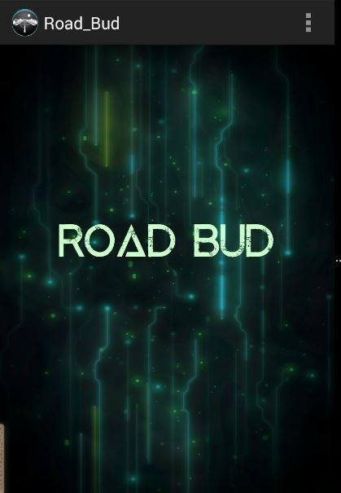
Splash Screen

Slide 5
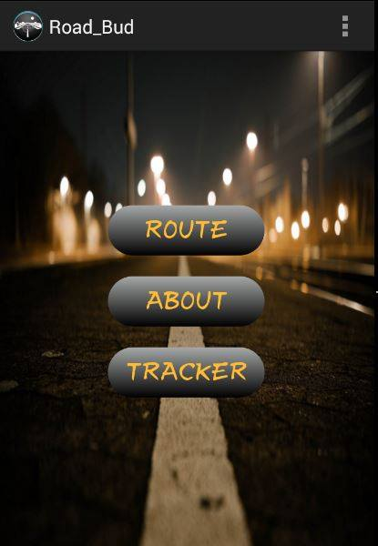
Menu page

Slide 6
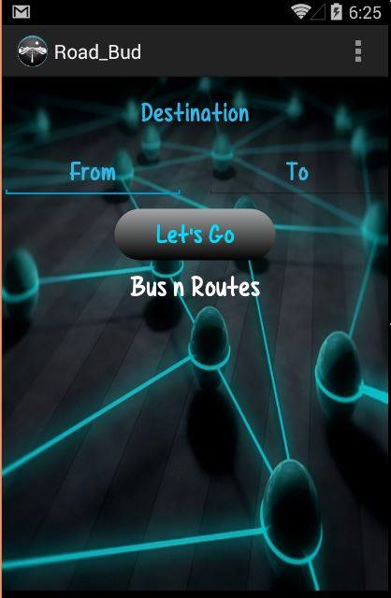
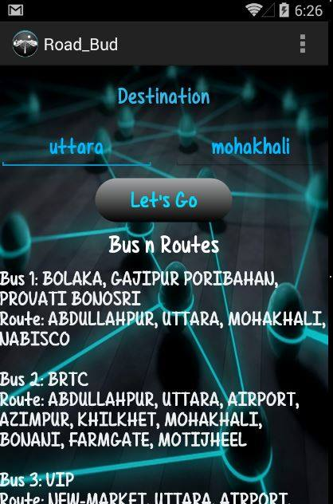
Route page

Slide 7
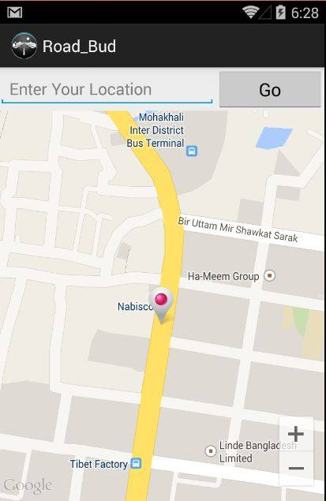
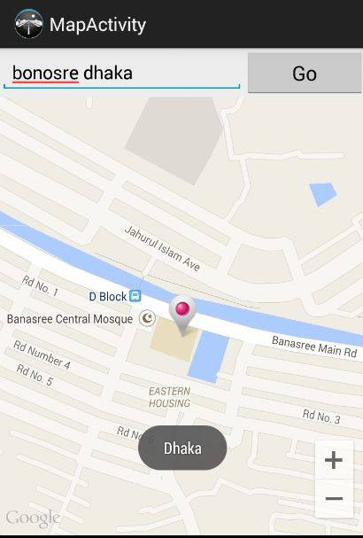
Google map

Slide 8
THANK YOU for listening

