Slide 1
PICK AND DROP SERVICE SYSTEM

Slide 2
Group Members
S.M.Nasif Sadiq 1530117042
Sajid Al Hossain 1512510042

Slide 3
INTRODUCTION
The pick and drop service system is used to pick a product from one place and drop it to another place within the city in a specific time and this delivery can be done only by the USER of the website. Basically this means, a user can help another user to pick and drop any kind of product. A user also can sell a product and deliver it using this website. While taking orders from customers, it will give all the details of it’s customers who is placing the orders and all the details of the recipient such as address, name and phone number.

Slide 4
REQUIRMENTS
This project will be devolved on HTML, CSS, bootstrap, PHP and MySQL.

Slide 5
FEATURE LIST
Post for Sell (Form Sign up)
Buying product
Delivery (Form Sign up)
User Review
etc.

Slide 6
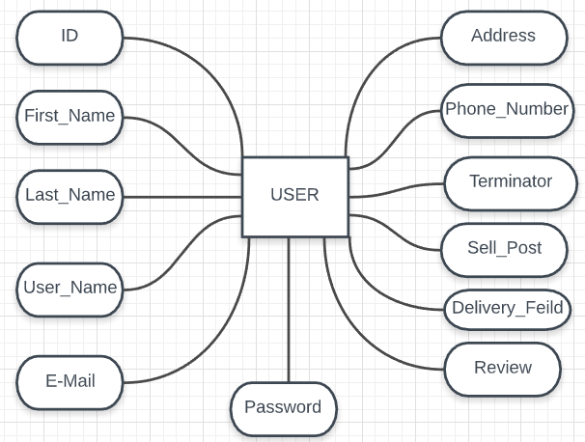
E-R Diagram

Slide 7
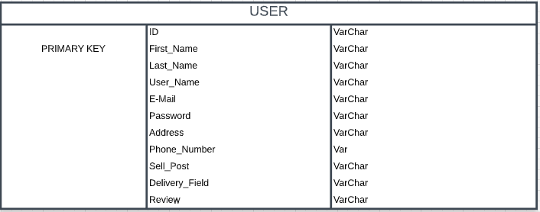
Schema Diagram

Slide 8
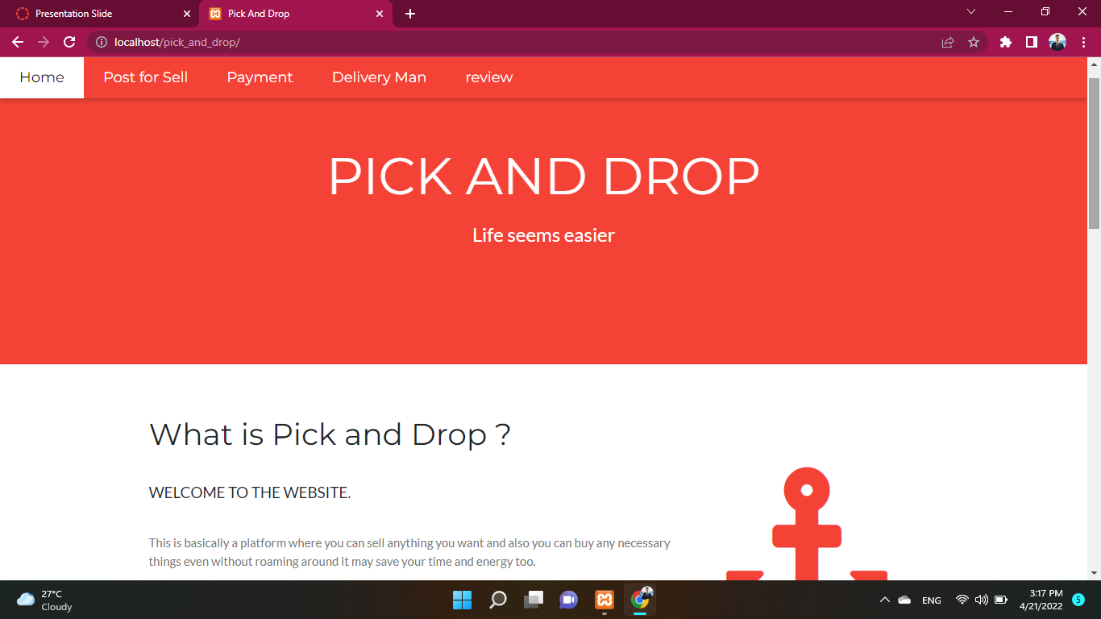
UI Diagram

Slide 9
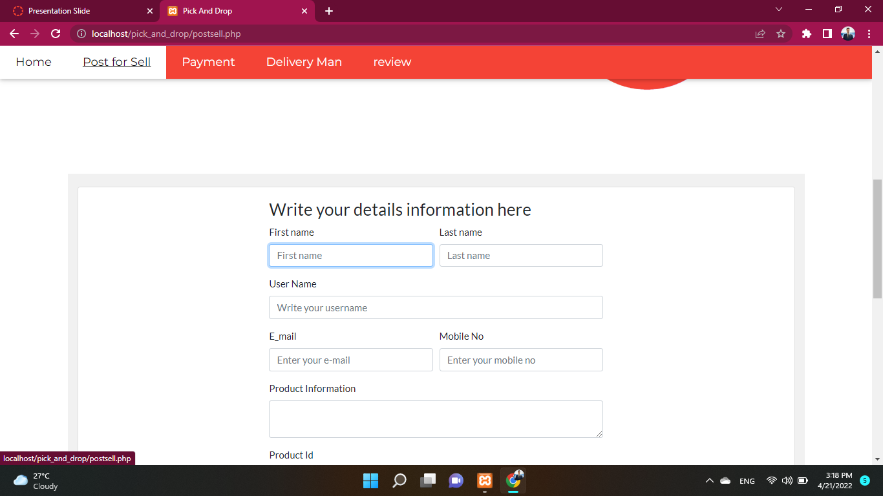
UI Diagram

Slide 10
CONCLUSION
A self-delivery system can also be a way of earning. This is more like you are saving others time and getting paid for it. And in this system you can also sell any item so this is also a good way of earning. So we can say that any user can be benefitted using this service system because it will save time and energy too.

Slide 11
THANK YOU ☺

