Slide 1




CODING WITH PYTHON
A COURSE FOR ABSOLUTE BEGINNERS

Slide 2
DATA-TYPES IN PYTHON

Slide 3
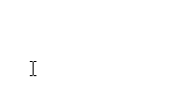
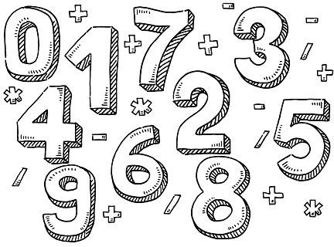
PYTHON NUMBERS
These include:
Integer
Floats
Complex number
they are represented as int, float and complex.
Integers - can hold a value of any length, the only limitation being the amount of memory available.
Float, or “floating point number” - is only accurate up to 15 decimal places. After that, it rounds the number off.
Complex numbers - are written with a “j” as the imaginary part.

Slide 4

STRINGS IN PYTHON
A string is simply a series of characters.
Anything inside quotes is considered a string in Python
You can use single or double quotes around your strings
This flexibility allows you to use quotes and apostrophes within your strings

Slide 5
LISTS IN PYTHON
A list is a collection of items in a particular order.
It can include
the letters of the alphabet
the digits from 0–9
the names of all the people in your family.
You can put anything you want into a list
The items in your list don’t have to be related.

Slide 6
DICTIONARIES IN PYTHON
A dictionary in Python is a collection of key-value pairs.
Each key is connected to a value
You can use a key to access the value associated with that key.
A key’s value can be a number, a string, a list, or even another dictionary.

Slide 7
VARIABLES IN PYTHON

Slide 8
VARIABLES ARE LIKE LABELS
Each variable is connected to a value
This is the information stored in that variable
It could be a number, text, or a list of the same.
You can change the value assigned to a variable at any time in your
program, and Python will always keep track of the current value.
If you re-assign a new value to the same variable, it will be replaced.

Slide 9
NAMING VARIABLES
There are some conventions and rules for naming variables.
Some may cause errors, and others simply make your code more readable.
Variable names can contain only letters, numbers, and underscores
They can start with a letter or underscore, but not a number
Spaces are not allowed, but underscores can be used to separate words
Avoid using python keywords or function names as variable names
Best to keep names short and descriptive
It’s best to use lowercase letters in the names.

Slide 10
OPERATORS IN PYTHON

Slide 11
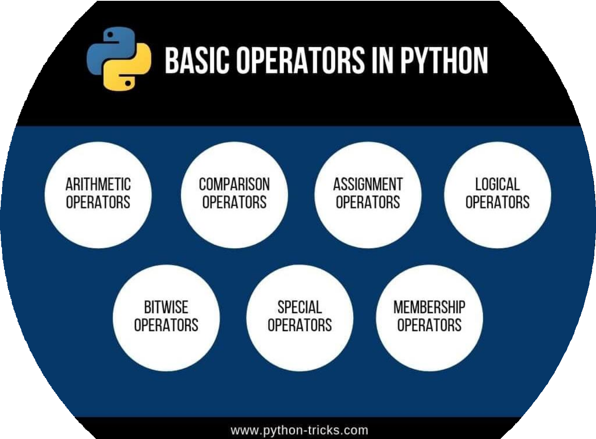

Slide 12

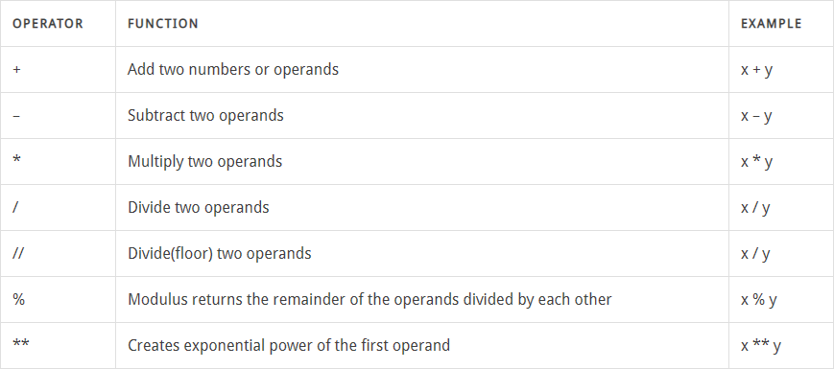

ARITHMETIC OPERATORS

Slide 13
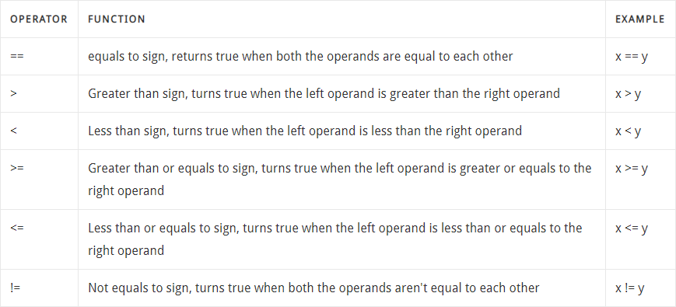
COMPARISON OPERATORS

Slide 14
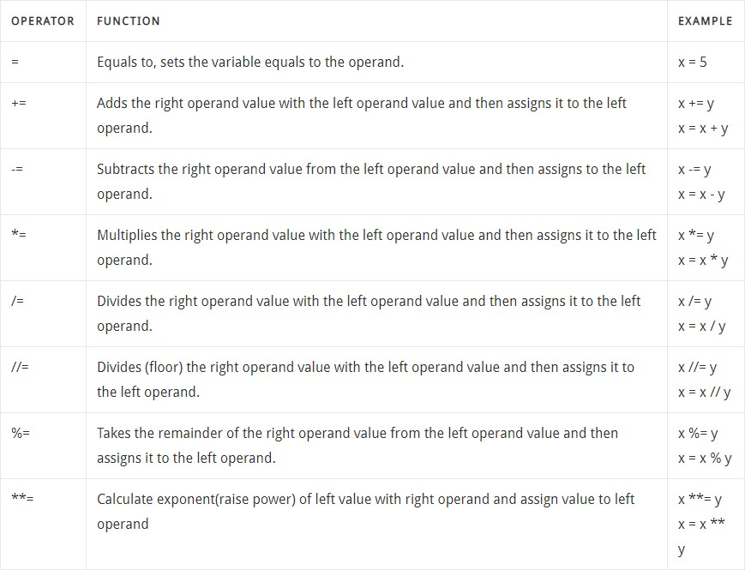
ASSIGNMENT OPERATORS

Slide 15
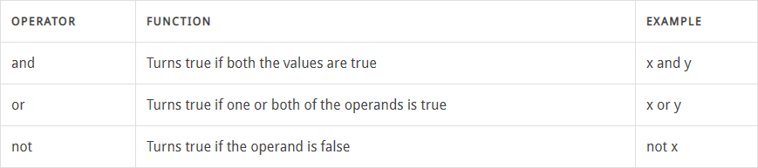
LOGICAL OPERATORS

Slide 16
NUMBERS IN PYTHON

Slide 17
PYTHON NUMBERS
These include:
Integer
Floats
Complex number
they are represented as int, float and complex.
Integers - can hold a value of any length, the only limitation being the amount of memory available.
Float, or “floating point number” - is only accurate up to 15 decimal places. After that, it rounds the number off.
Complex numbers - are written with a “j” as the imaginary part.

Slide 18
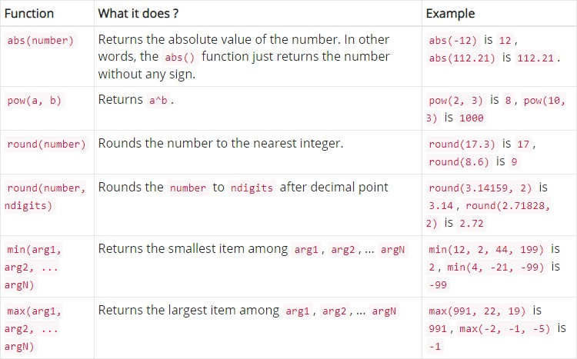
COMMON MATHEMATICAL FUNCTIONS

Slide 19

MORE NUMBER FUNCTIONS
type() - takes one argument and returns which class it belongs to.
int() - converts another numeric type into an int.
float() - converts another numeric type into a float.
int(), float() can’t convert a complex number.
complex() - converts another numeric type into a complex number.
abs() – returns the absolute value of a number
log() – returns natural logarithm of a number
round() – number is rounded to “n” digits from the decimal point.
sqrt() – returns the square root of a number

Slide 20
STRINGS IN PYTHON

Slide 21
STRINGS IN PYTHON
A string is simply a series of characters.
Anything inside quotes is considered a string in Python
You can use single or double quotes around your strings
This flexibility allows you to use quotes and apostrophes within your strings

Slide 22


To display a single character from a string, we put its index in square brackets.
Remember that indexing begins at 0.
Sometimes, we may want to display only a part of a string.
For this, we use the slicing operator [].
There are many variations of this command, we’ll look at some of them.

Slide 23
Concatenation is the operation of joining stuff together.
In python strings can be joined using the concatenation operator “+”.
Similarly, you can use the “*” to print multiple copies of a string
Also, you may want to put a tab, or a newline, or other characters in your string.
We can do this using an escape sequence.
An escape sequence is a backslash followed by a character.
\n – newline
\t – tab
\\ – backslash
\’ – single quote
\” – double quote

Slide 24


MORE STRING FUNCTIONS
len() - returns the length of a string.
strip() - removes whitespaces from the beginning and end of the string.
isdigit() - returns True if all characters in a string are digits.
isalpha() - returns True if all characters in a string are alphabets.
startswith() - takes a string as an argument and returns True if the string begins with the string in the argument.
endswith() - takes a string as an argument and returns True if the string ends with the
string in the argument.

Slide 25



find() - takes an argument and searches for it in the string. Then returns the index of the substring.
If the string doesn’t exist in the main string, then the index it returns is 1.
replace() - takes two arguments. The first is the substring to be replaced. The second is the substring to replace with.
split() - takes one argument. The string is then split around every occurrence of the
argument in the string.

Slide 26

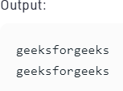

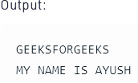
In Python, lower() is a built-in method
used for string handling.
The lower() methods returns the lowercased string from the given string.
It converts all uppercase characters to
lowercase.
In Python, upper() is a built-in method used for string handling.
The upper() methods returns the uppercased string from the given string.
It converts all lowercase characters to uppercase.

Slide 27
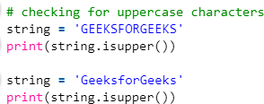
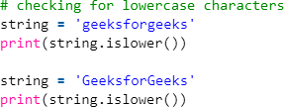
In Python, isupper() is a built-in method used for string handling.
The isupper() methods returns “True” if all characters in the string are uppercase. Otherwise, It returns “False”.
In Python, islower() is a built-in method used for string handling.
The islower() methods returns “True” if all characters in the string are lowercase, Otherwise, It returns “False”.

Slide 28
SOME ERRORS YOU MIGHT COME ACROSS

Slide 29
SYNTAX ERRORS
Frequent errors include:
Having a different number of open and close brackets or parenthesis
Forgetting to place quotes around a string
Misspelled variable or function names. Python is case sensitive.
Using = instead of == or vice versa.
In Python, “= “is used for assigning a value to a variable, and “== “is used for comparing.
A typical input-output error is attempting to open a file that does not exist, or does not exist in the location that you specified.
It is safest to load a data file in the same folder as the Python code that reads or writes
to it. Python looks to the same folder by default.

Slide 30
SAVING AND RUNNING PYTHON SCRIPTS

Slide 31
Entering commands at the prompt is just the beginning.
IDLE has two modes
Interactive
Script
We have been using the interactive mode so far.
It immediately returns the results of commands we enter into the shell.
In script mode, you will write a script and then run it.
Remember to always save your scripts using the .py extension !

Slide 32
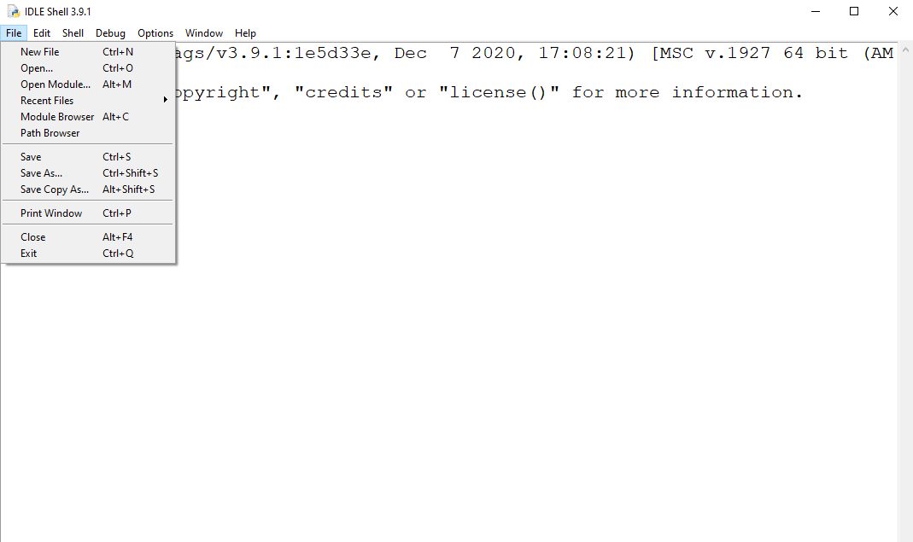
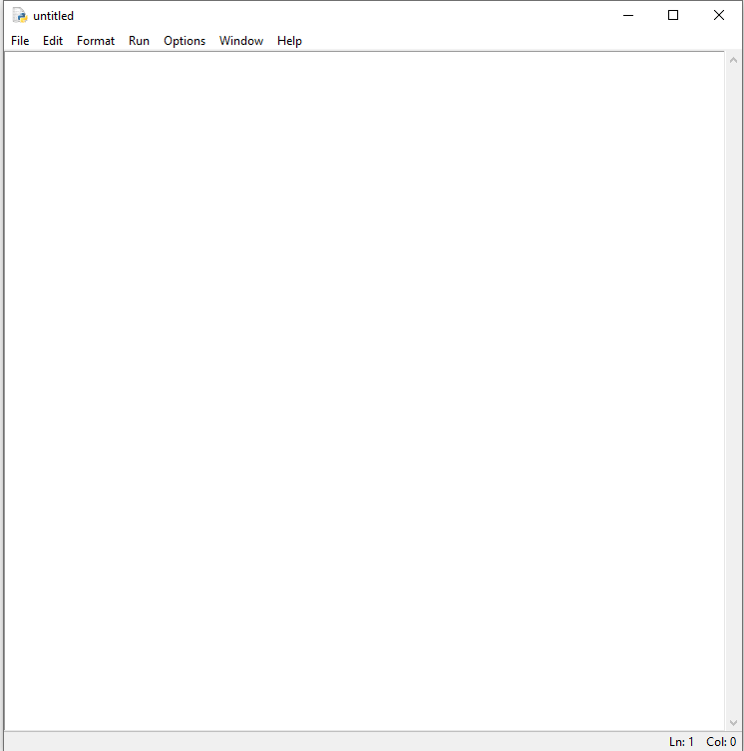
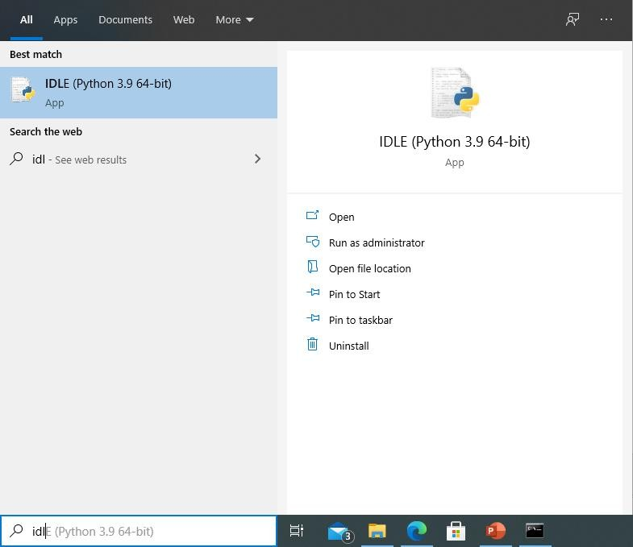

Slide 33
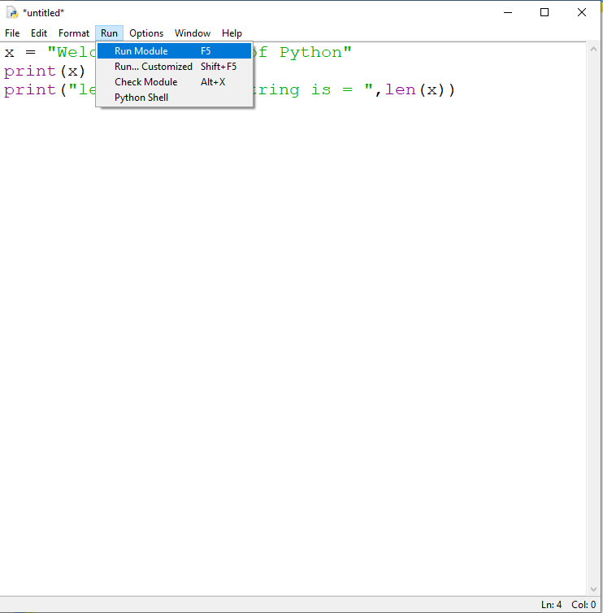
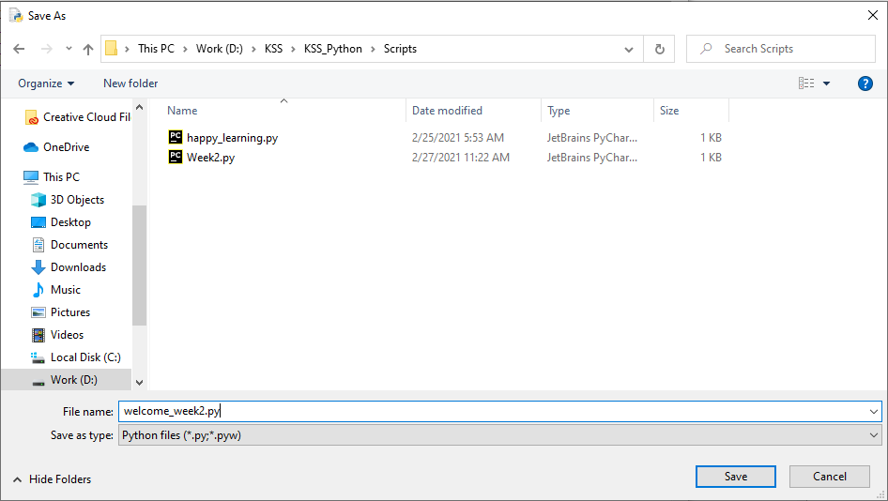
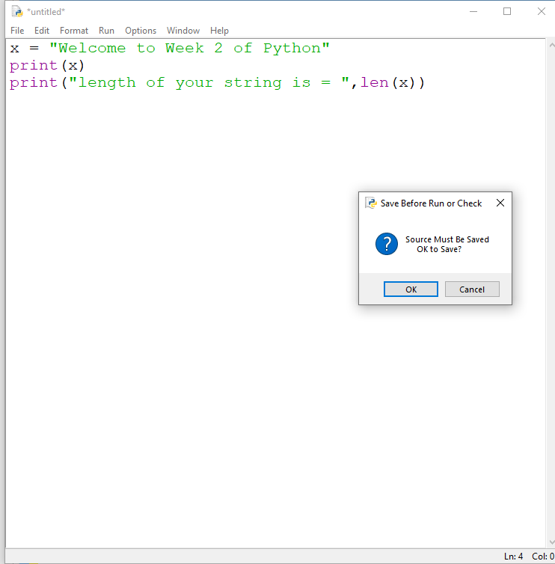
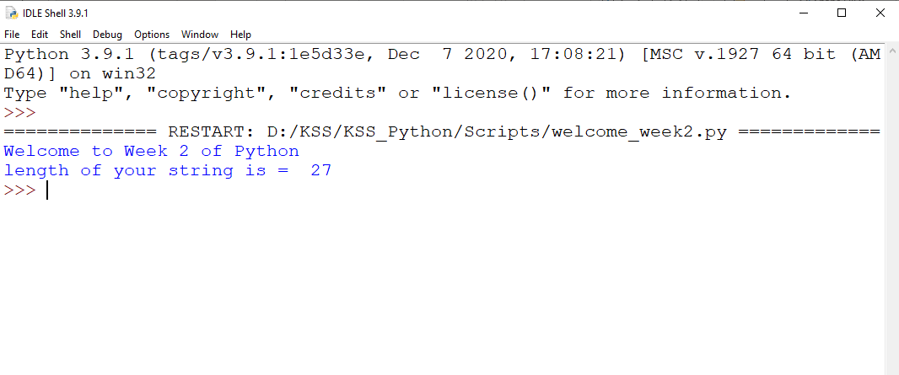

Slide 34
Python Comments, Indentation, and Statements

Slide 35
INDENTATION IN PYTHON
Unlike C++ or Java, Python does not use curly braces for indentation.
Instead, Python makes use of indentation.
Python indentation is a way of telling a Python interpreter that the group of statements belongs to a particular block of code.
A block is a combination of all these statements.
There are no strict rules on what kind of Python indentation you use.
But it must be consistent throughout the block.
Without proper indentation, you will get an error, and the code will not be compiled.

Slide 36

COMMENTS IN PYTHON
We use comments to explain the code, and the interpreter ignores them.
You never know when a programmer may have to understand code written by another and make changes to it.
Its also good to help yourself remember these details when you look at the code later.
For these purposes, good code will hold comments in the right places.
To declare a Python comment, use the hash (#) sign.

Slide 37



MULTI-LINE PYTHON STATEMENTS
In Python, every statement ends with a newline character.
But it is possible to span a statement over multiple lines.
We do this using the ‘\’ character.
You can also easily put multiple statements in python on one line.

Slide 38
Some Exercises

Slide 39
Assign a message to a variable, and then print it.
Use a variable to represent a person’s name, and print a message to
that person. Something like, “Hi Ayesha, how are you feeling today?”
Find a famous quote. Print the quote with the name of the person.
Apply any 4 of the string functions you’ve learnt today on your name.
Add atleast 2 lines of comment to your code. Your name and current
date, and what your code does.
Take a screenshot of your code and output for record. We will be reviewing this in the next session

