Slide 1

Course: System Design, Engineering, and Testing
Instructor: Md Rafiqul Islam
Smart Dustbin for City Waste Management
March 25, 2025
Presented By
Sadiya Islam Mou(2101028)
Md.Zahid Hasan[2101032]
Md.Sajid Islam[2101034]

Slide 2
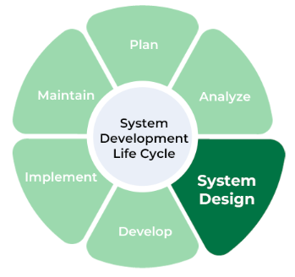
Course Overview
This course focuses on building a business-oriented project
Implementation of System Design, Engineering, and Testing concepts
Incorporates principles of SDLC, scheduling, requirement specification, and risk management

Slide 3
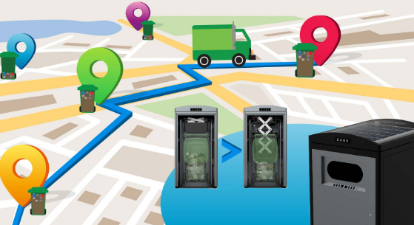
Problem Statement
Traditional waste collection methods are inefficient
Overflowing bins create unhygienic conditions
Lack of real-time monitoring and delayed cleaning
Proposed Solution
Implementation of Smart Dustbins with ESP32 and Ultrasonic Sensors
Real-time monitoring using IoT and Cloud-based data storage
Automated notification system for authorities
Integration of risk and configuration management for system stability

Slide 4
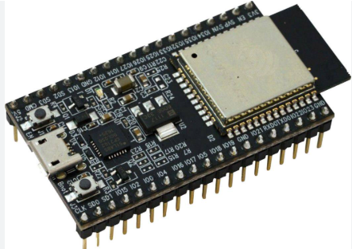
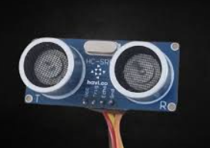
System Components
Microcontroller - ESP32 for data processing and communication
Sensors - Ultrasonic sensors to measure trash levels
Communication Module - WiFi/MQTT for cloud connectivity
Cloud Platform - Data storage and analysis using MQTT
Notification System - SMS alerts to authorities
Risk & Configuration Management - Ensuring system stability and security

Slide 5
System Development Life Cycle (SDLC) - Planning & Analysis
Planning Stage
Analysis Stage
Research existing waste management problems in cities
Define project scope, objectives, and expected outcomes
Conduct feasibility analysis (technical, economic, operational)
Identify necessary hardware, software, and cloud resources
Establish timeline and budget estimation
Gather data from municipal waste management authorities
Identify requirements for IoT connectivity, data storage, and real-time monitoring
Develop Software Requirement Specification (SRS) document

Slide 6
System Development Life Cycle (SDLC) - Design & Development
Design & Prototyping Stage
Development Stage
Develop block diagram for system architecture
Select hardware (ESP32, ultrasonic sensors, communication module)
Design cloud-based architecture for MQTT data handling
Build a prototype to test sensor readings and connectivity
Program ESP32 for sensor data collection and transmission
Configure MQTT broker for real-time data monitoring
Implement cloud database for bin status tracking
Develop SMS notification system for authorities

Slide 7
System Development Life Cycle (SDLC) - Testing & Deployment
Testing Stage
Deployment & Integration Stage
Maintenance & Improvement Stage
Test sensor accuracy for waste level detection
Validate MQTT communication and cloud data reception
Conduct unit testing for ESP32 firmware
Perform integration testing with SMS notification system
Deploy smart dustbins in selected locations
Monitor data transmission in real-time
Train municipal workers on system usage
Regular system updates and bug fixes
Optimize sensor power consumption for efficiency
Expand system scalability for additional smart bins

Slide 8
System Requirement Specification (SRS) - Functional Requirements
Bin must detect trash levels using ultrasonic sensors
Must send real-time data to the cloud
Must notify authorities when the bin is full
Must re-send alert if the bin is not cleaned by 5 PM
Should support multiple bins for city-wide scalability

Slide 9
System Requirement Specification (SRS) - Non-Functional Requirements
Low latency in data transmission
Secure and scalable cloud storage
Reliable communication protocol (MQTT)
Energy-efficient operation with low power consumption
User-friendly monitoring system for authorities

Slide 10
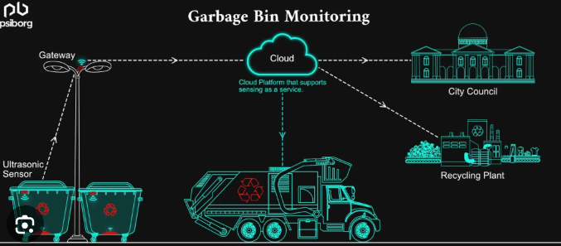
System Design & Implementation
Architecture Diagram - Show system workflow from sensor data collection to notification
Hardware Design - ESP32 integration, sensor connections
Software Design - Code structure, MQTT integration, data handling

Slide 11
Risk & Configuration Management
Potential Risks:
Risk Mitigation Strategies:
Sensor failure affecting data collection
Network disruptions leading to delayed notifications
Unauthorized access compromising data integrity
Implement backup communication channels
Ensure proper maintenance and sensor calibration
Use encryption for secure data transmission
Version Control with Git: Ensuring system updates and stability
System Configuration Management: Tracking changes in software and hardware

Slide 12
Project Benefits & Impact
Efficiency: Optimized waste collection
Cost-Effectiveness: Reduced operational costs
Scalability: Expandable to other smart city initiatives
Environmental Benefits: Cleaner cities, reduced pollution

Slide 13
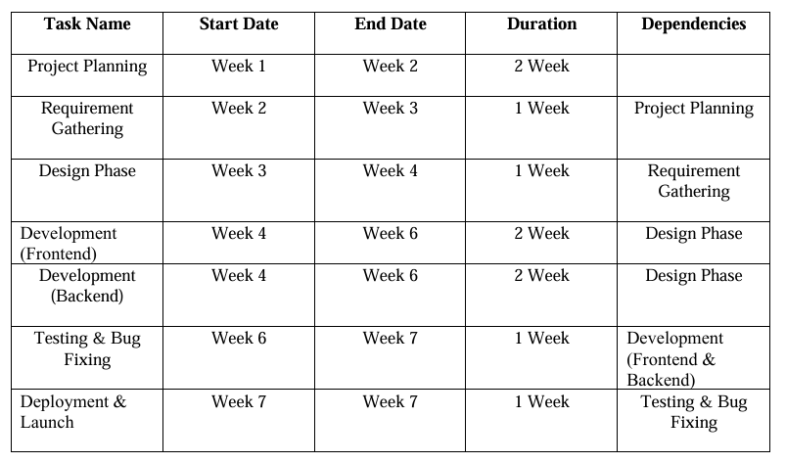
Project Scheduling & Gantt Chart

Slide 14
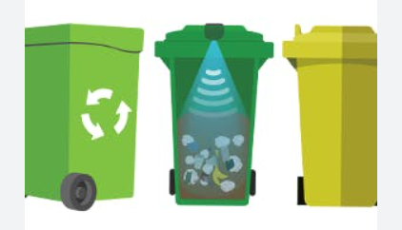
Future Enhancements & Conclusion
AI-based waste sorting
• Solar-powered dustbins
• Mobile app integration for user monitoring
• Predictive analytics for better waste management
• Summary of project goals and implementation
• Questions and discussions • Thank you for your attention!

