Slide 1
PHONEPE TRANSACTION INSIGHTS
Analysing Transaction Dynamics, Engagement, and Growth Potential
BY SAJINA KOYADAN KOROTH
SAJINA KOYADAN KOROTH

Slide 2
Project work flow
Data Extraction
->Cloned and extracted Phone Pe Pulse data from the official GitHub repository.
Data Transformation
->Parsed JSON files and converted them into structured formats (like Data Frames).
Data Storage
->Stored the transformed data into a relational database (e.g., MySQL).
Data Analysis
->Analysed transaction trends, categories, states, districts, and more.
->Created graphs, charts, or summaries for better understanding using Streamlit

Slide 3
Agenda
Introduction
Business Use Case 1: Decoding Transaction Dynamics
Business Use Case 2: Device Dominance & Engagement
Business Use Case 3: Insurance Penetration & Growth
Business Use Case 4: Market Expansion Strategy
Business Use Case 5: User Engagement and Growth Strategy
Summary

Slide 4
Introduction
Phone Pe is one of India’s leading digital payment platforms, enabling users to make secure and convenient financial transactions .
This project aims to explore and analyse transaction data from Phone Pe across various states and categories, providing insights into usage patterns, transaction volumes, and regional trends.
Through this project, we seek to highlight key trends, visualize data, and draw meaningful conclusions from Phone Pe transaction records.

Slide 5
Business Use Case 1: Decoding Transaction Dynamics
Objective
->Analyse transaction patterns across states, quarters, and categories.
->Identify growth, stagnation, or decline trends.

Slide 6
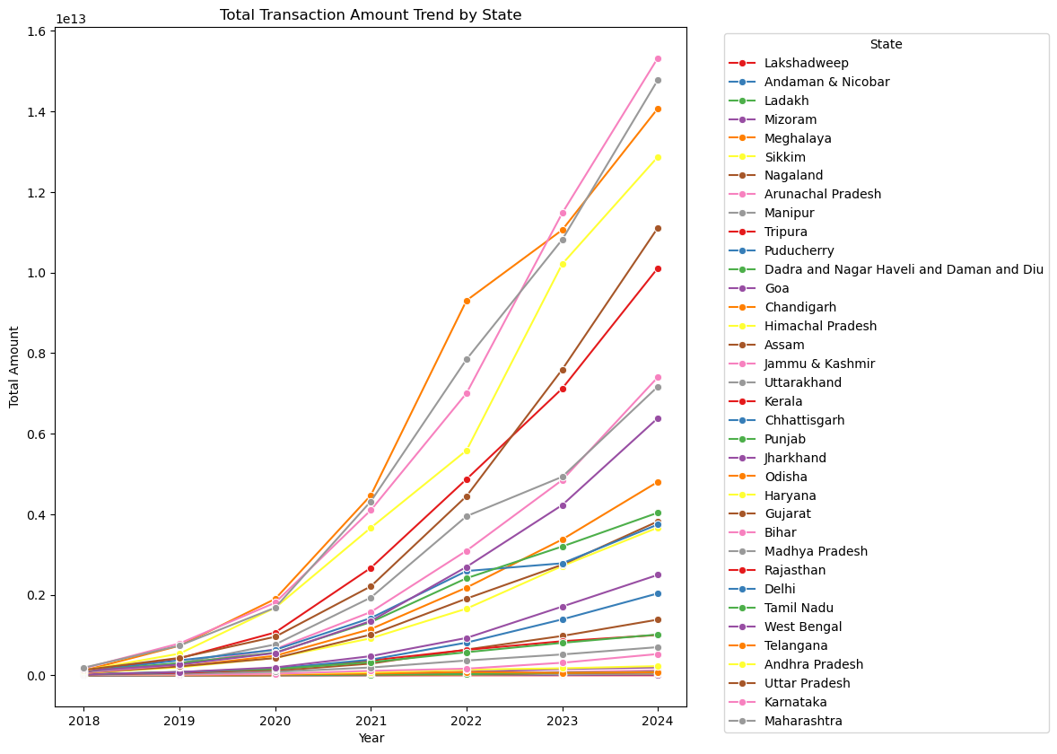
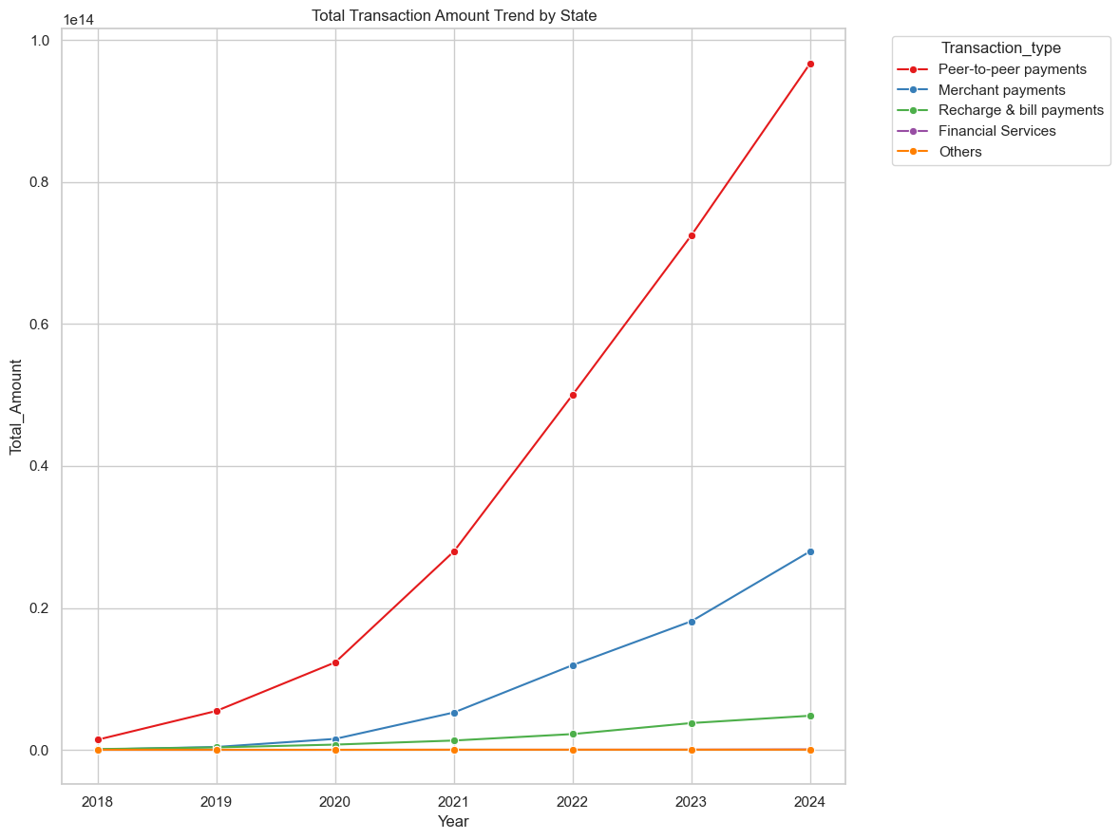
Visualisation
Total Transaction Amount Trend by State
Total Transaction Amount Trend by Transaction type

Slide 7
Insights
From the above graph Maharashtra, Telangana and Karnataka showing the highest growth.
Haryana , Bihar , Arunachal Pradesh showing the lowest growth
In Transaction type Peer to Peer and Merchant services have high growth

Slide 8
Business Use Case 2: Device Dominance and Engagement
Objective
->Understand app usage behaviour by device brand and region.

Slide 9
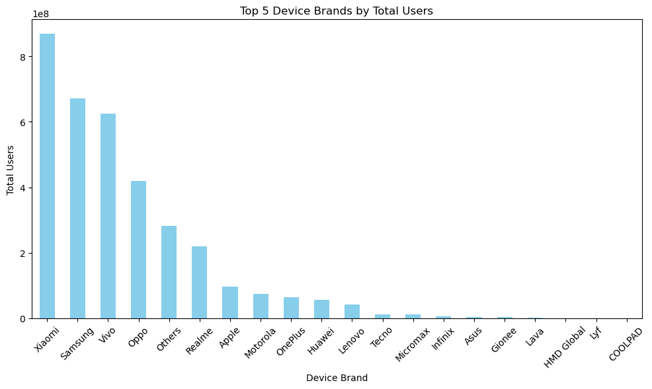
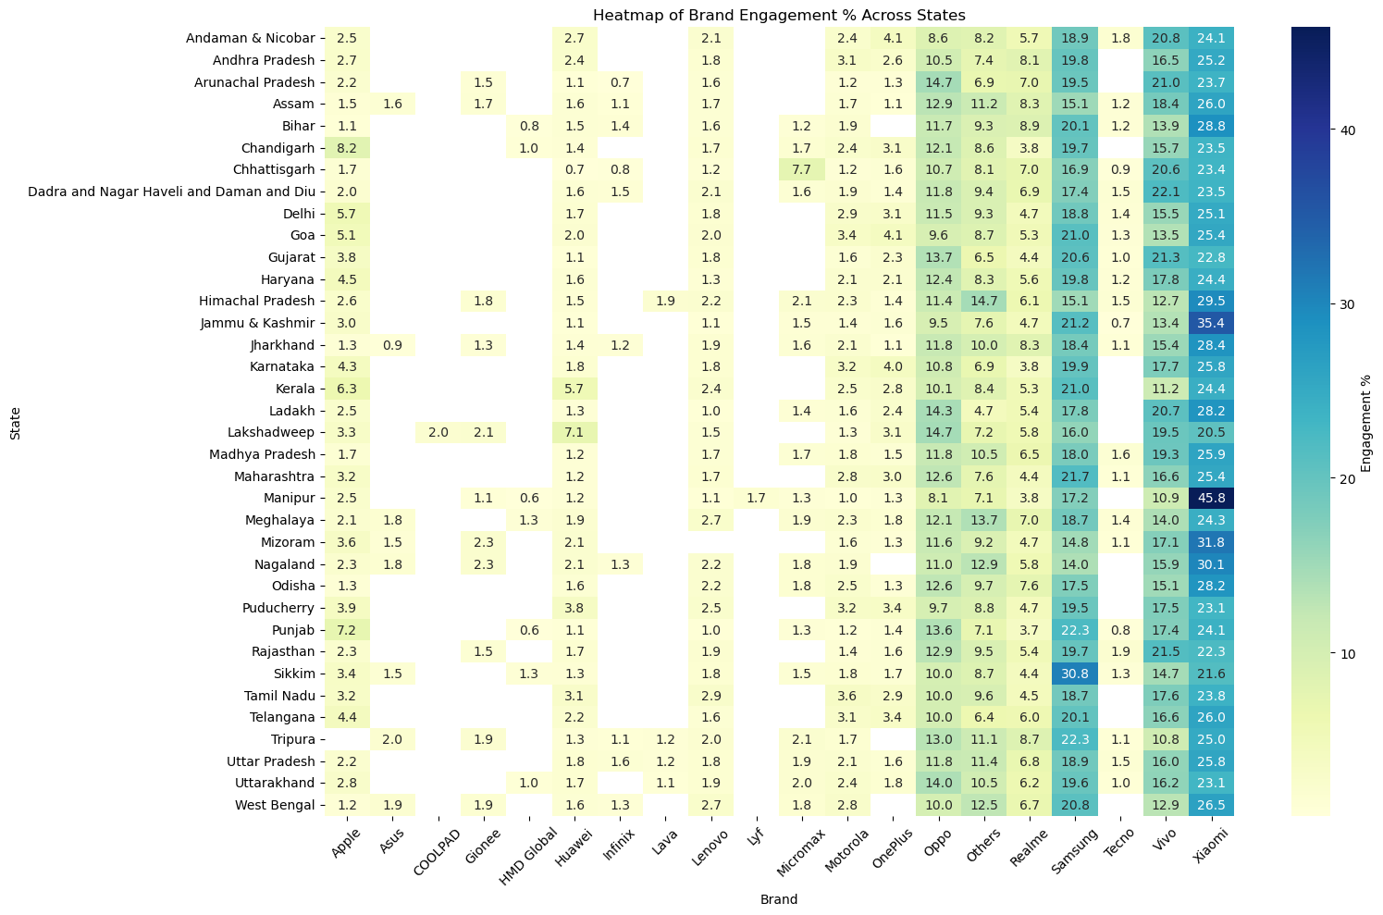
Visualisation
Top 5 Device Brands by Total Users
Brand Engagement % Across States

Slide 10
Insights
Optimize app for underutilized popular devices
->Some devices that are popular among users (e.g., certain Android phones or iPhones) may not be performing well with the app, or they may not be fully supported or optimized.
Regional UX customization suggestions
->The user experience (UX) may need to be tailored for different regions or countries based on cultural, language, or behavioural difference.
->Use analytics to see how users interact with the app in different regions, then suggest changes to better suit local preferences.

Slide 11
Business Use Case 3: Insurance Penetration Analysis
Objective
->Assess adoption of insurance products and identify growth opportunities.

Slide 12
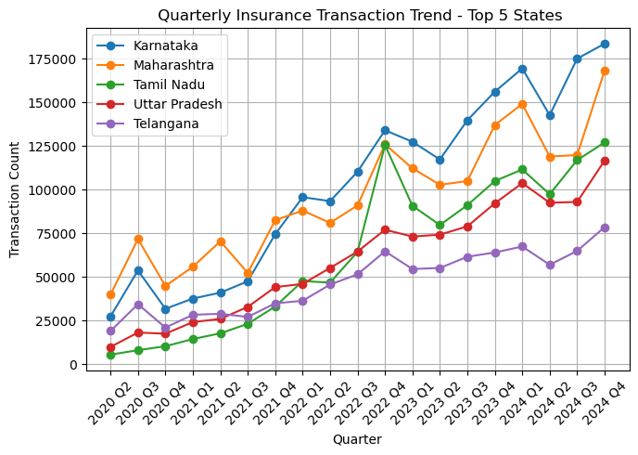
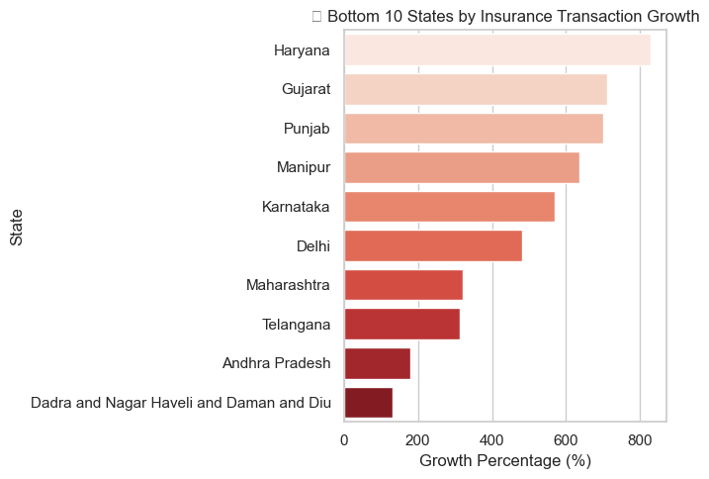
Visualisation
Quarterly Insurance Transaction Trend - Top 5 States
Top 10 Fastest Growing States in Insurance Transactions

Slide 13
Recommendations
Focus marketing in under-penetrated states
Localized insurance offers, tie-ups with state-based insurers

Slide 14
Business Use Case 4: Market Expansion Strategy
Objective
->Analyse transaction trends to guide regional expansion

Slide 15
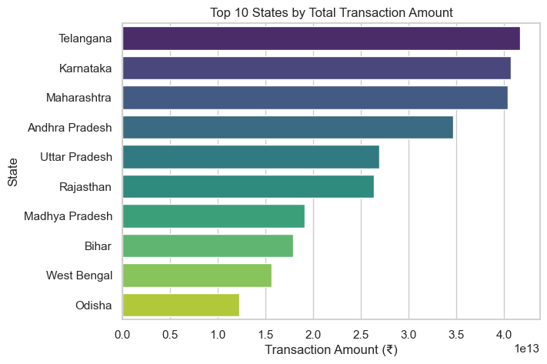
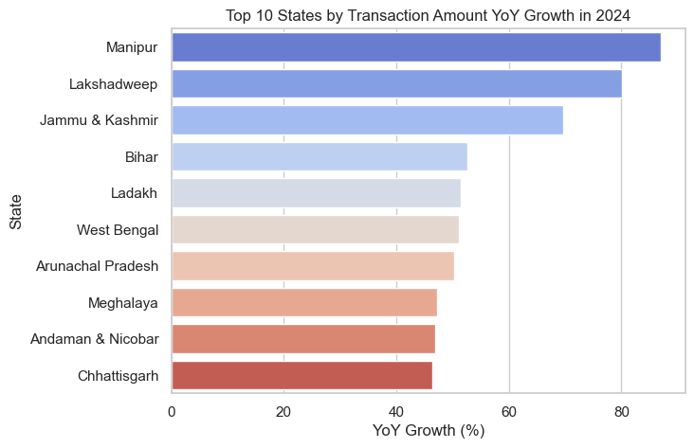
Visualisation
Top 10 States by Total Transaction Amount
Top 10 States by Transaction Amount YoY Growth in 2024

Slide 16
Recommendations
Invest in partnerships in emerging regions
Local language campaigns in Tier 2/3 cities

Slide 17
Business Use Case 5: User Engagement and Growth Strategy
Objective
->increase user retention, boost active usage, and drive user base expansion through targeted strategies and initiatives.

Slide 18
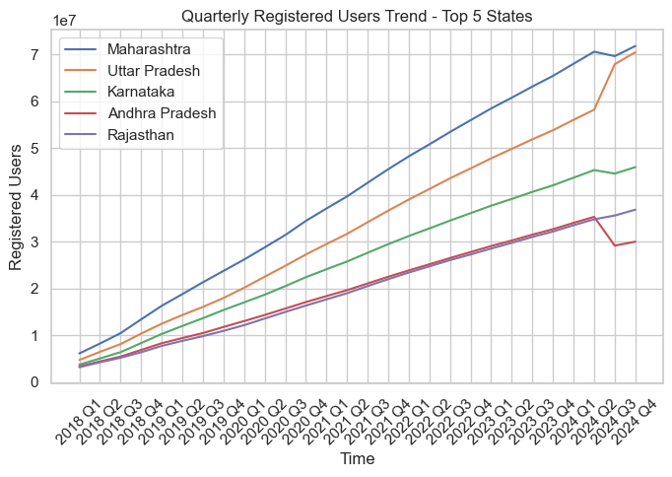
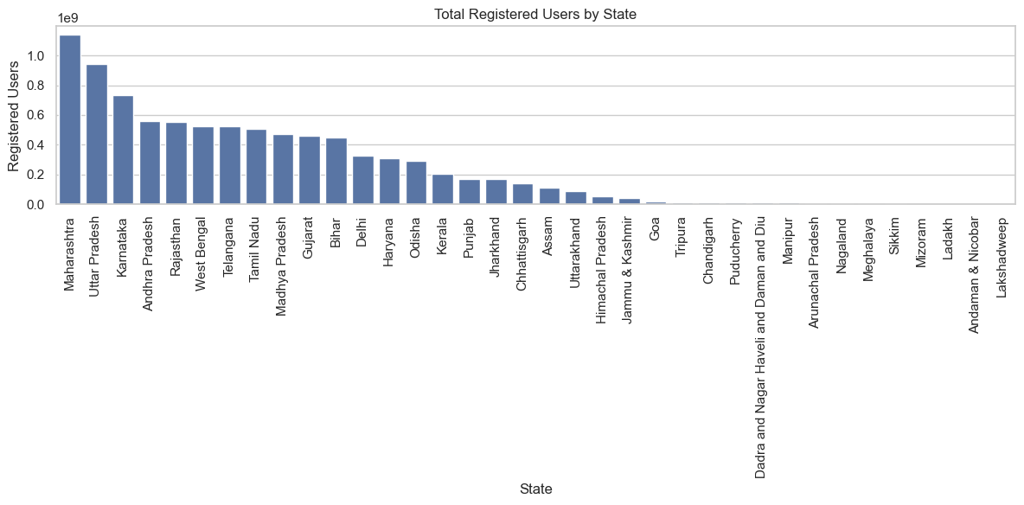
Visualisation
Total Registered Users by State
Quarterly Registered Users Trend - Top 5 States

Slide 19
Summary
Phone pe transaction insight analyses the transaction trends, user behaviour, and regional usage patterns on Phone Pe.
Steady increase in digital transactions, especially in Tier 2 and Tier 3 cities
Karnataka, Maharashtra, and Uttar Pradesh show highest transaction volumes.
Mobile recharges, utility bill payments, and peer-to-peer transfers dominate.

Slide 20
Thank You

