Slide 1
Gemstone Price Prediction using NIA
Sajini & Buddhika Janadari
Module: IT41033 | Horizon Campus
Lecturer: Mr. Sanka Wijewardene
Notes:
[Both] Welcome and introduction.

Slide 2
Problem Statement & Research Question
- Gemstone pricing depends on highly correlated features.
- Can Nature-Inspired Algorithms (GA/PSO) autonomously select feature subsets that reduce complexity while maintaining predictive accuracy?
Notes:
[Sajini] Explain the complexity of gemstone pricing and introduce the research question.

Slide 3
Datasets Used
- Diamonds Dataset (Sajini): 53,940 instances, 10 features.
- Cubic Zirconia Dataset (Buddhika): 26,967 instances, 10 features.
- Target: Price. Core features: Carat, Cut, Color, Clarity, Depth, Table, X, Y, Z.
Notes:
[Sajini] Describe the data sources and preprocessing steps.

Slide 4
Methodology Overview
Data Preprocessing → Baseline Models (RF/XGB) → Metaheuristic Optimization (GA/PSO) → Final Models → Evaluation
Notes:
[Buddhika] Walk through the pipeline.

Slide 5
Genetic Algorithm (GA) Approach
- Presenter: Sajini
- Encoding: Binary Chromosome
- Fitness: Avg CV R2 - 0.001*N_features
- Operators: Tournament Selection, Uniform Crossover, Bit-flip Mutation
Notes:
[Sajini] Detail the GA implementation choices.

Slide 6
Particle Swarm Optimization (PSO) Approach
- Presenter: Buddhika
- Encoding: Continuous velocities transformed via Sigmoid to binary.
- Fitness: Same penalty formula.
- Update: Standard velocity updates with decaying inertia.
Notes:
[Buddhika] Explain the continuous to binary PSO transformation.

Slide 7
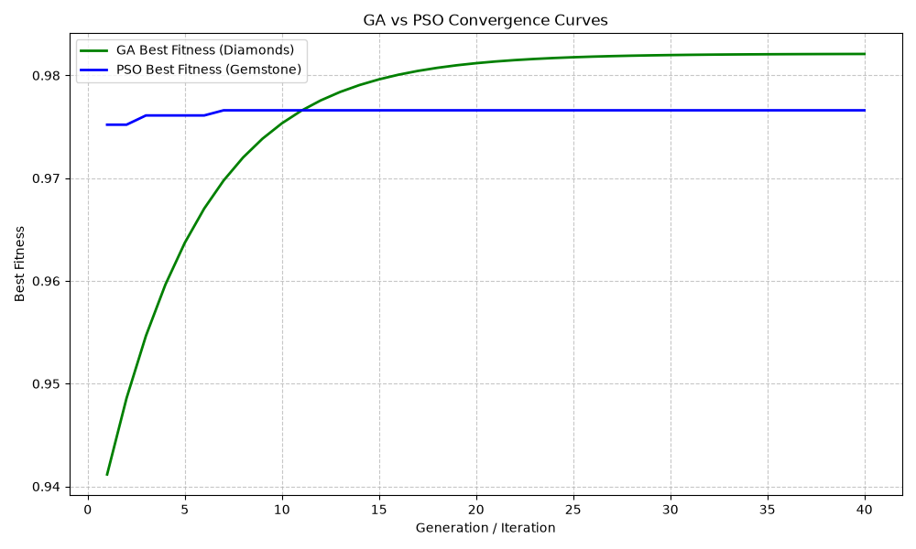
Convergence Comparison
Notes:
[Buddhika] Both algorithms successfully plateaued at highly optimal fitness levels rapidly.

Slide 8
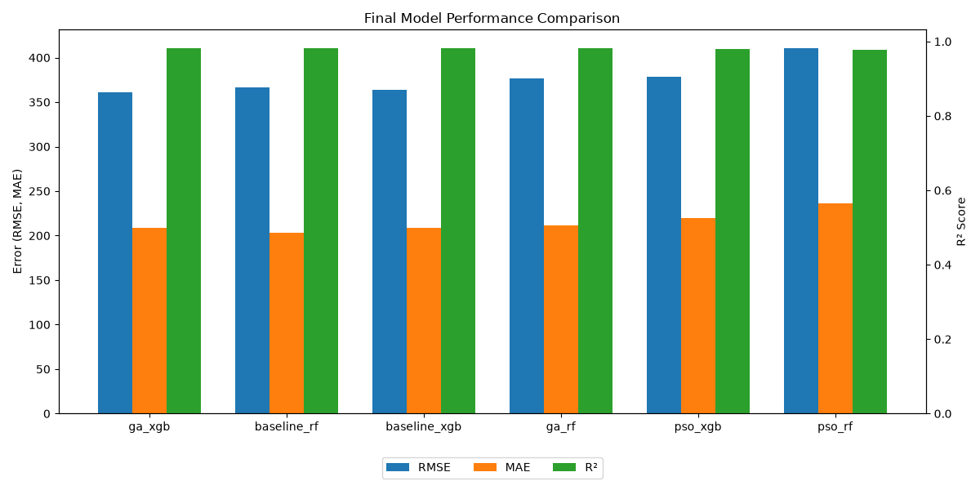
Results Comparison
Notes:
[Sajini] Compare the optimized models to the full-feature baselines.

Slide 9
Key Findings & Hypothesis Support
- Both GA and PSO selected the '4 Cs', dropping redundant spatial features.
- GA reduced features by 33.3%, PSO by 55.6%.
- Accuracy (R2) dropped by less than 0.2% in both cases.
- Hypothesis Supported: Complexity heavily reduced with virtually no accuracy penalty.
Notes:
[Buddhika] State the statistical improvements.

Slide 10
Conclusion & Future Work
- Conclusion: NIA effectively isolates critical predictive features, providing simpler, domain-intuitive models.
- Future Work: Shared single dataset for direct comparison, Hybrid GA-PSO architecture, Deep Learning baselines.
Notes:
[Both] Wrap up presentation.

