Slide 1

IP addressing: introduction
223.1.1.1
IP address: 32-bit identifier associated with each host or router interface
interface: connection between host/router and physical link
router’s typically have multiple interfaces
host typically has one or two interfaces (e.g., wired Ethernet, wireless 802.11)
223.1.2.1
223.1.1.2
223.1.1.4
223.1.2.9
223.1.1.3
223.1.3.27
223.1.2.2
223.1.3.1
223.1.3.2
dotted-decimal IP address notation:
223.1.1.1 = 11011111 00000001 00000001 00000001
223
1
1
1

Slide 2
IP addressing: introduction
223.1.1.1
IP address: 32-bit identifier associated with each host or router interface
interface: connection between host/router and physical link
router’s typically have multiple interfaces
host typically has one or two interfaces (e.g., wired Ethernet, wireless 802.11)
223.1.2.1
223.1.1.2
223.1.1.4
223.1.2.9
223.1.1.3
223.1.3.27
223.1.2.2
223.1.3.1
223.1.3.2
dotted-decimal IP address notation:
223.1.1.1 = 11011111 00000001 00000001 00000001
223
1
1
1

Slide 3

IP addressing: introduction
223.1.1.1
Q: how are interfaces actually connected?
223.1.2.1
223.1.1.2
A: wired
Ethernet interfaces connected by Ethernet switches
223.1.1.4
223.1.2.9
223.1.1.3
223.1.3.27
223.1.2.2
223.1.3.1
223.1.3.2
A: wireless WiFi interfaces connected by WiFi base station

Slide 4
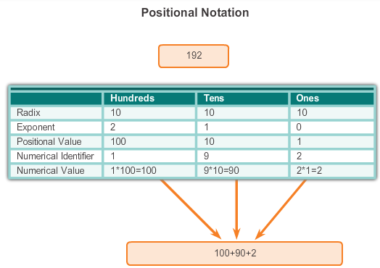
IPv4 Address Structure Binary Notation
Binary notation refers to the fact that computers communicate in 1s and 0s
Converting binary to decimal requires an understanding of the mathematical basis of a numbering system – positional notation
Notes:
Section 8.1.1.1

Slide 5

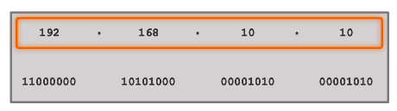


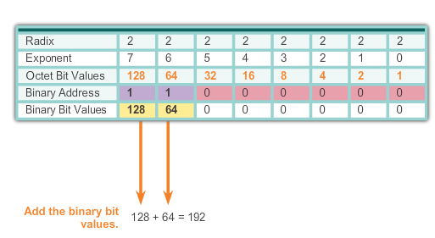
IPv4 Address Structure Binary Number System
Notes:
Section 8.1.1.2

Slide 6


IPv4 Address Structure Converting a Binary Address to Decimal
Practice
Notes:
Section 8.1.1.3 & 8.1.1.4

Slide 7
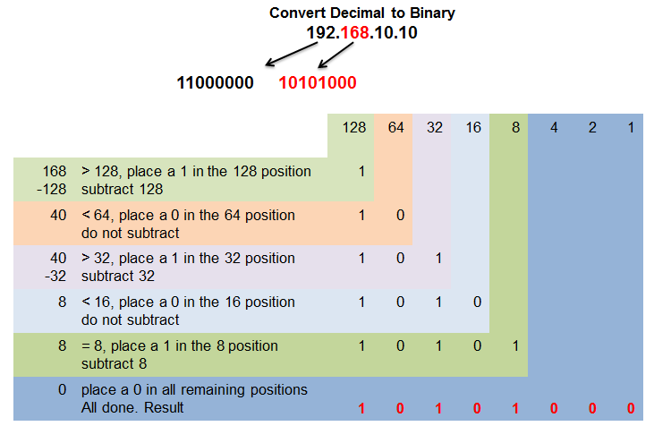
IPv4 Address Structure Converting from Decimal to Binary
Notes:
Section 8.1.1.5

Slide 8
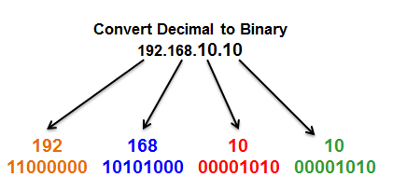
IPv4 Address Structure Converting from Decimal to Binary Conversions
Notes:
Section 8.1.1.6

Slide 9
Subnets
223.1.1.1
What’s a subnet ?
device interfaces that can physically reach each other without passing through an intervening router
223.1.2.1
223.1.1.2
223.1.1.4
223.1.2.9
223.1.1.3
223.1.3.27
223.1.2.2
IP addresses have structure:
subnet part: devices in same subnet have common high order bits
host part: remaining low order bits
223.1.3.1
223.1.3.2
network consisting of 3 subnets

Slide 10
Subnets
subnet 223.1.1.0/24
223.1.1.1
subnet 223.1.2.0/24
Recipe for defining subnets:
detach each interface from its host or router, creating “islands” of isolated networks
each isolated network is called a subnet
223.1.2.1
223.1.1.2
223.1.1.4
223.1.2.9
223.1.1.3
223.1.3.27
223.1.2.2
subnet
223.1.3.0/24
223.1.3.1
223.1.3.2
subnet mask: /24
(high-order 24 bits: subnet part of IP address)

Slide 11
Subnets
223.1.1.2
subnet 223.1.1/24
where are the subnets?
what are the /24 subnet addresses?
223.1.1.1
223.1.1.4
223.1.1.3
223.1.9.2
223.1.7.0
subnet 223.1.7/24
subnet 223.1.9/24
223.1.9.1
223.1.7.1
223.1.8.1
223.1.8.0
subnet 223.1.2/24
223.1.2.6
subnet 223.1.8/24
223.1.3.27
subnet 223.1.3/24
223.1.2.1
223.1.2.2
223.1.3.1
223.1.3.2

Slide 12
IP addressing: CIDR
CIDR: Classless InterDomain Routing (pronounced “cider”)
subnet portion of address of arbitrary length
address format: a.b.c.d/x, where x is # bits in subnet portion of address
subnet
part
host
part
11001000 00010111 00010000 00000000
200.23.16.0/23

Slide 13
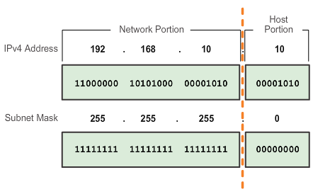
IPv4 Subnet Mask Network Portion and Host Portion of an IPv4 Address
To define the network and host portions of an address, a devices use a separate 32-bit pattern called a subnet mask
The subnet mask does not actually contain the network or host portion of an IPv4 address, it just says where to look for these portions in a given IPv4 address
Notes:
Section 8.1.2.1

Slide 14
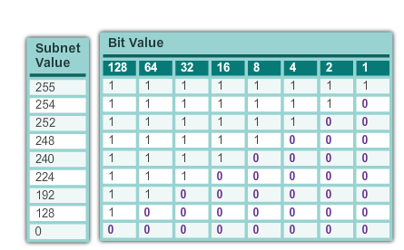
IPv4 Subnet Mask Network Portion and Host Portion of an IPv4 Address
Valid Subnet Masks
Notes:
Section 8.1.2.1

Slide 15
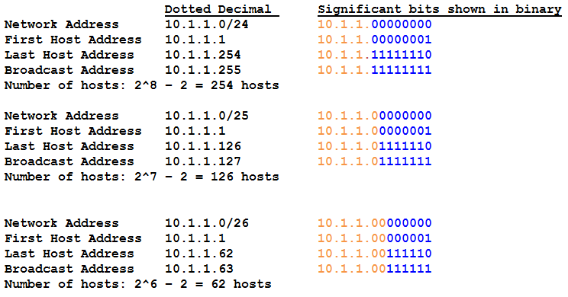
IPv4 Subnet Mask Examining the Prefix Length
Notes:
Section 8.1.2.2

Slide 16
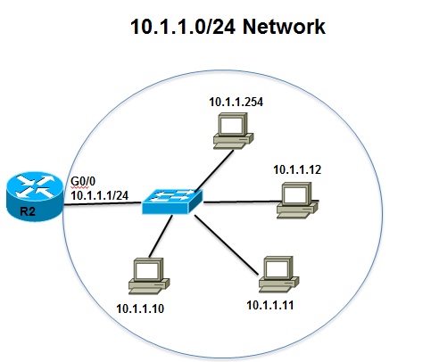
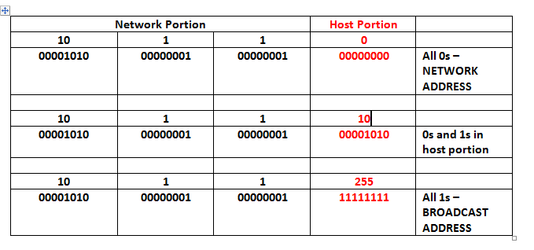
IPv4 Subnet Mask IPv4 Network, Host, and Broadcast Address
Notes:
Section 8.1.2.3

Slide 17
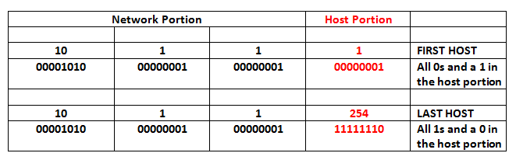
IPv4 Subnet Mask First Host and Last Host Addresses
Notes:
Section 8.1.2.4

Slide 18
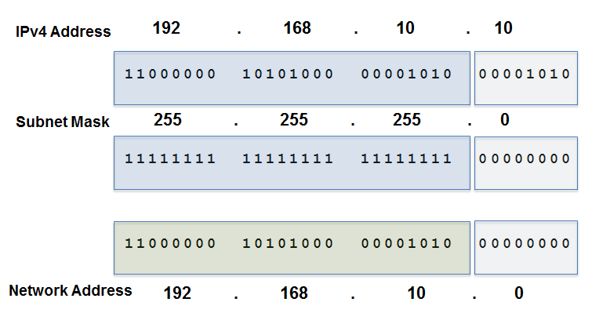
IPv4 Subnet Mask Bitwise AND Operation
1 AND 1 = 1 1 AND 0 = 0 0 AND 1 = 0 0 AND 0 = 0
Notes:
Section 8.1.2.5 and 8.1.2.6

Slide 19
IP addresses: how to get one?
That’s actually two questions:
Q: How does a host get IP address within its network (host part of address)?
Q: How does a network get IP address for itself (network part of address)
How does host get IP address?
hard-coded by sysadmin in config file (e.g., /etc/rc.config in UNIX)
DHCP: Dynamic Host Configuration Protocol: dynamically get address from as server
“plug-and-play”

Slide 20
DHCP: Dynamic Host Configuration Protocol
goal: host dynamically obtains IP address from network server when it “joins” network
can renew its lease on address in use
allows reuse of addresses (only hold address while connected/on)
support for mobile users who join/leave network
DHCP overview:
host broadcasts DHCP discover msg [optional]
DHCP server responds with DHCP offer msg [optional]
host requests IP address: DHCP request msg
DHCP server sends address: DHCP ack msg

Slide 21



DHCP client-server scenario
Typically, DHCP server will be co-located in router, serving all subnets to which router is attached
DHCP server
223.1.1.1
223.1.2.1
223.1.2.5
223.1.1.2
223.1.1.4
223.1.2.9
223.1.1.3
223.1.3.27
arriving DHCP client needs
address in this network
223.1.2.2
223.1.3.1
223.1.3.2

Slide 22


DHCP client-server scenario
DHCP server: 223.1.2.5
DHCP discover
Arriving client
src : 0.0.0.0, 68
dest.: 255.255.255.255,67
yiaddr: 0.0.0.0
transaction ID: 654
Broadcast: is there a DHCP server out there?
DHCP offer
src: 223.1.2.5, 67
dest: 255.255.255.255, 68
yiaddrr: 223.1.2.4
transaction ID: 654
lifetime: 3600 secs
Broadcast: I’m a DHCP server! Here’s an IP address you can use
The two steps above can be skipped “if a client remembers and wishes to reuse a previously allocated network address” [RFC 2131]
DHCP request
src: 0.0.0.0, 68
dest:: 255.255.255.255, 67
yiaddrr: 223.1.2.4
transaction ID: 655
lifetime: 3600 secs
Broadcast: OK. I would like to use this IP address!
DHCP ACK
src: 223.1.2.5, 67
dest: 255.255.255.255, 68
yiaddrr: 223.1.2.4
transaction ID: 655
lifetime: 3600 secs
Broadcast: OK. You’ve got that IP address!

Slide 23
DHCP: more than IP addresses
DHCP can return more than just allocated IP address on subnet:
address of first-hop router for client
name and IP address of DNS sever
network mask (indicating network versus host portion of address)

Slide 24
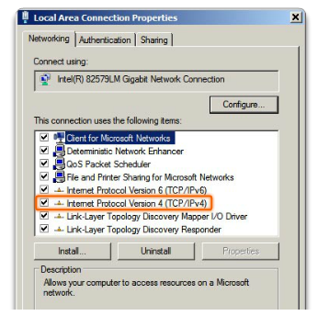
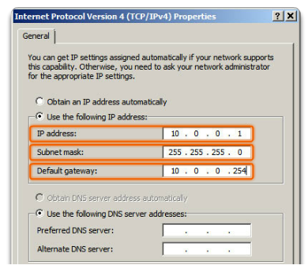
IPv4 Unicast, Broadcast, and Multicast Assigning a Static IPv4 Address to a Host
LAN Interface Properties
Configuring a Static IPv4 Address
Notes:
Section 8.1.3.1

Slide 25
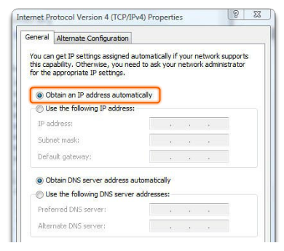
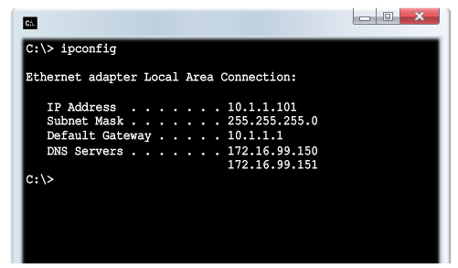
IPv4 Unicast, Broadcast, and Multicast Assigning a Dynamic IPv4 Address to a Host
Verification
DHCP - preferred method of “leasing” IPv4 addresses to hosts on large networks, reduces the burden on network support staff and virtually eliminates entry errors
Notes:
Section 8.1.3.2

Slide 26
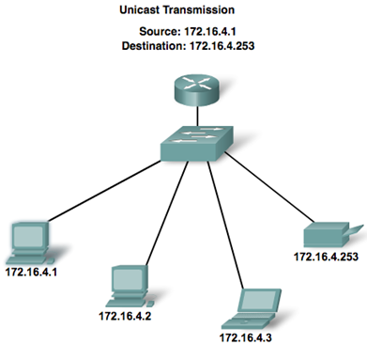
IPv4 Unicast, Broadcast, and Multicast Unicast Transmission
In an IPv4 network, the hosts can communicate one of three different ways:
Unicast - the process of sending a packet from one host to an individual host.
Notes:
Section 8.1.3.3

Slide 27
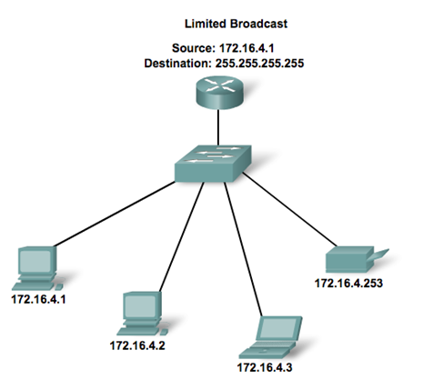
IPv4 Unicast, Broadcast, and Multicast Broadcast Transmission
Broadcast - the process of sending a packet from one host to all hosts in the network
Routers do not forward a limited broadcast!
Directed broadcast
Destination 172.16.4.255
Hosts within the 172.16.4.0/24 network
Notes:
Section 8.1.3.4

Slide 28
IPv4 Unicast, Broadcast, and Multicast Multicast Transmission
Multicast - the process of sending a packet from one host to a selected group of hosts, possibly in different networks
Reduces traffic
Reserved for addressing multicast groups - 224.0.0.0 to 239.255.255.255.
Link local - 224.0.0.0 to 224.0.0.255 (Example: routing information exchanged by routing protocols)
Globally scoped addresses - 224.0.1.0 to 238.255.255.255 (Example: 224.0.1.1 has been reserved for Network Time Protocol)
Notes:
Section 8.1.3.5

Slide 29
Types of IPv4 Address Public and Private IPv4 Addresses
Private address blocks are:
Hosts that do not require access to the Internet can use private addresses
10.0.0.0 to 10.255.255.255 (10.0.0.0/8)
172.16.0.0 to 172.31.255.255 (172.16.0.0/12)
192.168.0.0 to 192.168.255.255 (192.168.0.0/16)
Shared address space addresses:
Not globally routable
Intended only for use in service provider networks
Address block is 100.64.0.0/10
Notes:
Section 8.1.4.1

Slide 30
Types of IPv4 Address Special Use IPv4 Addresses
Network and Broadcast addresses - within each network the first and last addresses cannot be assigned to hosts
Loopback address - 127.0.0.1 a special address that hosts use to direct traffic to themselves (addresses 127.0.0.0 to 127.255.255.255 are reserved)
Link-Local address - 169.254.0.0 to 169.254.255.255 (169.254.0.0/16) addresses can be automatically assigned to the local host
TEST-NET addresses - 192.0.2.0 to 192.0.2.255 (192.0.2.0/24) set aside for teaching and learning purposes, used in documentation and network examples
Experimental addresses - 240.0.0.0 to 255.255.255.254 are listed as reserved
Notes:
Section 8.1.4.3

Slide 31
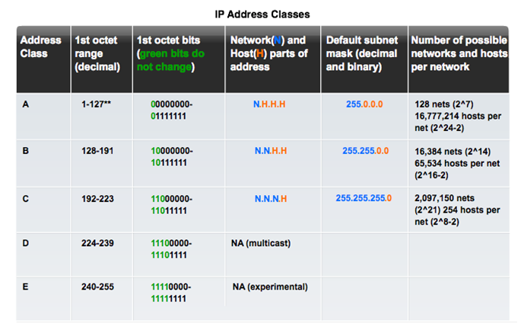
Types of IPv4 Address Legacy Classful Addressing
Notes:
Section 8.1.4.4

Slide 32
Types of IPv4 Address Legacy Classful Addressing
Classless Addressing
Formal name is Classless Inter-Domain Routing (CIDR, pronounced “cider
Created a new set of standards that allowed service providers to allocate IPv4 addresses on any address bit boundary (prefix length) instead of only by a class A, B, or C address
Notes:
Section 8.1.4.4

Slide 33
IP addresses: how to get one?
Q: how does network get subnet part of IP address?
A: gets allocated portion of its provider ISP’s address space
ISP's block 11001000 00010111 00010000 00000000 200.23.16.0/20
ISP can then allocate out its address space in 8 blocks:
Organization 0 11001000 00010111 00010000 00000000 200.23.16.0/23
Organization 1 11001000 00010111 00010010 00000000 200.23.18.0/23
Organization 2 11001000 00010111 00010100 00000000 200.23.20.0/23
... ….. …. ….
Organization 7 11001000 00010111 00011110 00000000 200.23.30.0/23

Slide 34
IP addressing...
Q: how does an ISP get block of addresses?
A: ICANN: Internet Corporation for Assigned Names and Numbers http://www.icann.org/
allocates IP addresses, through 5 regional registries (RRs) (who may then allocate to local registries)
Q: are there enough 32-bit IP addresses?
ICANN allocated last chunk of IPv4 addresses to RRs in 2011
NAT (next) helps IPv4 address space exhaustion
IPv6 has 128-bit address space
"Who the hell knew how much address space we needed?" Vint Cerf (reflecting on decision to make IPv4 address 32 bits long)

Slide 35
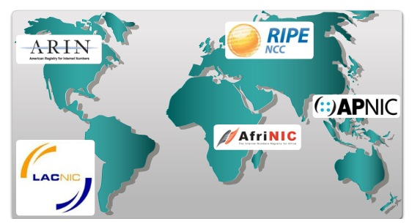
Types of IPv4 Address Assignment of IP Addresses
Regional Internet Registries (RRs)
The major registries are:
Notes:
Section 8.1.4.5

Slide 36

Slides taken from https://gaia.cs.umass.edu/kurose_ross/ppt.htm
And CISCO learning materials.
Computer Networking: A Top-Down Approach 8th edition Jim Kurose, Keith Ross Pearson, 2020

