Slide 1
Machine Learning Technology
Group 1
Hieu Tran, Lu Yang, Sajit Valiya Kizhakke, Yiyi Zhang
San Jose State University
Data 245
Notes:
Olivia

Slide 2
Industry Case Study
Patent: Patient State Detection Based on Support Vector Machine based algorithm
Inventor: David L. Carlson, Timothy J. Denison, Ali H. Shoeb
(Pub No. US 2010/0280574 A1; PCT/US2010/022118)
Notes:
Olivia

Slide 3
About the Patent
Motivation
The needful of medical devices which, more particularly, for each patient to detect the condition states to help on further therapy delivery
Goal
The patient state detection can be used to control therapy delivery, generate notification, initiated data recording or evaluate patient condition
Notes:
Olivia

Slide 4
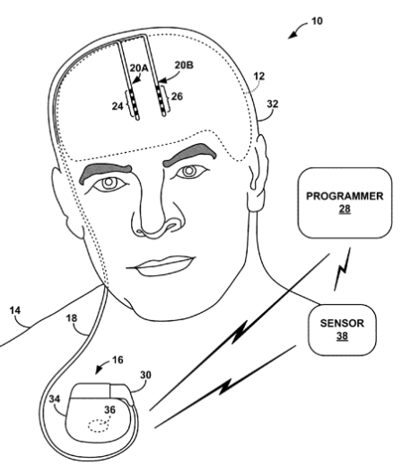
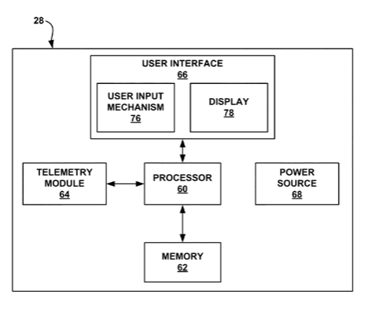
About the Patent
Deep Brain Stimulation (DBS) System
Medical Device Programmer
Above figure is from David L. Carlson (US 2010/0280574 A1)
Notes:
Olivia

Slide 5
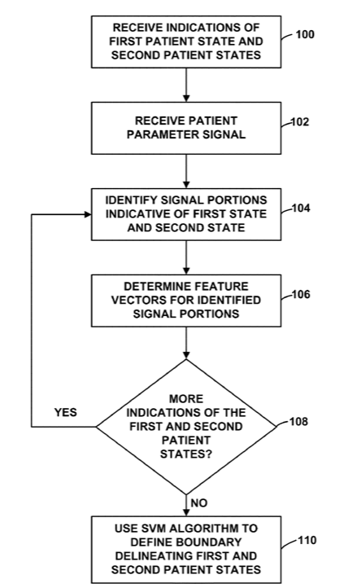
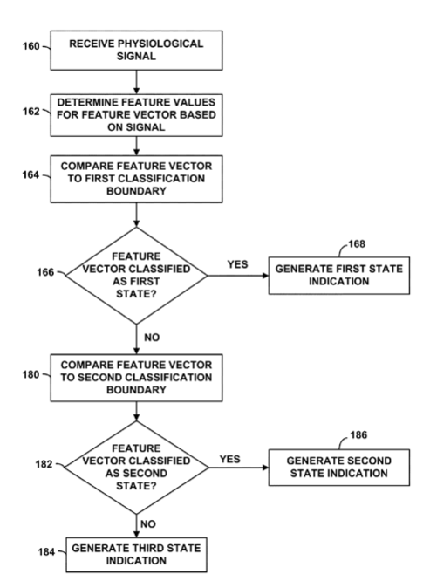
About the Patent
SVM training processing for determining a patient state based on real-time/stored parameter signals
The processor implement to determine multiple states based on parameter signals
Above figure is from David L. Carlson (US 2010/0280574 A1)
Notes:
Olivia

Slide 6
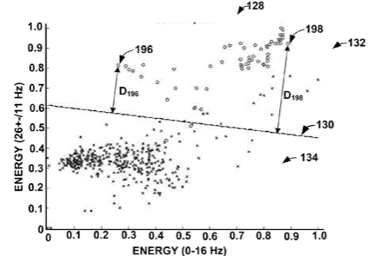
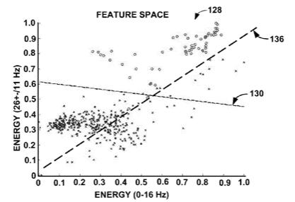
About the Patent
Feature Space include one or more Linear Classification boundary
Above figure is from David L. Carlson (US 2010/0280574 A1)
Notes:
Olivia

Slide 7
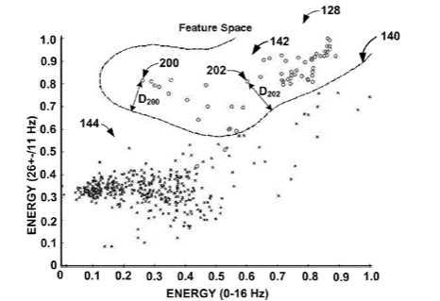
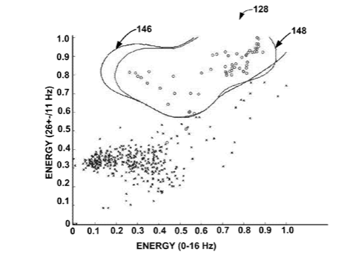
About the Patent
Feature Space include one or more Non-Linear Classification boundary
Above figure is from David L. Carlson (US 2010/0280574 A1)
Notes:
Olivia

Slide 8
Patient State Detection Based on SVM Based Algorithm
Relevance to course work
SVM: decision boundary is decided by support feature vector only.
Patent: use SVM to decide the data boundary.
SVM: can do fast prediction for it only related to support vector.
Patent: declarify SVM based machine learning algorithms for prediction.
Notes:
Olivia

Slide 9
Patient State Detection Based on SVM Based Algorithm
Key Learnings
Patient-specific vs. non patient-specific data
Multiple approaches and techniques to build ML model
Detecting depression from SVM based algorithms by the presence of low energy in alpha frequency signals
The classification boundary can be extended in a variety of directions and multi-dimensional feature space based on the number of features used to classify the states.
Notes:
Olivia

Slide 10
Significant Paper
Solving L1-regularized SVMs and Related Linear Programs:
Revisiting the Effectiveness of Column and Constraint Generation
Antoine Dedieu, Rahul Mazumder, Haoyue Wang
@Vicarious AI @Massachusetts Institute of Technology
Notes:
Lucy

Slide 11
About the Paper
Source of paper
JMLR (Journal of Machine Learning Research)
Impact factor > 4
arXiv from Cornell University
DOI: https://doi.org/10.48550/arXiv.1901.01585

Slide 12
About the Paper
Motivation
In huge samples, it is challenging to compute the penalized SVM problems involving minimizing the hinge loss function with convex sparsity-inducing regularizer
Goal
Suggests new computational algorithms for large scale Linear Programs considering column/constraint generation methods and first order methods for non-smooth convex optimization

Slide 13
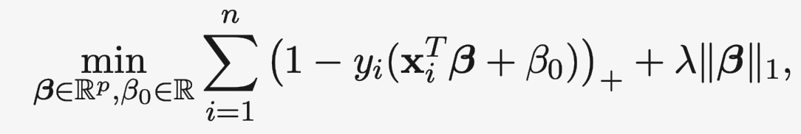
Relevance to course work
SVM & L1-regularize in course
Regularization， underfitting and overfitting
Purpose of all machine learning models: minimize the loss
L1-regularized SVM in paper.
p >> n
n >> p
n~p
Notes:
it used L1 regularized SVM with methods to reduce complexity on minimize loss functions in 3 cases

Slide 14
L1-SVM with Column and Constraint Generation
Key Learnings
Column and constraint generation for L1-SVM, Group-SVM, Slope-SVM
First order methods for non-smooth convex optimization
Notes:
Lucy

Slide 15
Predicting Soccer Players’ Market Value With Regression Models
Notes:
Lucy

Slide 16
Agenda
Introduction
Experimental Design
Exploratory Data Analysis
Modeling
Conclusion and Future Work
Notes:
Lucy

Slide 17
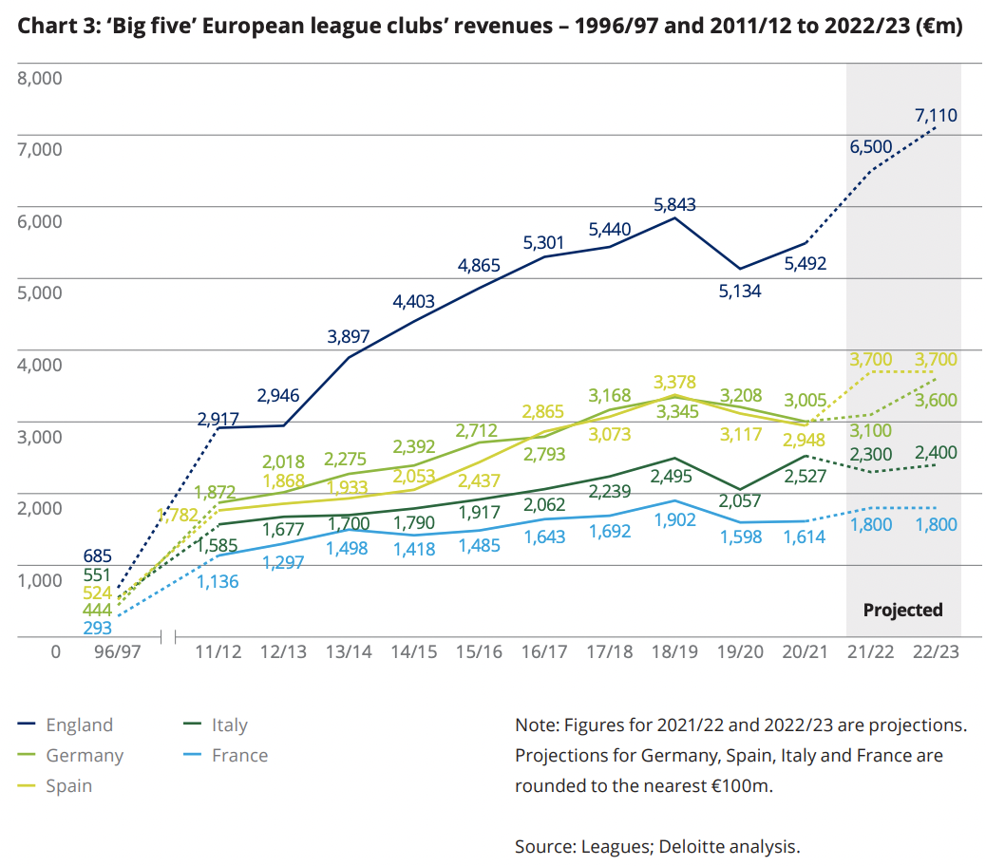
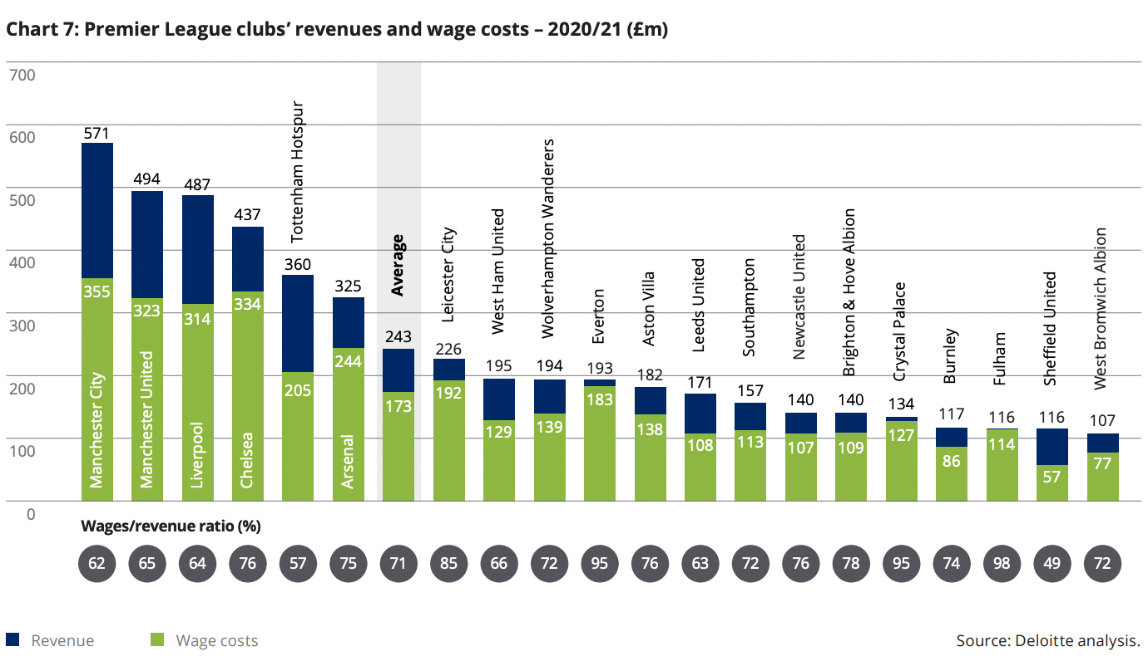
Introduction
Motivation
Soccer is one of the most popular sports in the world
Market value*
Lots of scope for Machine Learning
in sports analytics.
*: https://www2.deloitte.com/content/dam/Deloitte/uk/Documents/sports-business-group/deloitte-uk-annual-review-of-football-finance-2022.pdf
Notes:
Lucy

Slide 18
Introduction (cont.)
Relation to Course
Regression
Regularization
Cross-fold validation
Feature selection
Impact
Recommend features for Football/Soccer Club to choose players
Recommend market value for Football/Soccer Club to choose players
Application to other sport market
Notes:
Lucy

Slide 19
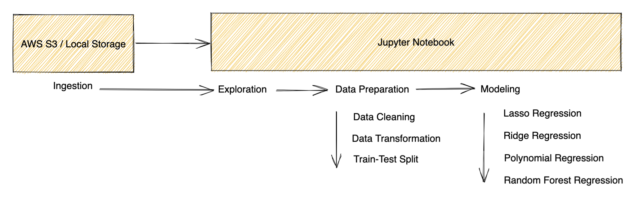
Workflow
Notes:
Hieu

Slide 20
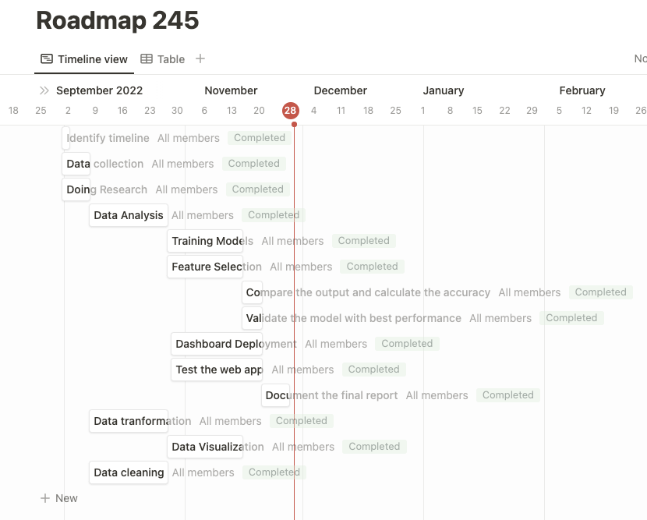





Platform & Software
Notes:
Hieu Notion

Slide 21
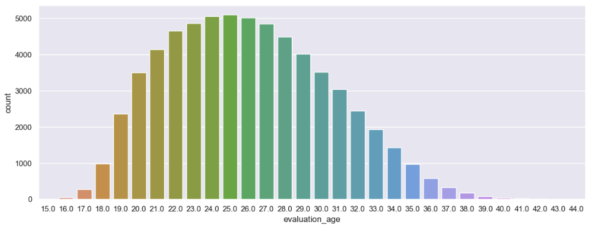
Exploratory Data Analysis
Age Distribution

Slide 22
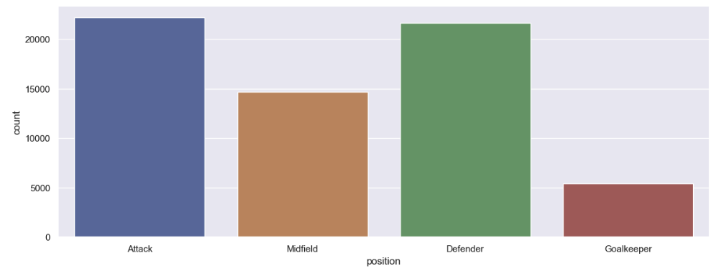
Exploratory Data Analysis (cont.)
Position Distribution

Slide 23
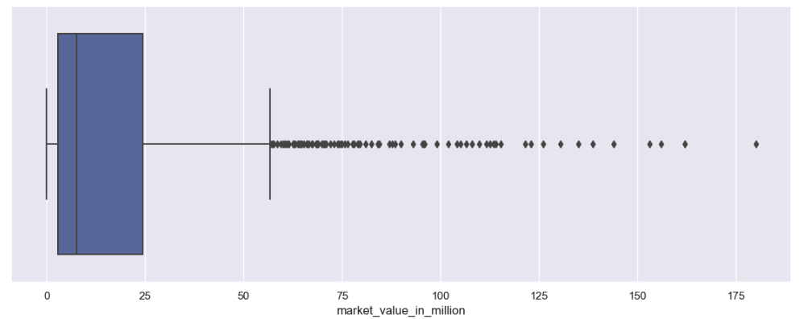
Exploratory Data Analysis (cont.)
Market Value Outliers
Outliers are outstanding players

Slide 24
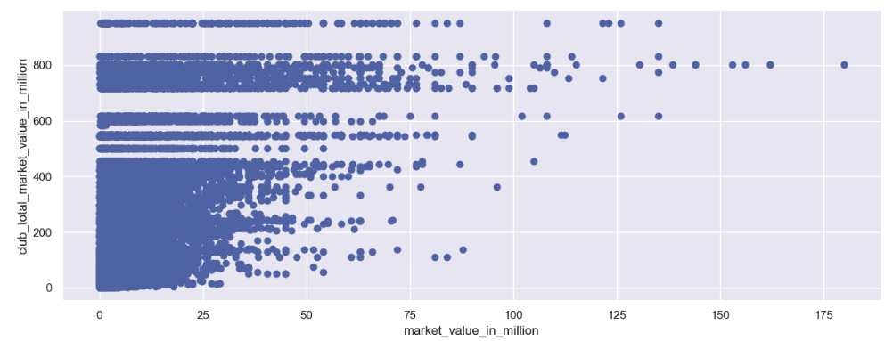
Exploratory Data Analysis (cont.)
Player Market Value vs. Club Market Value
Higher club value -> Higher player value

Slide 25
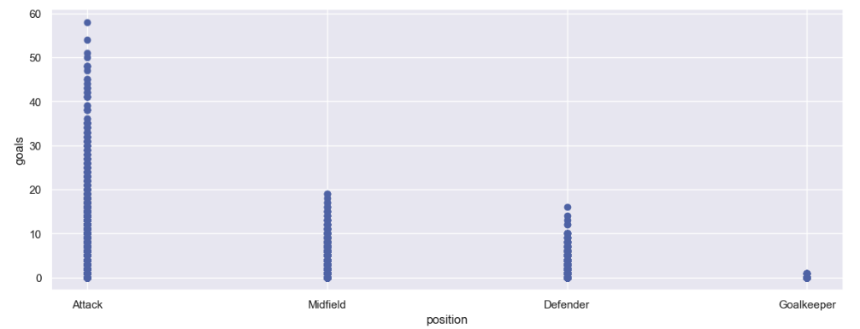
Exploratory Data Analysis (cont.)
Positions vs. Goals
Attack position has the most goals
Notes:
Hieu

Slide 26
Technical Difficulties
Feature Selection
For the polynomial regression model, incorporating the entire dataset led to a memory error i.e., the RAM wasn’t sufficient to process the model. We mitigated this by incorporating the filter method. We chose the top features that have the maximum impact on the prediction.
The filter method was performed on the basis correlation matrix, wherein the features were compared with each other to indicate the top performing features.
Notes:
Sajit

Slide 27
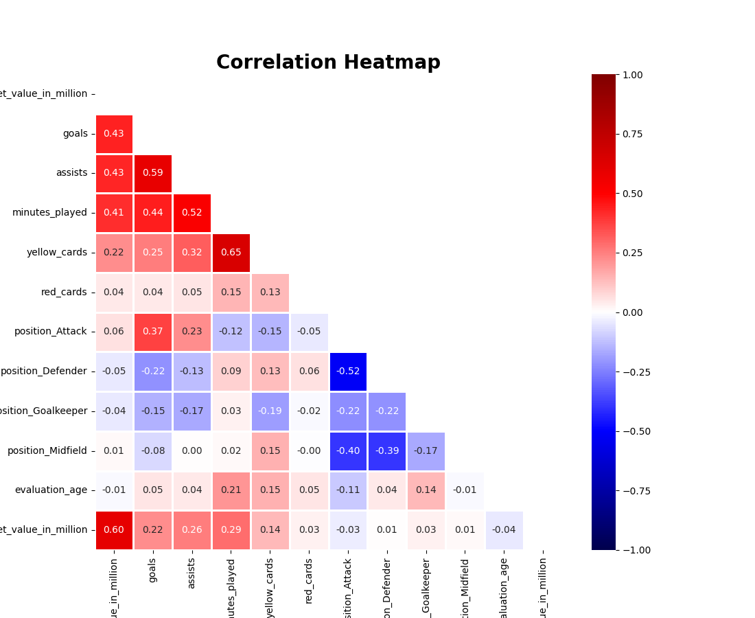
Technical Difficulties
Feature Selection (cont.)
Heatmap showcasing the most impactful features
Notes:
Sajit

Slide 28
Technical Difficulties
Categorical Variables … One Hot Encoding
player_id | foot
1 | left
2 | right
3 | both
4 | n/a
player_id | foot_left | foot_right | foot_both | foot_na
1 | 1 | 0 | 0 | 0
2 | 0 | 1 | 0 | 0
3 | 0 | 0 | 1 | 0
4 | 0 | 0 | 0 | 1
Notes:
Hieu

Slide 29
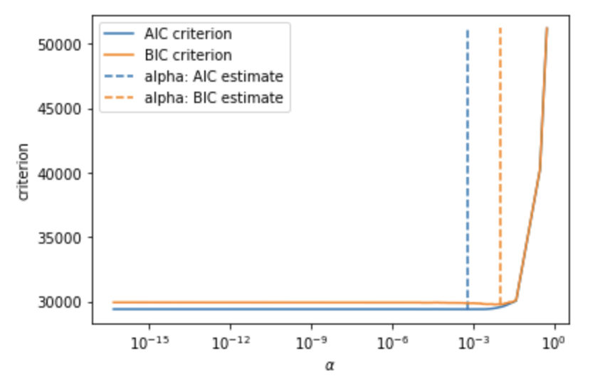
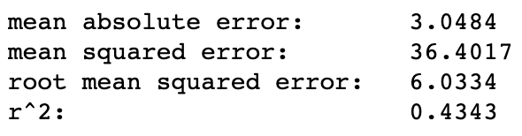
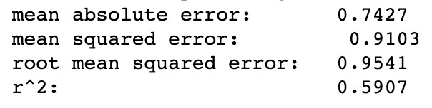
Modeling
Lasso Regression
R2 score is low in training-> Underfitting
AIC=2k−2ln(L), better for prediction
BIC=ln(n)k–2ln(L)
Testing metrics
Testing metrics with log preprocessing market value
Notes:
Lucy

Slide 30
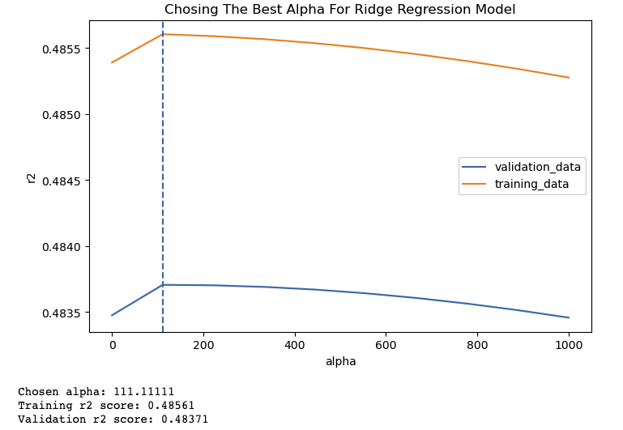

Modeling
Ridge Regression
Both training and validation scores are low -> Underfitting
Testing metrics

Slide 31
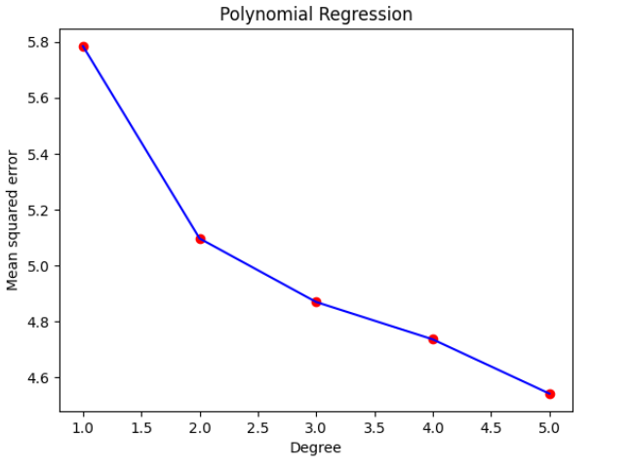

Modeling
Polynomial Regression

Slide 32
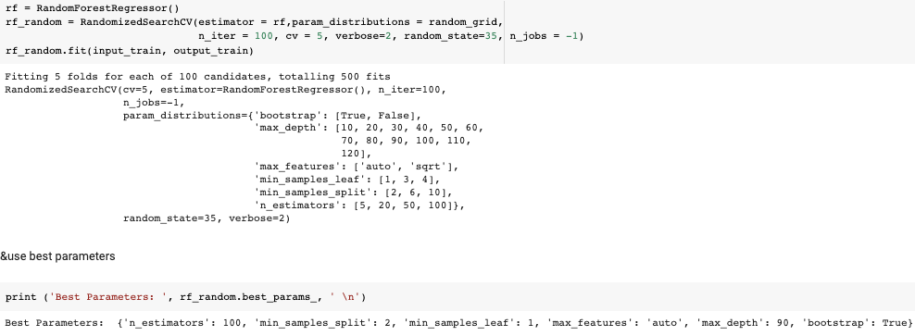

Modeling
Random Forest Regression
Testing metrics

Slide 33
Model Comparison
Metric | Lasso Regression | Ridge Regression | Polynomial Regression | Random Forest Regression
MAE | 3.0484 | 2.8327 | 2.1922 | 1.8002
RMSE | 6.0334 | 5.3487 | 5.0058 | 4.0307
R2 | 0.4343 | 0.5041 | 0.5656 | 0.7184
Notes:
Olivia

Slide 34
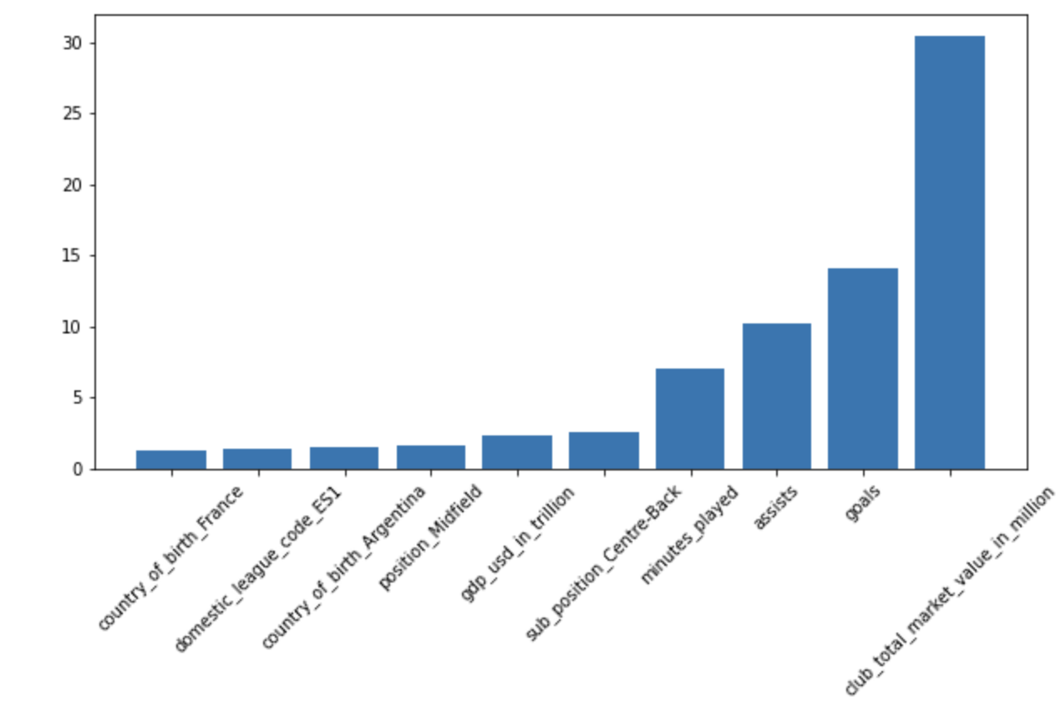
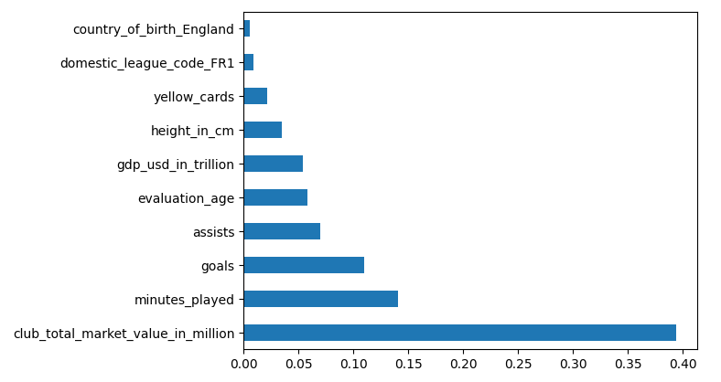
Model Comparison (cont.)
Top 10 features selected by Lasso Regression model and Random Forest model
Lasso Regression Model
Random Forest Model
Notes:
Olivia

Slide 35
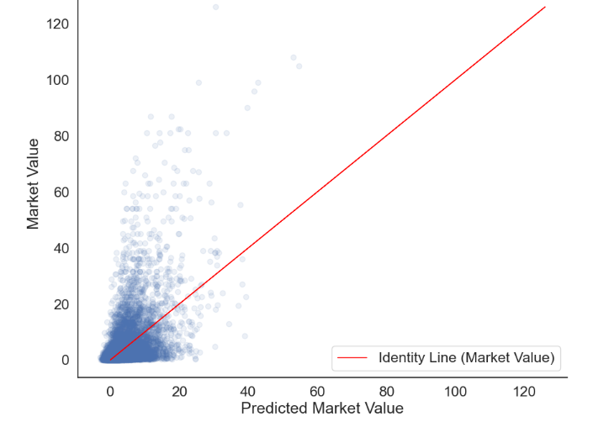
Conclusion
Comparison of actual vs. predicted market value
Notes:
Sajit

Slide 36
Conclusion
Lesson learned
How to use model
Cross validation
Preprocessing - One Hot Encoding
Select features
Evaluation method
Notes:
Sajit

Slide 37
Conclusion (cont.)
Future work
New method for preprocessing data with many outliers, like clustering the label and make regression in different cluster with different model
Application in other sport market like basketball
Handle high RAM problem in model processing
Notes:
Sajit

Slide 38
Demo

Slide 39
Q&A

