Slide 1
CodeFest Management System
CSSE-SE3070- Case Study Topic Finalization
Group No: CSSE-13

Slide 2
Group Details
 | Name | Registration Number | Email
1 | A.P.I.R Jayathilaka | IT15068774 | isuruj.94@gmail.com
2 | S.R Rajapakse | IT14104640 | srrajapakse1@gmail.com
3 | Liyanage S.C.G | IT14098888 | chamaraliyanage604@gmail.com
4 | D.A Polawattage | IT14084614 | dasunianupama@gmail.com

Slide 3
PROJECT Summary
We are creating a tool which is specifically designed to S.L.I.I.T to help in all management of it’s most prestigious event ‘S.L.I.I.T CodeFest’. In this project we are going to create a web site, which will help the organizers as well as the participants. They already have a website which helps them to register participants and aware the public on events, but from our project we are focusing mainly on management of the events.

Slide 4
Project Scope
We are creating a website which will be accessible to public.
Participants doesn’t have to login to register to an event or to see the competition details.
Organizing committee members should have to login to manage the events.
Organizing committee consist of two categories: lecturers and students.
Only lecturers can send mails to participants, create events, workshops, manage budget, recruit students to organizing committee and can maintain event round wise results(Ex: preliminary round, final round).
Student organizing committee members can see round wise results and help the ushering of the participants to relevant event location at right time.

Slide 5
Technologies
Applications
IntelliJ IDEA 2016.3.4(64x)
SQL Workbench
Technologies
Java EE
MySQL

Slide 6
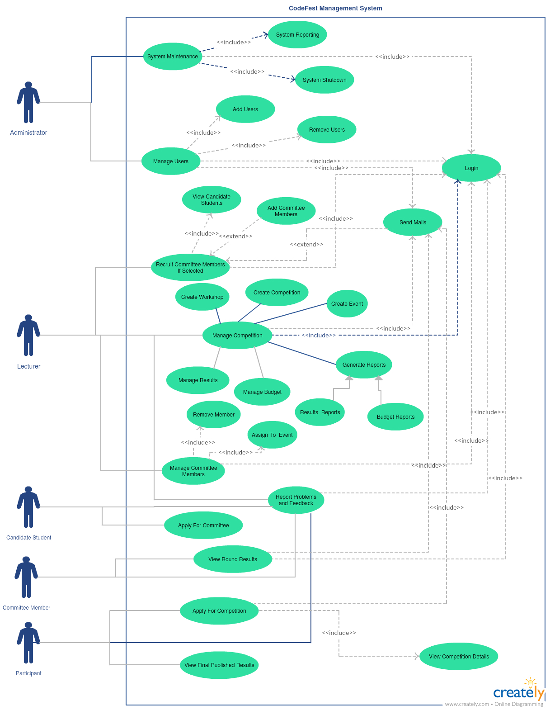
High Level Diagram

Slide 7
Functionalities
As an administrator I want to add users( Lecturers, Committee Members) so that they can interact with the system.
As an administrator I want to search/view users( Lecturers, Committee Members) so that I can search/view user details.
As an administrator I want to update/ remove users( Lecturers, Committee Members) so that I can update/remove user details and access.
As an administrator I want to view all the reported problems and feedbacks so that I can take decisions.
As an administrator I want to send emails to users regarding problems and feedbacks so that I can inform users.

Slide 8
As a lecturer I want to create a main competition so that I can inform users about competition and to add events under competition.
As a lecturer I want to search a main competition so that I can view details about competition.
As a lecturer I want to update/delete a main competition so that I can update/remove competition details and users can view the change(All the events under that specific competition will be updated/removed).
As a lecturer I want to create an event under a specific competition so that I can inform users about specific event.
As a lecturer I want to search an event so that I can view details about specific event.
As a lecturer I want to update/delete an event so that I can update/remove event details.

Slide 9
As a lecturer I want to create a workshop under a specific competition so that I can inform users about specific workshop.
As a lecturer I want to search a workshop under a specific competition so that I can view details about specific workshop.
As a lecturer I want to update/delete a workshop so that I can update/remove workshop details and users can view the change.
As a lecturer I want to create budget for a competition so that I can inform users about budget allocation.
As a lecturer I want to allocate/create budget for a specific event/workshop so that I can inform users about budget allocation for specific event/workshop.
As a lecturer I want to search budget for a specific competition so that I can view budget details about specific competition.
As a lecturer I want to search budget for a specific event/workshop so that I can view budget details about specific event/workshop.

Slide 10
As a lecturer I want to update/remove budget for a competition so that I can update/remove budget competition details and users can view the change(All the budgets allocated for events/workshops under that specific competition will be updated/removed).
As a lecturer I want to update/remove budget for an event so that I can update/remove event budget details and users can view the change.
As a lecturer I want to update/remove budget for a workshop so that I can update/remove workshop budget details.
As a lecturer I want to search a candidate student so that I can view details about candidate student.
As a lecturer I want to add candidate student to a specific event so that student get access to the system and will be added to organizing committee(Committee Member).
As a lecturer I want to revoke/delete committee member so that I can remove user details and access.

Slide 11
25. As a lecturer I want to send emails to committee members/lecturers/participants regarding events/new appointments/new changes so that I can inform users.
As a lecturer I want to report a problem or a feedback so that I can report faults/requests to administrator.
As a lecturer I want to add round results for an event so that I can inform users about event results.
As a lecturer I want to update/delete results of an event so that I can update/remove event result details and users can view the change.
As a lecturer I want to generate reports of the full summary of events so that I can save/print the event summary.
As a lecturer I want to generate reports of the budget so that I can save/print the budget summary.
As a lecturer I want to register the judges for the events so that I can know and get a count of judges.
As a lecturer I want to assign judges for teams so that I can reserve presentation schedules effectively.

Slide 12
As a lecturer I want to add a link to view the details about sponsorship company so that I can introduce the sponsorship company to users.
As a lecturer I want to add/edit a theme for the site so that I can update the theme according to the year.
As a lecturer I want to delete the theme from the site so that I can remove the theme when there is not any specific theme for some years.
As a candidate student I want to apply for organizing committee member position so that I can access system.
As a candidate student I want to revoke/update my application for organizing committee member position so that I can change/withdrawn my application.
As an organizing committee member I want to search for events so that I can view event details.
As an organizing committee member I want to view results for the event which I am allocated so that I can view event result details.

Slide 13
40. As a participant I want to search for events/workshops so that I can view event/workshop details.
41. As a participant I want to apply for an event so that I can enter competition.
42. As a participant I want to view results round wise for events so that I can know event results.
43. As a participant I want to send mails so that I can inquire about event/workshop details.
44. As a participant I want to access to their new proposing site through the enabled link at the event time so that I can register the team and submit the presentation to it.
45. As a participant I want to view the remaining time for the event when I need so that I can manage the workload accordingly.

Slide 14
46. As a participant I can search/copy the allocated group id/registration details so that I can view/copy the group id/registration details.
47. As a participant I can search and get the allocated registration table number/competition venue and time/presentation venue and time/panel number so that I can easily and quickly view important details when I need.
48. As an administrator/lecturer/organizing committee member I want to login to the system so that I can access system.
49. As an administrator/lecturer/organizing committee member I want to reset the username/password for the system so that I can access system when I forget the username or password.

