Slide 1

Reliability of Twitter
Date: 14-05-2017
Group ID : DSN-QRL-GR2
Student ID | Name with initials
IT15068774 | A.P.I.R. Jayathilaka
IT14084614 | D.A. Polwattage
IT14098888 | S.C.G Liyanage
IT14104640 | S.R. Rajapakse
IT15029928 | A.M.A.S. Dias
Domain : Social Networks
Attribute : Reliability

Slide 2
Introduction
IT14098888
Twitter is an online social media platform
Created on March in 2006 by Jack Dorsey, Noah Glass, Biz Stone and Evan Williams.
1. History of twitter reliability
2. Reliability definition by Twitter
3. Actions taken for improving reliability
4. Trade-offs
5. compare twitter with facebook

Slide 3
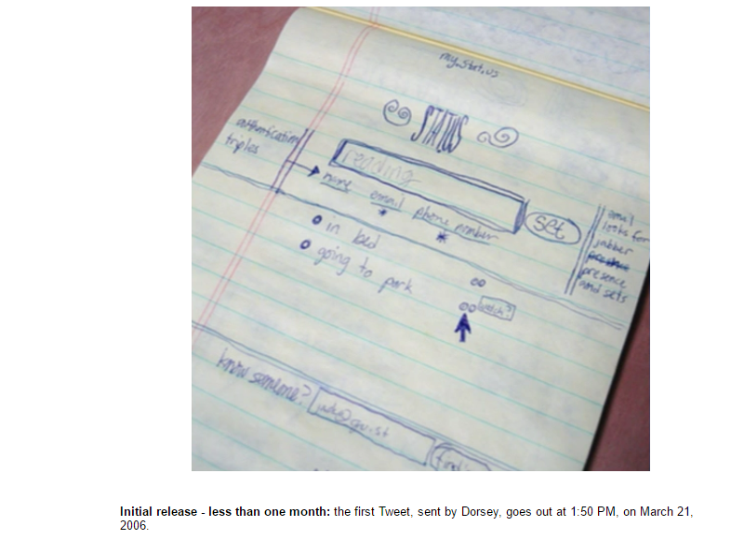
History of Twitter Reliability
IT14098888
created the prototype first.
internal service for Odeo
employees.

Slide 4

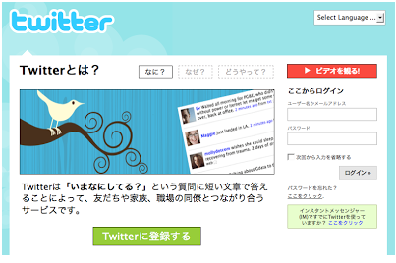
2006 – 2010
IT14098888
On March 2006, launched as twttr.com to all the private accounts.
Available to public on July.
SXSW conference in 2007- From 20,000 to 60,000 daily messages.
First non-English version in Japan on April 2008.

Slide 5
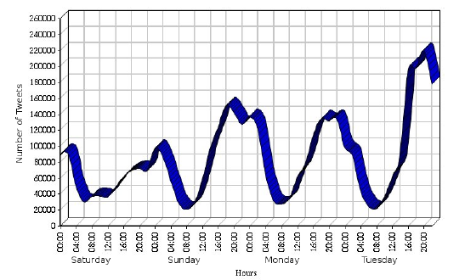
IT14098888
In 2009 dictionary attack.
33 high-profile accounts were compromised.
Launched beta version.
School shooting in Winnenden.
2010 earthquake in Chile.

Slide 6

IT14098888
FIFA World Cup in 2010.
2940 tweets were posted per second in the 30 second period of time.
Official football club accounts established in 2011.
In 2012 – Nielsen and Twitter entered a multi- year agreement.
Nielsen Twitter TV Rating to produce social TV ratings.
Because of real time news feeds.
One of the top ten most visited websites in 2013.
At least 5% accounts on Twitter are fraudulent – Twitterbots.

Slide 7
IT14098888
2014 – new connection with IBM to improve customer interaction.
TweetDeck – share team accounts in 2015.
No need to share passwords.
40 million election related tweets– 2016.
Twitter Lite introduced recently.
Progressive web app – regions with unreliable internet connection

Slide 8


