Slide 1

Reliability of Twitter
Date: 14-05-2017
Group ID : DSN-QRL-GR2
Student ID | Name with initials
IT15068774 | A.P.I.R. Jayathilaka
IT14084614 | D.A. Polwattage
IT14098888 | S.C.G Liyanage
IT14104640 | S.R. Rajapakse
IT15029928 | A.M.A.S. Dias
Domain : Twitter
Attribute : Reliability

Slide 2
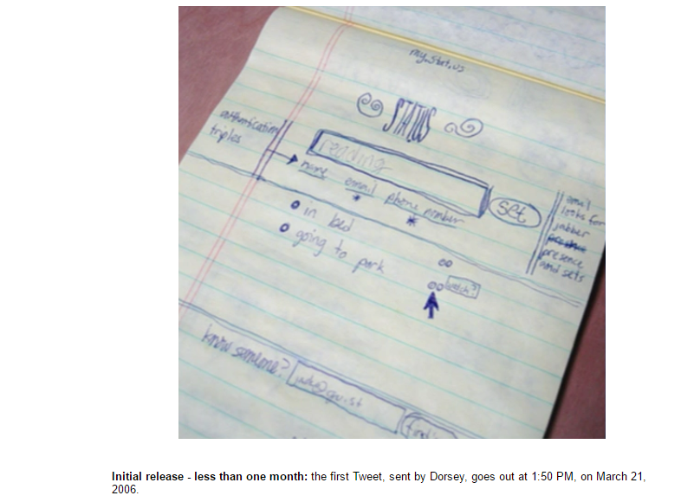
History of Twitter Reliability
IT14098888
created the prototype first.
internal service for Odeo
employees.

