Slide 1

Reliability
Why People Use Twitter?
Learn
Send and receive messages
News and politics
Sports
pop culture, Influencers and Utility etc.

Slide 2
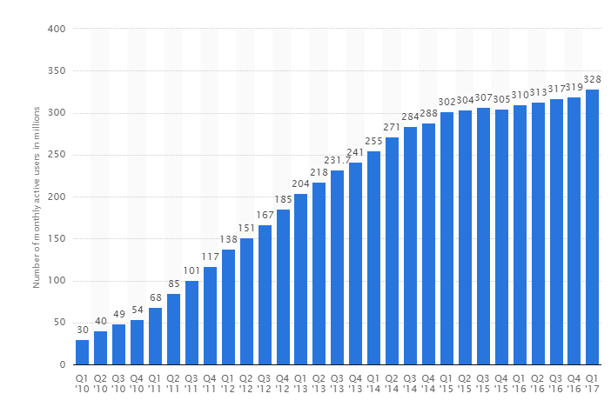
Number of Monthly Active Users

Slide 3
Definition
Reliability Definition
Operations with Free of failures for twitter over a specified time period (Give same result over and over again).
Key Attributes
Maturity
Recoverability
Availability
Accuracy
Predictability

Slide 4
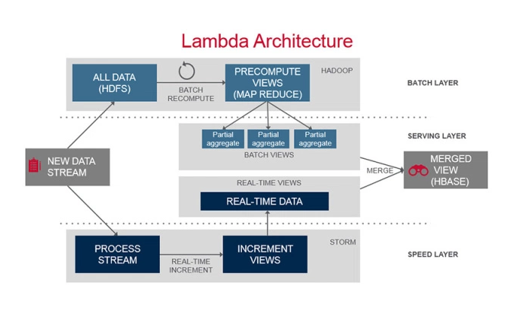
Maturity
Batch Layer
Speed Layer
Serving Layer

Slide 5

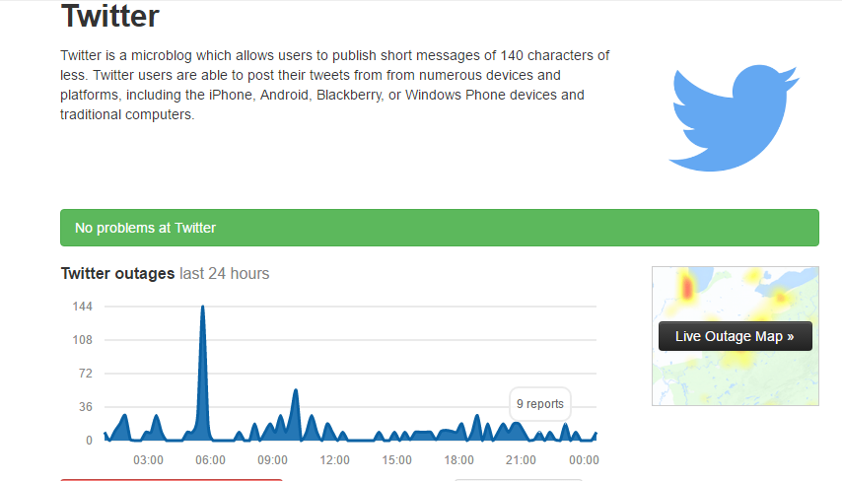
Recoverability
Use Memachache
Use MYSQL
Availability
http://downdetector.com/status/twitter

Slide 6
Accuracy
Boston marathon bombing
White House bombed
Predictability

