Slide 1
Route Error (RERR)

Slide 2
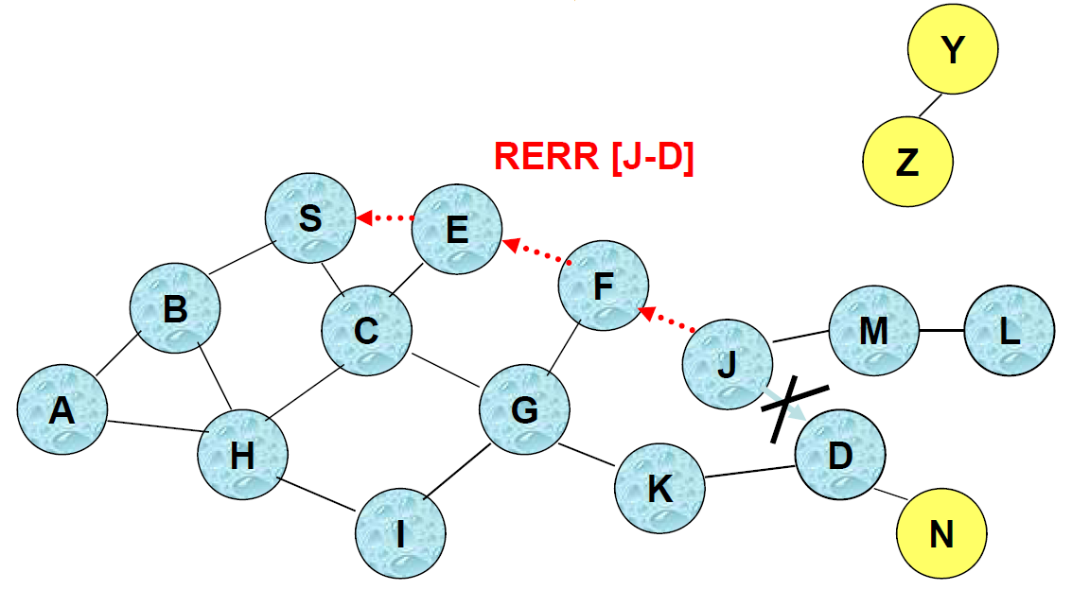
Route Error (RERR)
when J attempt to forward the data packet (with route SEFJD) to S but J-D fails, J sends a route error packet to S along route J-F-E-S
Nodes hearing RERR update their route cache to remove link J-D

Slide 3
Route Caching: Beware!
Stale caches can adversely affect performance
With passage of time and host mobility, cached routes may become invalid
A sender host may try several stale routes (obtained from local cache, or replied from cache by other nodes), before finding a good route
It may be more expensive to try several broken routes than to simply discover a new one!
RERR messages are unreliable, so news of broken routes may not even propagate completely!

Slide 4
DSR: Advantages
Routes maintained only between nodes who need to communicate
  reduces overhead of route maintenance
Route caching can further reduce route discovery overhead
A single route discovery may yield many routes to the destination, due to intermediate nodes replying from local caches

Slide 5
DSR: Disadvantages
Packet header size grows with route length due to source routing
Flood of route requests may potentially reach all nodes in the network
Care must be taken to avoid collisions between route requests propagated by neighboring nodes
  insertion of random delays before forwarding RREQ
Increased contention if too many route replies come back due to nodes replying using their local cache
  Route Reply Storm problem
  Reply storm may be eased by preventing a node from sending RREP if it hears another RREP with a shorter route

Slide 6
DSR: Disadvantages (2)
An intermediate node may send Route Reply using a stale cached route, thus polluting other caches
This problem can be eased if some mechanism to purge (potentially) invalid cached routes is incorporated.
  Static timeout
  Adaptive timeout of a link is based on:
    expected rate of mobility (mobility prediction is useful here)
    observed link usages and breakages

Slide 7
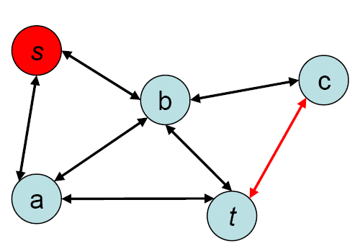
Classic Routing 1: Link-State Routing Protocols
Link-state routing protocols are a preferred iBGP (Internal Border Gateway Protocol) method (within an autonomous system – think: service provider) in the Internet
Idea: periodic notification of all nodes about the complete graph
Routers then forward a message along (for example) the shortest path in the graph
+ message follows shortest path
– every node needs to store whole graph,
even links that are not on any path
– every node needs to send and receive
messages that describe the whole
graph regularly

Slide 8
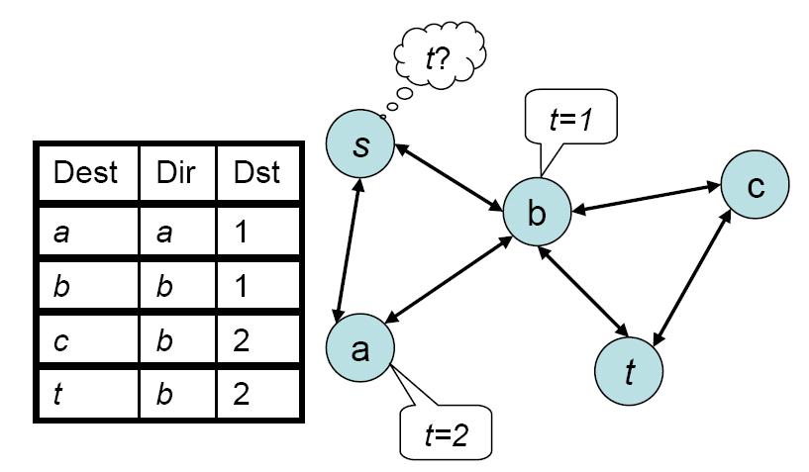
Classic Routing 2: Distance Vector Routing Protocols
The predominant method for wired networks
Idea: each node stores a routing table that has an entry to each destination (destination, distance, neighbor)
If a router notices a change in its neighborhood or receives an update message from a neighbor, it updates its routing table accordingly and sends an update to all its neighbors
+ message follows shortest path
+ only send updates when
topology changes
– most topology changes
are irrelevant for a given
source/destination pair
– every node needs to
store a big table
– count-to-infinity problem

Slide 9
Discussion of Classic Routing Protocols
Proactive Routing Protocols
Both link-state and distance vector are “proactive,” that is, routes are established and updated even if they are never needed.
If there is almost no mobility, proactive algorithms are superior because they never have to exchange information and find optimal routes easily.
Reactive Routing Protocols
Flooding is “reactive,” but does not scale
If mobility is high and data transmission rare, reactive algorithms are superior; in the extreme case of almost no data and very much mobility the simple flooding protocol might be a good choice.
There is no “optimal” routing protocol; the choice of the routing protocol depends on the circumstances. Of particular importance is the mobility/data ratio.

Slide 10
Ah-Hoc On-Demand Distance Vector (AODV)
Distance vector-based routing for ad hoc networks
Significantly more complicated protocol than DSR, because avoiding routing loops is much more difficult
  Loop elimination easy in DSR because entire route is available!
The following pictorial does not expose the complexity of AODV—just to give a basic idea

Slide 11
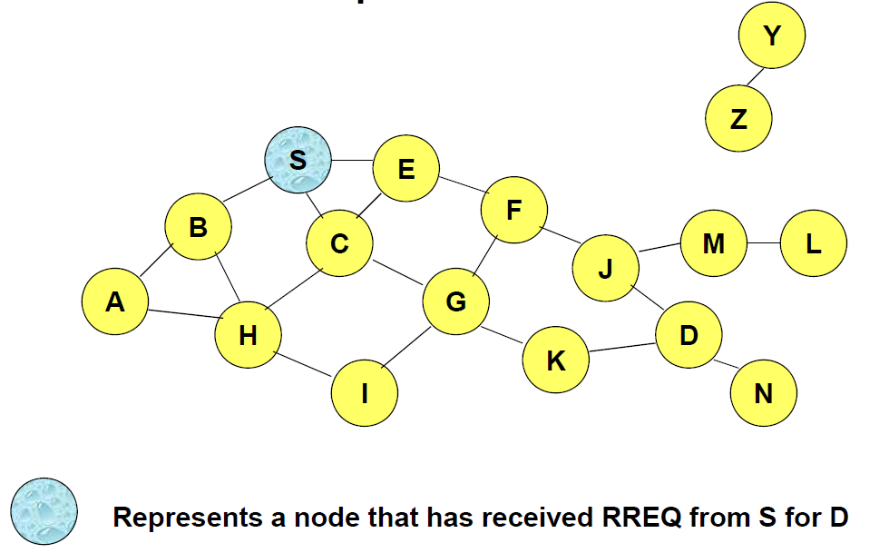
Route Requests in AODV

Slide 12
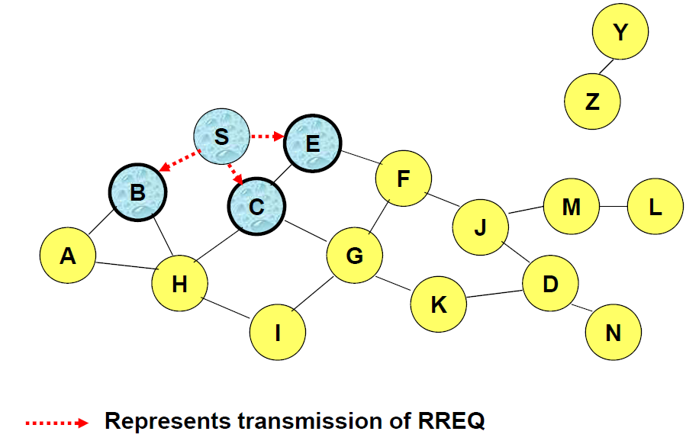
Route Requests in AODV

Slide 13
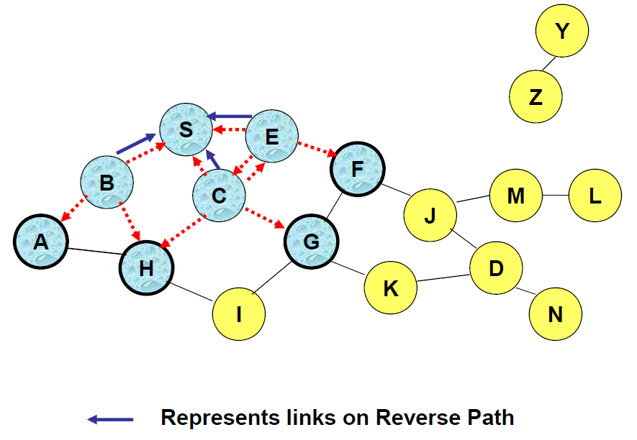
Route Requests in AODV

Slide 14
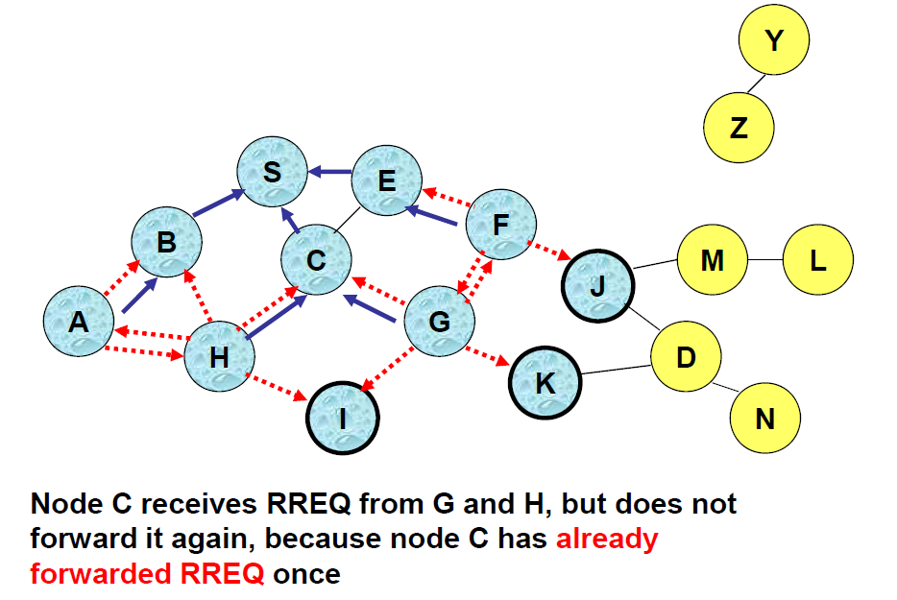
Reverse Path Setup in AODV

Slide 15
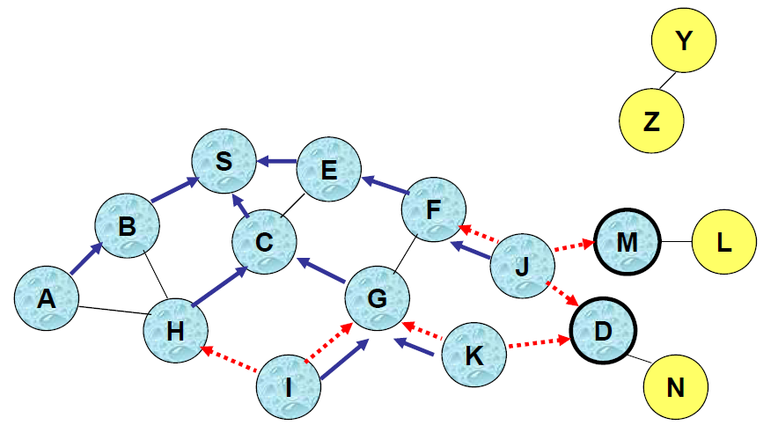
Reverse Path Setup in AODV

Slide 16
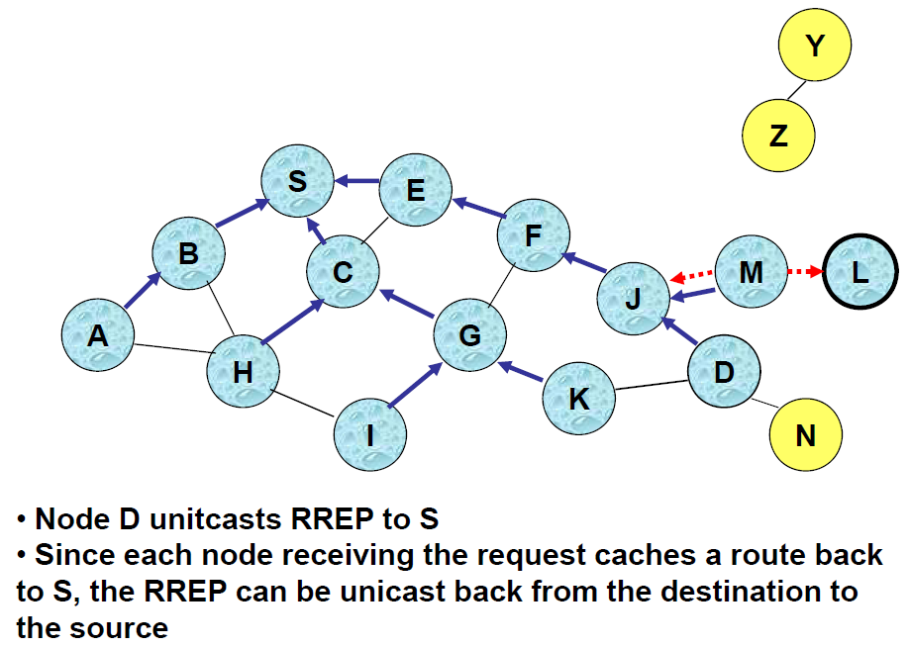
Reverse Path Setup in AODV

Slide 17
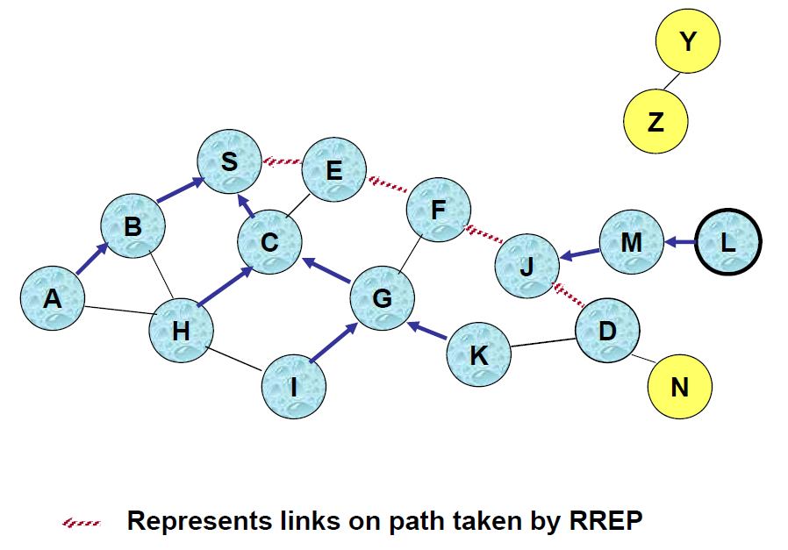
Route Reply in AODV

Slide 18
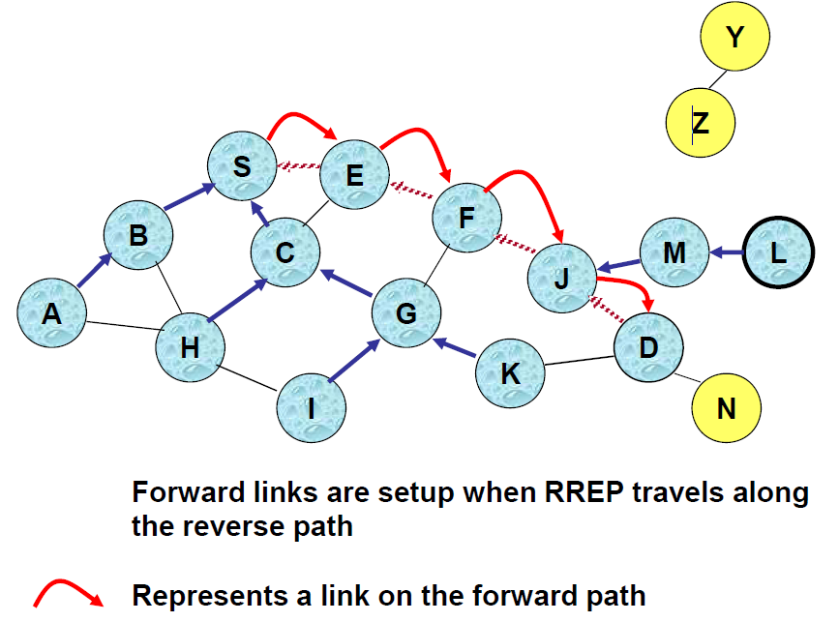
Forward Path Setup in AODV

Slide 19
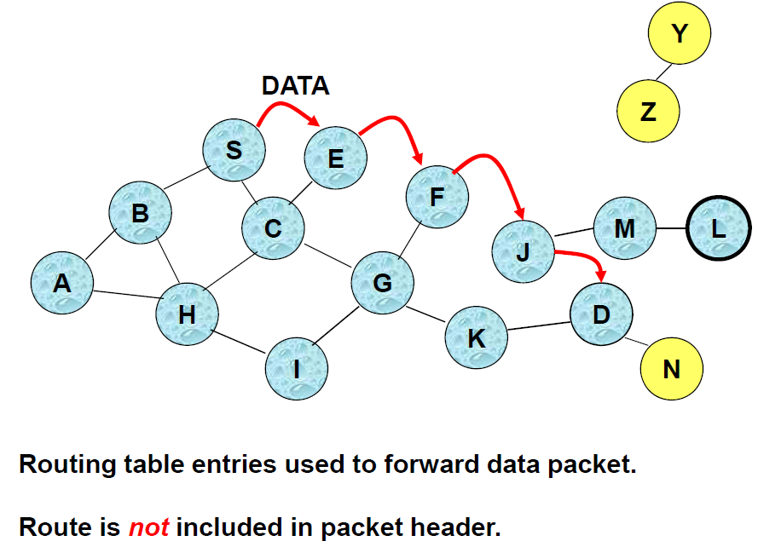
Data Delivery in AODV

Slide 20
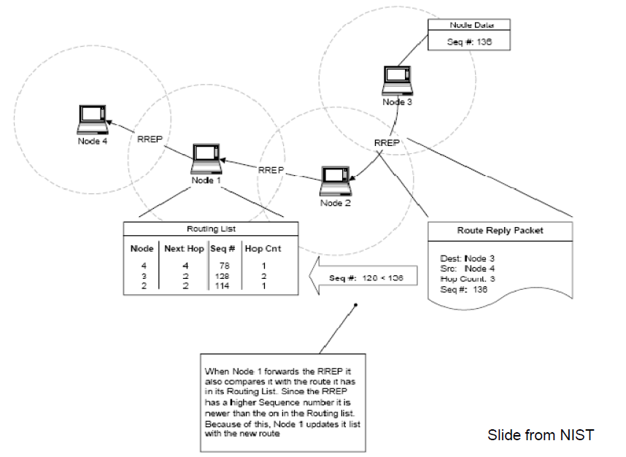
Routing Table Format in AODV

Slide 21
Discussion: Routing in Ad-Hoc Networks
Reliability
  Nodes in an ad-hoc network are not 100% reliable
  Algorithms need to find alternate routes when nodes are failing
Mobile Ad-Hoc Network (MANET)
  It is often assumed that the nodes are mobile
10 Tricks → 2¹⁰ routing algorithms
In reality there are almost that many!
Q: How good are these routing algorithms?!? Any hard results?
A: Almost none! Method-of-choice is simulation…
Perkins: “if you simulate three times, you get three different results”

Slide 22
Trick 1: Radius Growth
Problem of flooding (and similarly other algorithms): The destination is in two hops but we flood the whole network
Idea: Flood with growing radius; use time-to-live (TTL) tag that is decreased at every node, for the first flood initialize TTL with 1, then 2, then 3 (really?), …when destination is found, how do we stop?
Alternative idea: Flood very slowly (nodes wait some time before they forward the message) – when the destination is found a quick flood is initiated that stops the previous flood
+ Tradeoff time vs. number of messages

Slide 23
Trick 2: Source Routing
Problem: nodes have to store routing information for others
Idea: Source node stores the whole path to the destination; source stores path with every message, so nodes on the path simply chop off themselves and send the message to the next node.
“Dynamic Source Routing” discovers a new path with flooding (message stores history, if it arrives at the destination it is sent back to the source through the same path)
+ Nodes only store the paths they need
– Not efficient if mobility/data ratio is high
– Asymmetric Links?

Slide 24
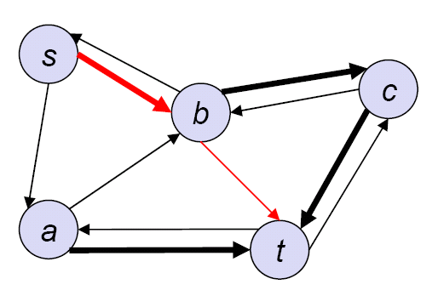
Trick 3: Asymmetric Links
Problem: The destination cannot send the newly found path to the source because at least one of the links used was unidirectional.
Idea: The destination needs to find the source by flooding again, the path is attached to the flooded message. The destination has information about the source (approximate distance, maybe even direction), which can be used.

Slide 25
Trick 4: Re-use/cache routes
This idea comes in many flavors:
Clearly a source s that has already found a route “s-a-b-c-t” does not need to flood again in order to find a route to node c.
Also, if node u receives a flooding message that searches for node v, and node u knows how to reach v, u might answer to the flooding initiator directly.
If node u sees a message with a path (through u), node u will learn (cache) this path for future use.
+ Without caching you might do the same work twice
– Which information is up-to-date? sequence numbers for
updates
– Caching is in contradiction to the source routing philosophy

Slide 26
Trick 5: Local search
Problem: When trying to forward a message on path “s-a-u-c-t ” node u recognizes that node c is not a neighbor anymore.
Idea: Instead of not delivering the message and sending a NAK to s, node u could try to search for t itself; maybe even by flooding.
Some algorithms hope that node t is still within the same distance as before, so they can do a flooding with TTL being set to the original distance (plus one)
If u does not find t, maybe the predecessor of u (a) does?
– One can construct examples where this works, but of course also examples where this does not work.

Slide 27
Trick 6: Hierarchy
Problem: Especially proactive algorithms do not scale with the number of nodes. Each node needs to store big tables
Idea: In the Internet there is a hierarchy of nodes; i.e. all nodes with the same IP prefix are in the same direction. One could do the same trick in ad-hoc networks
+ Well, if it happens that the ad-hoc nodes with the same numbers are in the same area are together, hierarchical routing is a good idea.
– There are not too many applications where this is the case. Nodes are mobile after all.

Slide 28
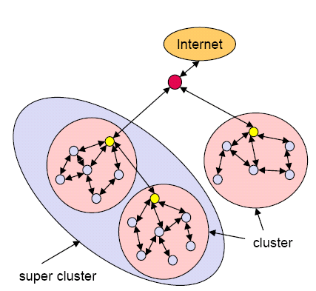
Trick 7: Clustering
Idea: Group the ad-hoc nodes into clusters (if you want hierarchically). One node is the head of the cluster. If a node in the cluster sends a message it sends it to the head which sends it to the head of the destination cluster which sends it to the destination
+ Simplifies operation for most nodes
(that are not cluster heads); this is
particularly useful if the nodes are
heterogeneous and the cluster
heads are “stronger” than others.
– A level of indirection adds overhead.
– There will be more contention at
the cluster heads.

Slide 29
Trick 8: Implicit Acknowledgement
Problem: Node u only knows that neighbor node v has received a message if node v sends an acknowledgement.
Idea: If v is not the destination, v needs to forward the message to the next node w on the path. If links are symmetric (and they need to be in order to send acknowledgements anyway), node u will automatically hear the transmission from v to w (unless node u has interference with another message).
Can we set up the MAC layer such that interference is impossible?
+ Finally a good trick

Slide 30
Trick 9: Smarter updates
Sequence numbers for all routing updates
+ Avoids loops and inconsistencies
+ Assures in-order execution of all updates
Decrease of update frequency
Store time between first and best announcement of a path
Inhibit update if it seems to be unstable (based on the stored time values)
+ Less traffic
Implemented in Destination Sequenced Distance Vector (DSDV)

Slide 31
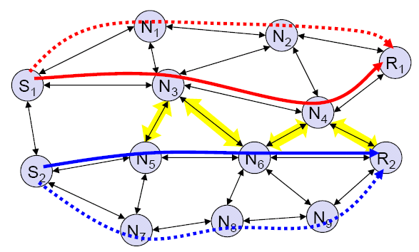
Trick 10: Use other distance metrics
Problem: The number of hops is fine for the Internet, but for ad-hoc networks other metrics might be better, for example: Energy, Congestion, Successful transmission probability, Interference*, etc.
– How do we compute
interference in an
online manner?
*Interference: a
receiving node is
also in the receiving
area of another
transmission.

Slide 32
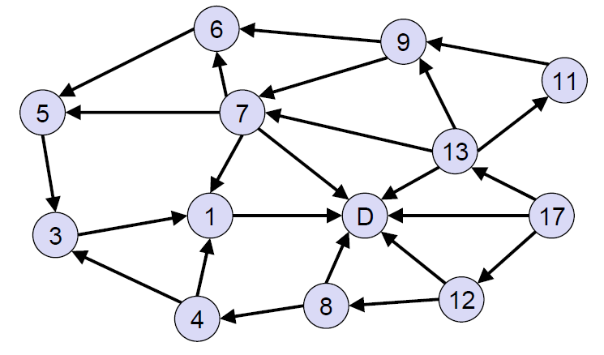
Link Reversal Routing
An interesting proactive routing protocol with low overhead.
Idea: For each destination, all communication links are directed, such that following the arrows always brings you to the destination.
Example (with only one destination D):
Note that positive labels can be chosen such that higher labels point to lower labels (and the destination label D = 0).

Slide 33
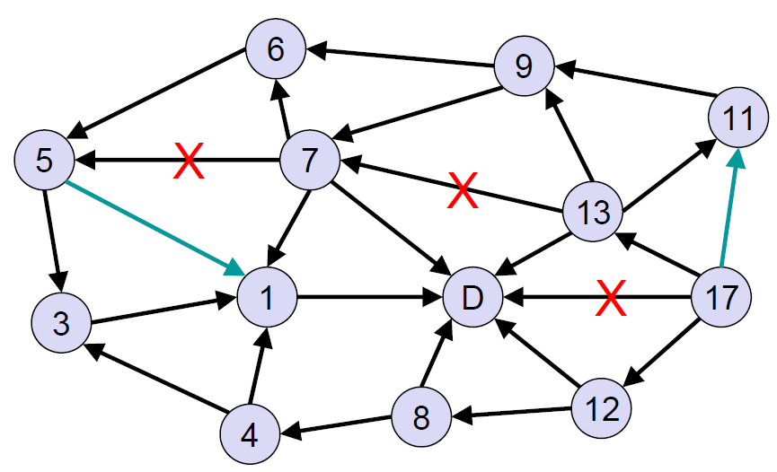
Link Reversal Routing: Mobility
Links may fail/disappear: if nodes still have outlinks → no problem!
New links may emerge: just insert them such that there are no loops (use the labels to figure that out)

Slide 34
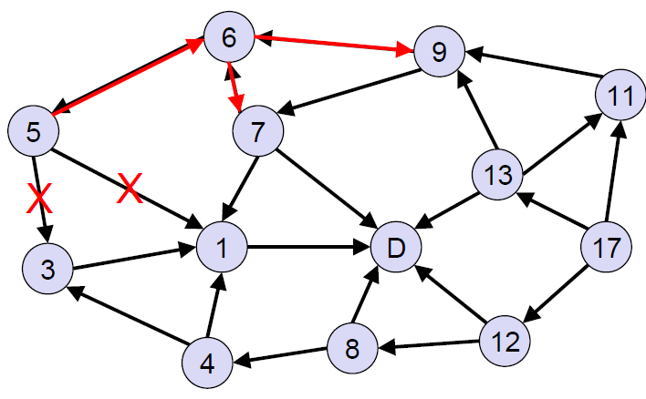
Link Reversal Routing: Mobility
Only problem: Non-destination becomes a sink → reverse all links!
Not shown in example: If you reverse all links, then increase label.
Recursive progress can be quite tedious…

Slide 35
Link Reversal Routing: Analysis
In a ring network with n nodes, a deletion of a single link (close to the sink) makes the algorithm reverse like crazy: Indeed a single link failure may start a reversal process that takes n rounds, and n links reverse themselves n² times!
That’s why some researchers proposed partial link reversal, where nodes only reverse links that were not reversed before.
However, it was shown by Busch et al. that in the extreme case also partial link reversal is not efficient, it may in fact even worse be than regular link reversal.
Still, some protocols (TORA:Temporally Ordered Routing Algorithm: "flat", non-hierarchical routing algorithm ) are based on link reversal.
Exercise: Discuss the efficiency of partial link reversal and the case taken by Busch et al.

