Slide 1
.Net Framework
Alankar Sooraj
Trainer / Consultant
Dot Net 4.5/4.0 , Sharepoint 2013/2010, Biztalk Server 2013 R2/2010 Certified
Android / Windows Phone Developer
MCT , MCTS , MCSD

Slide 2
Dot Net
Introduction …..

Slide 3
Why Dotnet Framework?
OOP Based
Multi – Language Support
Interoperability in Languages
Types of Application
Console
Windows / Desktop
Web Sites / Web Services
Distributed (Multi Tier) Applications
Windows Phone Apps
Based on Industries Standards
IDE / Built In Controls (APIs)
Ease of Deployment
.Net Core

Slide 4
. Net Framework / Architecture
.Net Framework
Framework Components
FCL / BCL (Framework Class Library)
CLR (Common Language Runtime)

Slide 5
. Net Framework / Architecture
Framework Versions
2.0 – Generic , Anonymous Method , Partial Class , 64Bits Support
3.5 – WCF , WPF , WF , Linq
4.0 – Improvement in 3.5 , Parallel Programming , C# New Features
4.5 Enhancement

Slide 6
. Net Framework / Architecture
Development
Visual Studio 2005 / 2008 / 2010 / 2012 / 2013
NotePad
Languages
VB.NET
C#
Compilers
Vbc , csc
Visual Studio Command Prompt

Slide 7
.Net
Demo
Using and Understanding Visual Studio Components
Creating Applications
Windows Application
Using Various Controls
Events in Windows Forms Application
Creating a User Entry Form
Console Application

Slide 8
.Net
.Net Application Execution Model
Important Components
CLR
MSIL
Metadata
JIT
CTS
CLS
GC
Managed Heap

Slide 9
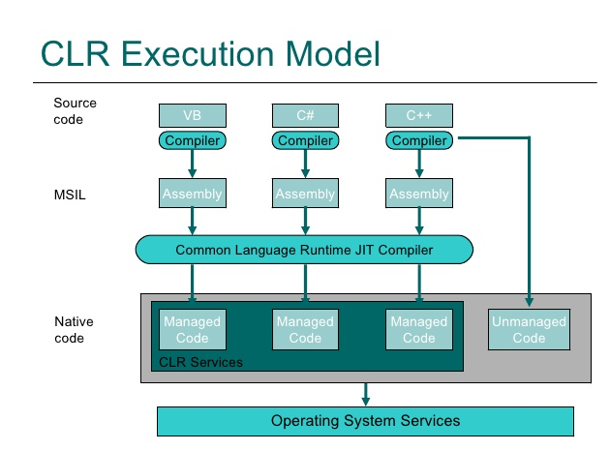
.net execution

Slide 10
.Net
What is Managed Code ????

Slide 11
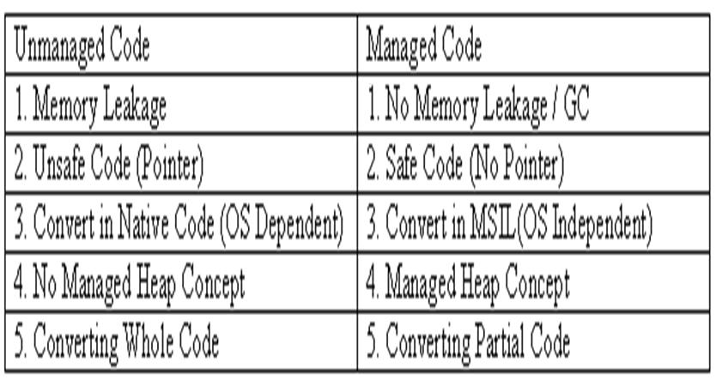
.Net (Managed Code)

Slide 12
.net
C# Programming
(Versions : 1.0 , 2.0 , 3.0 , 4.0 , 5.0)

Slide 13
.net c#
Introduction to C#
C# Basic
Structure of C#
DataTypes
Value Type (int , double , Boolean )
Class Type (String , Object , DateTime , TimeSpan)
Using Variables , Operators
Namespace

Slide 14
.net c#
Flow Control in C#
If – else
While loop
For loop
Switch Case
Foreach

Slide 15
assignment
Create a Console Application for Banking System
Options
New Account (AccountID , CustomerName , CustomerAddress, TypeofAccount, Balance)
Deposit (minimum 500)
Withdraw (maximum 5000 with available balance check)
CheckBalance
Exit
Note : Use variables , while loop , switch case , if else conditions

Slide 16
OO Programming in .NET – C#
OOP
Abstraction
Encapsulation
Polymorphism
Inheritance

Slide 17
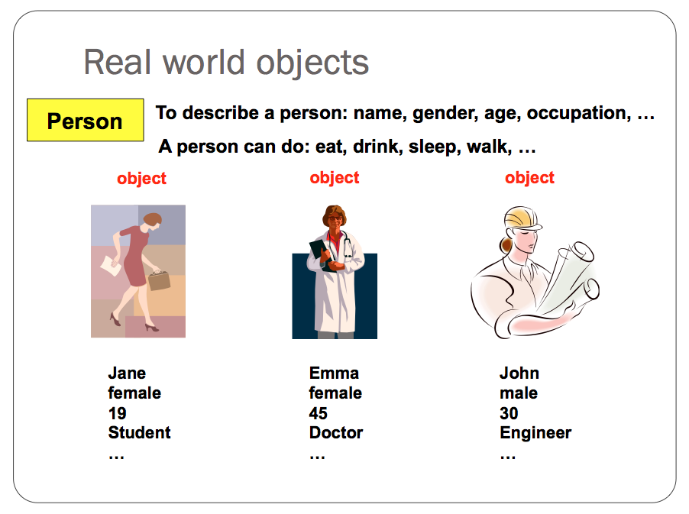
OOPs

Slide 18
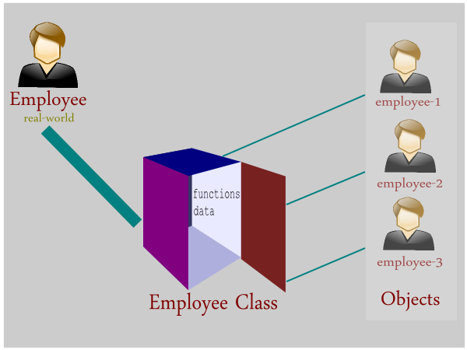
oops

Slide 19
OOPs
Classes and Objects (Customer/Employee)
this keyword
Constructor
Constructor Overloading
Constructor Chaining Concept
Understanding referencing concept

Slide 20
OO Programming in .NET – C#
Functions (Named & Optional Parameter)
Overloading

Slide 21
OO Programming in .NET – C#
Static
Fields , Functions , Constructor , Classes

Slide 22
OO Programming in .NET – C#
Access Modifiers
Public
Private
Internal
Protected
Protected internal
Partial Class

Slide 23
OO Programming in .NET – C#
Defining Properties for a class (Student)
ReadOnly, WriteOnly, ReadWrite

Slide 24
OO Programming in .NET – C#
Properties
Allow to access private members
Allow to execute business logic
Read / Write Only properties
Used in Data Binding
Used for creating Format of Data
Used for Creating Indexer
Auto Implemented Properties

Slide 25
assignments
Create a class called “Order” with these properties (OrderID , ItemID , ItemQTY , ItemPrice , OrderValue, CustomerName.
Create orders by using while loop
OrderID should be auto generated (Show the orderid)
Display number of orders created after the while loop.
Create a SingleTon Class (Manager)

Slide 26
OO Programming in .NET – C#
Inheritance
Inherit a class
Object Class
base keyword
Constructor
Overriding
Seal keyword

Slide 27
oops
Overriding
Overriding is used for extending the code or customizing the application without changing the whole application.
In Overriding, a base class function gets override by the derived class function
Function definition must be the same in the base and the derived class.
Sealed keyword is used to stop overriding and inheritance .

Slide 28
OOPs
Overriding Demo
Employee Class
EmployeeContract Class

Slide 29
oops
Assignment
Create an Order Class with getorderamt function and orderid , custname , itemqty , itemprice variables (use constructor)
Create order object in the main method and display the order amount by calling getorderamt function.
Create Order_overseas class and override getorderamt function (Change some logic) (Tax)
Ask user to enter the type of order (either Order or Order_overseas) and instantiate the order object accordingly.

Slide 30
OOPs
Abstract Class

Slide 31
oops
Abstract Class (Rules / Features of Abstract class)
Abstract class is a class
It can have abstract functions
It can have general functions
It can not be instantiated by programming ( using Concrete Class Definition)
It should be used as a base class
It can have constructors and variables
All abstract functions body must be defined in the derived class
Abstract class enforces Abstraction

Slide 32
oops
Abstract Class Demo (Account)
Saving Class
Current Class
DEMAT Class

Slide 33
.net OOps
Interface

Slide 34
.net
Interface
Interface is a contract between two objects and it is used for a communication between objects.
Interface enforces to implement some certain functionalities in an object.
Interface can have only declaration of functions.
Interface functions must be defined in the implemented class.
Interface type variable can have reference of implemented class.
Interface can extend another interface.
Interface can not be instantiated (It is not a class).
Interface enforces Abstraction.

Slide 35
.net
Interface Example
Product Classes
ProductA , ProductB
Transport Class

Slide 36
assignment
Implement Interface Concept
Employee Class
EmployeeID , EmployeeName , EmployeeCity , EmployeeSalary, EmployeeAddress, EmployeeProjectDetails , EmployeeExp , EmployeeAccountNumber , EmployeeAccBankName , EmployeeAge.
Interfaces
IHR
getEmployeeAddress
getEmployeeSalary
getEmployeeID
IAccounts
getEmployeeSalary
getEmployeeAccountNo
getEmplopyeeID
IManager
getEmployeeID
getEmployeeExp
getEmployeeProjectDetails

Slide 37
Generics
What is Generic ?
Generics introduce to the .NET Framework the concept of type parameters<T>, which make it possible to design classes and methods without specifying the datatypes.
public T GenericFunc<T>(T para)
{
return para;
}
int result=GenericFunc<int>(200);
String str=GenericFunc<string>(“Hello”);

Slide 38
generics
Advantage of Generics
It improves code reusability
It implements type safety
It improves performance

Slide 39
generics
Generic Types
Class , Method , Interface , Delegates

Slide 40
Generics
Using Generics:
Methods
Collections
ArrayList (Without Generic)
Performance Issue (Boxing & UnBoxing)
List<>
Dictionary<>

Slide 41
.Net - Assignment
Create a console application for managing Employees and Company.
Employee Class ( EmployeeID , EmployeeName ,EmployeeCity)
Company Class (List<Employee>)
AddEmployee (Employee)
SearchEmployee(EmpID)
RemoveEmployee(EmpID)
ShowEmployees()
EmployeeID must be auto generated
Use a Generic List for storing employee objects

Slide 42
OOPs
Garbage Collector
Destructor (Finalize)
GC.Collect
GC.SuppressFinalize

Slide 43
.Net
String
String is a class.
A string is a sequential collection of characters that is used to represent text.(Like an Array).
Strings are immutable (Read Only).
Strings get stored in String Intern (Pool).
Strings are not getting destroyed by GC.
Difference between == operator and equals function of String type.

Slide 44
.net
Jagged Array
A jagged array is an array whose elements are arrays. (Array of Arrays)
int [][]jaggedarray =new int[3][];
jaggedarray[0]=new int[3];
jaggedarray[1]=new int[2];
jaggedarray[2]=new int[4];

Slide 45
.net
Windows Forms Application
Designing Windows Form
Working with various controls
Label , TextBox , Button , ListBox , ComboBox , CheckBox , RadioButton
Using Events
Validations
Opening another Form

Slide 46
.net - Assignment
Create a Windows Forms Application for order entry
Order ID (TextBox)
Customer Name (TextBox)
Item ID (TextBox)
Item Qty (TextBox)
Item Price (TextBox)
Delivery Address (TextBox)
Order City (DropDownList)
Order Date (TextBox)
Payment Option (RadioButton)
Place Order(Button) , Reset (Button)
Implement Validations on the Button Click
Create a class called Order as per the above design.
Create Order class object and store data in the same and call getordervalue function to get the order value and show in a message box.

Slide 47
.Net Framework
What are assemblies?
An Assembly is the smallest unit of versioning, security, deployment and reusability of code in Microsoft. NET Framework. An assembly contains compiled code.
Assembly contains the followings :
· Assembly Identity – name, version , culture , public key token
· Manifest
· Metadata
· MSIL code
· Security information

Slide 48
.Net Framework
GAC
Global Assembly Cache
Types of Assembly ?
Private /Weak
Shared / Strong
Advantages of Strong Signed Assemblies
Use of Utility ILDASM

Slide 49
.Net Framework
Creating Simple .Net Application
Creating a DLL
Calling the DLL in Windows Application
Deploying DLL in the GAC

Slide 50
.net assignment
Create an assembly (class library) for calculating salary of employee. Library function will take two parameters (per_day_salary & no_of_days) and function will return calculated salary value.
Make this assembly as a strong assembly(sign the assembly)
Deploy the assembly in the GAC (Optional)
Call the assembly in Windows Forms Application and Console Application.

Slide 51
Delegate
Delegates
Types of Delegate
Single Cast
Multi Cast
Anonymous Functions

Slide 52
delegate
Use of Delegate
Event Delegation Model
Threads
Events
Custom Event and Delegate
Company& Employees example

Slide 53
.Net - Assignment
Create a console application for managing Employees and Company.
Employee Class ( EmployeeID , EmployeeName ,EmployeeCity , EmployeeAge)
Company Class (List<Employee>)
AddEmployee (Employee),SearchEmployee(EmpID)
RemoveEmployee(EmpID),ShowEmployees()
EmployeeID must be auto generated
Use a Generic List for storing employee objects
Implement Delegate - Event in the above assignment.
Add a function in the Employee class – TakeLeave
Add an event handler function in the Company class.

Slide 54
.Net - Assignment
Create a console application for managing Students and College.
Student Class ( StudentID , StudentName )
College Class (List<Student>)
AddStudent (Student),SearchStudent(StudentID)
Use a Generic List for storing Student objects
Implement Delegate - Event.
Add a function in the Student class – LeaveRequest(StudentID ,Reason)
Add an event handler function in the College class.

Slide 55
.net
Threads
A thread is a single execution sequential flow of control within a program.
A thread is an independent execution path.
A thread is the entity within a process that can be scheduled for execution.
A process, in the simplest terms, is an executing program. One or more threads run in the context of the process. A thread is the basic unit to which the operating system allocates processor time.

Slide 56
Threads
Introduction to Thread
Single Threaded App
Main Thread Only
Multi Threaded App

Slide 57
Threads
Life cycle of a Thread
Start
Sleep
Time Exp/Int Thread
START
Suspend
Resume
Abort
Work Complete
Thread Stop
Thread

Slide 58
Threads
Demo
Creating a Thread and Executing a function
Wrapper Class – Thread
ThreadStart Delegate
Background and Foreground Thread

Slide 59
Threads
Synchronization / Locking
Lock
Monitor

Slide 60
.net threads
Join function
AutoResetEvent

Slide 61
Asynchronous Calling
What is Asynchronous Calling ?
Calling a method asynchronously is called Async Call.
Demonstrate
How to Call a Synchronous Function Asynchronously.

Slide 62
.net threads
Thread Affinity
Cross Thread Operation

Slide 63
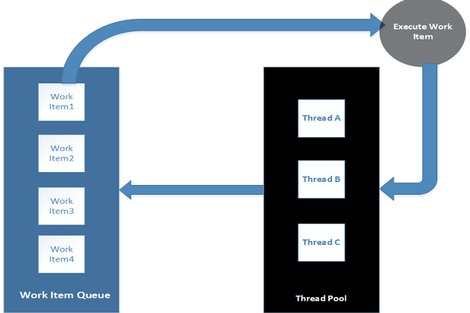
.net threads
ThreadPool
Provides a pool of threads that can be used to execute tasks. Once tasks executed then threads come back to the pool.

Slide 64
.net
Demo
Simple Thread
Async Call
Lock / Monitor
ThreadPool
AutoResetEvent

Slide 65
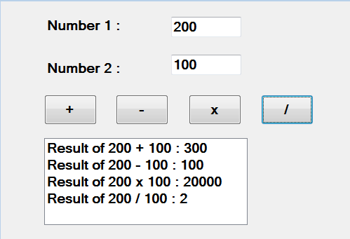
assignment
Create a multithread calculator (use async call)

Slide 66
XML in Details
Advantages of XML
It provides a way for creating domain-specific vocabulary.
It can be used for storing data.
It allows data interchange between different frameworks.
Almost every framework supports xml.

Slide 67
XML in Details
Rules for creating a well formed XML Doc.
Every start tag should have an end tag
Empty tag must be closed.
All attributes value must be in double quotes.
Tags must be nested correctly.
XML tags are case – sensitive.

Slide 68
.Net
Practice
OOPs
Assemblies (DLL)
Delegates
Threading
Exception Handling

Slide 69
.net
SQL Server
Database
Tables
SQL
Create , Insert , Update , Delete , Select

Slide 70
ADO.net
ADO.NET
ADO.NET is an object-oriented set of libraries that allows you to interact with data sources. Commonly, the data source is a database server such as SQL Server , Oracle Server etc, but it could also be a text file, an Excel spreadsheet, or an XML file.

Slide 71
Ado.net
Architecture of ADO.NET
Connected
Disconnected
Data Cached in DataSet

Slide 72
Architecture of ADO.NET
Managed Data Provider
SqlClient
Oledb (Object Linking and Embedding Database)
Oracle
ODBC

Slide 73
Architecture of ADO.NET
Data Provider
Front End
.Net
Back End
SQLServer,
ORACLE
Connection
Command
DataReader
DataAdapter
DataSet

Slide 74
Ado.net
Connection
Establishes a connection to a specific data source.
Command
Executes a command (SQL Statement) against a data source.
DataReader
Reads a forward-only, read-only stream of data from a data source.
DataAdapter
Populates a DataSet and resolves updates with the data source.

Slide 75
DataSet Architecture
A DataSet contains a collection of zero or more tables represented by DataTable objects.
DataTableCollection
DataTable
DataTable
DataTable
DataRelation
DataTable
DataRelationCollections
DataRow
DataRowCollection
DataColumn
DataColumnCollection
Primary Key
DATASET

Slide 76
.Net
ADO.NET Objects (SQLClient Provider)
SQLConnection
Open() , Close()
SQLCommand
ExecuteNonQuery()
ExecuteReader()
ExecuteScalar()
Data Reader
Read() , HasRow
Data Adapter
Fill() , Update()
DataSet / DataTable

Slide 77
.Net
Demo
Using SqlConnection ,
Using SqlCommand ( CRUD)
Using Data Reader
Storing Connection string in configuration file
Creating a Login Form
SQL Injection

Slide 78
.net assignment (60 mins)
Create Login Form (EmployeeID , EmployeePassword)
Create a table called Customers(CustomerID , CustomerName, CustomerCity , CustomerAge , CustomerDOJ)
(CustomerID – Autogenerated , PK)
Add Customer with Form Design
Find Customer based on Customer ID
Use Combobox for the CustomerCity.
Use Cities Table
Store connection string in the app.config file.

Slide 79
Ado.net
Disconnected Architecture
Using Data Adapter
Using Dataset

Slide 80
Ado.net
DAL – Data Access Layer
Creating DAL
Calling DAL

Slide 81
Ado.net
Transaction (ACID Properties)
ACID – Atomicity , Consistency , Isolation , Durability
Types of Transaction
Local
Distributed
Orders & OrderDetails

Slide 82
ADO.NET
MARS – Multiple Active ResultSets
DataReader to DataTable
Saving and Loading from XML File

Slide 83
.Net - Assignment
Create a windows application for generating tickets
BankTransctions ( TransID , AccountNo , Amount , TransDate)
Tickets (TicketNo, MovieName , MovieDate , Timings , NoOfTickets , TransID , TicketDate)
Show TicketNo & TransID in a MessageBox
Use Transaction concept.
Use DAL
TicketsDAL
BuyTicket(BankTransaction , Ticket)

Slide 84
.Net - Assignment
Create a windows application for managing employees details
EmployeesProfessionalDetails (EmployeeID(PK), EmployeeName, EmployeeExp , EmployeeDept , EmployeeCity, EmployeeDOJ)
EmployeesPersonalDetails (EmployeeID(FK+PK) , EmployeeDOB, EmployeeContactInfo , EmployeeAddress)
Use Transaction concept.
Use DAL

Slide 85
Ado.net
Calling Procedures using ADO.NET
Calling Procedure (Parameters)
Calling Procedure (Return Value)

Slide 86
Exceptions Handling
What is Exception Handling?
Try , Catch and Finally
System.Exception Class
Using finally block
Handling exceptions in different ways

Slide 87
WPF
Windows Presentation Foundation

Slide 88
WPF
Windows Presentation Foundation is a completely new presentation framework, integrating the capabilities of those frameworks that preceded it, including User, GDI, GDI+, and HTML, and heavily influenced by toolkits targeted at the Web, such as Macromedia Flash, and popular Windows applications such as Microsoft Word.

Slide 89
WPF
Presentation Framework to develop enhanced and customizable UIs and give best User Experience.
Advantages
Broad Integration: Uniform Development Model (Declarative) through XAML
Hardware Acceleration: Developed over top of DirectX
Rich composition and customization
XAML (eXtensible Application Markup Language)
XML based language to declaratively design UI

Slide 90
WPF
Advantages of WPF
Declarative Programming (XAML)
Better Screen Resolution using DirectX
High Level of Customization
Template , Transform , Shapes , Layouts
2D , 3D Animation Support
Data Binding
Easy to Use

Slide 91
WPF
WPF Application (.xaml)
Windows / Desktop Application
Web Application (xbap) (IE)
Web Application
Required SilverLight plug in (Browser)

Slide 92
WPF
Windows
Some basic Xaml Controls
Layouts
StackPanel
Grid Layout

Slide 93
WPF
WPF Controls

Slide 94
WPF
Controls
Button
TextBlock
TextBox
PasswordBox
Image
Slider
ToolTip

Slide 95
WPF
Windows
Application Object (SingleTon)
ShutDownMode
Opening another window

Slide 96
WPF- ASSIGNMENT
Login Window
Home Window (Calculator , Place Order )
Create a Calculator (use grid layout)
Create Order Entry Window
Login ID
Order ID
Customer Name
Order Date
Product Name
Delivery Address (Address , City , Pin , State)
Payment Options (Cash , Card , NetBanking)
Save Button (ToolTip)

Slide 97
WPF
Styles & Resources

Slide 98
WPF
Styles
Inline
Shared

Slide 99
WPF
Triggers
Trigger is an action in WPF , which gets invoked whenever a specific property changed , event fired or data modified.
Property Trigger
Data Trigger
Event Trigger

Slide 100
WPF
Resources
Binary (Files)
Resource
Embeds resource into the assembly
Content
Leaves resource as loose file, is not embedded to assembly.
Logical

Slide 101
WPF- ASSIGNMENT
Implement Styles (with triggers) in the previous assignment (Application level resource )
Create styles for TextBox , TextBlock, Button
FontSize , Foreground , FontFamily , Background
Create Triggers
IsFocused
IsMouseOver

Slide 102
WPF
Graphics & Transformations

Slide 103
WPF
Graphics
Brushes
SolidColorBrush
LinearGradientBrush
RadialGradientBrush

Slide 104
WPF
Shapes
<Line Stroke="Red" StrokeThickness="2"
X1="50" Y1="50" X2="200" Y2="200"/>
<Rectangle Height="100" Width="200" Fill="Green" Stroke="Red" />
<Ellipse Height="100" Width="100" Stroke="Yellow" Fill="Tomato" />

Slide 105
WPF
Transformation
Rotate
Scale
Translate

Slide 106
WPF
Data Binding

Slide 107
WPF
Data Binding Options
We can bind a property of a WPF control with:
1. any other property of a WPF Control
2. in-memory CLR Object
.NET Collection Object
ADO.NET Object (DS)
LINQ
Entity Framework Objects

Slide 108
WPF
Data Binding Modes
OneWay The target is updated whenever the source changes.(D)
TwoWay— A change to either the target or source updates the other.(D)
OneWayToSource— The opposite of OneWay. The source is updated whenever the target changes.
OneTime— This works just like OneWay, except changes to the source are not reflected at the target. The target retains a snapshot of the source at the time the Binding is initiated

Slide 109
WPF
Demo (Products , Orders )
DataBinding with WPF Controls Property
DataBinding with .Net Collection Objects
Layout Binding
Using ListBox (Data Template)
ObservableCollection
Using DataGrid Control
ObservableCollection
Implementing Types of Binding
(OneWay , TwoWay , etc)
Data Access Layer

Slide 110
ASSIGNMENT
Create a WPF Application
Login Window
Add Employee
Home Window
Find Employee Window
Leave Request Window
Show Requested Leaves Window(DataGrid)
Logout
Create DAL for the same. (EmployeeDAL – Login, AddEmployee, FindEmployee , LeaveRequest , ShowLeaves.
Employee Table : (EmployeeID , EmployeeName , EmployeeExp, EmployeePassword, EmployeeDept, EmployeeDesignation , ManagerID )
LeaveRequest : (LeaveID , EmployeeID , LeaveReqDate , LeaveDate , NoOfDays , LeaveType , Reason , LeaveStatus, ManagerID)

Slide 111
Assignment

Slide 112
.net Project
Banking Application

Slide 113
WPF
Routed Events
Bubbling
This event is raised on the source element and navigates up to the visual tree until it reaches the root element or until the bubbling is stopped by marking the event as handled.
Tunneling
This event is raised on the root element and navigates down to the visual tree until it reaches the source element or until the tunneling is stopped by marking the event as handled.
Direct
The event is raised on the source element and must be handled on the source element itself.

Slide 114
WPF
Dependency Property
Understanding Dependency Property
The purpose of dependency properties is to provide a way to compute the value of a property based on the value of other inputs. These other inputs might include data binding and animations/storyboards, styles.
Advantages of Dependency Property
Animation
Data Binding
Notification
CallBack
Data Validation

Slide 115
ASP.NET

Slide 116
ASP.NET
Refers to Web Application Development Framework within .NET
Used for creating dynamic and static web pages.
It’s a runtime engine (ASP.NET Runtime Engine) which executes all the requests.
Executed by W3wp.exe CLR HOST.
aspnet_isapi.dll ISAPI Filter acts as bridge between IIS and the asp.net Host (ASP.NET Runtime Engine)
ISAPI : Internet Server Application Programming Interface

Slide 117
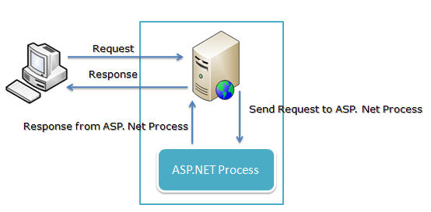
Asp.net

Slide 118
ASP.NET
Web Page Extension – .aspx
For Every Web Page
Design File : Page1.aspx
The Web UI Design Logic is placed here
Code Behind : Page1.aspx.cs/Page1.aspx.vb
The Page Life Cycle as well user event code is written here.
For eg: Page Load/ Button Click/Selection Changed

Slide 119
ASP.NET
DEMO

Slide 120
ASP.NET
PostBack
IsPostBack
AutoPostBack
Response.Redirect
QueryString
Server.Transfer
Web.config
HttpContext.Current.ApplicationInstance.CompleteRequest();

Slide 121
ASP.NET
Login Page
Using Server Controls
Validating the Web Pages
Using Various ValidationControls
Using Custom Validator
Using JavaScript (Reset)
FileUpload1.SaveAs(MapPath("~/Files/" + TextBox1.Text + ".jpg"));

Slide 122
Assignment
Create a web site for managing orders info.
Login Page,Home Page
PlaceOrder Page
Customer ID (TextBox)
Order City (DropDownList)
Item ID (TextBox)
Item Price (TextBox)
Item Quantity (TextBox)
Payment Type (RadioButtons)
Net Banking , Debit Card , COD
Delivery Address (TextBox)
Note : Use appropriate Validators
Only one Payment Type can be selected.
Add Order in Database and show the generated order id in the OrderPlaced page
OrdersASP Table : (OrderID , CustomerID, ItemID , ItemPrice, ItemQty , PaymentType,OrderCity ,Address)

Slide 123
ASP.NET
Master Pages
Common Web Page Informational Segments/Areas are Designed and Embedded in a page called Master.
Various Relevant Pages (Content Pages) can be created based on the Master, which logically inherits OR gets the contents from Master.
Master Page allows Customization of Content Page through ContentPlaceHolder Control
Master Page can be applied Declaratively or through Web.Config or even dynamically at Runtime.

Slide 124
Asp.net
Master Pages
Creating a Master Page
Using ContentPlaceHolder Control
Creating Content Pages
Accessing Master Page Controls
Accessing Content Page Controls

Slide 125
Asp.net
Master Page
Changing Master Page
Runtime (PreInit)
Declarative
Web.Config

Slide 126
assignment
Create a Bank Application
Login Page (Without Master Page) (Use dummy user id and password for the login) (UserID , Password , Login Type)
Create CustomerMaster & EmployeeMaster pages
Create CustomerHome & EmployeeHome Pages
Customer
MakeTransaction
ViewTransations
BillPayment
UpdateProfile
Employee
NewAccount
NewCustomer
ViewStatements
MakeTransations

Slide 127
ASP.net
Data Driven Pages by ADO.NET

Slide 128
Developing Data Driven Pages
Interacting with Database
Option 1
Write ado.net code in the code behind file to perform all operations through DataBound controls.
Option 2
Use DataSource Controls introduced in asp.net 2.0
SQLDataSource
AccessDataSource
XMLDataSource
ObjectDataSource

Slide 129
ASP.NET
ASP.Net Controls
GridView:
Usefull for Displaying Tabular Data.
We can embed Button/Dropdown/CheckBox Controls
Supports Sorting and Paging
Validation of Input Possible
Templates for Modifying

Slide 130
ASP.NET
DataList:
Use full for Displaying Information in Custom Format
We can embed Button/Dropdown/CheckBox Controls.
Validation of Input Possible
Templates for Modifying

Slide 131
ASP.NET
DEMO
Adding Rows with Image Address (Product)
GridView
Paging , Selection
Custom GridView
Selection , Image
DataList
ItemCommand

Slide 132
assignments
Create a Web Form for adding Orders
Send the generated orderid to the next page
(Order Placed Successfully , Your Order ID : )
Show the list of orders in GridView using Custom Columns.
Create DAL
Show the list of employees in a GridView using Custom Columns.
Add a Link Button (Show Leaves)
Display all the leaves in a new page using GridView (Custom Columns).
Create a DAL

Slide 133
assignment
Create a Test Page (QuestionID , Question , Option1, Option2 , Option3, Option4 ). Test Submit Button will generate the result in a Label (Use DataList)
Tables
Questions : QuestionID , Question, Option1 , Option2 , Option3, Option4 , Answer.

Slide 134
ASP.NET
Architecture of ASP.NET
IIS
WorkerProcess
AppDomain
Http Handlers and Modules
Page Life Cycle

Slide 135
ASP.NET Page Life Cycle (Very First Time)
PreInit
Init
InitComplete
PreLoad
Load
LoadComplete
PreRender
PreRenderComplete
Save State
Render
Unload

Slide 136
ASP.NET Page Life Cycle (PostBack)
PreInit
Init
InitComplete
Load State
Load Postback Data
PreLoad
Load
Postback Data Event
LoadComplete
PreRender
PreRenderComplete
Save State
Render
Unload

Slide 137
ASP.NET Page Life Cycle
Testing Page Life Cycle Concept

Slide 138
ASP.NET
State Management
Client Side
ViewState
View state is a repository in an ASP.NET page that can store values that have to be retained during postback.
QueryString
Cookies

Slide 139
ASP.NET
State Management
Server Side
Application
Application state is a data repository available to all classes (Pages) in an ASP.NET application. Application state is stored in memory on the server and is faster than storing and retrieving information in a database. It is a singleton object.
DataBase
Session

Slide 140
ASP.NET
Session Management
ASP.NET creates session as per the browser instance.
Every Session has a unique Session Id, browser stores session id either in Cookies or URL Address.
Session data stored at the Server side.
Session Modes : InProc, OutProc (SQLServer , ASPStateServer)
IIS Restarted
Web Farm

Slide 141
Asp.net
ASP.NET Security
Forms Based Authentication
Forms authentication lets you authenticate users by using your own code and then maintain an authentication token in a cookie or in the page URL.

Slide 142
Asp.net
Authentication
Authentication is the process of verifying/identifying the identity of a user by obtaining some sort of credentials.
Authorization
Authorization is the process of allowing an authenticated users to access the resources(Pages).

Slide 143
ASP.NET
ASP.NET Security Framework :
ASP.NET Authentication
FormsAuthentication.SetAuthCookie(username, false);
FormsAuthentication.Signout();
FormsAuthentication.RedirectToLoginPage();

Slide 144
Asp.net
ASP.NET Security Framework :
Providers
A provider is APIs module that provides a uniform interface between a service and a data source. Services are like Security Service , Profile Service etc.
Membership Provider
Role Provider

Slide 145
Asp.net
Forms Authentication Steps
Creating a WebSite with Login and Home Page
Generating Tables in a Database for storing credentials
Using aspnet_regsql utility
Enabling Forms Authentications in the Web.Config file.
Enabling MemberShip Provider.
Generating Authentication Token for users after validation.

Slide 146
ASP.NET
MemberShip Provider :
<membership defaultProvider="MyMembership">
<providers>
<add name="MyMembership"
type="System.Web.Security.SqlMembershipProvider"
connectionStringName="constr" requiresQuestionAndAnswer="true"
requiresUniqueEmail="false"/>
</providers>
</membership>

Slide 147
ASP.NET
Some important Classes :
Membership
MembershipUser
Roles

Slide 148
assignment
Create a Bank Application (Implement Security in the previous assignment)
Login Page (Without Master Page) (Use dummy user id and password for the login) (UserID , Password , Login Type)
NewCustomer Page (CustomerID , CustomerName , CustomerDesignation , CustomerPassword , CustomerEmail ,SecurityQuestion , SecurityAnswer)
Create CustomerMaster & EmployeeMaster pages (Show the logged in user id ) , Logout (Link Button)
Create CustomerHome & EmployeeHome Pages
Customer
MakeTransaction
ViewTransations
BillPayment
UpdateProfile
Employee
NewAccount
NewCustomer
ViewStatements
MakeTransations

Slide 149
ASP.NET
Caching
Caching is one of the most important factor in building high-performance application.
It has the ability to store items, like data objects, pages, or parts of a page, in memory.
It is used for increasing the performance of an application.

Slide 150
Asp.net
Caching
Types
Output Caching
Fragment Caching
Data Caching
Expiration : sliding , absolute
Important Factors
Duration , Dependency (key , file , SQL)

Slide 151
Asp.net
Caching Demo
Output Caching
Data Caching
Expiration
Dependency
Key , file

Slide 152
Mini project (Shopping site)
Login Page with New Customer Design
Home Page ( with master page) (HyperLinks)
Show Products, My Orders , My Cart Items , Logout , AddProduct
Show Products Page (GridView with Image)
ProductDetails (Add to Cart)
MyCart Page (GridView – Show all the products)
PlaceOrder (Select Link) -> PlaceOrder Page -> OrderPlaced Page with OrderID
My Orders Page (GridView - Show all the orders)
Tables
Customers (CustomerID (PK, Auto), CustomerName, CustomerContactNo) + Membership tables
Products ( ProductID , ProductName , ProductPrice , ProductDesc, ProductModel ,ProductCategory, ProductImageAddress)
Orders (OrderID (PK , Auto) , CustomerID , ProductID , Quantity , Price, OrderDate).
Cart (CustomerID , ProductID , AddedDate )

