Slide 1
MS SQL Server

Slide 2
SQL Server
Introduction to SQL Server

Slide 3
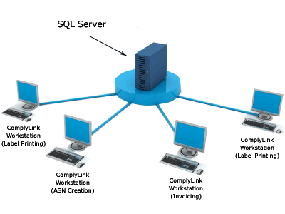
Overview of Client/ Server Architecture

Slide 4
SQL Server
SQL Server is a Relational Database Management System (RDBMS).
Microsoft SQL Server is designed to support high-volume transaction processing as well as data warehousing and decision-support applications.

Slide 5
SQL Server
Data Storage
RDBMS
Data Types
Security
Maintain the Data Integrity
Constraints , Trigger etc

Slide 6
Connecting to SQL Server
AUTHENTICATION
SQL Server Verifies Trusted Connection
Windows 2008
Group or User
Windows 2008
SQL
Server
OR
SQL Server
Verifies Name and Password
SQL Server Login Account
Notes:
6

Slide 7
SQL Server
Programming Tools
SQL Server Management Studio
SQL Server Configuration Manager
Database Engine Tuning Advisor
Command Prompt Utility – BCP

Slide 8
SQL Server
Database & SQL
(SQL Server Database) is a collection of objects such as tables, views, stored procedure, function, triggers and constraints
SQL Server data is stored in databases. The data in a database is organized into the logical components visible to users. A database is also physically implemented as two or more files on disk (mdf , ndf , ldf).

Slide 9
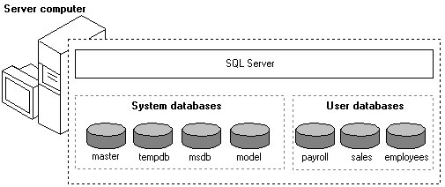
SQL Server

Slide 10
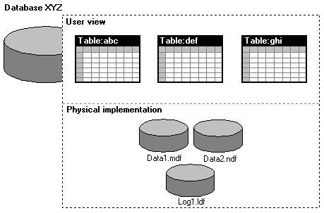
SQL Server

Slide 11
SQL Server
System Databases
Master
Model
MSDB
TempDB
User Defined Databases

Slide 12
SQL Server
Types of SQL
DDL (Data Definition Language)
DCL (Data Control Language)
DML (Data Manipulation Language)
TCL (Transaction Control Language)

Slide 13
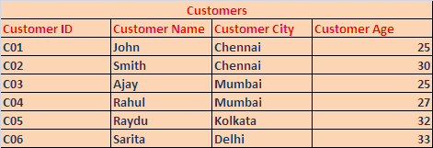
SQL Server
This is a raw data (CSV or Excel) , needs to store in SQL Server

Slide 14
SQL Server
Demo
Lets get into SQL Server
Security Modes

Slide 15
SQL Server
Data Types :
Numeric Types
Int , numeric , money , decimal , long
Date and Time
Datetime , Date
Character strings
Char , VarChar , text
Binary
Binary , Image
Other Type
Cursor , Table , UniqueIdentifier (GUID) , Xml

Slide 16
SQL Server
Demo
Creating a Database
Creating Table (Customers)
Inserting Data
Using basic select queries
Updating Data
Deleting Data
Altering Table
Dropping Table
sp_rename ‘OldTableName’,‘NewTableName‘
sp_rename ‘TableName.ColumnName‘,‘NewColumnName',‘Column'

Slide 17
SQL Server
Using Different Queries (Employees table)
Select Query with clauses
columns
Where
In
Is
Between
Order by with ties (top 3 with ties * …)
Top

Slide 18
SQL Functions
Built In Functions
select len('Hello')
select substring('hello',1,4)
select ltrim(' hello ')
select rtrim(' hello ')
select lower('HELLO')
select upper('hello')
select left('hello',2)
select right ('hello',2)
select isnumeric('12a')
select ceiling (25.01)
select floor(25.99)
Select round(253.2595,2)
Select IsNull(column_name,0)

Slide 19
SQL Server
Built In Functions
Aggregate Function
Sum
Avg
Max
Min
Count

Slide 20
SQL Server
Built In Functions
Date Functions
Getdate()
Dateadd()
Datediff()
Datename()
Datepart()
Type Cast Functions
Convert
Cast(x as int)
select convert(varchar(10),empsal) from employee
select convert (varchar(20), getdate(),6)

Slide 21
SQL Server
Group by Clause (Employees)
Using Aggregate Functions
SELECT EmployeeCity, COUNT(*) EmployeeCount FROM Employees GROUP BY EmployeeCity

Slide 22
SQL Server
Group by Clause
Having Clause
Difference between having and where clause

Slide 23
SQL Server
Rank Functions
Select employeeid,employeesalary ,row_number() over (order by employeesalary desc) from employees
1 2 3 4 5
Select employeeid,employeesalary ,rank() over (order by employeesalary desc) from employees
1 2 2 4 5
Select employeeid,employeesalary ,dense_rank() over (order by employeesalary desc) from employees
1 2 2 3 4

Slide 24
SQL Server
Assignments

Slide 25
SQL Server
Identity
@@Identity
create table accounts
(
AccountID int identity(1,1),
CustomerName varchar(20)
)

Slide 26
SQL Server
Data Integrity
Entity Integrity
Referential Integrity
Domain Integrity

Slide 27
SQL Server
Keys
Candidate Keys
Primary Keys
Alternate Keys
Composite Keys
Unique
Foreign Key

Slide 28
SQL Server
Demo
Implementing Data Integrity (Items , Invoices , InvoiceItems)
InvoiceID
CustomerID
CustomerName
InvoiceDate
PaymentType
DeliveryDate
TransationID

Slide 29
SQL Server
create table projects
(
empid int foreign key references employeedata(empid)
on delete cascade on update cascade,
pname varchar(20)
)

Slide 30
SQl server
Assignment

Slide 31
SQL Server
Sub Queries
Intro to Sub Queries
Where
In ,> any ,> all
Co – related sub-queries

Slide 32
SQL Server
> Any or all
select * from employeedata
where empsal > all
(
select AVG(empsal) from employeedata group by empcity
)

Slide 33
SQL Server
Co Related Sub Query
select * from employee e1 where e1.salary > (select avg(e2.salary) from employee e2 where e2.designation=e1.designation)

Slide 34
SQL Server
Joins
Intro to Joins
Inner Join
Outer Join
Left , Right , Full
Cross Join
Self Join

Slide 35
SQL Server
Self Join
select s1.employee_code, s1.names, s1.department ,
s1.manager_code as 'Manager Code',s2.names as
'Manager Name' from employee1 s1 left outer join employee1 s2
on
s1.manager_code=s2.employee_code

Slide 36
SQL server
Rows Joining
UNION
UNION ALL
Intersect (Common Rows)
Except (Except the second query rows)

Slide 37
SQL server
select * from (
select employeecity , sum(employeesalary) as 'salary' from employees group by EmployeeCity) as x
order by x.EmployeeCity desc

Slide 38
SQL Server
TSQL – Transact SQL
Programming in SQL Server
Declaring variables
Writing loops
Conditional Operators

Slide 39
SQL server
declare @table1 table(c varchar(10),d varchar(30))
insert @table1 values('AA','BB');
insert @table1 values('AA','BB');
insert into @table1 select customername,customercity from Customers
select * from @table1

Slide 40
SQL Server
Procedures
A stored procedure is a group of sql statements that has been created and stored in the database as an object format. It may have all DML statements

Slide 41
SQL Server
Advantages of Procedure
Reduce server/client network traffic
Stronger security
Encapsulation & Reuse of code
Easier maintenance ( no need to update client application)
Improve performance

Slide 42
SQL Server
Procedures
Create proc sp_products
As
Select pid,pname,pdetails from product
Exec sp_products

Slide 43
SQL Server
Types of Procedure
Sub Procedure
Parameter Procedure
Input
output
Return Procedure
Recursive Store Procedure (32 levels)

Slide 44
Sql server
Demo
Sub Procedure
Parameter Procedure
Input
output
Return Procedure

Slide 45
Sql server
Assignment

Slide 46
SQL Server
Trigger
A trigger is a special kind of a store procedure that executes in response to certain action on a table like insertion, deletion or updation of rows.
It is a database object which is bound to a table and is executed automatically.
You can’t explicitly invoke triggers.

Slide 47
SQL Server
Types of Trigger
After Trigger (For Trigger)
Instead of Trigger
Magic Tables
Inserted , Deleted

Slide 48
SQL Server
create trigger trg
on customers
for insert
as
select 'Trigger Fired'

Slide 49
SQL Server
Trigger Demo
Creating Simple Trigger
Creating Trigger with magic tables
sp_helptrigger customers
drop trigger trgname

Slide 50
SQL Server
After Trigger Sequences
All constraints are enforced
Referential Integrity constraints are enforced
Magic tables are created
DML Statement is executed
After Trigger gets executed
Instead Trigger Sequences
Magic tables are created
Instead of Trigger gets executed

Slide 51
Sql server
Assignment
Create a Trigger for updating the account balance in the account table as per transaction (withdraw / deposit).

Slide 52
Sql server
PIVOT in SQL Server
TransData (TransID ,AccID, TransType , Amt , TransDate)
select AccID , [C] as 'Credit' , [D] as 'Debit' from (select AccID ,TransType from TransData) as T
pivot( count(TransType) for TransType in ([C],[D])) as PVT
select AccID , [C] as 'Credit' , [D] as 'Debit' from (select AccID ,TransType , Amt from TransData) as T
pivot( sum(Amt) for TransType in ([C],[D])) as PVT

Slide 53
SQL Server
Case statements
Select OrderID , CustomerName , 'Order Level'=
case
when (ItemQty*ItemPrice) < 10000 then 'Level 1'
when (ItemQty*ItemPrice) < 25000 then 'Level 2'
when (ItemQty*ItemPrice) >= 25000 then 'Level 3'
end
From Orders

Slide 54
SQL Server
Indexes
Advantage of Indexes
Types
Clustered
Non Clustered

Slide 55
SQL Server
Demo
create clustered index idx
on employee(code)
drop index employee.idx
Testing with Execution Plan

