Slide 1
WCF…
Windows Communication Foundation

Slide 2
WCF
Introduction to WCF
Windows Communication Foundation (WCF) is a platform, a framework , for creating and distributing connected applications. It is a fusion of current distributed system technologies designed and developed from day one with the goal of achieving SOA.

Slide 3
WCF
WCF is based on these standards :
WS-Specifications
Basic Profile (Web Services)
WS-*

Slide 4
Web Service
Web service is a method of communication between two frameworks / technologies over the World Wide Web.
It is used for data interchange in standard xml format.
Its platform independent service.
Web Service is based on a Standard called Web Service Basic profile.
Standard is designed by W3C.

Slide 5
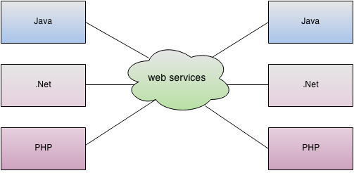
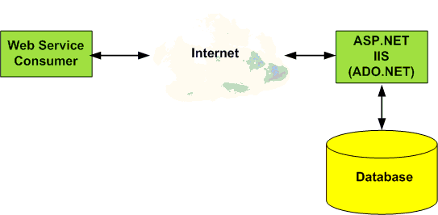
Web Service

Slide 6
Web Services
Important Components
SOAP
Envelope , Body , Header , Fault
WSDL

Slide 7
SOAP Format
<?xml version="1.0" encoding="utf-8"?>
<soap:Envelope>
<soap:Body>
<getemployees xmlns="http://tempuri.org/">
<city>Chennai</city>
</ getemployees >
</soap:Body>
</soap:Envelope>

Slide 8
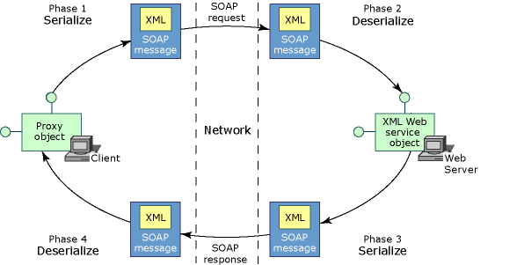
Web service call

Slide 9
Proxy
A client and a Web service can communicate using SOAP messages, which encapsulate the input and output parameters as XML. A proxy class maps parameters to XML elements and then sends the SOAP messages over a network.

Slide 10
Web Service
Creating a Web Service using ASP.NET
Creating a Test Service
Consuming the Service in Windows Application
Testing the Application

Slide 11
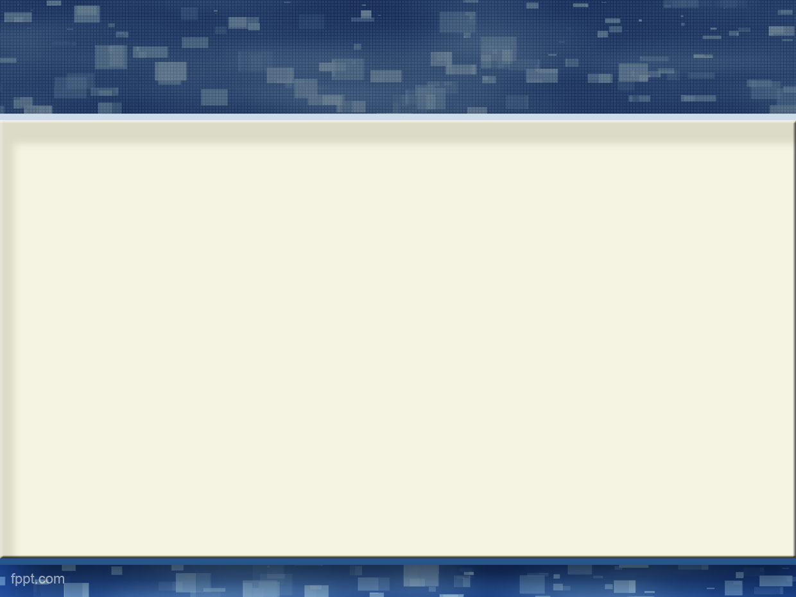
WCF
But why WCF ???

Slide 12
WCF
Advantage of WCF (WS*)
Multiple Protocols Support (HTTP , TCP , SMTP , FTP etc)
Message Level Security (Without SSL).
Supported by all the Protocols
WS Security Features
Message Integrity
Data Privacy (Confidential)
Client and Service Authentication
Reliable Messaging
No Replay, Message ordering,100 % Message Delivery
Transaction Management
Session Management
Multiple types of Hosting (IIS , Custom)

Slide 13
WCF
Follows WS-* Specification
One Solution for All

Slide 14
WCF Architecture

Slide 15
WCF
A – Address
B – Binding
C – Contract

Slide 16
WCF
A – Address ( Service Endpoint Address )
A service exposes one or more endpoints. Each endpoint exposes one or more service operations. Address uniquely identifies the endpoint . Tells consumer to locate the service.

Slide 17
WCF
B – Binding
A binding defines how an endpoint communicates to the world. At the very least, a binding defines the transport (such as HTTP or TCP) and the encoding being used (such as text or binary).
With binding , we can specify the following feature :
a. Transport Protocol
b. Security Requirement
c. Encoding format

Slide 18
Binding Features
Binding | Interoperability | Mode of Security (Default) | Session (Default) | Transactions | Duplex
basicHttpBinding | Basic Profile 1.1 | (None), Transport, Message, Mixed | None, (None) | (None) | n/a
wsHttpBinding | WS | None, Transport, (Message), Mixed | (None), Transport, Reliable Session | (None), Yes | n/a
wsDualHttpBinding | WS | None, (Message) | (Reliable Session) | (None), Yes | Yes
netTcpBinding | .NET | None, (Transport), Message, Mixed | Reliable Session, (Transport) | (None), Yes | Yes
webHttpBinding | Rest | None | (None) | (None) | No

Slide 19
Contract
The Contract outlines what functionality the endpoint exposes to the client. Such as
What operations can be called by a client
The form of the message
The type of Input parameter or return type.
Service Contract
Operation Contract
Data Contract
Fault Contract
Message Contract

Slide 20
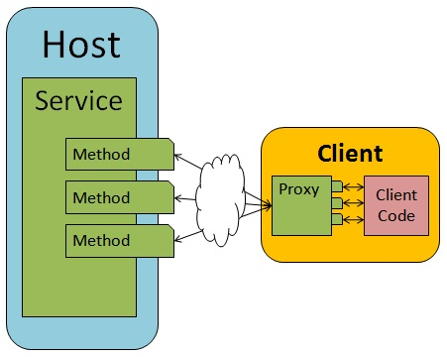

Slide 21
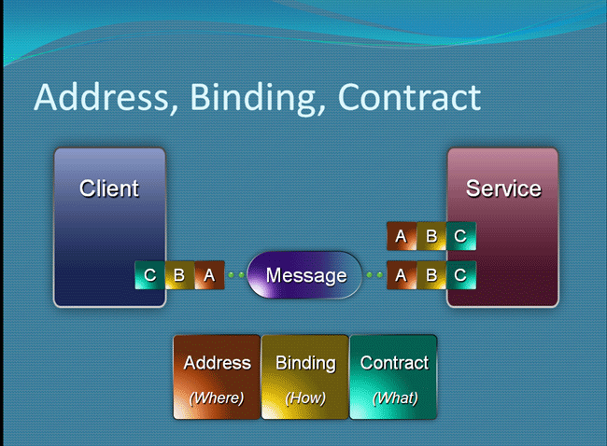
WCF

Slide 22
Demo
Create a Contract
Create a Service
Implement the Contract
Configure the Service in the Configuration file
Host the Service
Create a client
Add the service reference in the client application
Create a Proxy class object and call operations
Run and Test the WCF Application

Slide 23
WCF
Basic Example (Name , Namespace)
Multiple Endpoints

Slide 24
WCF Assignment
Create a Calculator WCF Service (wsHttpBinding)
GetSum(int num1,int num2)
GetDivision (int num1,int num2)
GetSubtract (int num1,int num2)
GetMultiply(int num1,int num2)
Consume the service in Windows Forms Application

Slide 25
WCF
Data Contract (Customer)
A data contract is a formal agreement between a service and a client that abstractly describes the data to be exchanged
DataContract
DataMember (IsRequired)

Slide 26
WCF
Demo
Creating a WCF Service for managing Customers
AddCustomer (Customer)
List<Customer> GetCustomers()

Slide 27
Assignment
Create a WCF Service called OrderService
AddOrder(Order) (return order id)
GetOrders(CustomerName) (return a List Collection)
Create a Windows Forms Application and Consume the Service.
Order Class / Table (OrderID , CustomerName , OrderAmt , OrderCity).
OrderID should be auto generated

Slide 28
WCF
Instancing Behavior
Instancing refers to controlling the lifetime of service objects
o Single (Single service object handles all clients requests)
o Per Call (A new service object is created for each client request)
o Per Session (A new service object is created for every client proxy and handles all the requests from the proxy)

Slide 29
WCF
Instancing Behavior
Demo

Slide 30
Assignment
Create a WCF Service called OrderService (PerSession Instancing Behavior)
AddOrder(Order) (return order id)
GetOrders(CustomerName) (return a List Collection)
Create a Windows Forms Application and Consume the Service.
Order Class / Table (OrderID , CustomerName , OrderAmt , OrderCity).
OrderID should be auto generated

Slide 31
WCF
Asynchronous (Async) Call
With error handling

Slide 32
Assignment
Create a WCF Service called OrderService
(PerSession Instancing Behavior)
AddOrder(Order) (return order id)
GetOrders(CustomerID) (return a Collection)
Create a Windows Forms Application and Consume the Service.
Call the GetOrders method (Async)
Order Class Type (OrderID , CustomerID , ItemID , ItemQTY , ItemPrice , OrderCity).
OrderID should be auto generated

Slide 33
WCF
Error handling in WCF
Communicating Error
Proxy or Channel Error
Application Error (Fault Exception) (Async)
Untyped
Typed
[FaultContract(typeof(ErrorInfo))]

Slide 34
Assignment
Create a WCF Service called OrderService
(PerSession Instancing Behavior)
AddOrder(Order) (return order id)
GetOrders(CustomerName) (return a Collection)
Create a Windows Forms Application and Consume the Service.
Call the GetOrders method (Async)
Order Class Type (OrderID , CustomerName , ItemID , ItemQTY , ItemPrice , OrderCity).
OrderID should be auto generated
Implement Typed Error Handling in the assignment

Slide 35
WCF
Message Pattern
WCF supports several messaging patterns, including request-reply, one-way, and duplex communication. Different transports support different messaging patterns, and thus affect the types of interactions that they support.
a. Request-Reply
b. One-way
c. Duplex

Slide 36
WCF
Demo
One Way
Request - Reply
Duplex

Slide 37
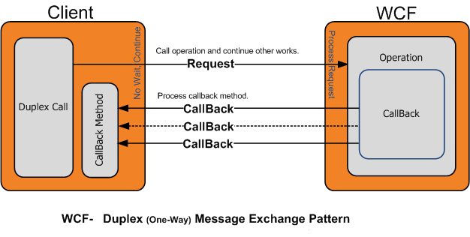
WCF

Slide 38
WCF - Duplex
Create a Service Contract
Create a Callback Contract
Attach the Callback Contract in the Service Contract
In the Service class access the reference of the client application
Configure the App.Config / Web.Config file
Run the service
Create a client and add the service reference
Implement the callback contract in the client application
Create a proxy class object
Test your application

Slide 39
WCF Transactions
Windows Communication Foundation (WCF) provides a rich set of features that enable you to create distributed transactions in your Web service application.
WCF implements support for the WS-Atomic Transaction (WS-AT) protocol that enables WCF applications to flow transactions to interoperable applications, such as interoperable Web services built using third-party technology. WCF also implements support for the OLE Transactions protocol, which can be used in scenarios where you do not need interop functionality to enable transaction flow.

Slide 40
WCF Transactions
Method Level
TransactionAutoComplete ,TransactionScopeRequired
TransactionFlow
[TransactionFlow(TransactionFlowOption.Mandatory)]
BindingConfiguration
[OperationBehavior(TransactionScopeRequired = true)]

Slide 41
Assignment
Create a Product Purchasing System (TransactionFlow)
A Windows Forms Application for purchasing tickets
ProductID,ProductPrice,BankName,AccountNo
Call some services for the same.
Create two services (PaymentService , PlaceOrderService)
Database Tables :
BankTransaction (TransactionID, AccountNo, Amount , TransactionDate) – BankDB returns TransationID
ProductsOrder( OrderID, ProductID , ProductPrice , OrderDate , TransationID,BankName)- OrdersDB – returns OrderID
Implement Transaction Flow
Display OrderID and TransactionID (if no error)

Slide 42
WCF REST Service
REST ( REpresentational State Transfer )
A software architecture style for designing scalable distributed applications
A simple alternative to SOAP , WSDL – based WEB services
A REST based service called as WCF Restful Service
System.ServiceModel.Web.dll
Rest support light weight format called JSON
System.Runtime.Serialization
REST URL (Get)
http://service_address/GetProducts/Mobile

Slide 43
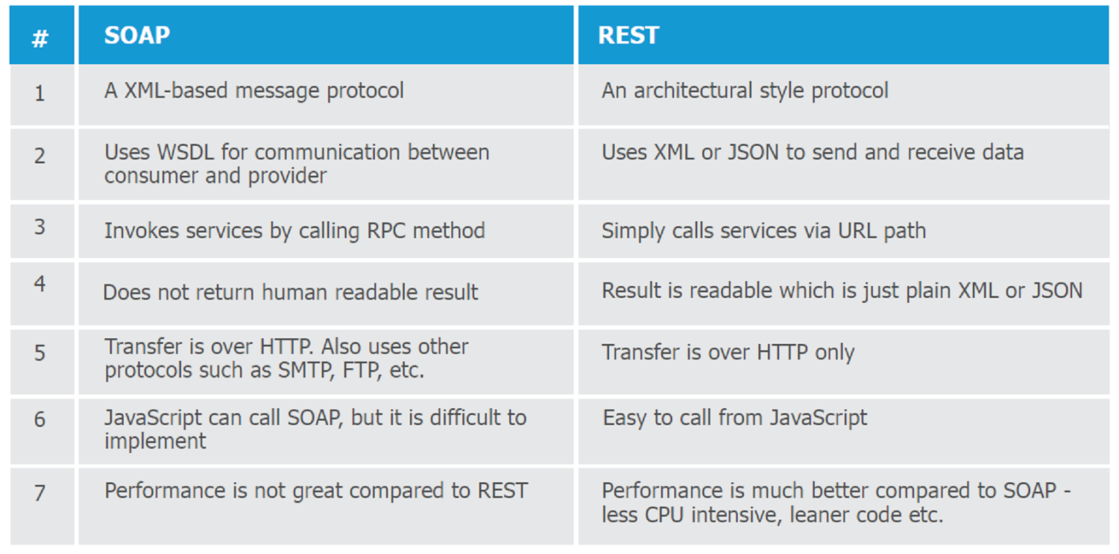
WCF REST Service

Slide 44
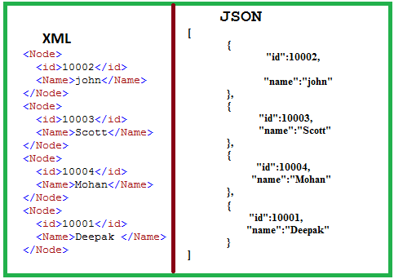
XML vs JSON

Slide 45
WCF REST Service
REST Supported Methods
GET
POST
PUT
DELETE

Slide 46
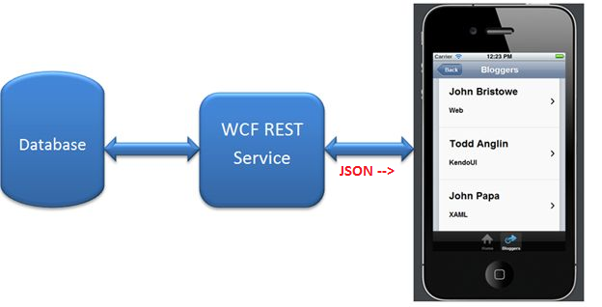
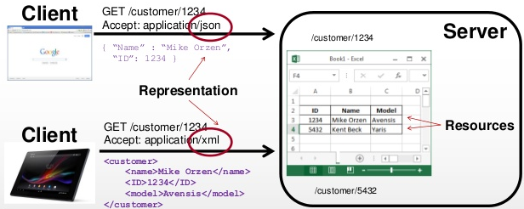
WCF

Slide 47
WCF REST Service
REST Demo (Order)
Creating a REST service using WCF
Using JSON Format
GET Method
Calling the REST Service

Slide 48
WCF
Overloaded Methods
Name and Namespace
Using svcutil command
Consuming WCF Service in ASP.NET WebSite (Async)

Slide 49
Thanks

