Slide 1
ASP.NET MVC
(Model – View - Controller)
MVC

Slide 2
ASP.NET MVC
The ASP.NET MVC simplifies the complex parts of ASP.NET Web Forms without any compromise of the power and flexibility of ASP.NET platform.
ASP.NET MVC implements Model-View-Controller UI pattern for web application development that lets you allows to develop applications in a loosely couples manner.
MVC pattern is separating the application in three parts- Model, View and Controller.
MVC

Slide 3
ASP.NET MVC
MVC makes it mandatory to have at least 3 kinds of objects or components apart from Business Layer, Validation Layer and other layers.
Model
View
Controller
MVC

Slide 4
ASP.NET MVC
Model :
Represents Data Source for the entire application. All the persistent data sources are accessed and manipulated using Model
View
Represents Visualization of Model.
It is responsible for Generating the UI Output (HTML) for rendering and presenting the business data
Accepting Input from the User
Validating the Input
MVC

Slide 5
ASP.NET MVC
Controller
Controller is basically C# class which is inherited by System.MVC.Controller
Controller handles all the requests.
Interprets the user request and responds to it.
Controller contains action method for all type of requests
Performs CRUD operation on Model as per requirement
Controller use ViewData or ViewBag for passing data to View (Additional Data)
MVC

Slide 6
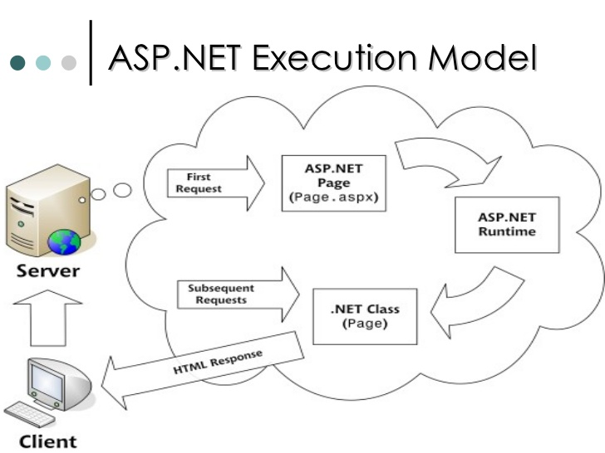
ASP.NET MVC
ASP.NET Request - Response
MVC

Slide 7
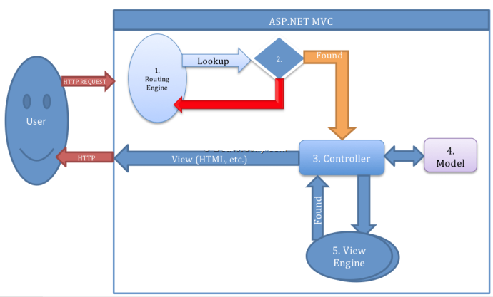
ASP.NET MVC
ASP.NET MVC Request - Response
MVC

Slide 8
ASP.NET MVC
Features of ASP.NET MVC
Easy way of managing complexity by dividing an application into the model , the view and the controller. (Separation of Code)
No ViewState and No PostBack
No Page Life Cycle
High Speed Web Sites
Enable full control over the rendered HTML
Rest enable URL for high performance
Support for third party view engine (razor)
MVC

Slide 9
ASP.NET MVC
Views
ASPX View
Razor View (MVC 3.0)
HTML Helper Methods
@Html.TextBox("Code", "E101", new {@style="width:300px; font-size:30px;color:red" })
MVC

Slide 10
ASP.NET MVC
Demo
Creating Simple MVC Application (Calculator)
Understanding Folder Structure
Controller
Actions
View
Understanding Routing
ViewBag
MVC

Slide 11
Assignment
Create a MVC Application with a Controller and Actions
Login Action and View (LoginID , Password ,RememberMe) with New User link
InvalidUser View with Try Again Link
Register Action and View (CustomerID , CustomerName , CustomerCity , CustomerPassword)
CustomerCreated View
Home Action and View
MVC

Slide 12
ASP.NET MVC
ActionResult (Abstract class)
ViewResult (View)
PartialViewResult (PartialView)
RedirectResult (Redirect)
Redirect(“/Home/Customer/1");
RedirectToRouteResult (RedirectToAction)
RedirectToAction("About","Home");
JsonResult (Json)
JavaScriptResult (JavaScript)
FileContentResult(File)

Slide 13
ASP.NET MVC
ViewBag
The ViewBag property enables you to dynamically share values from the controller to the view.

Slide 14
ASP.NET MVC
Routing
Routing is a pattern matching system that monitor the incoming request and figure out what to do with that request.
Route defines the URL pattern and handler information.

Slide 15
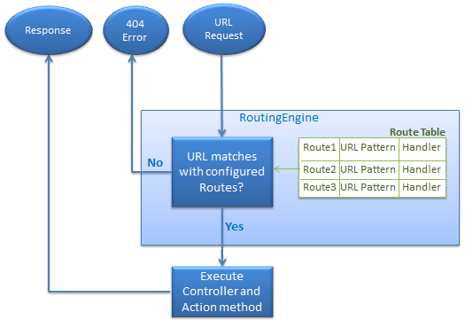
ASP.NET MVC

Slide 16
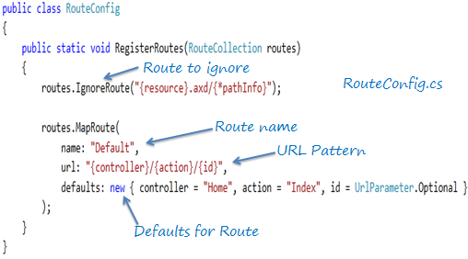
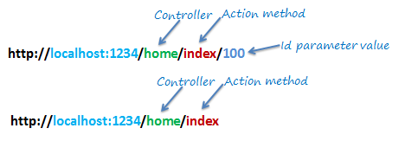
ASP.NET MVC

Slide 17
ASP.NET MVC
Routing
Implementing Multiple Routes
routes.MapRoute(
name:“Inautix",
url:"Inautix",
defaults: new { controller="Test",action=“About"});

Slide 18
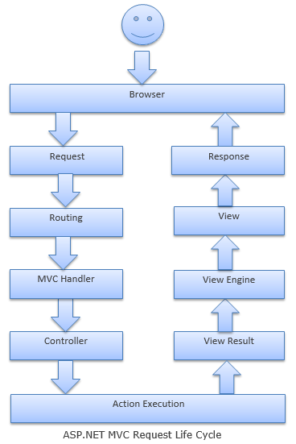
ASP.NET MVC
MVC

Slide 19
ASP.NET MVC
Some important points (State Management)
ViewBag
TempData
TempData in ASP.NET MVC is basically a dictionary object derived from TempDataDictionary. TempData stays for a subsequent HTTP Request as opposed to other options (ViewBag and ViewData) those stay only for current request. So, TempdData can be used to maintain data between controller actions as well as redirects.
Session

Slide 20
ASP.NET MVC
Some important points
Multiple Submit Buttons
Multi Forms
Using DropDownList
@HTML.AntyForgeryToken()
Uploading a File
FormMethod.Post, new { enctype = "multipart/form-data" }
MVC

Slide 21
Assignment
Create a MVC Application with a Controller and Actions
Login Action and View (LoginID , Password ,RememberMe) with New User link
InvalidUser View with Try Again Link
Register Action and View (CustomerID , CustomerName , CustomerCity , CustomerPassword)
CustomerCreated View
Home Action and View
Make CustomerCity as DropDownList
Show the LoginID on the Home View.
MVC

Slide 22
ASP.NET MVC
Layout
Razor supports a concept with a feature called “Layouts“, allow you to define a common site template, and then inherit its look and feel across all the views/pages on your web application. (MasterPage)
RenderBody : Renders the actual body of the associated View
RenderSection : Section to render at the given location in Layout
@Scripts.Render("~/bundles/jquery")
@Scripts.Render("~/bundles/jqueryval")

Slide 23
ASP.NET MVC
Creating Models
The Model represents a set of classes that describes the business logic and data (DAL). It also defines business rules for how the data can be changed and manipulated.
Represents Data Source for the entire application. All the persistent data sources are accessed and manipulated using Model.
MVC

Slide 24
ASP.NET MVC
Demo
Creating Model (Order)
Creating Strongly Typed Views using Scaffold Templates
Create , List , FindOrderDetails
Lambda Expression
Anonymous Function
(model=>model.OrderID)
string func(ModelType model)
{
return model.OrderID;
}

Slide 25
ASP.NET MVC
Validations using Model (Data Annotation)
Server
Client
Required , Range , StringLength , RegularExpression ,Compare, EmailAddress
DataType
Remote
@"^([a-zA-Z0-9_\.\-])+\@(([a-zA-Z0-9\-])+\.)+([a-zA-Z0-9]{2,4})+$“
Note : ref the site.css file

Slide 26
Assignment
Create a Table Called Customers
CustomerID , CustomerFName, CustomerLName , CustomerAge , CustomerCity , CustomerEmailID , CustomerAddress
Create a Model (Customer) with Validations
DAL ( AddCustomer , GetCustomers , CheckEmailID, GetCities)
Create a Home Action and View (with Links)
Use Layout
Create Views using Scaffold Template
Create
ShowAllCustomers

Slide 27
ASP.NET MVC
Partial Views
A partial view enables you to define a view that will be rendered inside a parent view. Can be called using two ways
Directly by View
@Html.Partial(“NameOfView”)
Using an Action
@Html.Action(“NameOfAction”)

Slide 28
Ajax
Asynchronous JavaScript And XML
MVC

Slide 29
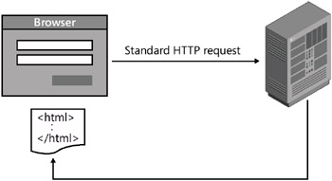
Ajax
Without Ajax Execution
MVC

Slide 30
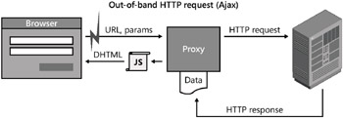
Ajax
MVC

Slide 31
ASP.NET MVC
AJAX in MVC (JQuery)
AJAX Views
Ajax Action
Calling a PartialView
Ajax Forms
@Scripts.Render("~/bundles/jquery")
@Scripts.Render("~/bundles/jqueryval")
MVC

Slide 32
ASP.NET MVC
Ajax Demo
Ajax Link
Ajax Partial View (Model)
Ajax Form

Slide 33
ASP.NET MVC
Bundling and Minification
Bundling and minification techniques were introduced in MVC 4 to improve request load time.
Bundling allow us to load the bunch of static files from the server into one http request.
Minification technique optimizes script or css file size by removing unnecessary white space and comments and shortening variable names to one character.

Slide 34
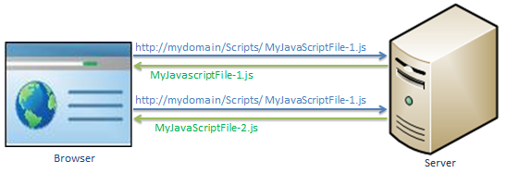
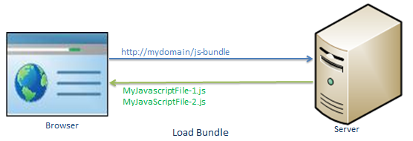
ASP.NET MVC

Slide 35
ASP.NET MVC
sayHello = function(name)
{
//this is comment
var msg = "Hello" + name;
alert(msg);
}
Minification
sayHello=function(n){var t="Hello"+n;alert(t)}

Slide 36
ASP.NET MVC
JQuery
JQuery is a fast and concise JavaScript Library created by John Resig in 2006 with a nice motto − Write less, do more. JQuery simplifies HTML document traversing, event handling, animating, and Ajax interactions for rapid web development.

Slide 37
ASP.NET MVC
Demonstration
Simple JQuery calling an Action
Calling an Action with parameters
Calling a Post Action
JQuery UI
@Scripts.Render("~/bundles/jquery")
@Scripts.Render("~/bundles/jqueryval")

Slide 38
ASP.NET MVC
<div id="rData">
</div>
<script type="text/jscript">
var url = "/Home/GetDate";
$.get(url, null, function (data) {
$("#rData").html(data);
});
</script>
<script src="~/Scripts/jquery-1.8.2.js" type="text/javascript"></script>
Or
@Scripts.Render("~/bundles/jquery")
@Scripts.Render("~/bundles/jqueryval")

Slide 39
ASP.NET MVC
<div>
<div id="rData"></div>
@Html.TextBox("UserName")
<input type="submit" value="Getdata" id="btn1" />
<script type="text/jscript">
$("#btn1").click(function(){
var uname = $('#UserName').val();
var url = "/Home/GetDate";
$.get(url, {username:uname}, function (data) {
$("#rData").html(data);
});
});
</script>
</div>

Slide 40
ASP.NET MVC
Jquery UI in MVC
@Html.TextBox("dob")
@section Scripts {
@Scripts.Render("~/bundles/jqueryval")
@Scripts.Render("~/bundles/jqueryui")
@Styles.Render("~/Content/themes/base/css")
<script type="text/javascript">
$("#dob").datepicker(
{
dateFormat: “mm/dd/yy",
changeMonth: true,
changeYear: true
});
</script>
}

Slide 41
Assignment
Create a Table Called Customers
CustomerID , CustomerFName, CustomerLName , CustomerAge , CustomerCity , CustomerEmailID , CustomerAddress
Create a Model (Customer) with Validations
DAL ( AddCustomer , GetCustomers , CheckEmailID, GetCities)
Create a Home Action and View (with Links)
Use Layout
Create Views using Scaffold Template
Create
PlaceOrder (Ajax Form)
OrderID , CustomerID ,ItemID, ItemQty , ItemPrice,Address.
FindOrder (Ajax Form) returns a Partial View(Model)
ShowAllCustomers
ShowOrders (Ajax with partial view (Model))

Slide 42
ASP.NET MVC
MVC Security (Forms Based Authentication)
Authentication
Authorization
<add name="MyMembership"
type="System.Web.Security.SqlMembershipProvider"
connectionStringName="constr" requiresQuestionAndAnswer="true"
requiresUniqueEmail="false"/>
MVC

Slide 43
ASP.NET MVC
Filters
ASP.NET MVC Filters are logical codes which are executed either before or after the action called.
Authorization Filters
Authorize , RequiresHttps
Action Filters
Custom (ActionFilterAttribute)
Result Filters
OutputCaching
Exception Filters
HandleError

Slide 44
ASP.NET MVC
Debugging
Output Windows
Breakpoints
Event Viewer
Event Log

Slide 45
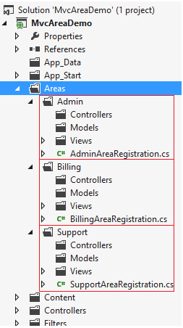
ASP.NET MVC
Areas provide a way to separate a large MVC Web Application into smaller functional groupings inside MVC Application and each group contains MVC Structure (Ex. Model, View and Controller folders).

Slide 46
Assignment
Create a Table Called Customers
CustomerID , CustomerFName, CustomerLName , CustomerAge , CustomerCity , CustomerEmailID , CustomerAddress
Create a Model (Customer) with Validations
DAL ( AddCustomer , GetCustomers , CheckEmailID, GetCities)
Create a Home Action and View (with Links)
Use Layout
Create Views using Scaffold Template
Create ,
PlaceOrder (Ajax Form)
ShowAllCustomers
ShowOrders (Ajax with partial view)
Implement FBA security

Slide 47
Assignment
Create a MVC Application for managing Employees (use Layout)
Model : EmployeeModel
DAL : EmployeeDAL
Controller Name : Employees
Actions : NewEmployee , ShowEmployees , GetEmployeeStatus (Ajax), UpdateEmployeeStatus (Ajax)
Implement validations : Client & Remote.
Table : Employees (EmployeeID , EmployeeName , EmployeeEmailID (R), EmployeeAge , EmployeeCity , EmployeeContactNo (R) ,EmployeePassword , ProjectStatus)

Slide 48
Entity Framework
Entity Framework (ORM)
The Microsoft ADO.NET Entity Framework is an Object/Relational Mapping (ORM) framework that enables developers to work with relational data as domain-specific objects, eliminating the need for most of the data access plumbing code(ADO.NET) that developers usually need to write.

Slide 49
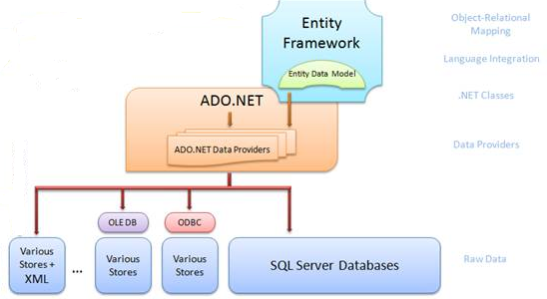
Entity Framework

Slide 50
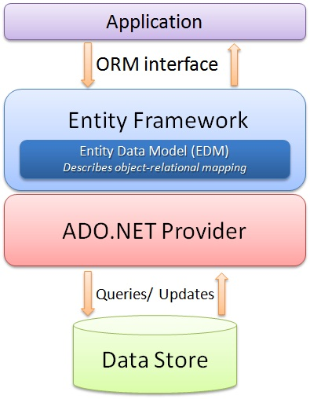
Entity Framework

Slide 51
Entity Framework
Entity Model (POCO) :
Entity model is a set of .Net classes which represent Database structure (tables) etc.

Slide 52
Entity Framework
The Entity Framework provides three approaches to create an entity model
Code First
Model First (edmx file)
Database First

Slide 53
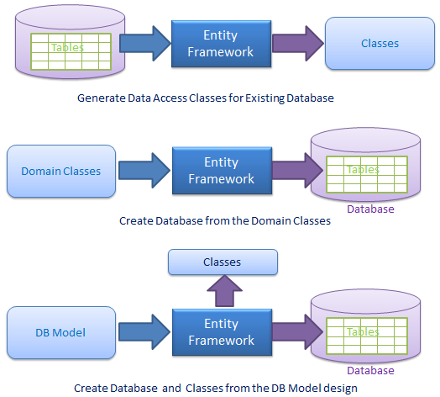
Entity Framework

Slide 54
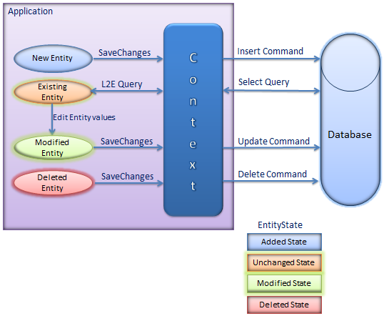
Entity Framework

Slide 55
Entity Framework
Entity Framework
CRUD Operations
Create
Read
Update
Delete

Slide 56
LINQ
LINQ
Language INtegrated Query
Uniform Programming Model for any kind of data

Slide 57
LINQ
LINQ
Consider simple Query
var query =
from row in db.Customers
where row.Country == “India"
select row;
foreach ( Customer c in query )
{
Console.WriteLine( c.name+” “ +c.city );
}
What is Customers?
SQL database
DataSet
An array of objects
.NET Collection

Slide 58
LINQ
LINQ
Select
Where
Top
Order By
Group By
Joins

Slide 59
Entity framework
Entity Framework with LINQ (Demo)
Generate Entities (Database First Approach)
CRUD Operations (Customers , Orders)

Slide 60
Entity framework
Entity Framework
SqlQuery
var data= dc.Customers.SqlQuery("Select * from Customers where CustomerName=@p0 and CustomerCity=@p1","A","Chn").ToList();
ExecuteSqlCommand
int i= dc.Database.ExecuteSqlCommand("Update Customers set CustomerName=@p0 where CustomerID=@p1", "ABC", "1005");
SqlQuery
var data = dc.Database.SqlQuery<Cust>("Select CustomerID,CustomerName from Customers where CustomerCity=@p0", "Chn").ToList();

Slide 61
Assignment
Create a Windows Application for managing products
Product Table : ProductID , ProductName , ProductPrice, ProductDescription , ProductCategory
Add Product
GetProducts
FindProducts (ProductCategory)
SearchProduct (ProductID)

