Slide 1

A Student Management System using Python And MySQL

Slide 2
OBJECTIVES
This student management system can manage every aspect of a student.
It is an automated version of the manual student management system.
The details include college information, student personal information, academic information, etc.

Slide 3
MODULES USED
1. Tkinter : To create the GUI. 2. MySQL : To connect the program to the database and store information in it. 3. TkCalender : To get the user to enter a date. 4. Datetime.date : To convert the date from the tree to a Datetime.date instance so that it can be set in. 5. Tkinter.messagebox : To show a display box, displaying some information or an error. 6. Tkinter.ttk : To create the tree where all the information will be displayed.

Slide 4
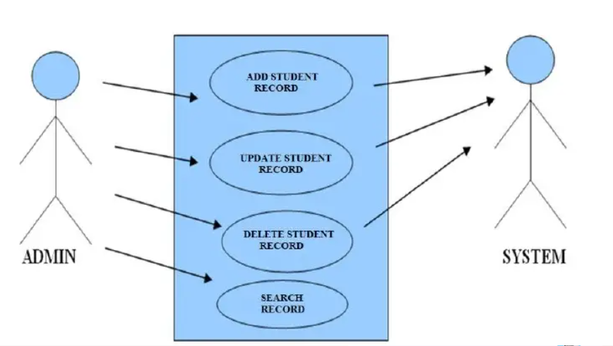
USE CASE DIAGRAM

Slide 5
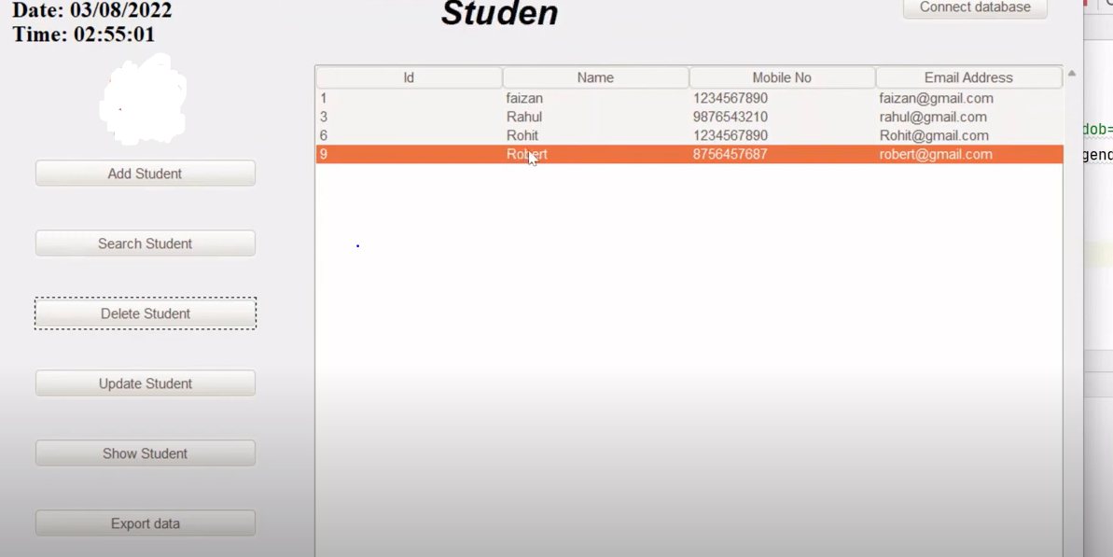

Snapshot

Slide 6
BENEFITS
Records management for students is made simple by software.
The software has a very user-friendly interface that is simple to use and comprehend.
Software protects private data by concealing it.
Software starts up quickly and uses very little memory.

Slide 7
LIMITATIONS
Software is only available on desktops.
Python interpreter must be installed on the system.
The current version does not include all available student management options.
Security options only offer minimal protection from inexperienced attackers.
GUI only exists in English.

Slide 8
FUTURE ENHANCEMENT
Any OS can use this software.
This software can include features for higher security.
This software can also include programmed scheduling.
This software could be created to serve as a tutorial for new users to learn the fundamentals of OS.
This system can be used with an operating system to eliminate the need to install and run each tool's interface at a different location.
This can implement the Automatic Shutdown through SMS service.

