Slide 1
Linear Data Structure
Data Structure and Algorithms

Slide 2
Outline
Types of Data Structures
Linear vs. Non-linear data structures
Foundational Data Structures:
Array
Linked List

Slide 3
Types of Data Structures
Data Structure is an arrangement of data in a computer’s memory and a set of operations that can be performed on that data.
Data Structure
Linear
Non Linear
List
Stack
Queue
Tree
Graph
Implementation Approaches
Array
Linked List

Slide 4

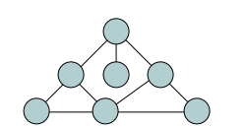
Linear vs. Non-Linear
How data is organized?
In linear data structures, data elements are organized sequentially and therefore they are easy to implement in the computer’s memory. They have strictly one successor and predecessor, except the starting and ending data element.
In nonlinear data structures, a data element can be attached to several other data elements to represent specific relationships that exist among them.

Slide 5
Foundational Data Structures
Approaches to implement Data structures
Every data structure needs some memory to store values. Two key approaches are:
Contiguous memory allocation → Array
Linked memory allocation → Linked List
Array and linked list are two very basic data structures as they do not impose any rules on arrangement of values themselves. Main purpose of both is to support implementation of other data structures like Stack, Queue, List, Set, Map, Graph and Tree etc.
So they are better known as foundational structures and not ADTs.

Slide 6
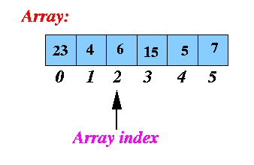
Arrays
Array is a list of fixed number of homogeneous data elements stored in successive memory locations. Data elements can be referred through index (subscript) , such as item[0], item[1], item[2]….
Declaration:
Java
int []item=new int[N];
Data Type
Name
N>0
Notes:
The Redo button will reverse the last use of the Undo button, restoring the previous action.
The Ctrl-Y keyboard shortcut also can be used in place of the Redo button.

Slide 7
Memory Implementation
Whole array is stored in a contiguous memory block.
Index of any array ranges from lower bond (L) to upper bound (U)
For example in many languages like C/C++, java
L is 0
U= N-1 where N is the length of array
If we know L and U
N=U-L+1
Because the memory location are continuous
So we can access each successive element by
incrementing index with 1.
Every element occupies the equal number of bytes
depending upon its data type and word size of underlying
machine hardware .
1001
12
1002
item[0]
1003
1004
1005
9
1006
item[1]
1007
1008
1009
15
1010
item[2]
1011
1012

Slide 8
Memory Implementation
Address of the first element is called the base (start) address of array.
The location/ address of the i^{th} element is given by the following formula:
Location_{i} = base_address + w*(i – L)
w: number of words per memory cell
L: Lower bound of array index
Example:
assume w is 4
Location₂ = 1001 + 4*(2 –0 )=1009
Base Address
1001
12
1002
item[0]
1003
1004
1005
9
1006
item[1]
1007
1008
1009
15
1010
item[2]
1011
1012

Slide 9
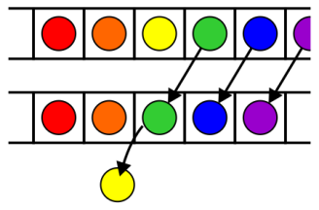

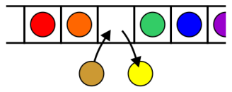
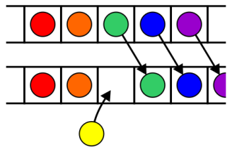
Set of Operations
Retrieval/Accessing/indexing
Accessing a specific value at given index
Replacement
Replacing a value at given index
Insertion
Inserting a value at given index
Deletion
Deleting a value
Traversing
Visiting all values one by one
Searching
Searching a specific value
Merging
Given two arrays of size n1 and n2, merge them in a list of size n1+n2
Sorting
Converting the unordered list into ordered list

Slide 10
Algorithm Notation
A→ an array of size N
N→ Total size of A
N>0
K→ Actual number of elements in A
K<=N && K>=0
V→ a value to be searched, inserted or deleted
L/I→ an index to searched or given

Slide 11
Searching
A search traverses the list until
The desired element is found
Or the collection is exhausted
Given an array A of capacity N find the element V in it.
Linear search
Binary search

Slide 12
Linear/Sequential Search
Algorithm: LINEAR_SEARCH(A, K, V)
Input: Array, size, value to be searched
Output: index of value if found, -1 otherwise
Steps:
Start
set i=0
While i<K
If (A[i]==V)
return i
End If
i=i+1
End While
return -1
End

Slide 13
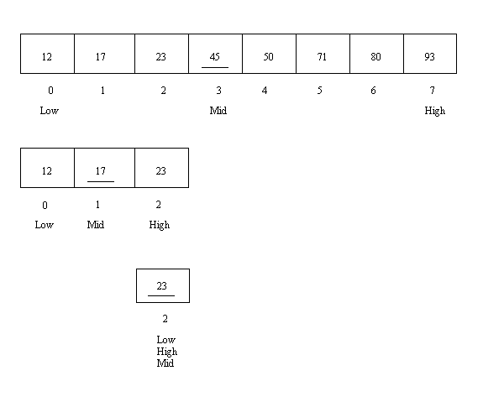
Binary Search
If the list is ordered, May be we don’t need to look at all elements
We can stop looking when we know the element cannot be in the collection.
Can we improve our search algorithm if array is sorted?
If we have an ordered list and we know lower and upper bound of list we can use a different strategy.
Mid= (Low+High)/2
Stop searching when Low become equals to High

Slide 14
Binary Search
We need to search value V
Calculate mid=(low+high)/2
There can be three situations:
V is equal to A[mid]
We have found the element
It is less than < A[mid]
It cannot be in right half of array
So search in left half only
It is greater than A[mid]
It cannot be in left half of array
So search in right half only
1 | 5 | 10 | 11 | 15 | 20 | 22 | 27 | 29 | 30 | 40
0 | 1 | 2 | 3 | 4 | 5 | 6 | 7 | 8 | 9 | 10
Low
Mid
High
1 | 5 | 10 | 11 | 15 | 20 | 22 | 27 | 29 | 30 | 40
0 | 1 | 2 | 3 | 4 | 5 | 6 | 7 | 8 | 9 | 10
Low
Mid
High
1 | 5 | 10 | 11 | 15 | 20 | 22 | 27 | 29 | 30 | 40
0 | 1 | 2 | 3 | 4 | 5 | 6 | 7 | 8 | 9 | 10
Low
Mid
High
1 | 5 | 10 | 11 | 15 | 20 | 22 | 27 | 29 | 30
0 | 1 | 2 | 3 | 4 | 5 | 6 | 8 | 9 | 10
Low
High
Mid

Slide 15
Binary Search
Algorithm:BINARY_SEARCH(A, K, V)
Input: Sorted Array in ascending order , lower and upper index of list, value to be searched
Output: index of value if found
Steps:
Start
Set low=0, high=K-1
While (low <= high)
mid = (low + high) / 2;
If (V < A[mid]) //If value in the left half
high = mid - 1; //Update high index
Else If (V > A[mid]) //If value in the right half
low = mid + 1; //Update the low index
Else
return mid; // value == Array[mid]
End If
End While
return -1; //index was not found
End
The binary search gets its name because the algorithm continually divides the list into two parts.
Binary search algorithm is good for larger arrays.
If array size is very small, there is not huge difference between linear search and binary search algorithm time

Slide 16
Retrieval, Replacement, Traversing
Retrieval
How we access value at index i?
A[i]
Replacement
How to replace value at index i?
A[i]= V
Traversing
Looking all elements one by one
set i=0
While i<K
A[i]=i
i=i+1
End While

Slide 17
Insertion
To insert a new item, we need to know the index:
Suppose we have an array of total capacity 10. Initial number of elements are 5
Suppose we want to insert at location 2
All values to be shifted right
Index
Value
0 | 1 | 2 | 3 | 4 | 5 | 6 | 7 | 8 | 9
25 | 12 | 56 | 78 | 41
Index
Value
0 | 1 | 2 | 3 | 4 | 5 | 6 | 7 | 8 | 9
25 | 12 | 56 | 78 | 41

Slide 18
Insertion
Shifting numbers to right
Insert 10 at index 2
Index
Value
0 | 1 | 2 | 3 | 4 | 5 | 6 | 7 | 8 | 9
25 | 12 | 56 | 78 | 41 | 41
Index
Value
0 | 1 | 2 | 3 | 4 | 5 | 6 | 7 | 8 | 9
25 | 12 | 56 | 78 | 78 | 41
Index
Value
0 | 1 | 2 | 3 | 4 | 5 | 6 | 7 | 8 | 9
25 | 12 | 56 | 56 | 78 | 41
Index
Value
0 | 1 | 2 | 3 | 4 | 5 | 6 | 7 | 8 | 9
25 | 12 | 10 | 56 | 78 | 41

Slide 19
Insert Algorithm
Algorithm: INSERT(A, K, N, L, V)
Input: array, size of array(Elements), total capacity, location for new value, value to be inserted
Output: array with inserted value
Pre: L >-1 && <=K, K <=N
Post: K=K+1
Steps:
Start
If L<=K and L >-1
Set i=K
While i>L
Set A[i]=A[i-1]
i=i-1
End While
Set A[L]=V
K=K+1
End If
End
V: value to be inserted in array
L: location at which value needs to be inserted

Slide 20
Delete Operation
Delete can work in two ways:
Index is given, we need to delete the value
Value is given, we need to search its index and delete it
Initial Array
N=10
K= 5
Suppose we want to delete value at index 2
All elements will be shifted to left
Index
Value
0 | 1 | 2 | 3 | 4 | 5 | 6 | 7 | 8 | 9
25 | 12 | 56 | 78 | 41
Index
Value
0 | 1 | 2 | 3 | 4 | 5 | 6 | 7 | 8 | 9
25 | 12 | 56 | 78 | 41

Slide 21
Delete
Shifting numbers to left
After Deletion
Index
Value
0 | 1 | 2 | 3 | 4 | 5 | 6 | 7 | 8 | 9
25 | 12 | 56 | 78 | 41
Index
Value
0 | 1 | 2 | 3 | 4 | 5 | 6 | 7 | 8 | 9
25 | 12 | 78 | 78 | 41
Index
Value
0 | 1 | 2 | 3 | 4 | 5 | 6 | 7 | 8 | 9
25 | 12 | 78 | 41 | 41
Index
Value
0 | 1 | 2 | 3 | 4 | 5 | 6 | 7 | 8 | 9
25 | 12 | 78 | 41

Slide 22
Delete Algorithm
Algorithm: DELETE_LOCATION(A, K, N, L)
Input: array, size of array(Elements), capacity , location to be deleted
Output: array without deleted value
Pre: A must not be empty, K>0
Post: K=K-1 if L is valid
Steps:
Start
If L<K and L>-1
Set i=L
While i<K-1
A[i]=A[i+1]
i=i+1
End While
K=K-1
End If
End
L: location whose value needs to be deleted

Slide 23
Delete Algorithm
Algorithm: DELETE_VALUE(A, K, N, V)
Input: array, size of array(Elements), capacity , value to be deleted
Output: array without deleted value
Pre: A must be non-empty
Post: K=K-1 if V is found
Steps:
Start
Set i=0
while i<K
if A[i]= =V
DELETE_LOCATION(A,K,N,i )
break
End if
i=i+1
End While
End
This algorithm is deleting only one value, what change is required if there are duplicate values in array?

Slide 24
Sorting
Given an un ordered array, sort it into ascending order. Many algorithms exist for sorting like selection sort, bubble sort, insertion sort, quick sort, merge sort etc.
Selection Sort
Idea:
find the smallest element
put it in the first position
find the next smallest element
put it in the second position
…
And so on, until you get to the end of the list
0 | 1 | 2 | 3 | 4 | 5
8 | 20 | 15 | -5 | 7 | -55
0 | 1 | 2 | 3 | 4 | 5
-55 | -5 | 7 | 8 | 15 | 20

Slide 25
Selection Sort
Find index of minimum element?
Compare all elements one bye one
Where to start?
Which two elements will be compared first?
0 | 1 | 2 | 3 | 4 | 5
8 | 20 | 15 | -5 | 7 | -55
Min_index

Slide 26
Selection Sort
Find index of minimum element?
Min_index
Min_index
0 | 1 | 2 | 3 | 4 | 5
8 | 20 | 15 | -5 | 7 | -55
0 | 1 | 2 | 3 | 4 | 5
8 | 20 | 15 | -5 | 7 | -55
Is this number < number at Min_index?
Is this number < number at Min_index?
Min_index
Min_index
0 | 1 | 2 | 3 | 4 | 5
8 | 20 | 15 | -5 | 7 | -55
0 | 1 | 2 | 3 | 4 | 5
8 | 20 | 15 | -5 | 7 | -55
Is this number < number at Min_index?
Is this number < number at Min_index?
Min_index
0 | 1 | 2 | 3 | 4 | 5
8 | 20 | 15 | -5 | 7 | -55
Is this number < number at Min_index?

Slide 27
Selection Sort
Find index of minimum element?
Swap with start of list element
Now a part of list has been sorted
Repeat step 1 and 2 on remaining unsorted part of list
Min_index
0 | 1 | 2 | 3 | 4 | 5
8 | 20 | 15 | -5 | 7 | -55
Min_index
0 | 1 | 2 | 3 | 4 | 5
8 | 20 | 15 | -5 | 7 | -55
0 | 1 | 2 | 3 | 4 | 5
-55 | 20 | 15 | -5 | 7 | 8

Slide 28
Selection Sort
0 | 1 | 2 | 3 | 4 | 5
8 | 20 | 15 | -5 | 7 | -55
0 | 1 | 2 | 3 | 4 | 5
-55 | 20 | 15 | -5 | 7 | 8
Swap
0 | 1 | 2 | 3 | 4 | 5
-55 | -5 | 15 | 20 | 7 | 8
0 | 1 | 2 | 3 | 4 | 5
-55 | -5 | 7 | 20 | 15 | 8
0 | 1 | 2 | 3 | 4 | 5
-55 | -5 | 7 | 8 | 15 | 20
0 | 1 | 2 | 3 | 4 | 5
-55 | -5 | 7 | 8 | 15 | 20
0 | 1 | 2 | 3 | 4 | 5
-55 | -5 | 7 | 8 | 15 | 20

Slide 29
Selection Sort
Algorithm: SELECTION_SORT(A, N)
Input: an array and its size N
Output: sorted array
Pre: array must be non empty/more than one element?
Post: array must be sorted
Steps:
Set min_index=-1;
For(i=0; i<N; i++)
//find minimum
min_index=i //consider 1st element of remaining array minimum
for(j=i; j< N; j++) //try it with for(j=i+1; j< N; j++) and see any difference in result
if (A[j]<A[min_index])
min_index=j
End if
End For
//swap the min with value at i (that will be first index of unsorted array)
tmp=A[min_index]
A[min_index]=A[i]
A[i]=tmp
End For

Slide 30
Applications
Wherever you need fixed size allocation, some uses are follows:
CPU Scheduling
As queue
Recursion
As stack
Polynomial evaluations
Matrix manipulation
2 dimensional arrays
Used for solving linear system of equations
Image processing
3 dimensional arrays
And many more (search from net)

