Slide 1
BST
CSC-114 Data Structure and Algorithms

Slide 2
Outline
Search Trees
Binary Search Tree
Search
Insertion
Deletion
Constructing with Traversal Orders

Slide 3
Binary Search Tree
A very popular search tree which supports efficient processing of data. It stores data in a manner which allows faster lookup.
A Binary Search Tree is a binary tree with a special property:
Each node has some comparable data field(key) and it fulfills following rule:
Node’s left sub tree holds keys less than the node's key,
Node’s right sub tree holds keys greater than the node's key.
Note: No duplicate keys are allowed
BSTs are used to present sorted data:
If you traverse tree in order, it will produce sorted keys:
10 13 25 38 50 70 77 90 99
Operations:
Search
Insertion
Deletion
50
25
70
10
38
90
13
77
99

Slide 4
Search
Search 77 Search 97
How much time will it take?
What would be the worst case scenario?
50
77>50
50
97>50
25
70
77>70
25
70
97>70
10
38
90
77<90
10
38
90
97>90
13
77
99
13
77
99
97<90
77=77
null
Grey node is shown here to present null node, just for understanding

Slide 5
Search: Algorithm
BST_SEARCH(node, key)
Input: root node of tree, key to be searched
Output: node which contains key
Steps:
Start
If node== null OR key==node.key // value found or not found
Return node
Else If key < node.key // < node.key
Return BST_SEARCH( node.left, key)
Else // > node.key
Return BST_SEARCH( node.right, key)
End

Slide 6
Insertion
Let say we want to insert 5
What is the correct position for it
5<10
Move to left
Left child of 10 is null
Make 5 it’s left child
5<50
50
5<25
25
70
5<10
10
38
90
13
77
99
null

Slide 7
Insertion
Insert 5
5<50
50
50
5<25
25
70
25
70
5<10
10
38
90
10
38
90
13
77
99
5
13
77
99
null

Slide 8
Insertion
Insert 85
50
85>50
50
25
70
85>70
25
70
10
38
90
85<90
10
38
90
85>77
5
13
77
99
5
13
77
99
85
null

Slide 9
Insert: Algorithm
Have you observed?
New node is always inserted as leaf node
So
If root is null
New node is root
And if root node is not null
Some other node’s links will be updated
If new node is smaller, update left child
Else update right child
How to write a recursive function?
What it should receive?
What it should return?

Slide 10
Insert: Algorithm
BST_INSERT(node, newNode)
Input: root node of tree, node to be inserted
Output: updated tree with newNode
Steps:
If node == null //base case
node = newNode
Else If newNode.key < node.key
node.left = BST_INSERT(node.left, newNode)
Else If newNode.key > node.key
node.right = BST_INSERT(node.right, newNode)
End If
Return node

Slide 11
Deletion
After deletion of any node, Tree must remains BST
Let say:
We want to delete 5
We want to delete 70
We want to delete 25
What is difference between these nodes?
50
25
70
10
38
90
5
13
77
99
85

Slide 12
Deletion
There are three cases when deleting a node:
Node is leaf node
Simply delete
Node has only one child
Link parent of node to child of node
Node has two child
Complex case
50
25
70
10
38
90
5
13
77
99
85

Slide 13
Deletion
Case 1: If node is leaf node
Unlink from parent
50
50
25
70
25
70
10
38
90
10
38
90
5
13
77
99
5
13
77
99
85
null

Slide 14
Deletion
Case 2: If node has one child
Link parent of node to child of node
50
50
25
70
25
10
38
90
10
38
90
5
13
77
99
5
13
77
99
85
85

Slide 15
Deletion
Case 3: If Node has two child
Consider node 25 in following modified tree
Left link of 50 needs to be updated
But with which node?
BST order property must be maintained.
What about 5? Order will be disturbed
What about 10? It has two children, where will 38 go?
38 is more appropriate choice?
What about 13?
50
25
70
10
38
90
5
13
77
99
85

Slide 16
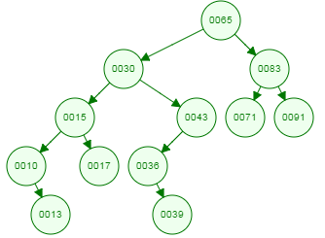
Deletion
Case 3: If Node has two child
Delete 30
Which node will become left child of 65
13? Order will be disturbed
15? Better choice is 17
No order disturbance, leaf node
43? Order will be disturbed
36? yes
Have you observed the pattern for choosing node?
Chosen node has single child – simple case
Or it is leaf node – simple case
If we choose node from left sub-tree
It will not have a right child and it is largest in left-sub tree
If we choose from right sub-tree
It will not have left-child and it is smallest in right sub-tree
See the next slide

Slide 17
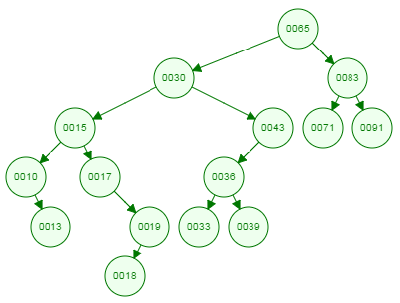
Deletion
Case 3: If Node has two child
See the tree with few changes
Now is it good to choose 17?
Order will be disturbed?
So now choose 19
Same is the case with 36
Now 33 is choice
Actually if you do the in-order traversal of tree
10, 13, 15, 17, 18, 19 , 30 , 33 , 36, 39, 43, 65, 71, 83, 91
Then your chosen node is either predecessor or successor of deleted node
In-order Successor of a node is a node which comes after the node in in-order traversal.
In-order predecessor of a node is a node which comes before the node in in-order traversal.

Slide 18
Deletion
Case 3: If Node has two child
Either
Find in-order successor of node
Replace contents of node with successor node
Delete successor
OR
Find in-order predecessor of node
Replace contents of node with predecessor node
Delete predecessor
Next slides discuss the first approach.

Slide 19
Deletion
Case 3: If Node has two child
50
50
50
25
70
38
70
38
70
10
38
90
10
38
90
10
90
5
13
77
99
5
13
77
99
5
13
77
99
85
85
85
Grey node is shown here to present null node, just for understanding

Slide 20
Deletion
Case 3: If Node has two child
30
36
36
39

Slide 21
Deletion
Find in-order successor of node?
INORDER_SUCCESSOR(node)
Set curr= node.right
While(curr.left!=null)
curr=curr.left
End While
Return curr
For 25 it will return 38
50 25 10 5 13 38 70 90 77 85 99
50
25
70
10
38
90
5
13
77
99
85

Slide 22
BST_DELETE(node, key)
Input: root node of tree, key to be deleted
Output: updated tree without node that contains key
Steps:
If(node!=null)
If key ==node.key
If hasLeft(node) and hasRight(node) //case 3
successor= INORDER_SUCCESSOR(node)
copy(node,successor)
node.right= BST_DELETE(node.right, successor.key )
Else //case1, case 2, you can break it in 2 if’s
node=getChildNode(node);
End If
Else If key < node.key
node.left =BST_DELETE(node.left,key)
Else // key > node.key
node.right =BST_DELETE(node.right,key)
End If
return node // updated node
End If
return node // null
getChildNode(node)
If hasLeft(node)
return node.left
Else If hasRight(node)
return node.right
Else
Return NULL// leaf node case
End if
copy(node,successor)
node.key=successor.key
Copy other data attributes if present but not child links

Slide 23
Deletion
Case 3: If Node has two child
30
36
36
39

Slide 24
Explanation
node.right= BST_DELETE(node.right, successor.key )
Why not pass successor along with successor.key?
Reason: when function is called with successor as root, it store child of successor to right of current node, which in this case is null, and sub-tree starting at 70 is removed
50
65
So rather than jumping to successor node, start from most immediate right node, and systematically delete successor node
25
70
25
10
38
65
90
10
38
5
13
77
99
5
13
85

Slide 25
Deletion
Case 3: If Node has two child
Even though it does not affect BST property if you choose successor or predecessor, but it is good to choose randomly between them to maintain tree balance
Otherwise.
Tree will become skewed. One side will become extremely short than other

Slide 26
BST Time Complexity
Depends upon height
Big-Oh➔h
h=log n h=almost log n h=n
Best
Average
Worst

Slide 27
Tree Building with Traversal Orders
Can we build a binary search tree if we are given only one traversal order?
Pre-Order: 50, 25, 10, 5, 13, 38, 70, 90, 77, 85, 99
Post-Order: 5, 13, 10, 38, 25, 85, 77, 99, 90, 70, 50
In-Order: 5, 10, 13, 25, 38, 50, 70, 77, 85, 90, 99
50
25
70
10
38
90
5
13
77
99
85

Slide 28
Tree Building with Traversal Orders
Pre-Order: 50, 25, 10, 5, 13, 38, 70, 90, 77, 85, 99
Root node?
First node
Left nodes?
Nodes between root and next maximum
Right nodes?
Nodes starting from that maximum
Repeat
For Post-Order, do the opposite.
What about In-Order?
Which node is root node?
50
{5, 10, 13, 25, 38}
{70, 77, 85, 90, 99}

Slide 29
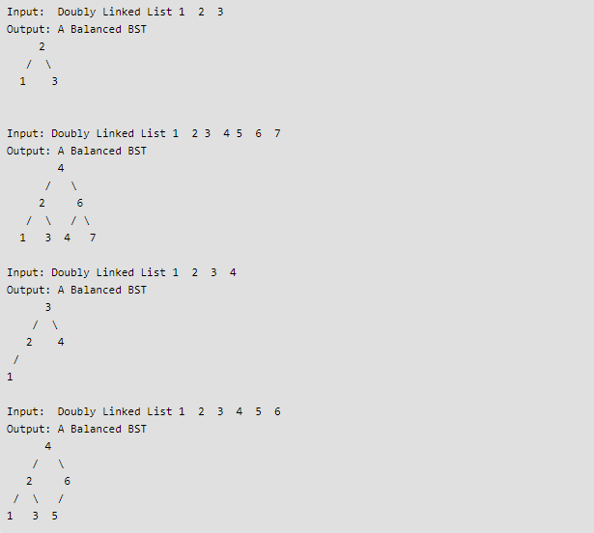
How to check if a given Binary Tree is BST or not?
In-place conversion of Sorted DLL to Balanced BST

Slide 30
What is a Trie

