Slide 1
Height Balanced BSTs
CSC-114 Data Structure and Algorithms

Slide 2
Outline
Search Trees
Self Balancing Binary Search Trees
AVL
Insertion
Deletion

Slide 3
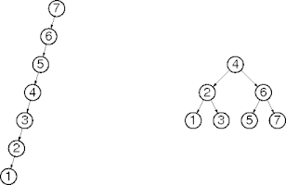
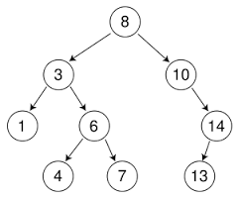
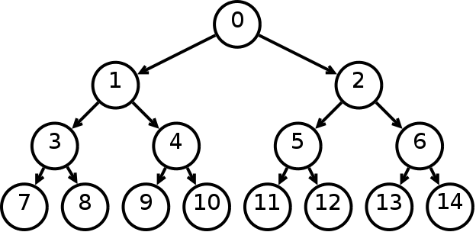
Tree Balancing
Time complexity of tree algorithms depends upon their height.
Where height can vary from O(log n) to O(N)
Total nodes N=2^{H+1}-1
What is the average case height of a binary tree?
What is the worst case height of a binary tree?

Slide 4
Tree Balancing
If a tree is not well balanced and is skewed, it can lead to a worst case time complexity of O(N) because height H is equal to N-1.
In a BST, when we delete a node and bring a node only from one side, let say from left sub-tree (predecessor) or right sub-tree (Successor) then tree will become skewed ultimately.
If we delete root 3-4 times and always bring next node from right
What will be final tree?
If we are given an almost sorted list of numbers then resultant tree will also be a skewed tree again.
What will be BST of 1 2 3 4 5 6 7?

Slide 5
Balanced Tree
To handle such situation, we need to ensure the tree to be height balanced.
A perfectly height balanced tree is where height of left sub-tree is equal to height of right sub-tree
But this case is not very common.
But, we can achieve an almost perfectly balanced tree
We will define a height balanced tree as: a tree in which height of left sub-tree and right sub-tree differs by almost 1
Note: This lecture assume Height= max Depth/level +1
It will make more sense here
So, single node Height=1, empty tree Height =0

Slide 6
Balanced Tree
Which trees are not balanced?

Slide 7
Self Balancing or Height Balanced BSTs
Binary search trees that keep their height as small as possible.
This is achieved by doing rotations at time of insertion and deletion
AVL Trees
Red Black Trees
Splay Trees
Multiway search Trees like B- Trees, 2-3 Trees
And many others

Slide 8

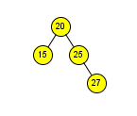
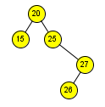
AVL(Adelson-Velsky and Landis) Tree
A self balancing binary search tree in which height of left sub-tree and right sub-tree of each node differs by at most 1. So, balance factor of any node can be -1, 0 or 1
Balance Factor of node: height(left sub-tree of node) – height( right sub-tree of node)
After insertion or deletion, if balance factor of some becomes more than 1 or less than -1, then a rotation is performed to get desired balance.
Rotation will re-arrange these nodes in a way, that both properties of AVL will be retained
Re-arranged tree will be a height balanced tree
It will be a BST
Which tree is AVL?
0
-1
-2
-1
-2
1

Slide 9
AVL Tree
Insertion
When we insert a node into a tree, height of few nodes can be affected.
What is the relationship between the imbalanced node and newly inserted node?
If we are inserting a node in left side of tree then is it possible that height of nodes in right sub tree can be affected? → NO
Means a newly inserted node can only affects its ancestor nodes at max
-1
-2
-1
-2
1

Slide 10
AVL-Insertion
Insertion
Insert the node according to BST rule, let’s call it w
Check balance factor of each ancestor of this node until an imbalanced ancestor is found
Let’s call it z
Let y be the root of taller sub-tree of z (y must be an ancestor of w)
Let x be the root of taller sub-tree of y (x must be ancestor of w or it can be w itself)
Now perform rotation on this node combination to restore balance of z.
There are four rotation scenarios depending upon position of y and x
All four cases requires Single or Double rotations

Slide 11
Insertion
Left-Left case
After inserting 1
We will go up to see if some ancestor has become imbalanced,
3 is balanced, so go 1 step above to 8
Tree has become imbalanced at 8 that would be labeled as z
3 would be y and 1(w) would be x
Rotation
Make z right child of y
z
8
2
y
3
1
x=w
1
y
3
0
x
1
8
z

Slide 12
Insertion
z
Left-Left case
After inserting 5
Rotation?
Make z right child y
If y has already a right child,
Make this right child the left child of z
19
2
y
27
13
1
x
8
1
18
y
13
0
w
5
Point to Remember: after rotation, height of tree will be same as it was before getting imbalanced
Z(imbalanced parent) would always be a grand parent, it can never be an immediate parent
x
8
1
z
19
1
5
18
27

Slide 13
Insertion
Right-Right case (Mirror of Left-Left case)
After inserting 6
Rotation?
Make z left child of y
If y has already a left child,
Make it right child of z
z
10
-2
5
y
18
-1
12
x
25
-1
y
18
0
63
w
z
10
0
x
25
-1
5
2
63

Slide 14
Insertion
Left-Right case
After inserting 13
A single rotation is not enough
If we simply do rotation on z
Tree will not be balanced
z
18
2
y
10
-1
x
13
10
2
18
-1
13

Slide 15
Insertion
Left-Right case
Rotations
Make it a left-left case by swapping values of y and x, and then x be the left child of y
Apply solution of left-left case
1st rotation 2nd rotation
z
8
2
z
8
2
3
0
y
1
-1
y
3
1
1
8
x
3
x
1

Slide 16
Insertion
Right-Left Case
Make it right-right case
Then apply solution of right-right case
1st rotation 2nd rotation
z
15
-2
y
19
1
15
-2
x
17
17
0
17
-1
15
19
19

Slide 17
Insertion
So what is the time complexity of AVL Insertion?
It performs two functions actually
BST Insertion is →O(logn)
Rebalancing
It involves two steps
Finding imbalanced ancestor → may take O(logn)
Rotation of nodes → constant time since maximum two rotations are required

Slide 18
Deletion
If we delete 15
Balance factor of 20 will be affected
After rebalancing 20
Balance of 30 will be affected
And may be after rebalancing of 30
50 can also become imbalanced
In worst case, we may need to balance all ancestors of deleted node
It will lead to O(logn) rotations
50
0
-1
30
75
-1
Assume a balanced sub-tree is present here whose height is 5
z
20
-1
36
-1
w
15
23
-1
33
-1
40
-1
y
x
27
35
38
43
-1
47

Slide 19
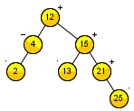
Deletion
Deletion is more complex than insertion, as it may require more than 2 rotations. In worst case it may lead to rotations at each level which would be equivalent to O(logn).
We know deleted node can be of three different types:
Node is leaf
Very simple
Node has single child
In case of AVL tree, that child will must be a leaf node, because its grand parent will be balanced actually.
Node has two child
As usual bring successor/predecessor node at place of node
That successor/predecessor node will again will have only one child and that child will be a leaf node
Base cases

Slide 20
Deletion
So, in case of AVL, we can reduce every case to leaf case. How? Let the deleted node is pointed to by w.
W is leaf
Delete it
W has single child
Because that child is simply a leaf node, copy it to W
Now W will point to child node
W has two child
Find successor, copy it to W
W will point to successor node
Successor has one child that is leaf, that becomes case 2.
So, in all three cases, it’s a leaf node that is actually deleted

Slide 21
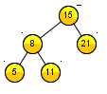

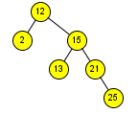
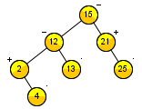
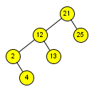
Deletion
21
Leaf
4
One child
15
Two child
w
w
2
25
w

Slide 22
Deletion
Let say w is the node contains key to be deleted
Delete the w according to 3 cases
Find the x, y and z nodes (same as in insertion)
Start from parent of actual deleted node w, go up in the path to root un-till the first node is found that is imbalanced
Let’s call it z.
Let y be the root of taller sub-tree of z (y must not be an ancestor of w)
Let x be the root of taller sub-tree of y, if both sub-trees are of same height, then x will be the root of sub-tree that is on same side as y (if y is left, x would also be left and vice versa).
Perform rotation according to possible 4 cases.
After rebalancing z, move upward repeating same process until root.

Slide 23

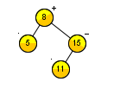
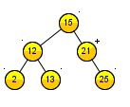
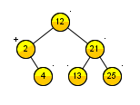
Deletion
21
Leaf
4
One child
15
Two child
z
y
w
x
z
y
2
x
w
z
y
25
x
w

Slide 24
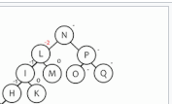

Slide 25
Helpful Links
http://en.wikipedia.org/wiki/AVL_tree
http://www.mathcs.emory.edu/~cheung/Courses/323/Syllabus/Trees/AVL-insert.html
http://www.mathcs.emory.edu/~cheung/Courses/323/Syllabus/Trees/AVL-delete.html
http://www.mathcs.emory.edu/~cheung/Courses/323/Syllabus/Trees/AVL-height.html

