Slide 1
Tree
CSC-114 Data Structure and Algorithms

Slide 2
Outline
Non-Linear Data Structures
Tree
Tree Terminologies
Memory Representation
Tree as ADT
Binary Tree
Traversal Strategies
BFS
DFS
Pre order
Post order
In order

Slide 3
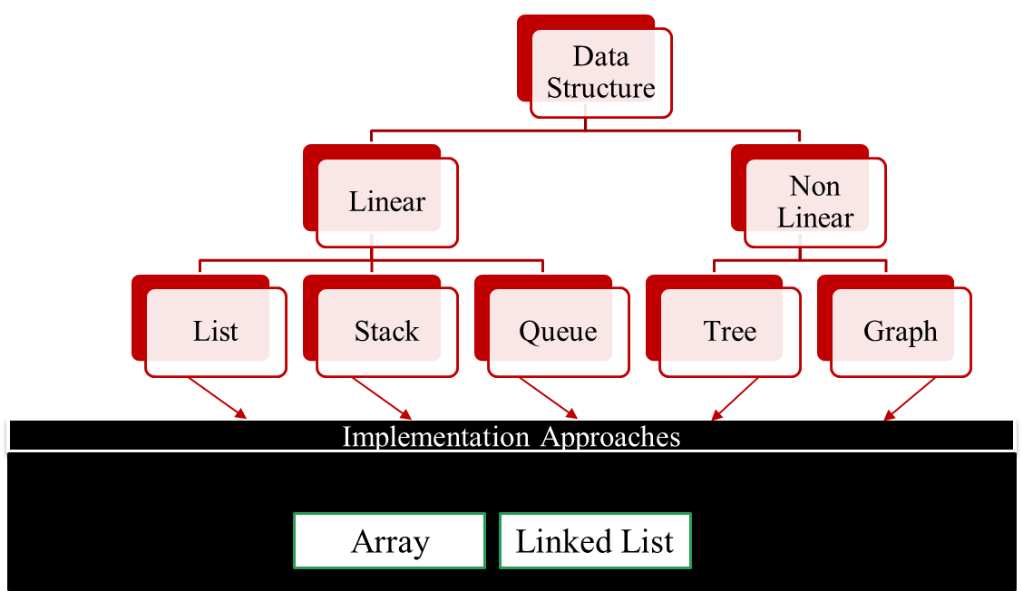
Non-Linear Data Structure
Linear vs non-linear classification of data structures is dependent upon how individual elements are connected to each other.
All linear data structures have one thing in common that they are sequential
Lists, Stack, Queue
In Non-Linear data structures, data elements are not sequential, an element can refer to more than one elements
Tree, Graphs

Slide 4
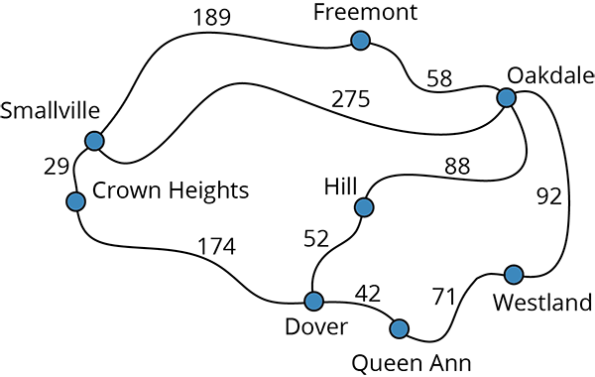
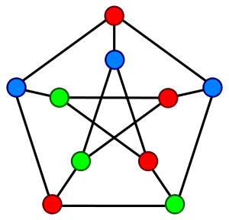
Graph
Graph is a non-linear mathematical structure that is defined as G= (v, e), where v is a set of vertices{v₁, v₂, …v_{n}} and e is a set of edges {e₁,e₂,e₃,…e_{m}}
Where edge e is a pair of two vertices, means a connection between two vertices

Slide 5
Tree
Tree is a connected graph which does not contain cycle. Every vertex has only one parent.
Cycle means a path which starts and ends at same node
In field of computer science, a specific form of trees is more common, which is called rooted trees.
These rooted trees are directed graphs with left-to-right order
Some nodes are below, some are above
You can reach any node from root node
c
b
a
c
d
a
b
h
d
e
h
e
a
b
c
d
e
f
g
h

Slide 6
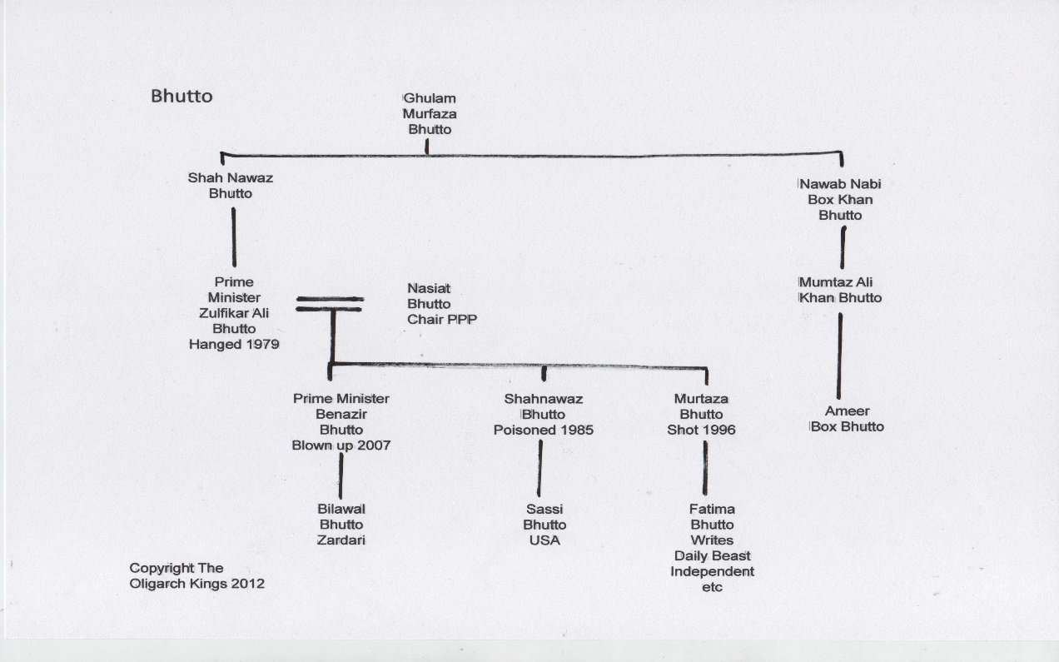
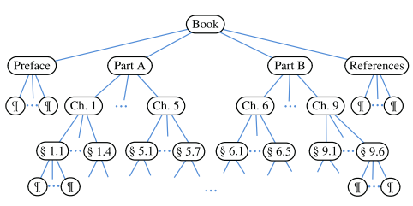
Tree
So, Tree is defined as data structure which presents hierarchical relationship between data elements. Hierarchical means some elements are below and some are above from others. Like family tree, folder structure, table of contents
C:/
Windows
Program Files
Users
Guest
Public
Java
Microsoft
Google

Slide 7
Tree: a Data Structure
Tree is a recursive data structure, it contains patterns that are themselves are trees.
A data structure is recursive if it is composed of smaller pieces of it’s own data type. Such as list and trees.
a is root of all nodes like b, d etc.
b, c, d are also root of their sub trees and so on.
So, a tree T can be defined recursively as:
Tree T is a collection of nodes such that:
T is empty/NULL (No node) OR
There is a special node called root,
which can have 0 or more children (T₁, T₂, T₃ …T_{n})
which are also sub-trees themselves.
T₁, T₂, T₃ …T_{n} are disjoint sub trees ( no shared node)
a
b
d
e
f
h
i
j
k
l

Slide 8
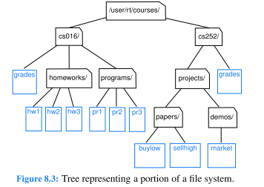
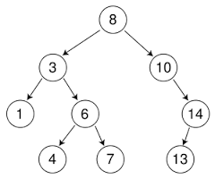
Tree Applications
Tree is an extremely useful data structure, it provides natural organization of data which exhibits hierarchy, due to their non-linear structure they provide efficient operations with compare to linear data structures. Few uses are as follows:
Disk File System
Used by operating system to stored folder hierarchy
Search trees
More efficient than sorted list

Slide 9
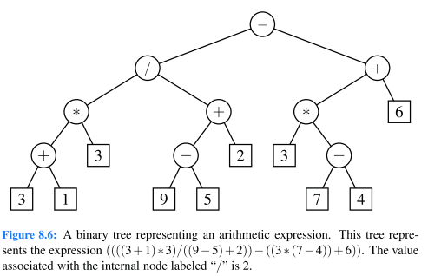
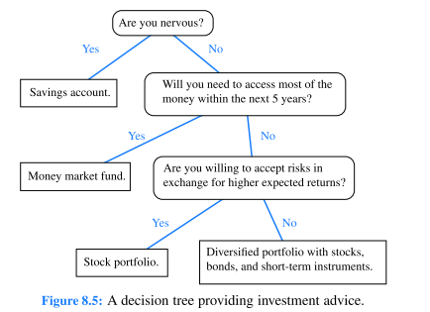
Tree Applications
Parse Trees
Used by compilers to produce machine code
Decision Trees
Used in artificial intelligence to build knowledge base

Slide 10
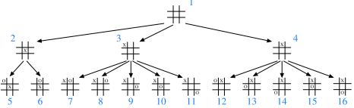
Tree Applications
Games
are used in logic games
Data Compression
Huffman coding trees
Priority Queue
Heap Tree
And many more other applications.

Slide 11
Tree Terminologies
Node/Vertex
One data unit of tree
Edge
Arc/link from one node to other
Root node
The top node of tree. A node with no parent
Leaf/External node
Node with no child
Internal Node:
Node with child
Ancestors of Node
Parent, all grand parents and all great grand parents of node.
a, b and e are ancestors of i.
Root
a
Internal
b
c
d
e
f
g
h
Edge
i
j
k
l
Leaf

Slide 12
Tree Terminologies
Descendants of Node
Child , all grand children and great grand children of node.
i, j, e and f are descendants of b.
Sub Tree
A node within tree with descendants
Degree of Node:
Number of its children
a’s degree is 3
b, h and e’s degree is 2
c’s degree is 1
Degree of Tree
Maximum degree of any node
Since a has degree 3 that is maximum so degree of tree is 3
a
b
c
d
e
f
g
h
i
j
k
l
Sub-tree

Slide 13
Tree Terminologies
Depth/Level of Node
Number of ancestors or length of path from node to root
j has depth 3
c has depth 1
Length of Path means # of edges on the path from one node to other
Siblings
Nodes with same parent and at same level
i and j
b and c and d
Height of Tree
Maximum depth of any node→3
Longest path from root to any leaf node → 3
a
Level 0
b
c
d
Level 1
e
f
g
h
Level 2
Level 3
i
j
k
l

Slide 14
Tree as ADT
A tree T provides following basic operations:
Tree Methods:
size(root): returns total number of nodes
isEmpty(root): if tree is empty or not
root(): returns root node of tree
Node Methods:
parent(node): returns parent of node
children(node): returns list of all child’s of node
isInternal(node): if node is non-leaf
isExternal(node):if node is leaf
isRoot(node): if node is root

Slide 15
Binary Tree
Binary Tree is a special tree where each node can have maximum two children. In other words maximum degree of any node is 2.
Each node has a left child and a right child. Even if a node has only one child, other child is still mentioned with NULL.
a
a
General Tree
Binary Tree
b
d
b
d
h
e
f
h
g
i
g
j

Slide 16
Binary Tree
Recursive Definition:
T is a binary tree if
T is empty (NULL) OR
T’s root node has maximum two children's, where each child is itself a binary tree.
Left child is called left subtree and right child is called right subtree
Binary Tree
Binary Tree
General Tree

Slide 17
Full Binary Tree
Degree of each node is either 0 or 2.
Full Tree is also referred as Proper Tree
A tree that is not Full/Proper , is called improper or not-full
Full
Full
Not-Full

Slide 18
Perfect
A Full/Proper binary tree in which each leaf node has same depth/level.
Perfect & Full
Not-Perfect But Full
Not Perfect Nor Full

Slide 19
Complete Binary Tree
A tree that is completely filled at all levels, except the last level which is filled from left to right
Complete But Not Full
Not-Complete
Not-Complete But Full

Slide 20
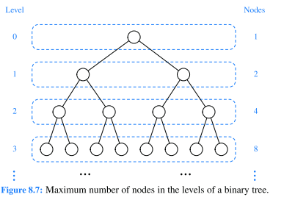
Binary Tree
Maximum nodes at level i of binary tree?
2^{i}
Maximum nodes in a binary tree?
2^{H+1}-1
If n is total nodes in a binary tree
H ≈ log(n)
Number of leaves in a perfect tree?
2^{H}

Slide 21
Binary Tree ADT
In addition to previous function Binary Tree provides additional functions:
left(node): returns left child of node
right(node): returns right child of node
hasLeft(node): tells if a node has left child or not
hasRight(node): tells if a node has right child or not
sibling(node): returns sibling of given node
First find parent, then see it node itself is left or right child

Slide 22
Binary Tree Implementation
Linked representation
Each node has two links left and right
If root node is null, means tree is empty
If node’s left, right links are NULL, it means its leaf node
Optionally, a parent field with a reference to the parent node
class Node{
data;
Node left;
Node right;
}
left
data
right
left
data
right
left
data
right
left
data
right
left
data
right
left
data
right
left
data
right
left
data
right

Slide 23
Binary Tree Implementation
Array representation
A fixed size tree can be represented using 1-D array.
If we know the height of tree, we can define size of array to hold maximum possible number of nodes → 2^{h+1}-1
Root of tree → array[0]
Left child of root →array[1]
Right child of root →array[2]
-----
-----
Left child of node at index k →array[2k+1]
Right child of node at index k→ array[2k+2]
a
0
1
b
g
2
3
c
f
4
5
h
6
0 | 1 | 2 | 3 | 4 | 5 | 6
a | b | g | c | f | NULL | h

Slide 24
Tree Traversal
A tree traversal means visiting each node of tree once.
Due to non-linear structure of tree there is not a single way to traverse node:
Breadth First Search
Depth First Search
Pre-order
In-order
Post-order
a
b
g
c
f
h
d
e

Slide 25
Breadth First Search (BFS)
Starting from root node, visit all of its children, all of its grand children and all of its great grand children
Order of nodes: a b g c f h d e
Nodes at same level must be visited first before nodes of next level
Also known as level order traversal
Implementation?
We should store nodes to keep track of them.
The sequence in which we store them effects the
the sequence in which we retrieve them back
Which data structure can be used to store nodes?
array, stack or queue
a
b
g
c
f
h
d
e

Slide 26
Breadth First Search (BFS)
a
a b c d e f g h i j a b d e f h i j k l
a
b
c
b
d
d
e
f
e
f
h
g
h
i
i
j
k
l
j

Slide 27
Breadth First Search (BFS)
a
Algorithm: Iterative_BFS(Tree root)
Input: root node of Tree.
Steps:
If root is not NULL
Set Q =new Queue ()
Set node = root
Q.enqueue(node)
While Q is not empty
node=Q.dequeue()
print(node)//print node’s data ….
If hasLeft(node)
Q.enqueue(node.left)
If hasRight(node)
Q.enqueue(node.right)
End While
End If
b
g
c
f
h
d
e
a
 |  |  |  | h | d | e
b | g
 |  |  |  |  | d | e
 | g | c | f
 |  |  |  |  |  | e
 |  | c | f | h
 |  |  | f | h | d | e

Slide 28
Recursive BFS
Recursive_BFS(node, queue)
Input: root node of Tree, an empty queue
Steps:
If node is not NULL
Print node
If hasLeft(node)
queue.enqueue(node.left)
If hasRight(node)
queue.enqueue(node.right)
If queue is not Empty
Recursive_BFS(queue.dequeue(), queue)
End if

Slide 29
Depth First Search (DFS)
Using the top-down view of the tree, starting from root, go to each sub tree as far as possible, then back track
Possible Orders:
Left sub tree and then right sub tree
a b c d e f g h
right sub tree and then left sub tree
a g h b f c e d
Implementation:
Can we use a stack instead of queue
a
b
g
c
f
h
d
e

Slide 30
Depth First Search (DFS)
a
a b d e g h j c f i a b e i j f d h k l
a
b
c
b
d
d
e
f
e
f
h
g
h
i
i
j
k
l
j

Slide 31
Depth First Search (DFS)
a
Algorithm: Iterative_DFS(root)
Input: root node of Tree.
Steps:
If root is not NULL
Set S=new Stack()
Set node = root
S.push(node)
While( S is not empty)
node=S.pop()
Print node
If hasRight(node)
S.push(node.right)
If hasLeft(node)
S.push(node.left)
End While
End If
b
g
c
f
h
d
e
a
b
g
c
f
g
d
e
f
g
e
f
g
f
g
g
h

Slide 32
Depth First Variations
Depth First Search can also be implemented with recursive approach. And depending upon the order in which we go in depth can bring different variations in order of node traversal. Which are:
Pre-order (simple DFS)
Visit node
Visit left child of node
Visit right child of node
Post-order
Visit left child of node
Visit right child of node
Visit node
In-order
Visit left child of node
Visit node
Visit right child of node
a
b
g
a
b
g
a
b
g

Slide 33
Pre-order vs. Post-order vs. In-order
Pre-order (node-left-right)
a b c d e f g h
Post-order (left-right-node)
d e c f b h g a
In-order (left-node-right)
d c e b f a g h
a
b
g
c
f
h
d
e

Slide 34
Pre-order vs. Post-order vs. In-order
a
a
b
c
b
d
d
e
f
e
f
h
g
h
i
i
j
k
l
j
Pre-order: a b d e g h j c f i
Post-order: d g j h e b i f c a
In-order: d b g e j h a c i f
Pre-order: a b e i j f d h k l
Post-order: i j e f b k l h d a
In-order: i e j b f a k h l d

Slide 35
Tree Traversal-Recursive Algorithms
Recursive_Preorder(Tree node)
If node is not NULL
Print node
Recursive_Preorder(node.left)
Recursive_Preorder(node.right)
End If
Recursive_Postorder(Tree node)
If node is not NULL
Recursive_Postorder(node.left)
Recursive_Postorder(node.right)
Print node
End If
Recursive_Inorder(Tree node)
If node is not NULL
Recursive_Inorder(node.left)
Print node
Recursive_Inorder(node.right)
End If
This is traditional DFS

Slide 36
Tree Building with Traversal Orders
Can we build a binary tree if we are given a traversal order?
Pre-order: 5, 15, 10, 8, 7, 9, 11, 19
Post-order: 10, 8, 15, 11, 19, 9, 7, 5
In-order: 10, 15, 8, 5, 7, 11, 9, 19
What is special about each traversal order?
How you will decide that which node is root node?
Which node is left?
Which node is right?
5
15
7
10
8
9
11
19

Slide 37
Tree Building with Traversal Orders
Can we build a general binary tree using one traversal order?
Will it be unique? Or different trees are possible
Pre-order: 5, 10
What if another order is also given?
In-order: 5, 10
Which tree is correct now?
5
5
10
10

Slide 38
Tree Building with Traversal Orders
We need 2 traversal orders to build a general binary tree. One of them must be In-order.
Pre-order: 5, 15, 10, 8, 7, 9, 11, 19
Post-order: 10, 8, 15, 11, 19, 9, 7, 5
In-order: 10, 15, 8, 5, 7, 11, 9, 19
Find root
First in Pre-order and last in Post-order
Left Nodes
nodes on left-side of root node in In-order
Right Nodes
nodes on left-side of root node in In-order
Repeat
5
15
7
10
8
9
11
19

Slide 39
Tree Building with Traversal Orders
Pre-order: 5, 15, 10, 8, 7, 9, 11, 19
Post-order: 10, 8, 15, 11, 19, 9, 7, 5
In-order: 10, 15, 8, 5, 7, 11, 9, 19
A few minutes video to learn how to construct a binary tree from inorder
https://youtu.be/2OYj9-NjBno
5
50
{10, 15, 8}
{7, 11, 9, 19}
15
7
{10}
{8}
{11, 9, 19}

Slide 40
HomeWork-2
For every algorithm, root node is given as input along with any other input (if mentioned).
To find and return parent of given node?
To find and return depth/level of given node?
To find and return depth of tree
To find if a tree is Full or not?
To find if two nodes are at same level of tree or not?
To find and return total number of nodes?
To check if two trees are equal or not?
To check if two trees are same or not?
Two trees are same if they have same shape, but values may vary
Book Problems:
8.20
8.33
8.45
Note: book uses word position instead of node.

