Slide 1


3D Mobile Application for Learning Human Brain.

Slide 2

Our Team
Team Members:
Mohammad Hasnain
Sajjad Ali
Mujeeb Ahmed
Supervised by:
Dr. Ahsanullah Abro

Slide 3
Agenda
Introduction & Background
Problem Statement
Proposed Solution
Objectives
Literature Review
Methodology
Proposed Solution and Expected Results
Scope of the Project
Gantt Chart
Work Division

Slide 4
Introduction & Background
The Brain is the most important and complicated organ in the human body.
It controls and coordinates all the actions and reactions that we make.

Slide 5
Introduction & Background
The human brain is studied by considering its four perspectives:
Taxonomy
Anatomy
Physiology
Morphology

Slide 6
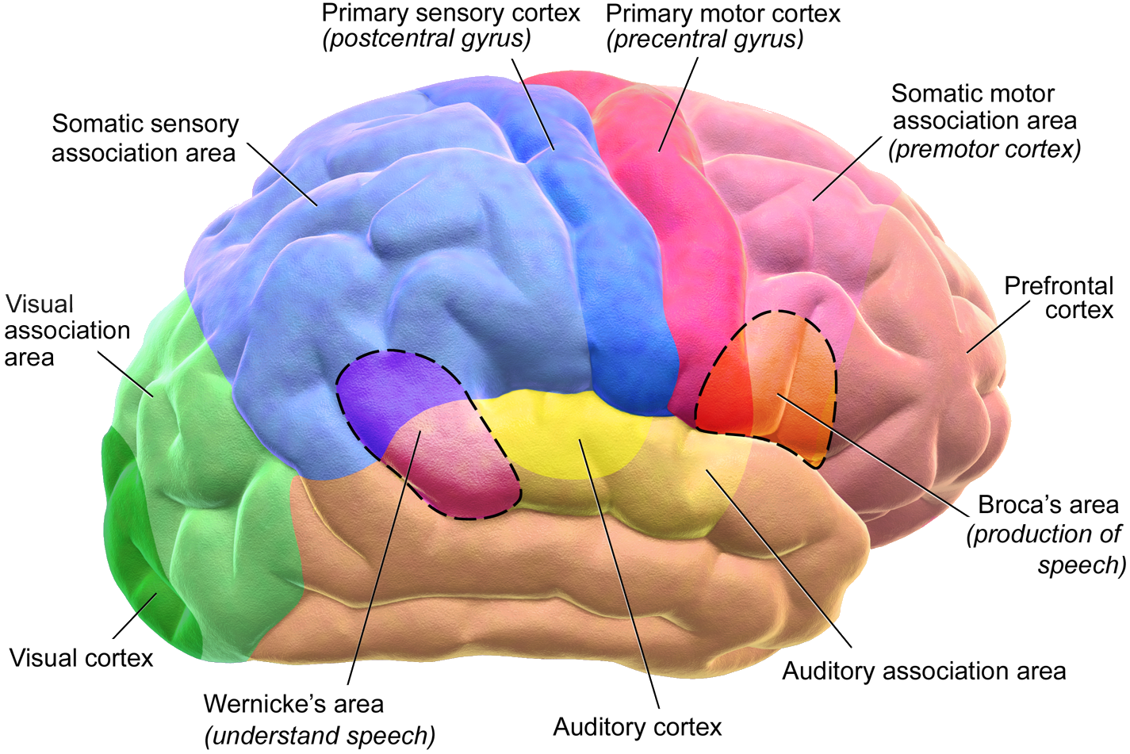
Introduction & Background
Taxonomy of Human Brain
Study of classification of different parts of the Brain with their specific and proper Function and working system.

Slide 7
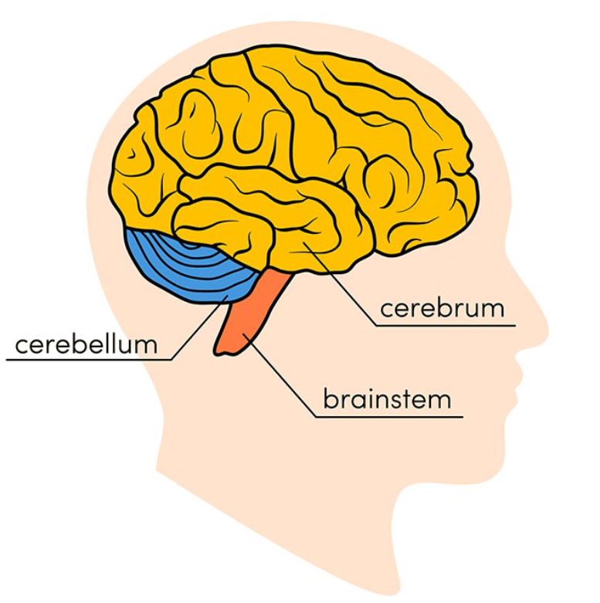
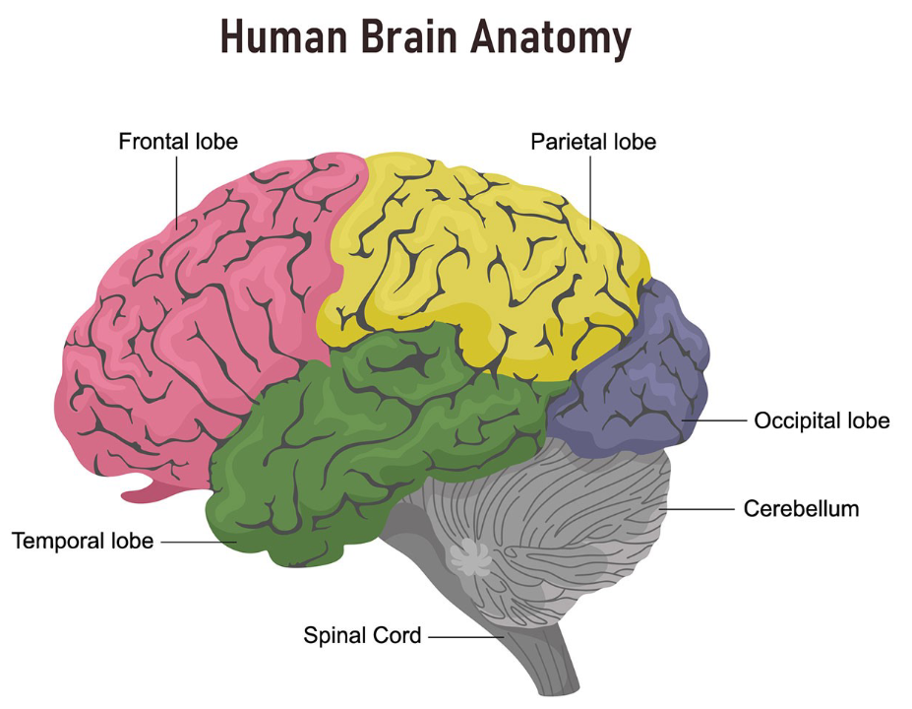
Introduction & Background
Anatomy of Human Brain
Study of structural parts of human brain

Slide 8
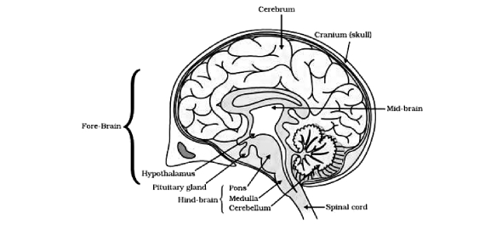
Introduction & Background
Physiology of Human Brain
Study of functions and activities of human brain

Slide 9
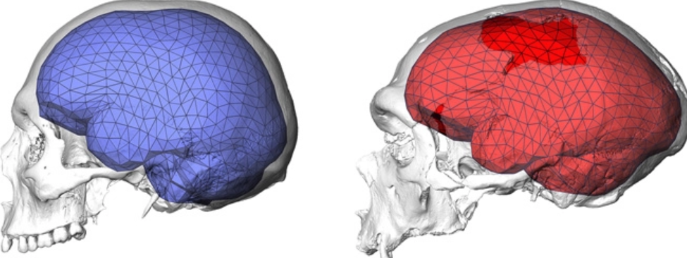
Introduction & Background
Morphology of Human Brain
study of the structural measures of the brain, e.g., volume and shape

Slide 10
Problem Statement
Students frequently run into difficulties when studying the human brain, especially college students or beginners.
A lack of 2D/3D desktop/mobile applications for understanding the human brain from the aforementioned perspectives

Slide 11
Proposed Solution
By considering the above-mentioned problem, we have chosen the project to develop a 3D mobile application for understanding the human brain. It will specifically focus on the morphology, anatomy, physiology, and taxonomy of the human brain. As a result, learners will find it easier to grasp the concepts of the human brain with our app.
The main objective of our project is to design and develop an application system that will have a human-centered interface.
System that boosts positive usability.

Slide 12
Objectives
In order to illustrate the morphology, taxonomy, anatomy, and physiology of the human brain, we plan to create a user-friendly 3D application.
Our project's major goal is to design and create an application system with a user-centered interface that will improve usability.

Slide 13
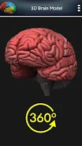
Literature Review
We have reviewed many real-world existing 3D applications for learning the human brain. They do have some amazing features, but also lack some features such as information design, content, etc. Some of them are given below:
3D Human Brain
It is an android/windows application that contains 3D models of the human brain which you can easily use for visualization. However, it does not describe any of the four perspectives taxonomy, anatomy, physiology, or morphology.

Slide 14
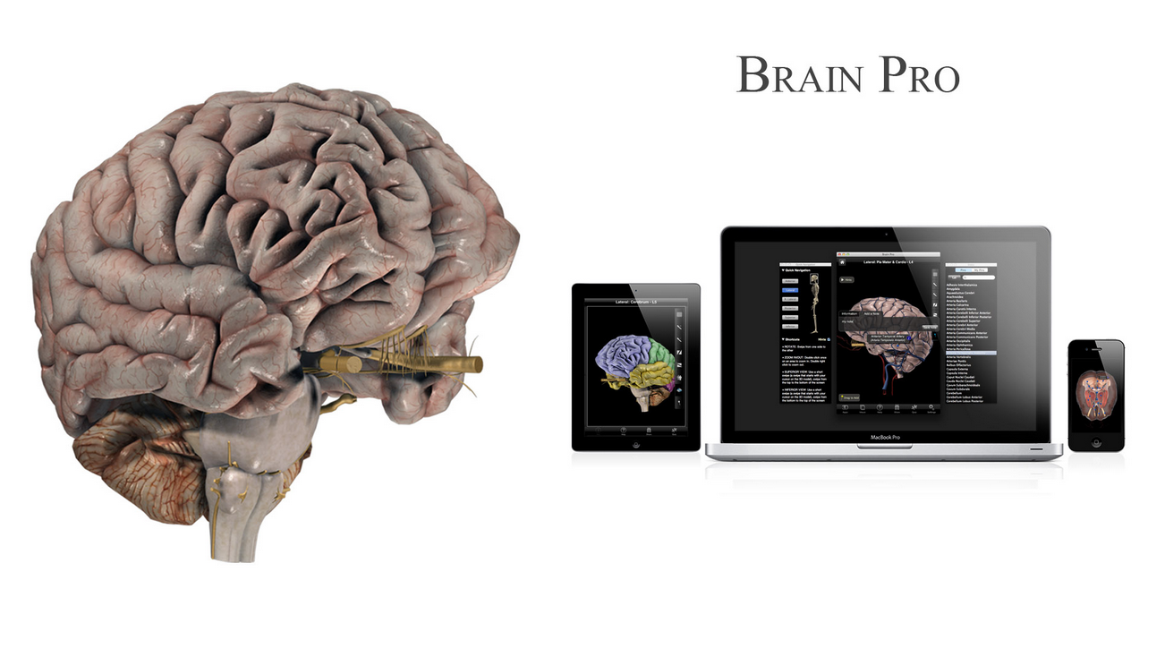
Literature Review
Brain Pro
It is a mac edition 3D app that has wonderful features for the anatomical perspectives of the brain. Following are some of its main features:
Allows sectioned views and custom label
360-degree rotation and slice
View, Edit and Add pins with notes
Layers, Map and Transparency
Some of its limitations are:
It does not describe other characteristics such as taxonomy, physiology, and morphology
It is only available for MAC.
It is not free

Slide 15
Scope of the Project
It will just focus on the basic introduction of the human brain with the aforementioned perspectives. It will not have the features of visualizing the working of neurons for example.

Slide 16
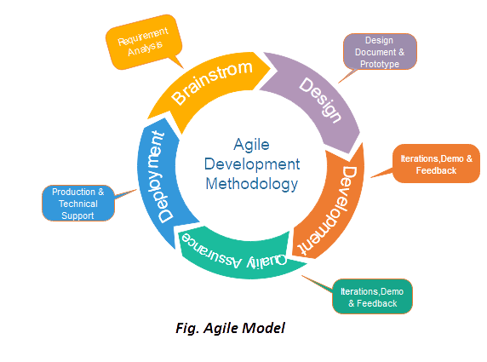
Methodology
We would choose the Agile methodology for design and development. Specifically, we would be following the Extreme Programming (XP) discipline of Agile.
It provides many benefits such as shorter development times, control over cost and schedule, accepting changes, and producing high-quality projects.
Agile Model

Slide 17
Methodology
Agile Model
The following are four values of agile methodology:
Requirements gathering
Design the requirements
Construction/ iteration
Testing/ Quality assurance
Deployment
Feedback

Slide 18
Proposed Solution and Expected Results
Students will understand the concepts of the brain efficiently with the use of this application, which has an effective UI/UX design.
Students can also master the taxonomy, morphology, physiology, and anatomy of the brain through improved memory design with recognition and recall.
Additionally, users can realistically move and rotate the virtual 3D human brain in the app while viewing from different angles and magnifications more designed with recognition and recall.

Slide 19
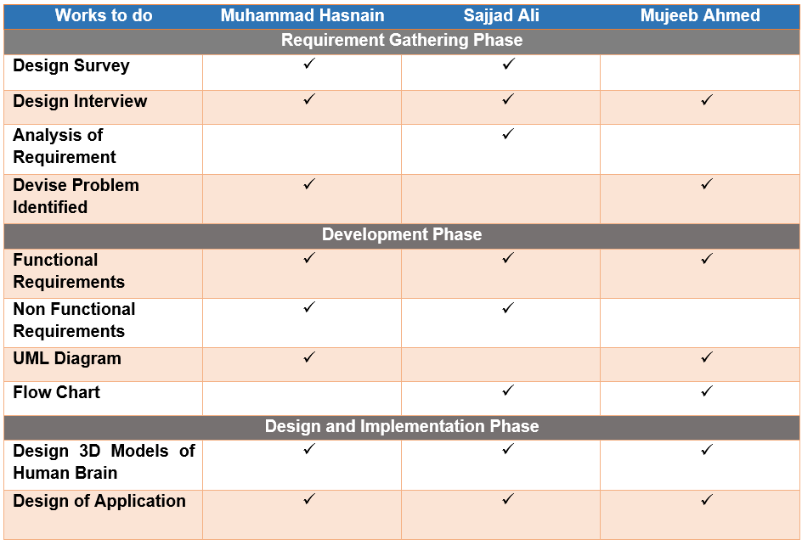
Work Division

Slide 20
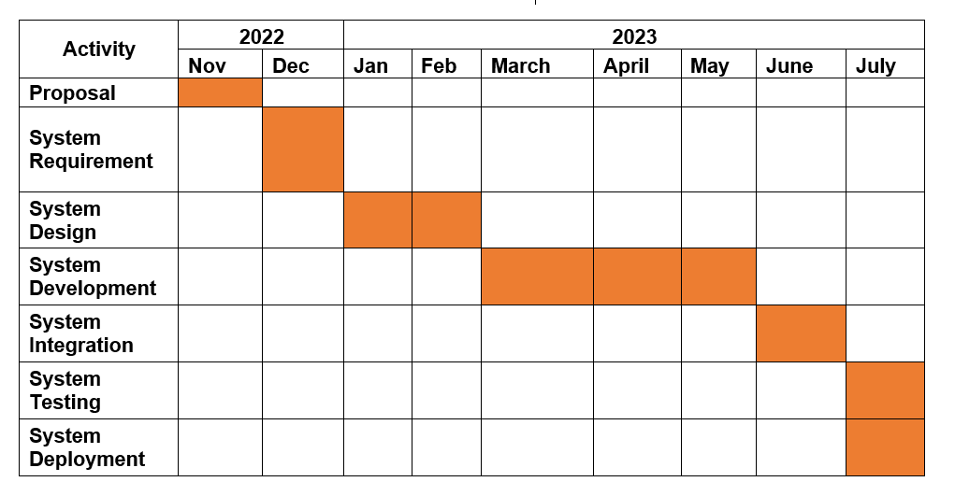
Gantt Chart

Slide 21
Thanks!

