Slide 1
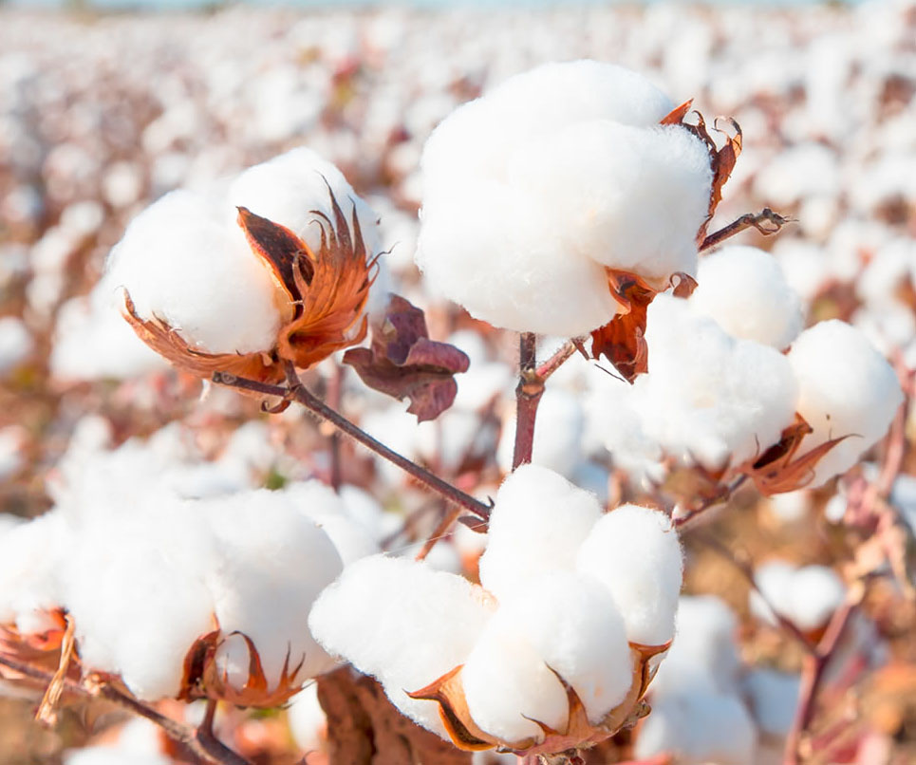
Cotton Quality Analysis & Classification System using Digital Images
Group Members:
Anand Kumar
Navesh Kumar
Supervisor:
Dr. Ghulam Murtaza Memon
Notes:
To change the image on this slide, select the picture and delete it. Then click the Pictures icon in the placeholder to insert your own image.

Slide 2
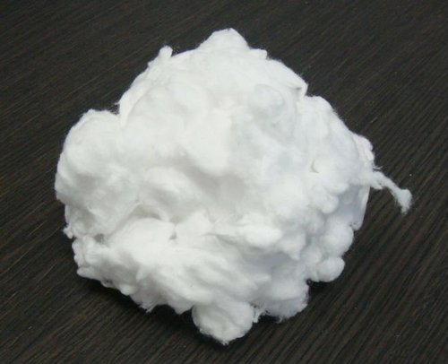
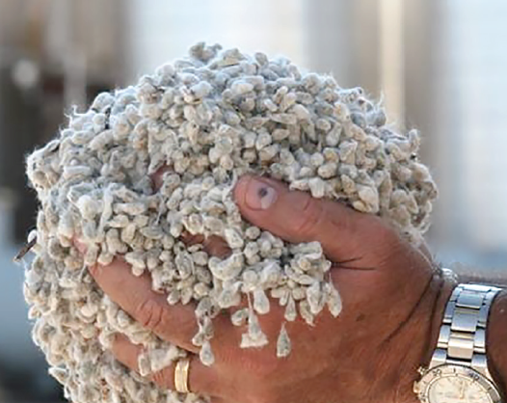
Introduction
Cotton Fiber
Cotton Lint
Cotton Seed

Slide 3
Quality Checking of Cotton in Ginning Factories
Three Main Factors:
Color quality
Moisture Measurement
Ratio of Cotton Lint and Seed

Slide 4
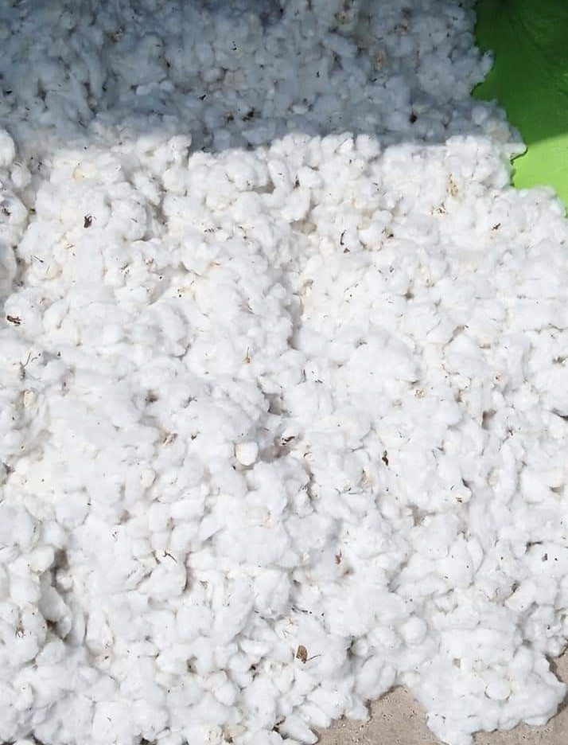
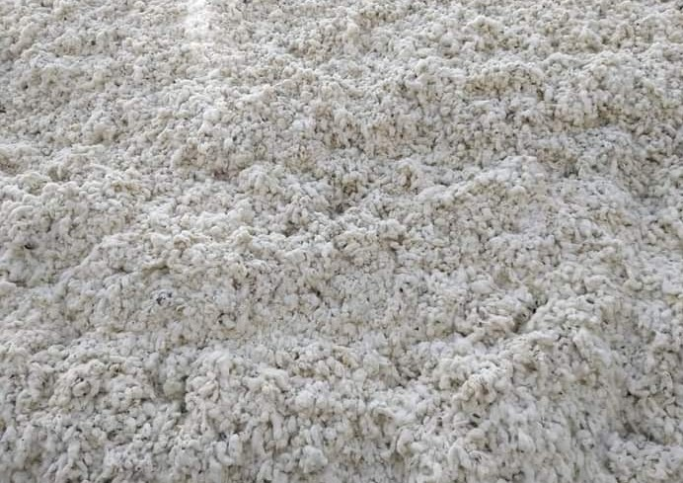
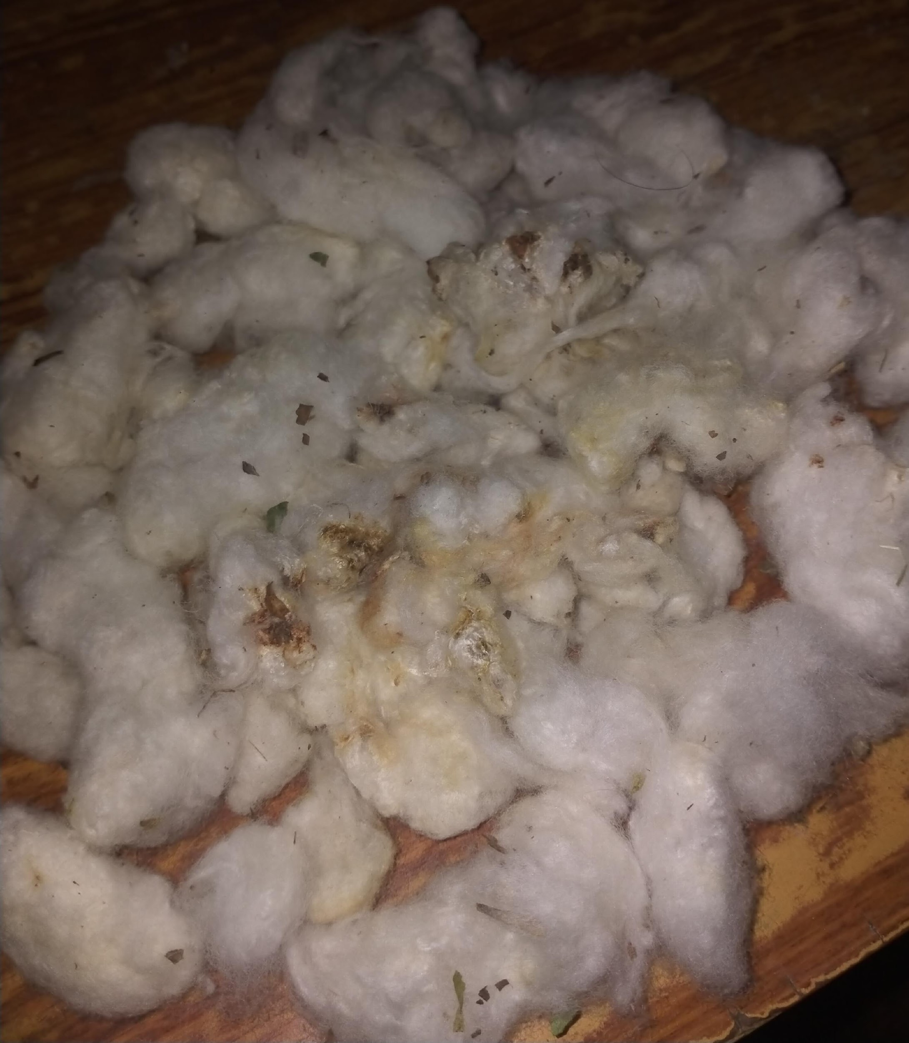
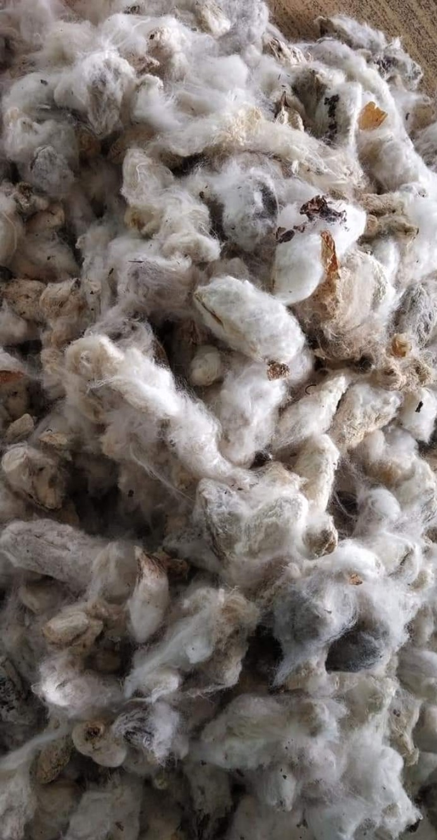
Color Quality
White and Dry
Average
Yellowish
Dodh and rainy

Slide 5
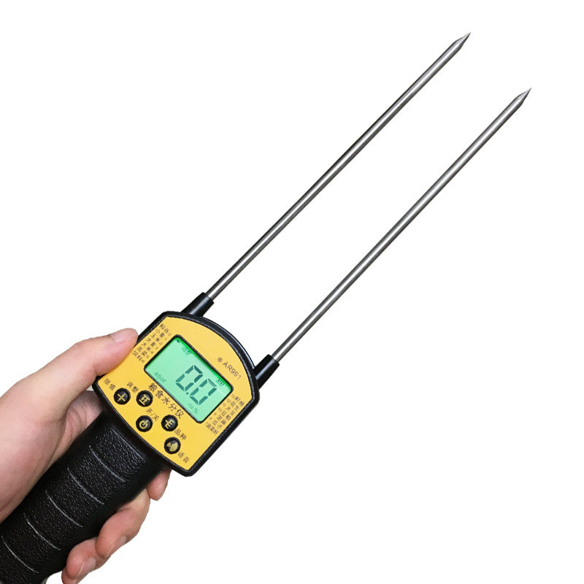
Moisture Measurement
Manual
A sample of cotton is weighted, then dried.
The dried cotton of that sample is again weighted.
Automatic
Expensive in repairment
Price around 90,000

Slide 6
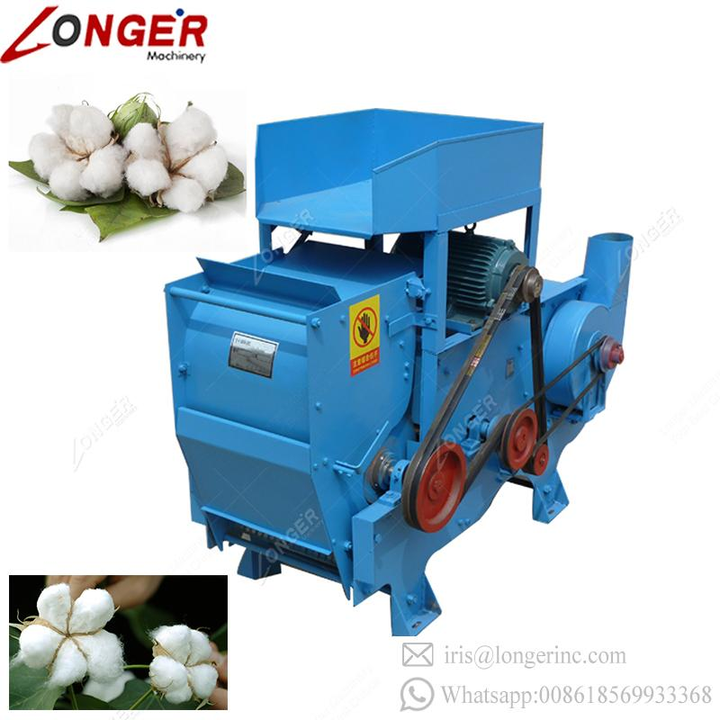
Ratio of Cotton Lint and Cotton Seed
A sample(1 kg) cotton lint and cotton seeds are separated by small ginning machine.
The weight of a separate entity is done to estimate the percentage of ratio.

Slide 7
Problem Statement
The manual quality checking process of cotton
Problems:
Time consuming in drying and ginning a sample
Expensive in terms of hiring quality checker and machine repairment.
Require experience for the classification and estimation.

Slide 8
Proposed Solution
Image processing for ratio of seeds in a cotton sample
Classification model for Cotton quality grading
Sensor development for moisture measurement in cotton (It can be future work)

Slide 9
Why This System?
Automate the quality checking process of cotton
Time efficient
Cost effective
Beneficial for new ginners.

Slide 10
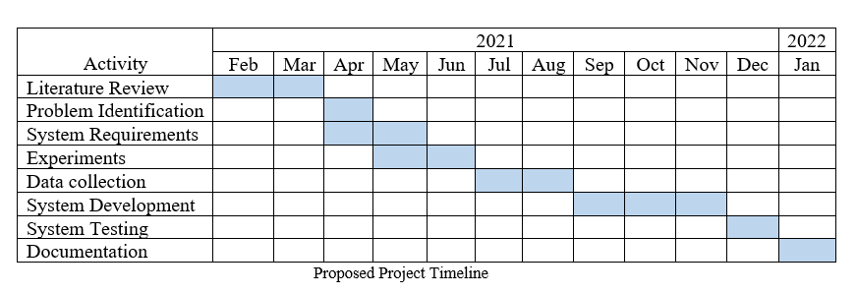
Proposed Timeline

Slide 11
Thank You

