Slide 1
Cotton Quality Classification System using Digital Images
Proposal Defense
Supervisor: Dr. Ghulam Murtaza Memon

Slide 2
Team Members
Anand Kumar
Navesh Kumar
Group Leader
Group Member

Slide 3
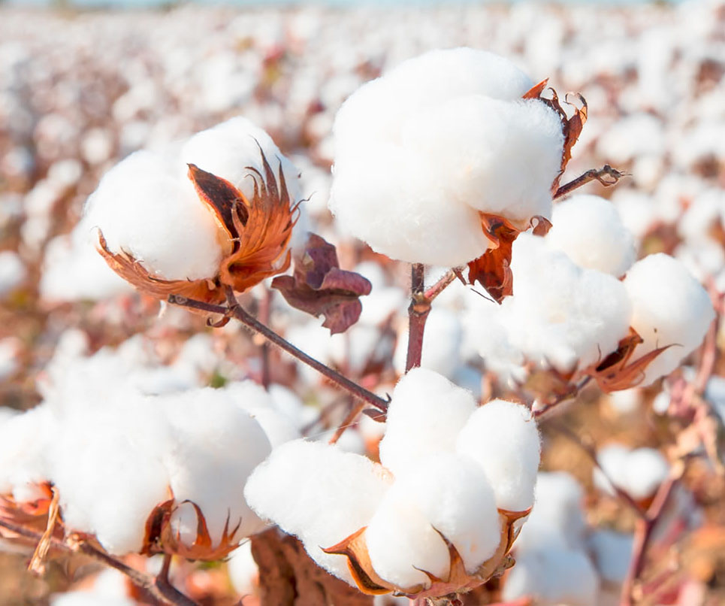
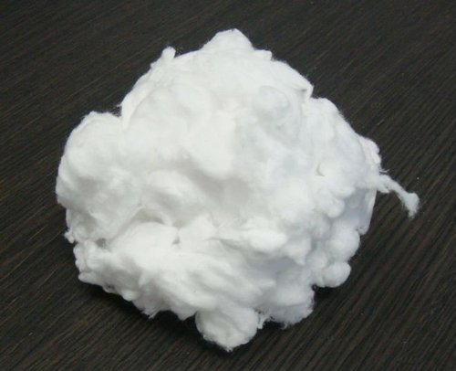
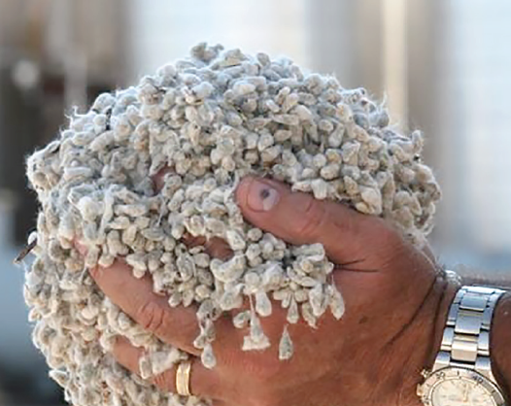
INTRODUCTION
Cotton Fiber
Cotton Lint
Cotton Seed

Slide 4
Factors of cotton quality in ginning factories
2. Moisture Measurement: The amount of moisture in cotton fiber
1. Color quality: pure white,
white, off white, yellowish.
3. Ratio of Cotton Lint and Seed
.

Slide 5
Manual quality checking process
Secondly, the amount of moisture is calculated by weighting the one kg cotton sample before and after drying in the air.
Initially, a visual examination of cotton sample is carried out by an expert for quality grading/classification.
Lastly, the ratio of cotton seed in the cotton lint is calculated by weighting one kg of cotton sample before and after separating the cotton seeds.

Slide 6
Problem statement
2. Time consuming in drying and ginning a sample
1. Expensive in terms of hiring quality checker and machine repairment
3. Require experience for the classification and estimation
.

Slide 7
Target customers
Factory ginners
Cotton traders
Cotton brokers
People who run cotton ginning factory
People who do the business of cotton
Middleman who do dealing of cotton.

Slide 8
Project goals
To investigate the existing quality checking process of cotton fiber
To collect the data set for cotton quality classification
To develop a system for the
classification of cotton quality
To evaluate the performance of the proposed system
To deploy the proposed system

Slide 9
Project technical approach and methodology
Following are the objectives of the proposed project:
1. Dataset development
2. Classification system model for cotton quality
3. Mobile application development

Slide 10
Dataset development
Data collection: We will collect approximately 2ooo images for five different classes of cotton quality. Total 10,000
images will be collected to develop the classification model.
Data labelling: Data will be labelled into five classes with the help of factory ginners experts that are
best (pure white and songriless),
better (white with some songri),
good (off white with more songri & trash),
bad (yellowish with trash & much more songri), and
worst (ungrown, lintless, closed flower, and rainy).
Data cleaning: Image cropping to remove the irrelevant background/boundaries of captured images, Image Resize, Remove Noise, Image Normalization, image augmentation.

Slide 11
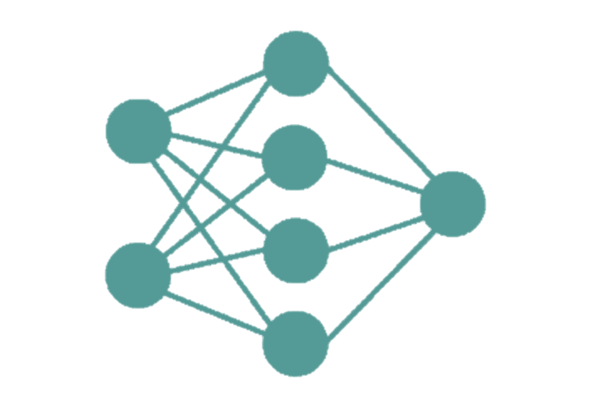
Cotton Classification model Development
For classification model, we will use CNN (Convolutional Neural Network) because of its high accuracy for image classification. The architecture of CNN is well suited to input 2D/3D images directly. Furthermore, the CNN will be used to train the model by following different approaches such as the holdout method, k cross-fold validation, and bootstrapping for training and testing the model.

Slide 12

Mobile application development
Android app In this process, an android application will be developed that will be used by end-users (factory ginner, brokers, and merchants) to run the system. The classification model discussed above will be integrated into this application

Slide 13
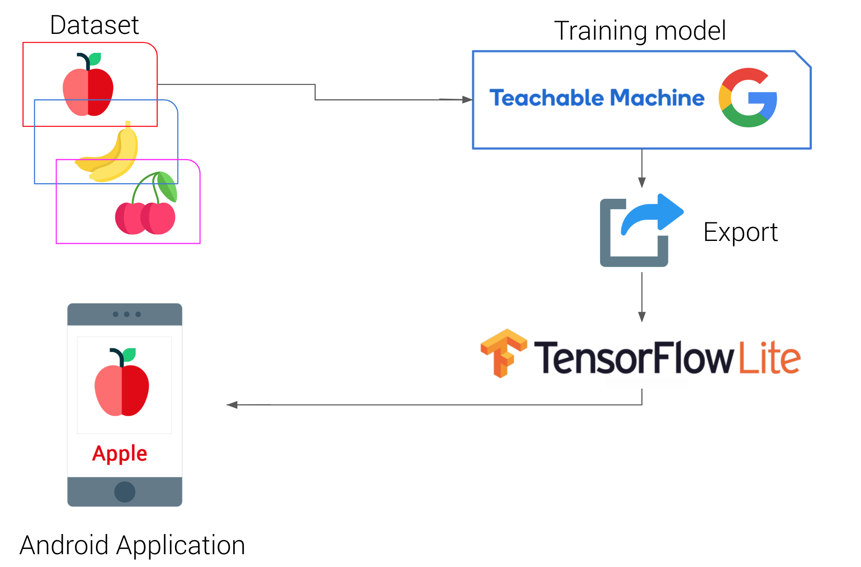
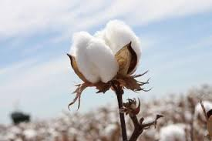
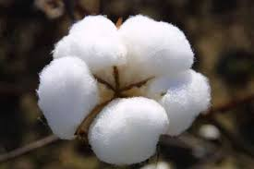
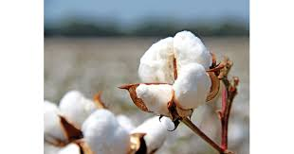
Development model
Dataset
Best

Slide 14






Hardware and software
Laptop/personal computer:
A quality camera : to capture images
Flutter: For mobile app development
Anaconda: Need GPU for model training
Open CV Python Library to develop CNN model
Keras Library: For evaluating models

Slide 15

Cost of data collection and Model development
The main cost of this project comprises of good quality camera and data collection by visit different ginning factories to capture the images of different cotton fiber samples. Furthermore, all the other parts such as dataset preprocessing, classification model creation, and mobile app development will be done by using a personal computer

Slide 16
Work division
Name | Work Division
 | SRS | SDS | Data Collection | Dataset Development | Classification Model | Application Development | System Evaluation | System Testing | Thesis
Anand | ✔ | ✔ |  | ✔ |  | ✔ | ✔ |  | ✔
Navesh | ✔ | ✔ | ✔ |  | ✔ | ✔ | ✔ |  | ✔
Factory Ginners |  |  |  | ✔ |  |  | ✔ | ✔

Slide 17
Project milestones and deliverables
Activity | 2021 |  |  |  |  |  | 2022
 | Jul | Aug | Sep | Oct | Nov | Dec | Jan | Feb
Data Collection | ✔ | ✔ | ✔ | ✔ | ✔
Dataset Development |  |  |  | ✔ | ✔
SRS Document |  | ✔ | ✔ | ✔ | ✔ | ✔ | ✔ | ✔
SDS Document |  | ✔ | ✔ | ✔ | ✔ | ✔ | ✔ | ✔
Classification Model |  |  |  |  |  | ✔
Application Development |  |  |  |  |  |  | ✔
System Testing |  |  |  |  |  |  | ✔
Final Thesis |  |  |  |  |  |  |  | ✔

Slide 18
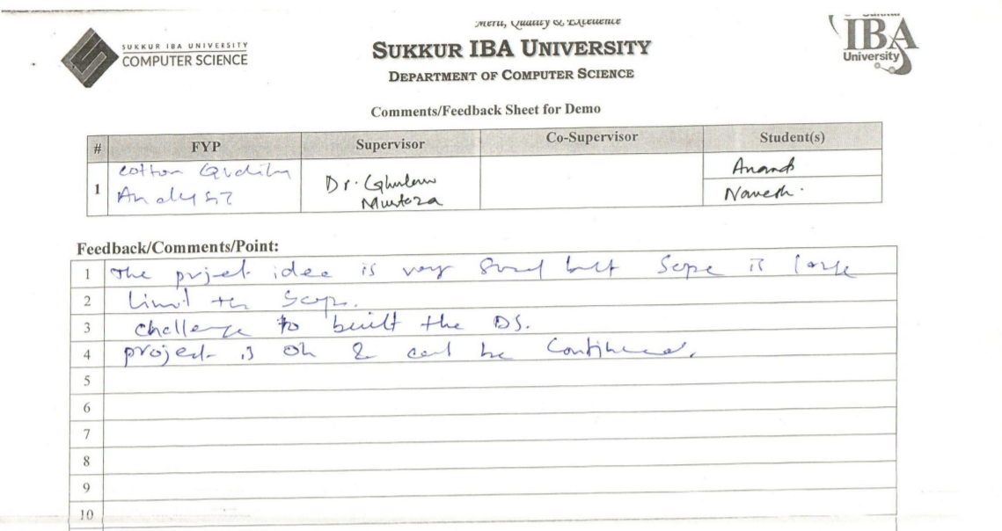
Previous comments by FYP committee

Slide 19
Thank you

