Slide 1


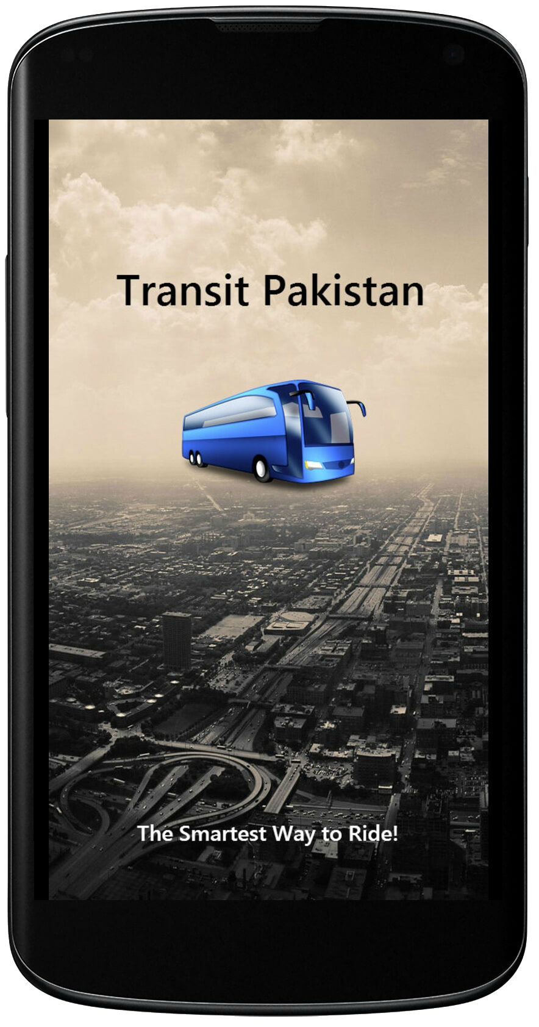


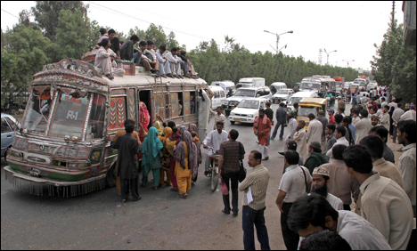





Transit Pakistan
Your Personal Transport Assistant App
Overview
Methodology
Features
Mobile App
Abstract
Karachi is the biggest city of Pakistan, whose population is about 14,500,000 inhabitants with more than 2 million people commute through public transport each day. There are a number of options available to these commuters including Buses, Mini Buses, Coaches, Chingchis, Rickshaws & Taxies. Yet an average commuter still wastes around 20 minutes per day waiting at the bus stop doing absolutely nothing which amounts to wasting 10 days per year. Moreover, vast majority of these commuters have obscure information about public transport routes.
Introduction
We believe that people should have access to all transport information for their day to day commute. For this we are developing Transit Pakistan – A Personal Transport Assistant. Transit will enable people’s access to public transportation information like bus routes along with other cost-effective travel options like cab service. This will empower commuters and increase the reach of urban transport. Once the goal of Transit Pakistan is achieved in Karachi, we will expand its circle to other cities around Pakistan with induction of other transport means such as By Air, Trains & Metro.
Technology
We are using following platform & technologies to develop Transit Pakistan.
How It Works?
Routes Information is processed via Transit Tool to include in API. Users will enter Starting Point & Ending Point details. This data will be send to Online Server via API Query, Server will process the query & send the routes suggestions with cost & time to the user. User will decide which route & suggestion to use based on his/her priorities.
Ride Options
Never miss your destination again. Transit Pakistan will give you all suggestions about the Routes & the Ride that you can take to reach your destination safely.
Cost & Time
We care for your budget & Schedule too. Transit Pakistan will provide you Ride suggestions with the average time & fares so you can get to your destination in time & budget.
Map Navigation
Don’t worry about your destination anymore. Transit Pakistan will highlight selected route on Map. This will help you to understand and visualize the areas around your routes.
SMS Service
No problem if you don’t have a Smartphone. Transit Pakistan will also support SMS queries. Just send a message with your location & destination and get suggestions on your Nokia 3310.
Future Works
We are planning to include following features to Transit Pakistan in near future.
Including other cities of Pakistan
Real Time Monitoring
Estimated Time of Arrival
Bus Schedules
Including Train & Metro (where applicable)
iOS Application
Web App
Open Source API to other Developers
<Suggestions are Welcome>
App Loading Screen
Conclusion
Start Mobile App
Enter Start Location
Enter Destination
Transport is the backbone behind the largest GDP generating city Karachi, so the problems faced by 2 million of its commuters need to be addressed. Transit will play an important role in minimizing the problems related to informations of routes & rides. Not only will this enhance the people’s reliability on public transport but it will also increase the reach of public transport.
Send Query to API
Online Server
Route Suggestions
cOMMANDER group
M. Sajjad Arif – 31231
M. Moaz Hassan – 31206
M. Haris Ali – 31226
Supervised by
Engr. Wafa Qaiser Khan
Lecturer
Department of
Computer and Software
Engineering

