Slide 1
Personal Transport Assistant App
Muhammad Sajjad Arif
Muhammad Moaz Hassan
Muhammad Haris Ali
Supervisor
Engr. Wafa Qaiser

Slide 2
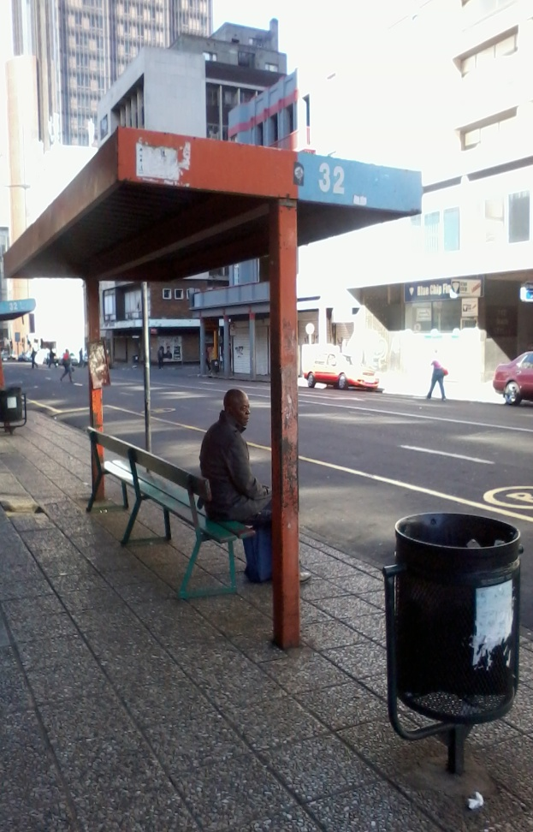
Problem Area
The present population of mega city Karachi is about 14,500,000 inhabitants⁽¹⁾ & more than 2 million people commute throughout the city using some sort of public transportation everyday⁽²⁾. Yet, most of them don’t have accurate information about transport routes.

Slide 3
Problem Area (cont)
An average person here wastes around 25 minutes per day waiting at the bus stop doing absolutely nothing which amounts to wasting 10 days per year. Moreover, vast majority of these commuters have obscure information about public transport routes.

Slide 4
Project Description
We wanted to solve these uncertainties associated with Karachi’s public transportation with our project. Our App will enable people’s access to public transportation information like bus routes along with other cost-effective travel options like cab service. Our project will empower commuters and increase the reach of urban transport.

Slide 5
Methodology
We will collect all transport data from relative transport authorities & from ground research.
Then we will map this collected transport data all over Google Karachi maps & create its cloud database.
This cloud database will be accessed by our app.
Users will be able to check this information on their smart phones using our App.

Slide 6
Platform Used (Hardware/Software)
Google Cloud EndPoints® for Cloud Database (https://cloud.google.com/endpoints/).
JSON or XML Service for Cloud API Calls.
Android Studio, Eclipse for Android App Development.

Slide 7
Expected Project Outcome
Transport Assistant App.
Cloud Database API for transport.
Project Reports.

Slide 8
Sources
1 : Sindh Government Transport Department
^{2 : Demographics of Karachi}

