Slide 1

VolCom
Community of Volunteers
Android based Volunteering App
Syed Sajjad Alam
K16-3412
Project Supervisor
Engr. Abdul Rehman Mehmood

Slide 2
Agenda
Introduction
01
Background, Issue addressed, Problem statement, Benefits, Previous work
Product Details
02
Details, Features, Flow
03
Tools And Technology

Slide 3
INTRODUCTION
In social media age, every details regarding to our problem as a society is highlighted very quickly and everyone raise voices for the resolution. Our society is full of problems that are created by us and the need to be addressed more than ever now. Problem like littering, green environmental issues and awareness issues etc. As a Karachites, we have huge number of population and if energy that lies inside it, channelized properly, can create huge difference. We have seen young generation waste most of their time sitting, chatting drinking teas etc.
With time, issues are piling up and organization comes forth whose ideology is to self-help rings my thought to build an app which can connect such people who want to give back to society

Slide 4
INTRODUCTION
Individuals deserve the opportunity to gain fulfillment through volunteering without having to jump through hoops.
Technology should be used to facilitate deeper, fulfilling connections with those around us and that true happiness comes from the satisfaction of work related to improve living standard around common people, by making it easier to volunteer (and to manage volunteers).It make a good use of technology to link up idle humanly time and resources and preform activities that can be beneficiary to society.
The motivation for this projects derived from the idea of community-based technology development initiatives. Living in a country where government have limited resources and problems are bigger than usual and continuously getting problematic sparks idea of taking action without dependencies. According to research, 65% population in Pakistan is under 35 years of age. Over 60 million user have access to digital world. Idea of this app is to provide an enabling environment volunteering, without any dependency of local service providers (Volunteering Service) as well as building community of volunteer using social interaction provided. Hence its contribution to the society can be in the form of awareness, better utilization of time, self-service and problem resolution.

Slide 5
ISSUE ADDRESSED
“To build an android application to provide a social platform using mobile devices from which issues related to vicinity, awareness drive, protest can be raised and build a team to solve those issues voluntarily in a most simplistic way, in other words build community of volunteers and give power to individuals who are always willing to execute for betterment of society.”

Slide 6
PROJECT IDEA
WHAT IS BLUE OCEAN STRATEGY?
Blue ocean strategy is the simultaneous pursuit of differentiation and low cost to open up a new market space and create new demand. It is about creating and capturing uncontested market space, thereby making the competition irrelevant. It is based on the view that market boundaries and industry structure are not a given and can be reconstructed by the actions and beliefs of industry players.
PLATEFORM THINKING
Where Consumers becomes Producers and Producers Can be Consumers

Slide 7
PROJECT IDEA
The vision behind this project is to let our people fix issues created by us, lack of governance etc. and to promote self-volunteerism in one own capacity without relying on other forces. The aim of the project named “VolCom” is to develop an android based application that shall enable group of people or individual to raise local issues, share them on social media, connect with each other, fix them collectively or escalate them to concern authorities. This project promote an idea of teams and to build community of volunteers. Since self-initiative is the core driving factor of this application, Gamification and social media sharing will help build continuous interest. People who cannot participate, can donate for the raised event.

Slide 8
PREVIOUS WORK
GiveGap: Its IOS based app which is a fundraising platform built for nonprofit organizations. Major features are Volunteering Management, Campaign Management, and Donations Collection
Give Today: Its android, US only based application which is donation centric volunteering features
Kiwanis: Its fairly complex app with huge set of features and US based
There are few more similar platforms like Volunteer App and My Selfless Act. These apps either used by organizations to manage their volunteering services or individuals to manage their volunteer works. Facebook events can also be used to solve such need but it lacks volunteering functions. Gaps that I found in available apps is that they are location specific or web based, and organization controlled, used commercially and complex for our needs. Some apps do fairly simple thing like collecting issue details and sending it to authorities to take actions.

Slide 9
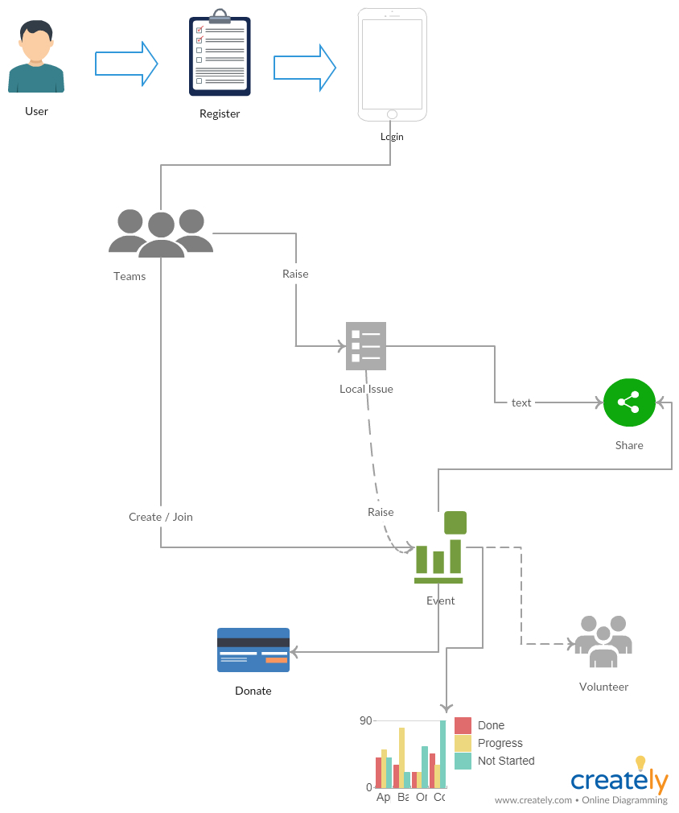
HOW IT WORKS?

Slide 10
SCOPE LIMITATION
The proposed idea is for Android platform only.
Only individual users can enter their requests for this project.
The use of the application is limited for Karachi users only. Since legal document is required for authentication.
Internet Availability must be required.

Slide 11
DETAILS
Events module
This module is built to cater event functionality. Events are objects that is created against any reported issue and it can only be created as a member of a team
Create and manage
Participation
Share it on Social media
Send it to mobile Contact list
Attach media related to it
Track and monitor
Donate for an event
Ratings and feedback
Moderate
Set closure for that event
Time line Module
This is the main splash screen module of the app where all the happening inside application can be viewed by the user. It’s the most simplistic version of Facebook news feed. This includes
Media Files related to events happening
Like and Comments
Share to Social platform and Contact list
Volunteering Tracking
Participation in events and activities can be managed using In App volunteering management system where user can track hours of volunteering and monitor them. This includes
Monitoring
Set Goal
Update Details

Slide 12
DETAILS
Profile module
This module represents the profile of the user and has following high level functions
Create/Update their profile
Manage and monitor selected events
Reviews and feedback
Track services you are engaged in
Team module
Team module is a set of user profiles joins as a team to perform particular tasks
Manage teams
Create/Update
Delete
Join or unjoin
Local Issue module
This module contains issue details that need to be raised by the user
Create/Update
Attach media related to it
Escalate to concern authorities
Status management
Monitor likes and Comment
Moderate
Share on Social Media
Send it to mobile Contact list

Slide 13
BASIC FLOW

Slide 14
FEATURES
REGISTRATION & LOGIN
PROFILE BUILDING AND MANAGEMENT
TEAM MANAGEMENT
CREATING LOCAL ISSUE AND MANAGE
EVENTS MANAGEMENT
RATINGS AND REVIEW
SOCIAL TIMELINE
ACTIVITY TRACKING AND MONITOR
ACTIVITY SHARING AND COMMNICATION

Slide 15
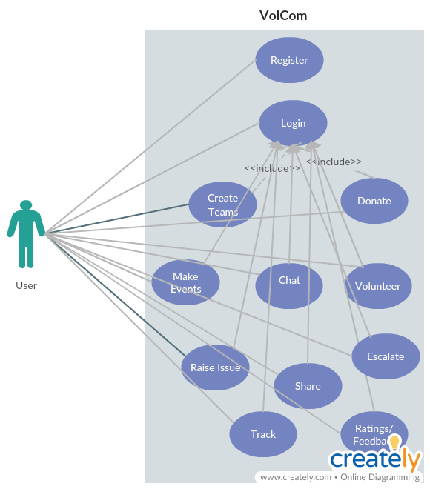
SYSTEM INTERFACES
We divide the proposed Application into Four distinct usable interfaces.
1.Creator (A person who create Issue and generate events against that issue.)
2.Participator (A person who is participating.)
3.Donator (A person who wish to donate something.)
4.Share (A person who Share activities to contacts.)

Slide 16
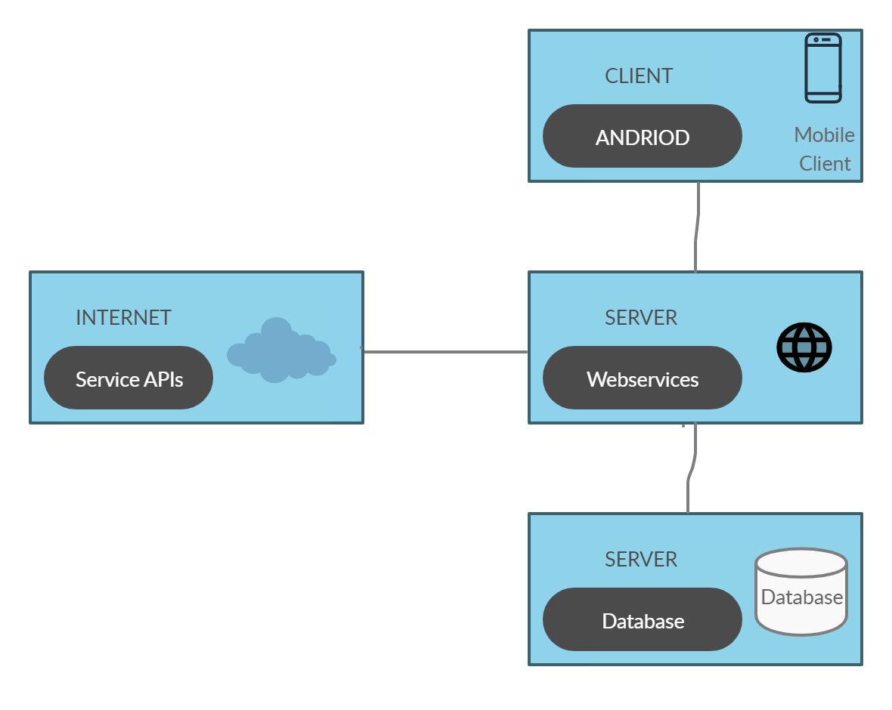
EQUIPMENT DETAILS
EQUIPMENT CONFIGURATION
SOFTWARE
Android Studio
Visual Studio
WebAPI
Entity Framework
MS SQL Server
Facebook APIs
Google Map API
Payment API
HARDWARE
Android Device
Web services Hosting Server
Database Server

Slide 17
DEMO

