Slide 1
Capstone Project The Battle of Neighbourhoods (Week 2)
Date of submission: 20th February 2021

Slide 2
Background
Dubai is a real estate hub
Properties of all sizes and facilities are available

Slide 3
Business Problem
Such large options makes its really difficult to choose the right ones that fits your residential needs or investment plans.
A solution is required
To help stakeholders in pinning down neighborhoods based over:
The facilities and amenities they provide and also,
Understand any possible correlation between certain amenities and property value.

Slide 4
Target Audience
1. People and investors planning to rent or buy properties
2. Real estate dealers

Slide 5
Data
Description of The Data
To resolve our problem, we need data of different properties across Dubai, their prices and amenities and facilities near to it.
Source of The Data
List of properties:
Licensed under CC0: Public Domain.
Contains over 1900 records along with their geolocation and their prices.
https://www.kaggle.com/dataregress/dubai-properties-dataset
Amenities and finicalities next to properties:
We will utilize Foursquare API for scrap list of facilities and venues next to our properties, using their location part of our dataset.

Slide 6
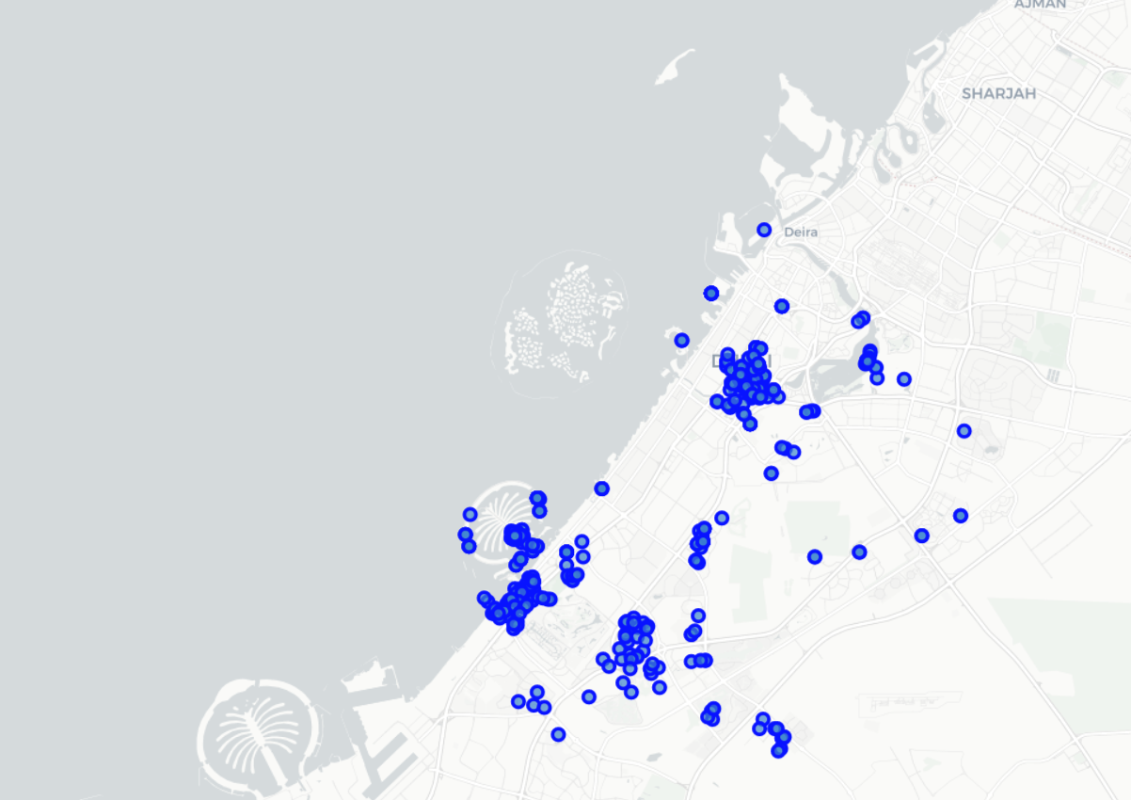
Methodology
Import our dataset in a CSV format
Sorted the data according to the prices and assigned a rank to each property to represent its value
Lower the rank higher that value of property in price.
Then these properties are mapped on Dubai’s map using the geo coordinates of the dataset so better visualize what we are working with.

Slide 7
Methodology
Utilizes Foursquare’s API venue endpoint to retrieve a list of functionalities surrounding our properties.
Applying one hot encoding to all retrieved property and take mean for each respective to each neighbourhood.
Sort the resulting dataset according to viability of a particular facility that the user wants to target and is interested in.
Apply K-means clustering to divide the data (our neighborhoods) in the chunks of neighbourhoods having high concentration of our category to neighbourhoods with the lowest. Visualizing each cluster on the map in the end.

Slide 8
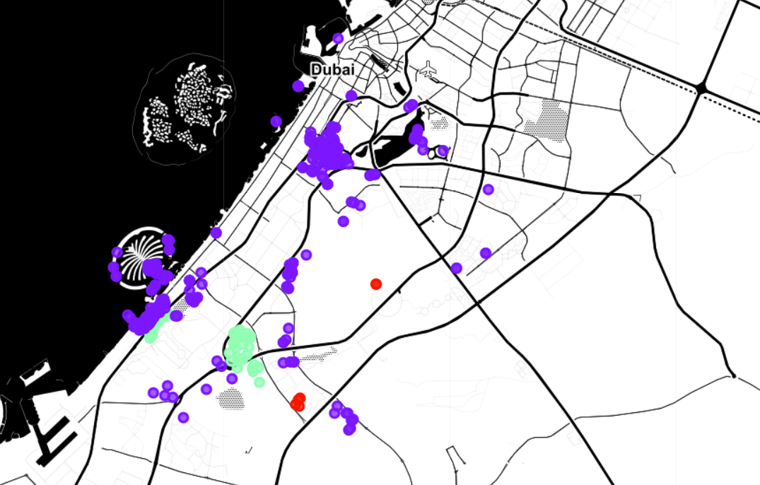

Slide 9
Observations
We can see that Cluster -2 contains the neighbourhoods with highest concentrations of the target category which in our case are ‘Gym’(s)
The neighbourhood on top in this category is ‘Al Barari’
In opposite Cluster -0 contains the neighbourhood with least gyms available in the surrounding of a property such as ‘Al Sufouh’.
However, no specific correlation between the existence of gyms nearby and prices of a property were observed.

Slide 10
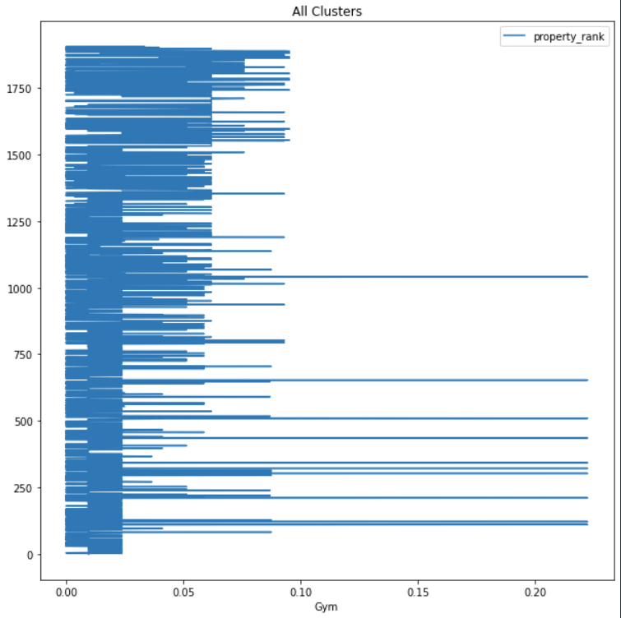

Slide 11
Results
It has been found and analysed that in order to own or rent a property that has feasible gym accessibility, the right neighborhood to live in is Al Barari.

Slide 12
Conclusion
We worked through a already existing dataset to work our way through the solution of categorising the properties and neighbourhood as per the preferred target category, which in our case was ‘Gym’.
We did geolocation and clustering to divided out dataset and information accordingly to nearby facilities and their concentrations and finally found results of most ideal and worst neighbourhood for particular facility.

Slide 13
Thankyou!

