Slide 1
Behave
behavior-driven development, Python style

Slide 2
What is BDD
BDD uses human-readable descriptions of software user requirements as the basis for software tests.

Slide 3
Behave
we should test how an application behaves in certain situations

Slide 4
Behavior
operation with inputs, actions, and expected outcomes

Slide 5
Feature
a desired product functionality often involving multiple behaviors

Slide 6
Scenario
specification of a behavior using formal steps and examples

Slide 7
Gherkin
a simple language used to explain the expected behavior of a system

Slide 8
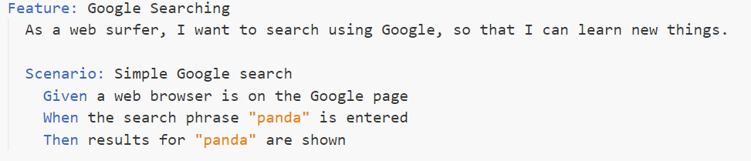
Simple Gherkin Scenario
“Given” initializes a state
“When” describes an action
“Then” states the expected outcome

Slide 9
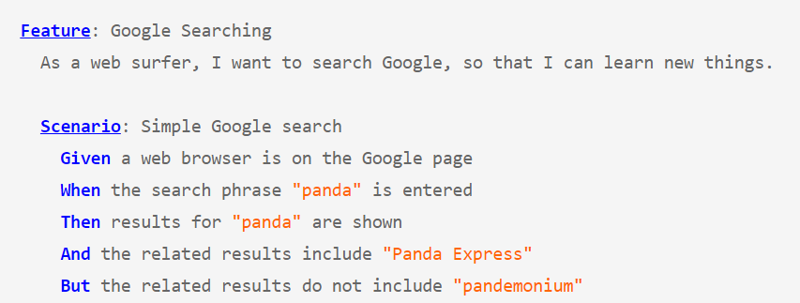
Other Keywords

Slide 10
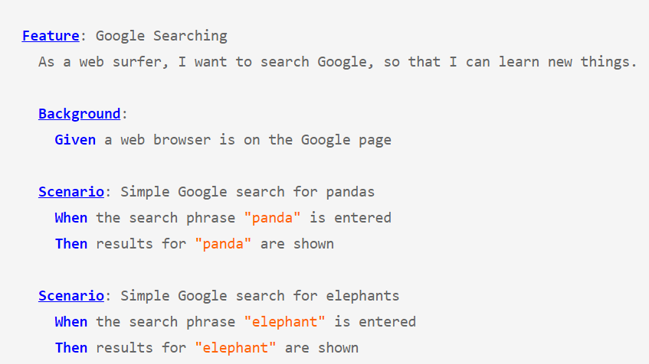
Using Background

Slide 11
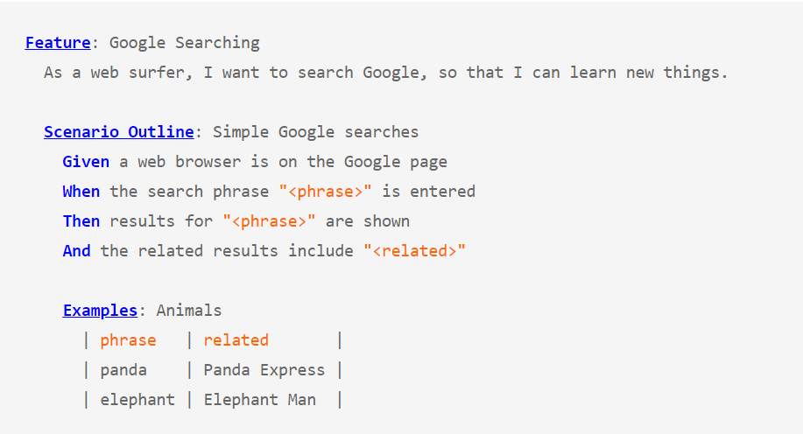
Scenario Outline

Slide 12
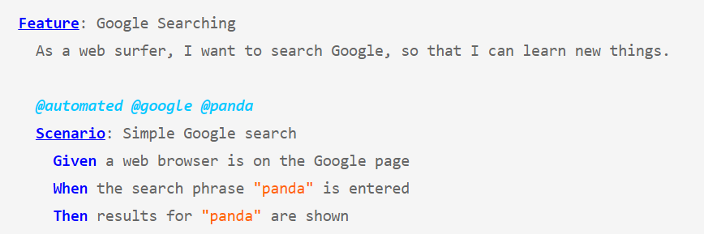
Tags
>behave --tag google

Slide 13
Steps
Python codes that are link between the descriptive tests in .feature files and the actual application code.

Slide 14

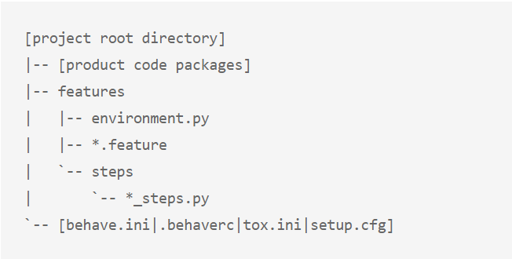
Project Structure

Slide 15
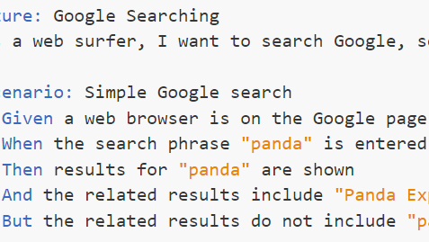
Quiz
Write one bdd feature
With at least two scenario

Slide 16
Let's check out a real-world example

