Slide 1
Behave
behavior-driven development, Python style

Slide 2
Behave
we should test how an application behaves in certain situations

Slide 3
Behavior
operation with inputs, actions, and expected outcomes

Slide 4
Feature
a desired product functionality often involving multiple behaviors

Slide 5
Scenario
specification of a behavior using formal steps and examples

Slide 6
Gherkin
a simple language used to explain the expected behavior of a system

Slide 7
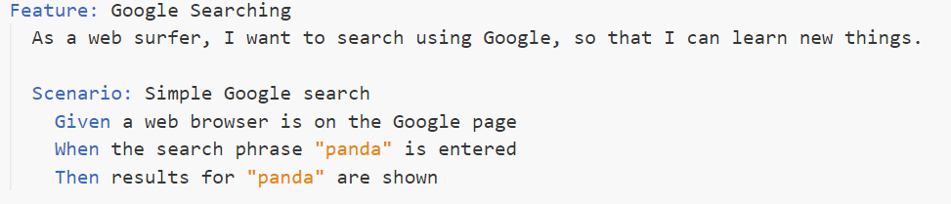
Simple Gherkin Scenario
“Given” initializes a state
“When” describes an action
“Then” states the expected outcome

Slide 8
Steps
Python codes that are link between the descriptive tests in .feature files and the actual application code.

Slide 9
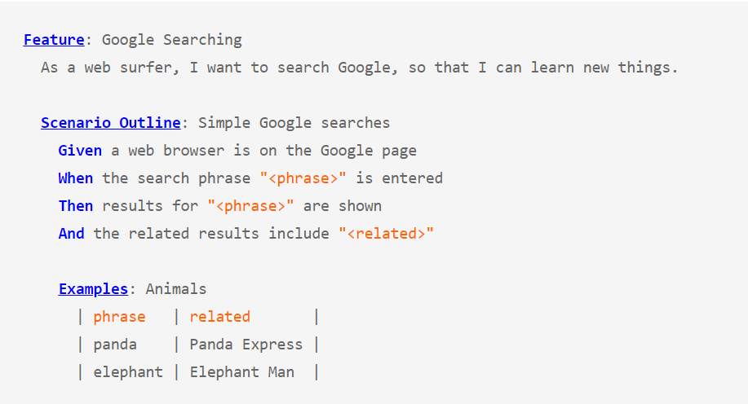
Tableized Test

Slide 10

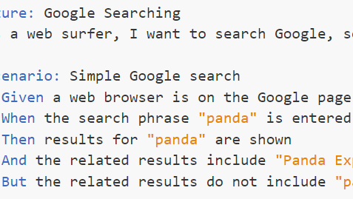
Quiz
Write one bdd feature
With at least two scenario

Slide 11
Let's check out a real-world example

