Slide 1
Behave
behavior-driven development, Python style

Slide 2
TDD vs BDD
we should test how an application behaves in certain situations

Slide 3
Behave
we should test how an application behaves in certain situations

Slide 4
Behavior
operation with inputs, actions, and expected outcomes

Slide 5
Feature
a desired product functionality often involving multiple behaviors

Slide 6
Scenario
specification of a behavior using formal steps and examples

Slide 7
Gherkin
a simple language used to explain the expected behavior of a system

Slide 8
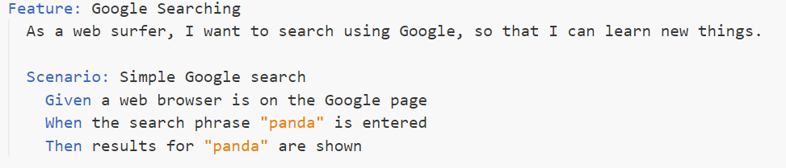
Simple Gherkin Scenario
“Given” initializes a state
“When” describes an action
“Then” states the expected outcome

Slide 9
Steps
Python codes that are link between the descriptive tests in .feature files and the actual application code.

Slide 10
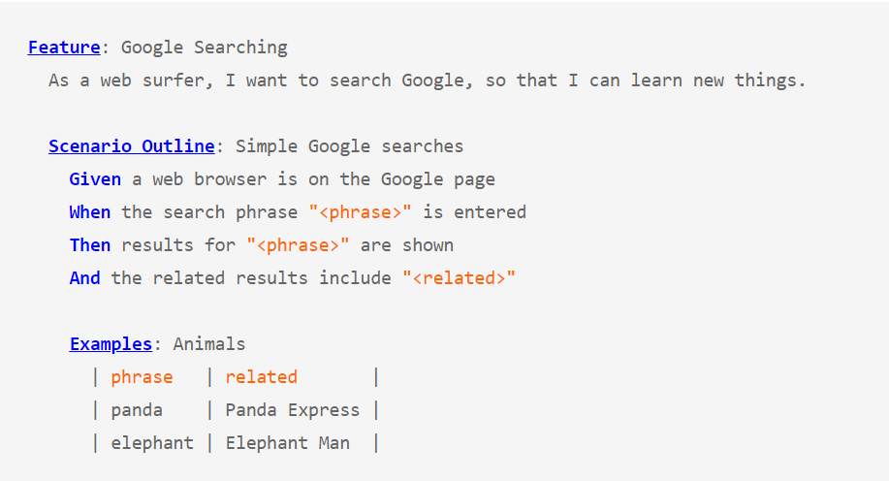
Tableized Test

Slide 11

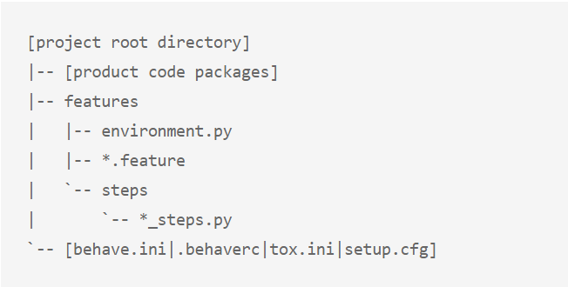
Project Structure

Slide 12
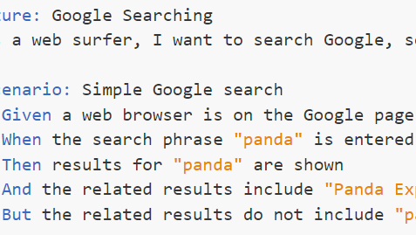
Quiz
Write one bdd feature
With at least two scenario

Slide 13
Let's check out a real-world example

