Slide 1

Data-Driven Cancer Detection: A Supervised Learning Approach
Sajjad Hussain
Zain Ul Abdin
Department of Electronic Engineering
Hanyang University, Seoul
Hanyang University

Slide 2
Contents
1
Introduction
2
Background
3
Proposed System and its Goals
4
Workflow ( Daily Progress )
5
Technology Stacks
6
Results
7
Future perspectives
8
Conclusion
Hanyang University

Slide 3
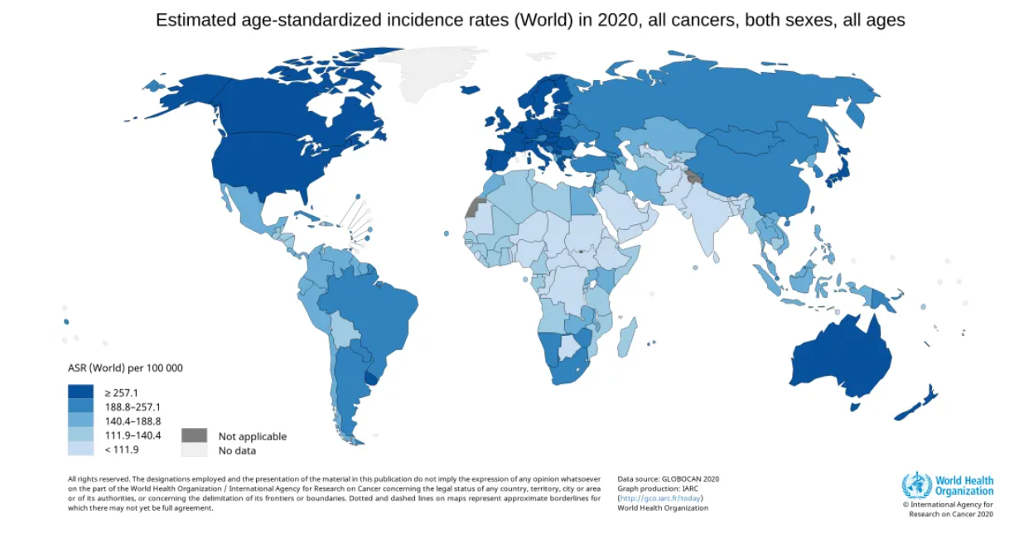
Introduction
Cancer is a generic term for many diseases that can affect any body part.
Cancer remains a significant global
health challenge.
leading cause of death worldwide.
complex and diverse nature.
Early detection is Important.
improving patient outcomes.
reducing the burden of cancer.
The most common is
Breast (2.26 million cases)
lung (2.21 million cases)
prostate (1.41 million cases)
skin (1.20 million cases)
Stomach (1.09 million cases)
Cervical (0.6 million cases)
Fig: 1
Hanyang University

Slide 4
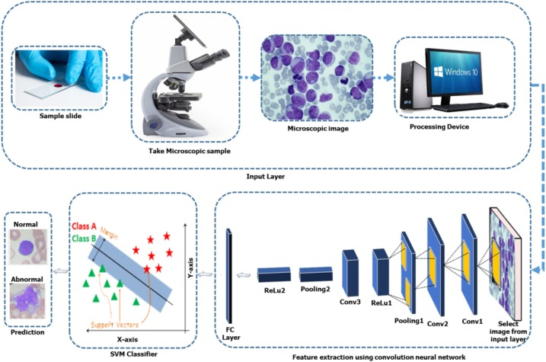
Background Explanations
Traditional diagnostic
Invasive procedures
Time-consuming analyses.
Technological Revolution:
Machine Learning (ML) emerged as a transformative tool for cancer detection.
Role of Machine Learning in Cancer Detection:
ML algorithms process vast datasets to identify detailed patterns indicative of cancer.
The ability to analyze complex data sets in real time allows for quicker and more accurate cancer diagnosis.
Fig: 2
Hanyang University

Slide 5
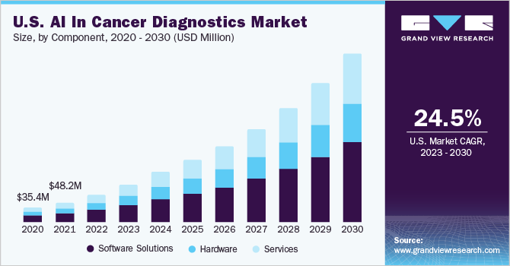
Background Explanations
Real World Impact
Speed-up diagnosis
Fig: 3
Hanyang University

Slide 6
Workflow ( Daily Progress )
Step-5
Enhanced Accuracy and verified it
Step-4
Analyze results by applying classification and regression models
Step-3
Apply different ML Algorithms
Step-2
Import Dataset
Data Preprocessing
Step-1
Datasets understanding
Hanyang University

Slide 7
Technology Stacks
Google. colab
Pandas
Numpy
sklearn
Matplotlib
Scipy
glob
Prettytable
Keras
Hanyang University

Slide 8
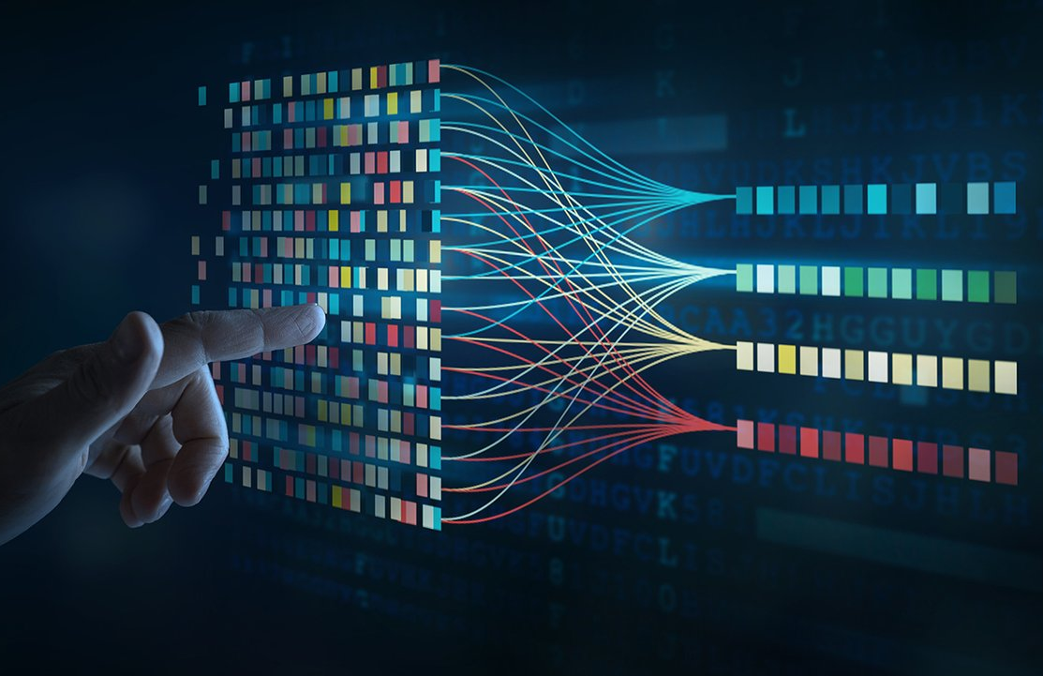
Coding Steps
Start
Data Preprocessing
Supervised Learning
Smoothing
Classification
Regression
Threshold
Data Splitting
Splitting Data
Finding main features
Model Training
Training
Testing
Evaluation
Cross Validation
End
Hanyang University

Slide 9
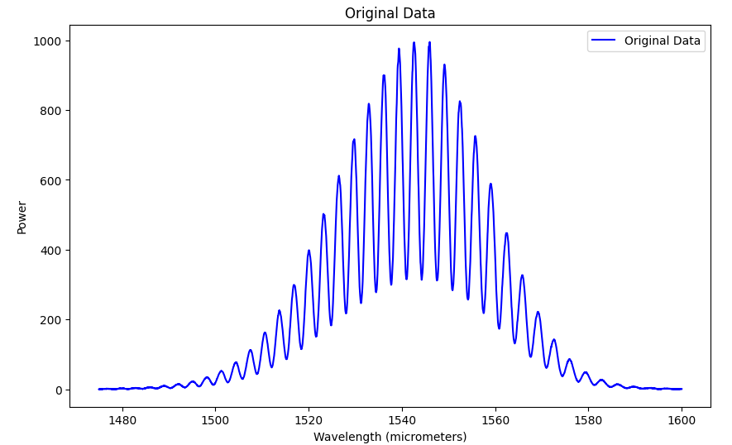
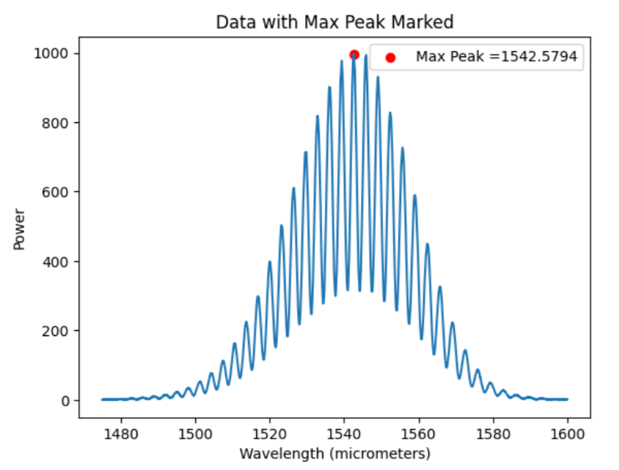
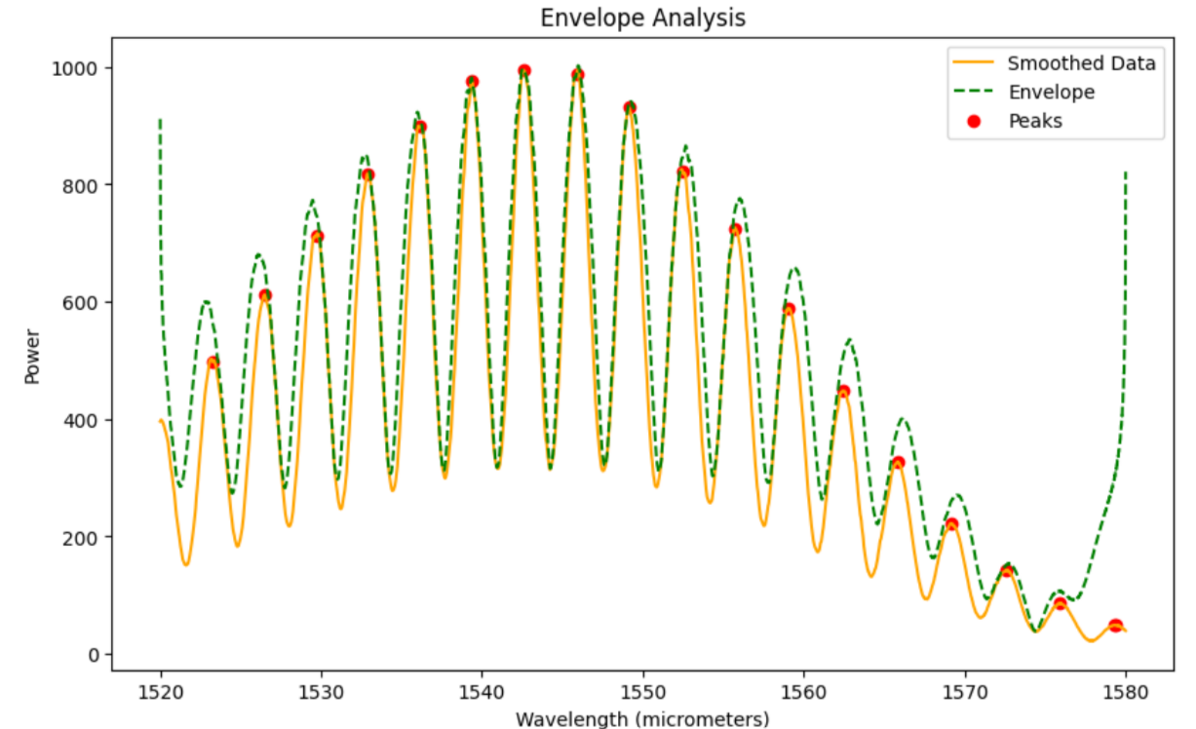
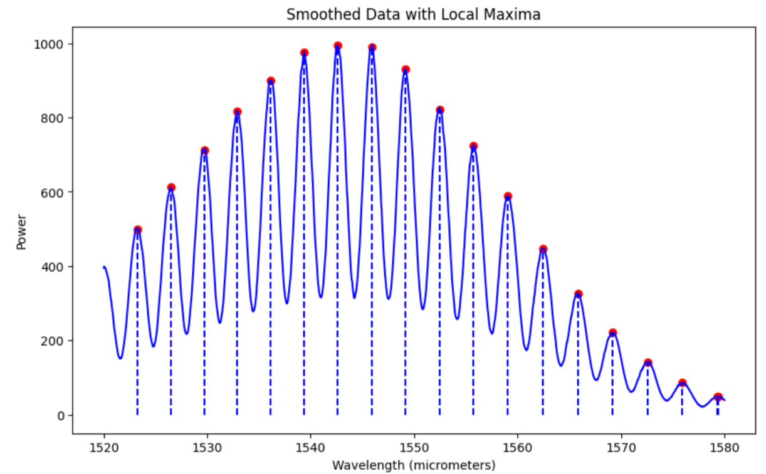
Results Preprocessing
Hanyang University

Slide 10
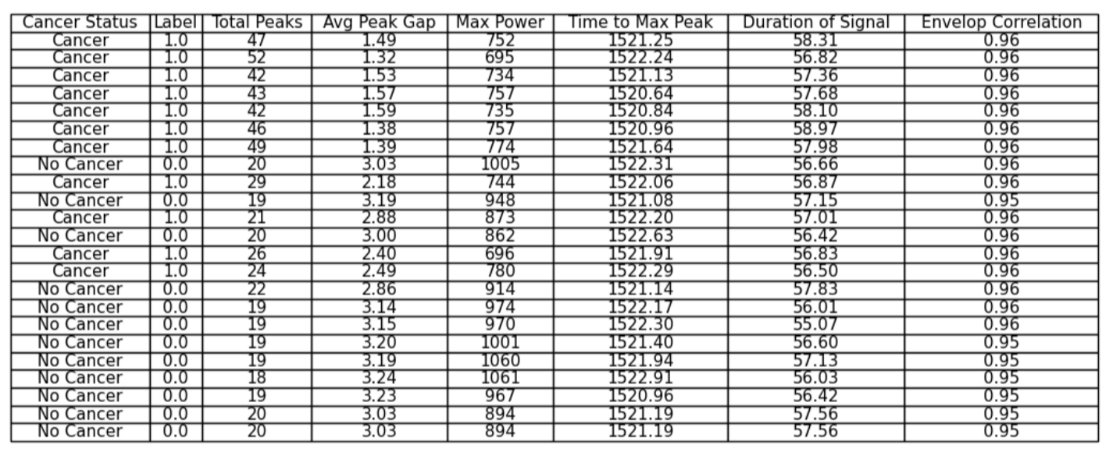
Results
All data set features
Hanyang University

Slide 11
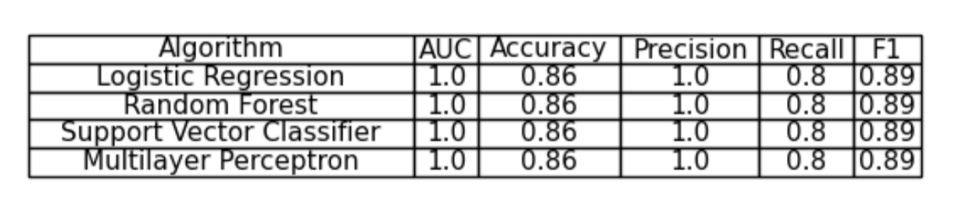
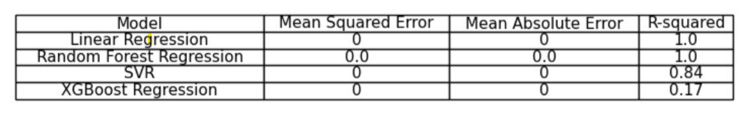
Supervised Learning
Training: 80% Testing: 20%
Classification algorithms comparison
Regression algorithms comparison
Cross-Validation Mean Squared Error: 0.3005
Hanyang University

Slide 12

Key Points
- Successful feature extraction: Key features were extracted from optical spectra data, including temporal features and envelope analysis.
- Classification with CNN: A Convolutional Neural Network (CNN) demonstrated strong performance in predicting cancer likelihood based on the extracted features.
- Comparative evaluation: Multiple machine learning algorithms, such as Logistic Regression, Random Forest, Support Vector Classifier, and Multilayer Perceptron, were evaluated for classification, providing a comprehensive comparison.
- Regression models: Support Vector Regression (SVR) and XGBoost Regression were employed for predicting refractive index values, with meaningful metrics such as Mean Squared Error, Mean Absolute Error, and R-squared.
- Cross-validation insights: Cross-validation using Random Forest and LightGBM algorithms provided valuable insights into the models' generalization capabilities for both classification and regression tasks.
Hanyang University

Slide 13

Future Plan
1. Diversify Dataset: Expand the dataset to include diverse photonic measurements, ensuring the model's robustness across various scenarios.
2. Optimize Model Architecture: Continuously refine the neural network architecture to enhance learning and predictive capabilities, exploring advanced structures.
3. Integrate Domain Knowledge: Collaborate with photonic experts to incorporate domain-specific knowledge into feature selection and model interpretation.
4. Implement Transfer Learning: Explore transfer learning techniques to leverage knowledge from one set of photonic measurements for improved performance on related tasks.
5. Enhance Temporal Analysis: Strengthen the model's temporal analysis abilities, especially in dynamic measurements, through the integration of time-series analysis methods and recurrent neural networks.
Hanyang University

Slide 14
Thank You for Your Attention
Hanyang University

