Slide 1

Advancing Fraud Detection through CTGAN - Based Synthetic Transactions
Generated synthetic fraud samples to improve model performance
Organization : Global Next Consulting India Private Limited

Slide 2
Project Flow
Load Imbalance data
Train CTGAN on fraud class
Generate synthetic data
Train RandomForest
Evaluate metrics

Slide 3
Abstract
This project aims to develop a fraud detection system for bank transactions using machine learning. The workflow includes:
Preprocessing: Data cleaning, encoding, scaling, and feature engineering.
Exploratory Data Analysis (EDA): Identifying patterns, anomalies, and key feature relationships.

Slide 4
Imbalance Handling: Leveraging Adversarial Variational Autoencoder (AVAE) to generate realistic synthetic samples for the minority (fraud) class.
Modeling & Visualization: Training classification models, evaluating performance with robust metrics, and visualizing results.
The ultimate goal is to build a balanced, accurate, and reliable fraud detection system that enables financial institutions to detect and prevent fraudulent transactions effectively.

Slide 5
Introduction
Financial fraud detection is a critical challenge for banking and digital payment systems. Since fraudulent transactions represent only a small fraction of total data, class imbalance often biases machine learning models. This project addresses theissue by preparing high-quality, balanced datasets through preprocessing and AVAE-based synthetic data generation. In subsequent stages, the enhanced datasetwill support machine learning models for fraud detection. The project integrates data preparation, visualization, and predictive modeling into an efficient, end-to-end pipeline for reliable fraud detection.

Slide 6
Objectives
To load, clean, and preprocess the bank transaction dataset for modeling.
To perform EDA to understand data patterns and correlations.
To balance the dataset using AVAE for synthetic data generation.
To train and evaluate machine learning models for fraud detection.
To visualize performance metrics (accuracy, precision, recall, ROC curve).
To prepare a complete, optimized dataset ready for deployment in fraud detection systems.

Slide 7
Problem Statement
Fraudulent transactions in banking data are rare, leading to imbalanced datasets where traditional models tend to misclassify minority (fraud) cases. Additionally, raw transaction data often contain missing values, mixed data types, and redundant information. The project aims to create a clean, balanced, and informative dataset using AVAE and preprocessing techniques, followed by model training and visualization to accurately predict fraudulent behavior.

Slide 8
Scope of Work
The project will cover:
Data Preprocessing: Cleaning, feature extraction, encoding, and scaling
Exploratory Data Analysis (EDA): Statistical and graphical analysis to detect patterns and anomalies
Synthetic Data Generation: Using AVAE to balance fraud and non-fraud data
Model Training: Building and evaluating machine learning models for fraud detection
Visualization: Feature importance plots, confusion matrices, and fraud pattern charts

Slide 9
Tools and Technologies
Programming Language: Python
Libraries: pandas, numpy, scikit-learn, matplotlib, seaborn, SDV (AVAE)
Environment: Google Colab /Jupyter Notebook
Techniques:
Data Cleaning and Feature Engineering
Encoding and Scaling

Slide 10
Dimensionality Reduction
Synthetic Data Generation (AVAE)
Fraud Detection (ML Models – upcoming)
Dataset: Bank_Transaction.csv

Slide 11
Methodology
Phase 1 : Data Preprocessing
Handle missing values using SimpleImputer.
Scale numeric columns with StandardScaler.
Encode categorical data with OneHotEncoder.
Extract new datetime features (year, month, hour).

Slide 12
Phase 2 : EDA
Analyze data distributions, correlations, and transaction trends.
Identify imbalance in fraud vs. non-fraud records.
Phase 3 : Synthetic Data Generation (AVAE)
Train AVAE on minority fraud data.
Generate realistic synthetic fraud transactions.
Combine synthetic and real data for balance.

Slide 13
Phase 4: Model Training
Evaluate models using Accuracy, Precision, Recall, F1-score.
Phase 5: Visualization
Plot feature importance, confusion matrix, ROC curve.
Visualize real vs. synthetic data distributions.

Slide 14
Outcome
Cleaned and preprocessed dataset ready for modeling.
Balanced dataset with realistic fraud samples using AVAE.
Fraud detection model capable of distinguishing fraudulent and legitimate transactions.
Visual insights showcasing model performance and fraud detection trends.

Slide 15
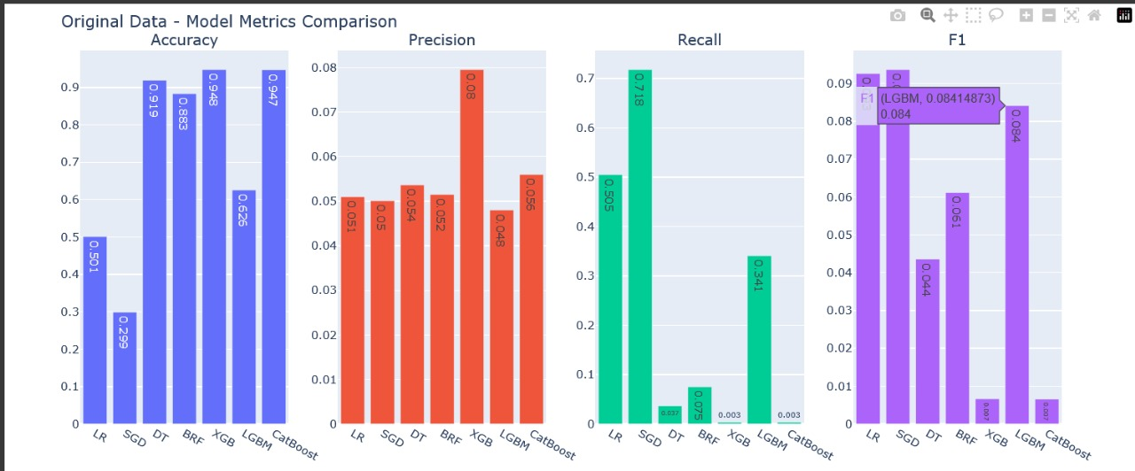
GRAPH
.
.
.

Slide 16
Team Details
Sajrudin Aalam :
Rekha Kumari Bheel
Data Preprocessing
Augmented Data Implementation
Model Training & Deployment
Data Preprocessing
Model Training and Deployment
Payal Dhokane
Riya Rawat
EDA(Exploratory Data Analysis)
Synthetic Data Generation
Visualization
Documentation

Slide 17
Drawing
a Conclusion
.
.
This project analyzed bank transactions to detect fraud. Using data exploration and synthetic augmentation, we identified key patterns and high-risk transactions. The insights can help financial institutions detect fraud early, reduce losses, and improve customer trust.

Slide 18
Scikit-learn Documentation – https://scikit-learn.org/stable/
SDV (AVAE) Documentation – https://docs.sdv.dev/
Kaggle: Bank Transaction Fraud Detection Dataset
Python Official Documentation – https://www.python.org/doc/

