Slide 1

Title:
Bank Transaction Fraud Detection
Submitted By :
Sajrudin Aalam
Riya Rawat
Rekha Kumari Bheel
Payal Dhokane
Organization : Global Next Consulting
India Private Limited

Slide 2
Abstract
This project focuses on developing an intelligent Bank Transaction Fraud Detection System using Machine Learning and Deep Learning. With the rise of digital banking, detecting fraudulent transactions has become a critical challenge. Traditional rule-based systems often fail to identify complex or evolving fraud patterns.
Our proposed system uses a combination of classical ML models and neural networks to detect fraud effectively. By analyzing transaction data containing information such as amount, type, device, and merchant category, the system learns patterns that distinguish genuine transactions from fraudulent ones. Data imbalance is addressed using SMOTE and synthetic data generation, and models are evaluated using metrics like accuracy, precision, recall, and F1-score.

Slide 3
Introduction
Digital transformation has reshaped the banking industry, making transactions faster and more convenient. However, this advancement also increases the risk of financial fraud. Fraudsters exploit weaknesses in digital systems, causing financial loss and damaging trust.
To address this issue, our project aims to build an automated fraud detection system that leverages Machine Learning (ML) and Deep Learning (DL). By learning from historical transaction data, the system can predict and flag potentially fraudulent activities in real time. A special emphasis is placed on solving the problem of data imbalance, where fraudulent transactions form only a tiny fraction of all transactions.

Slide 4
Problem Statement
Financial institutions struggle to detect sophisticated fraudulent transactions because conventional systems are unable to adapt to new patterns. Fraud detection is further complicated by the rarity of fraud cases compared to genuine ones. Our project addresses key challenges such as class imbalance, complex feature interactions, and ineffective evaluation metrics. Instead of relying solely on accuracy, we focus on optimizing recall and F1-score to ensure that fraudulent cases are not overlooked. The goal is to create a model that is both accurate and reliable for practical banking applications.

Slide 5
Objective
The main objectives of this project are to thoroughly explore the transaction dataset through Exploratory Data Analysis (EDA), handle data imbalance using SMOTE, and train multiple models such as Logistic Regression, Decision Tree, Random Forest, XGBoost, LightGBM, and CatBoost.
A deep learning neural network with Focal Loss is also implemented to enhance detection of rare frauds. We aim to optimize models using hyperparameter tuning and threshold adjustments, save the best-performing model, and generate visual insights on fraud-prone categories and time patterns.

Slide 6
System Architecture
The architecture begins with data collection from transaction logs containing details like amount, customer ID, device, and merchant type. This data undergoes preprocessing, where missing values are handled, categorical variables are encoded, and numerical values are normalized. Next, EDA is performed to visualize trends and anomalies, followed by data augmentation using SMOTE and synthetic samples to balance the dataset. Multiple ML and DL models are then trained and evaluated using metrics such as precision, recall, and F1-score. Finally, the best model and preprocessing pipeline are saved for deployment, allowing future real-time predictions.

Slide 7
Project Flow
Raw Transaction Data
Exploratory Data Analysis (EDA)
Data Preprocessing (Clean, Encode, Scale)
Model Training
· ML Models
· DT, LR, SGD
· LGBM, XGB
· CatBoost
Data Augmentation (SMOTE + Synthetic Data)
Deployment / Prediction

Slide 8
Tools and Technologies
The project is implemented in Python, using Pandas and NumPy for data handling, and visualization libraries like Matplotlib, Seaborn, and Plotly for EDA.
For model building, Scikit-learn, LightGBM, CatBoost, and XGBoost are employed for ML, while TensorFlow and Keras are used for the deep learning model. The environment of choice is Google Colab, providing GPU acceleration. Models are saved using Joblib and H5 formats for future deployment.

Slide 9
Data Analysis and Model Training
The data analysis phase focuses on understanding the distribution of fraudulent and non-fraudulent transactions through statistical plots and heatmaps. Insights such as transaction amount variations and state-wise fraud density help in feature engineering.
In the model training phase, several algorithms are tested on both original and augmented data. Models like CatBoost and XGBoost perform exceptionally well, achieving high recall scores, indicating their ability to detect most fraudulent cases. The LightGBM model provides a balanced performance with a good trade-off between accuracy and recall.

Slide 10
Deep Learning Model
A feedforward neural network is built using Keras, consisting of three dense layers with dropout regularization to prevent overfitting. The model is trained using Focal Loss, which enhances the system’s ability to learn from the minority fraud class.
The neural network achieves strong performance in terms of recall and F1-score, demonstrating that deep learning can effectively complement traditional ML techniques in fraud detection.

Slide 11
Insights
(Augmented Data)
Decision Tree (DT) → F1 = 0.23 (Recall = 0.85, but low Precision = 0.14)
SGD → F1 = 0.22 (Recall = 0.77, Precision = 0.14)
Logistic Regression (LR) → F1 = 0.21 (Recall = 0.51, Precision = 0.13)
LightGBM (LGBM) → F1 = 0.21 (Recall = 0.59, Precision = 0.14)
CatBoost → F1 = 0.19 (Recall = 0.34, Precision = 0.12)
XGBoost (XGB) → F1 = 0.19 (Recall = 0.31, Precision = 0.12)
Random Forest (RF) → F1 ≈ 0.00 (predicts majority)
Balanced RF (BRF) → F1 ≈ 0.00 (didn’t improve here)

Slide 12
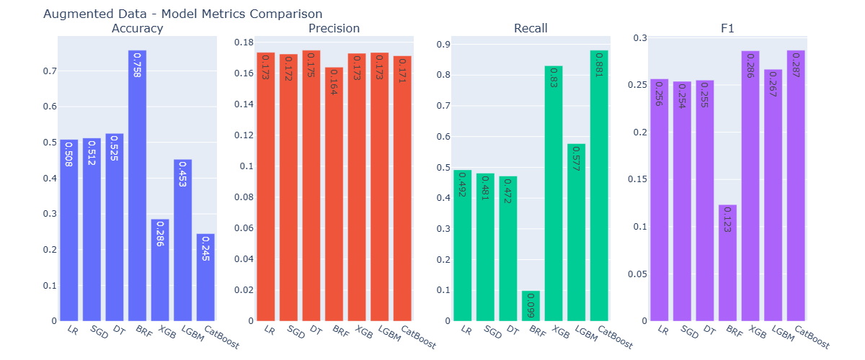
Training Model on Augmented Data
Key Insights
CatBoost and XGBoost achieved the highest F1-scores (~0.286), driven by very high recall (≈0.88 and 0.83).
These models are highly sensitive to fraudulent cases — ideal when catching fraud is more important than reducing false alarms.

Slide 13
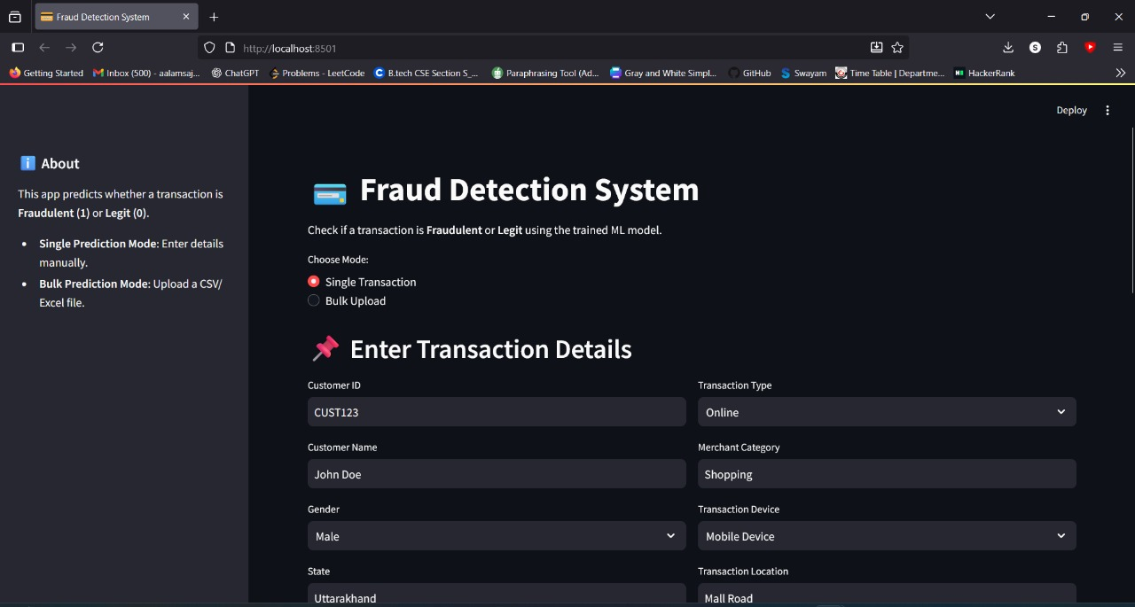
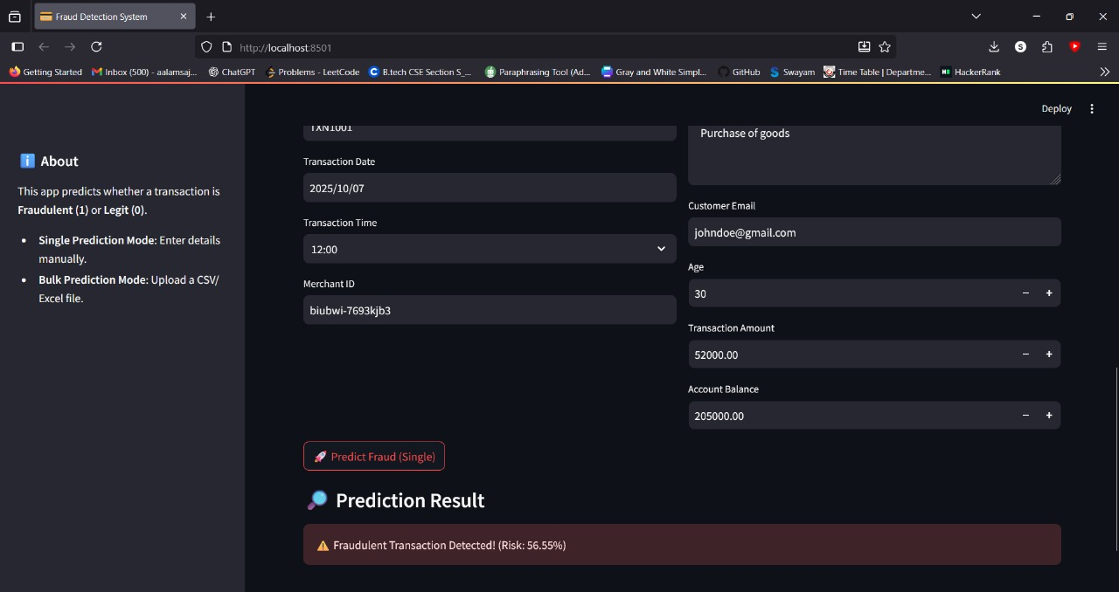
UI Of The Project

Slide 14
Limitations and Future Enhancements
Despite achieving promising results, the project faces some limitations. The imbalance in real-world data remains a challenge, and the system currently lacks real-time prediction capability. Deep learning models, though powerful, act as black boxes and lack interpretability.
In future, the system can be extended to include real-time APIs, integrate Explainable AI (SHAP/LIME) for better interpretability, and use Graph Neural Networks to capture relational fraud patterns among users, devices, and merchants.

Slide 15
Drawing a Conclusion
.
The project “Bank Transaction Fraud Detection Using Machine Learning and Deep Learning” successfully demonstrates how data-driven techniques can enhance fraud detection accuracy. By combining data preprocessing, augmentation, and advanced model training, a reliable fraud detection framework is created.
Through this work, we learned to handle imbalanced datasets, tune complex models, and evaluate performance using realistic metrics. The system’s scalability and robustness make it suitable for integration into real-world banking environments, providing an efficient defense against fraudulent transactions.

Slide 16
Scikit-learn Documentation – https://scikit-learn.org/stable/
Kaggle: Bank Transaction Fraud Detection Dataset
Python Official Documentation – https://www.python.org/doc/

