Slide 1
SALARY PREDICTION USING ENSEMBLE LEARNING
By:Sakshi Dwivedi

Slide 2
Project Overview
Predict salaries using interpretable symbolic machine learning
models.
Built with Python, scikit-learn, and optionally Streamlit for interface.
Symbolic models (like Decision Trees and Rule-based Learners)
allow human-readable rules for transparent salary prediction.
Dataset is sourced from Kaggle.

Slide 3
Tech Stack
Python – Programming & model development
Pandas – Data handling and feature engineering
scikit-learn – Symbolic models like DecisionTreeRegressor
Streamlit (optional) – UI for predictions
Pickle – Saving trained models
GitHub – Project version control

Slide 4
Project Structure
/salary-symbolic/
├── app.py → Streamlit web app (optional)
├── symbolic_model.pkl → Trained Decision Tree model
├── columns.pkl → Feature columns for predictions
├── requirements.txt → Dependencies
├── README.md → Project overview
└── salary_data.csv → Cleaned dataset

Slide 5
Dataset
Source: Kaggle
Link:
Features:
Age
Gender
Education
Job Title
Work Experience
Salary (Target Variable)

Slide 6
Model Details
Symbolic Models Used:
Random Forest Regressor – Ensembles of decision trees.
Voting Regressor:-Average predictions from multiple models.
Training Process:
Categorical features

Slide 7
Sample Prediction
Education: Bachelor's Degree Experience: 4 Years Job Title: Software Engineer Employment Type: Full-time → Predicted Salary: ₹9,60,000 annually

Slide 8
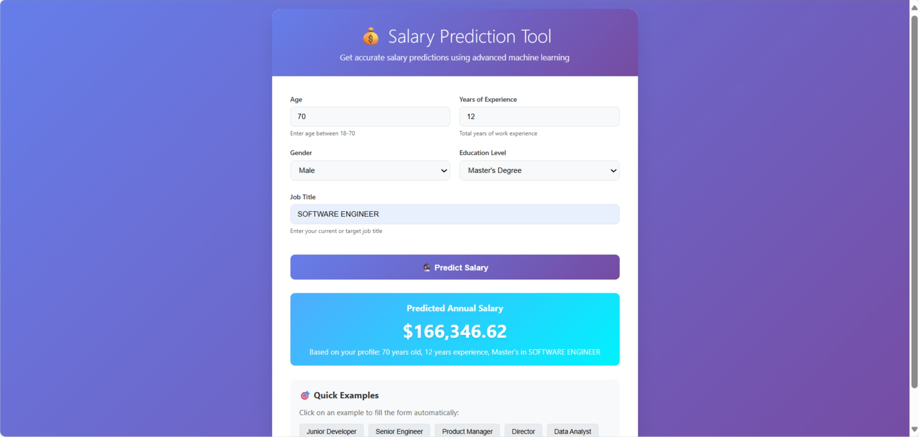
OUTPUT:

Slide 9
How to Run the App
Open terminal and go to project folder
Create virtual environment
Install dependencies: pip install -r requirements.txt
Launch app: streamlit run app.py
Open: http://localhost:8501 in browser

Slide 10
License&Acknowledgements
License: MIT License
Dataset: Kaggle
Tools: Scikit-learn, Streamlit.

