Slide 1
React Workshop
2019, November 7th Stampfenbachstr. 6, Zürich

Slide 2
introduction
Key concepts
Demo
https://github.com/Sakai-san/powercoders

Slide 3


REACT ?

Slide 4
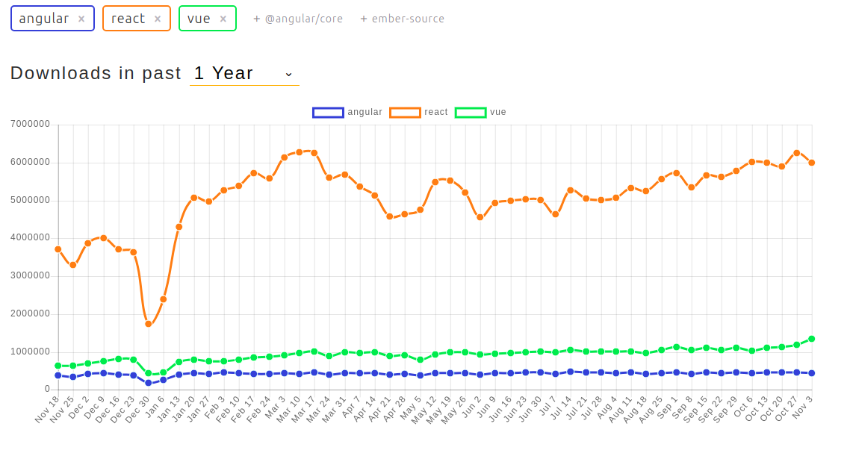


WHY ?

Slide 5
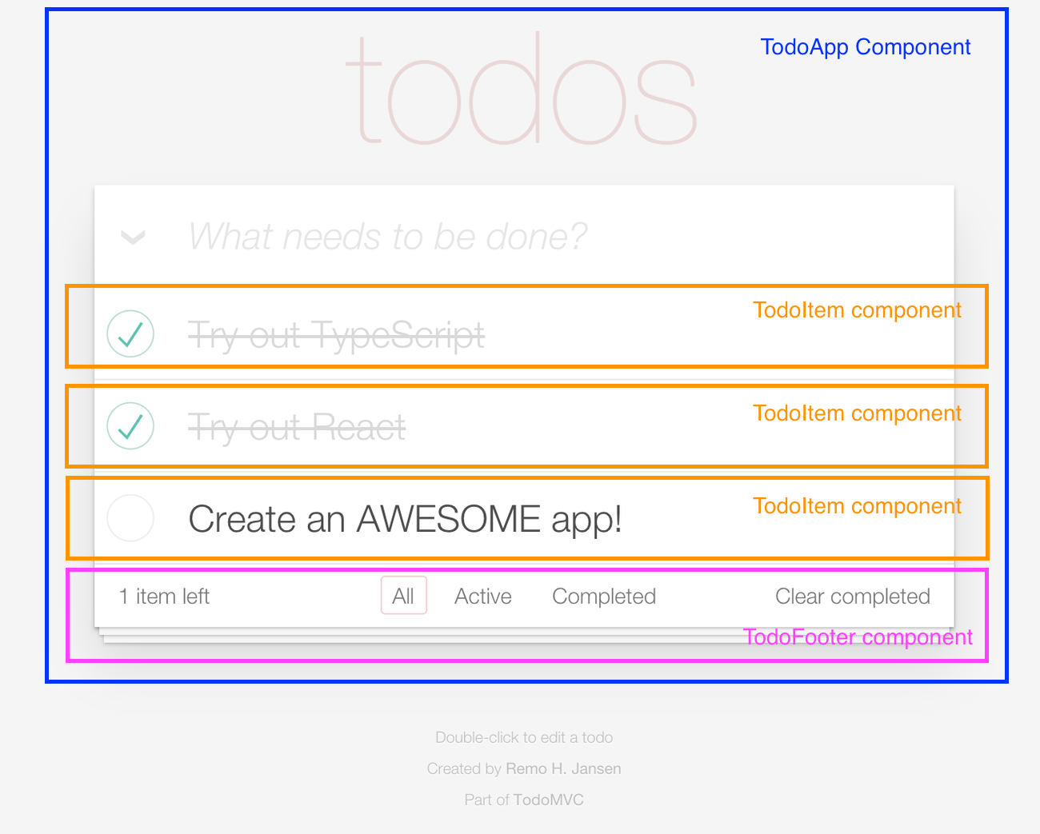
All about components

Slide 6
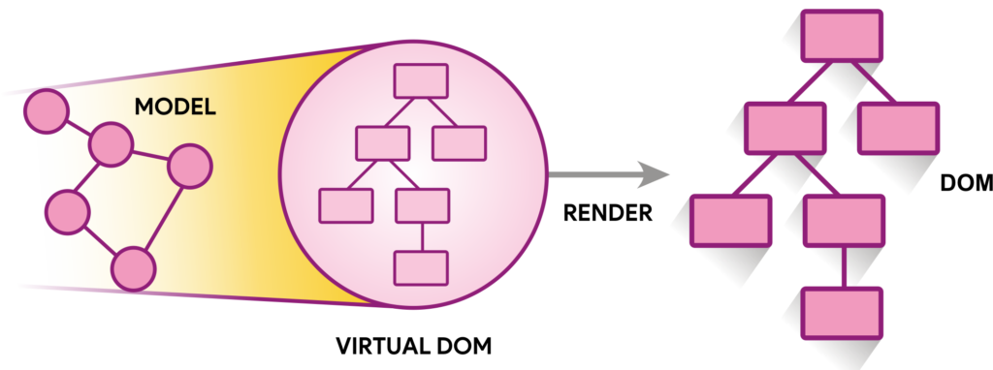
VIRTUAL DOM

Slide 7
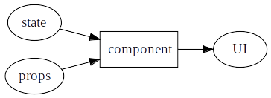
DECLARATIVE

Slide 8

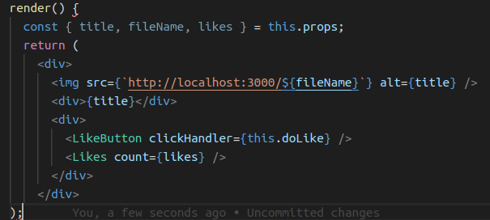
COMPOSABILITY

Slide 9
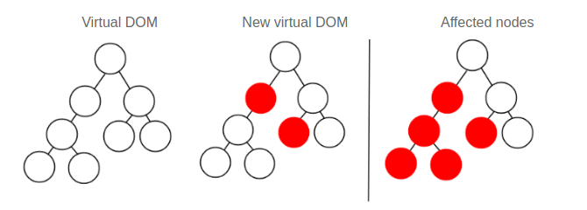
DATA FLOW

Slide 10
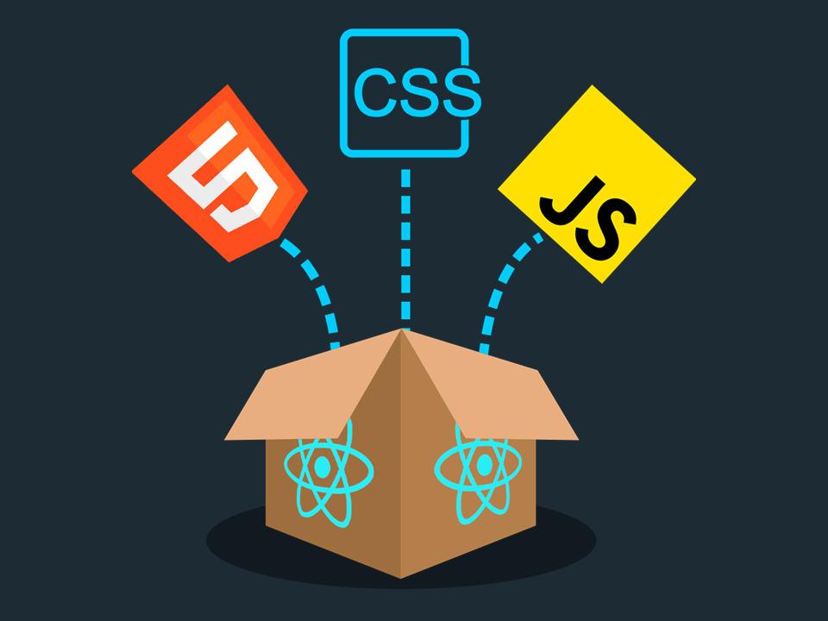
ARCHITECTURE

Slide 11
sources
https://www.systango.com/blog/react-js-infinity/
http://blog.krawaller.se/posts/composition-in-cyclejs-choo-react-and-angular2/
http://blog.wolksoftware.com/working-with-react-and-typescript
https://blog.10pines.com/2018/08/27/reactjs-virtual-dom/
https://everipedia.org/wiki/lang_en/jordan-walke
https://ed.team/blog/como-funciona-reactjs
https://www.npmtrends.com/angular-vs-react-vs-vue
https://reactjs.org/blog/2018/03/01/sneak-peek-beyond-react-16.html
https://element.eleme.io/#/en-US

