Slide 1
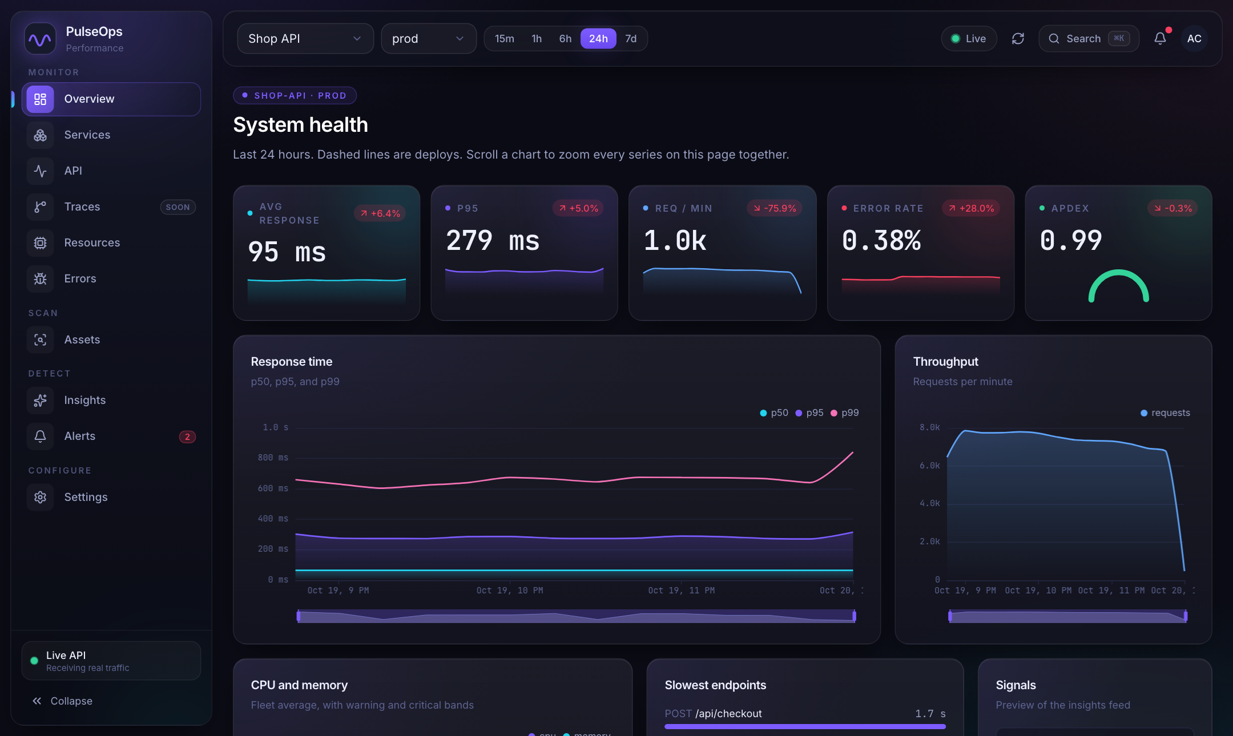
POC PRESENTATION
PulseOps
One project per app: asset scan and API performance in a single workspace.
End-to-end walkthrough with screenshots from the running application
Notes:
Open with the one-line promise: you point PulseOps at an app once, and it answers two questions: which files are wasted, and which API calls are slow or failing. Everything in this deck is a screenshot from the running application.

Slide 2
GOAL
What this POC sets out to prove
1
2
3
Two questions, one place
No code needed to start
Live traffic when you want it
Which asset files are unused, oversized or broken, and which API calls are slow or failing? Both answers live in one project.
A scan reads the repository and opens the running app in a browser. The app does not need to be changed.
Add a short SDK snippet to also see real traffic, throughput and errors as people use the app.
Earlier, asset scanning and API performance ended up as two separate project entries. The POC combines them into one app entry.
PulseOps proof of concept
Notes:
The earlier workflow created two entries for one app, one for the asset scan and one for APIs and Services. The key and snippet were hard to get from the dashboard, which is what pushed people to create a second project. This POC removes that.

Slide 3
ARCHITECTURE
How it fits together
Lab scan
Chromium (Playwright) opens your running app, visits the routes you list, and records assets, API calls and page timings. The repository is read too.
PulseOps API
Storage
Dashboard
FastAPI. Runs scans, accepts ingest calls with an API key, rolls data up, serves the dashboard.
PostgreSQL with TimescaleDB for metrics. Redis for rate limits.
React app on port 47321.
Browser SDK (optional)
A short snippet in the app sends fetch and XHR timings, page loads and errors every few seconds.
Pages: Overview, Services, API, Errors, Insights, Assets, Settings
PulseOps proof of concept
Notes:
Two ways in. The lab scan needs nothing in the app. The SDK is optional and adds real traffic. Both land in the same project, so the dashboard shows one app.

Slide 4
WALKTHROUGH
The end-to-end flow in six steps
1
2
3
Sign in
Create project
Scan assets
Open the dashboard and look at the seeded Shop API demo.
Assets, Edit setup, New project. Repository path, base URL, routes.
Run a Full scan. Read unused, large and broken assets.
4
5
6
Capture API calls
Read Services
Go live (optional)
API page, App capture. Per-route latency, errors, Apdex.
One card for the app, built from the same capture.
Settings: key and snippet. Live traffic joins the same project.
PulseOps proof of concept
Notes:
Roughly ten minutes. Steps 1 to 4 are the core story. Step 5 is a quick look. Step 6 is a talking point unless you want to show the key dialog.

Slide 5
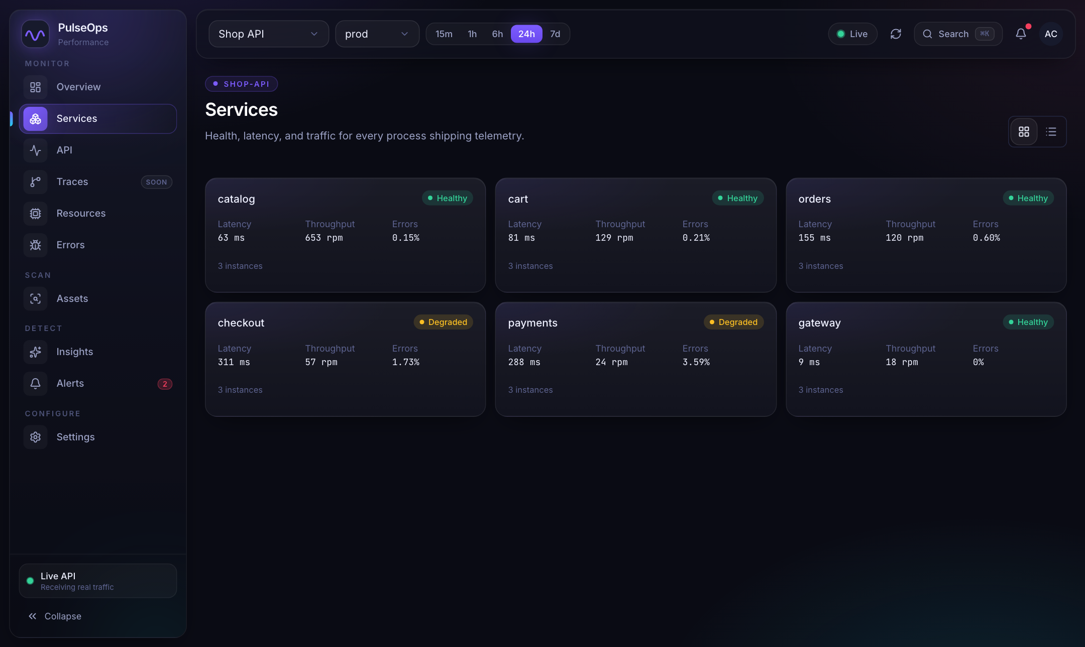
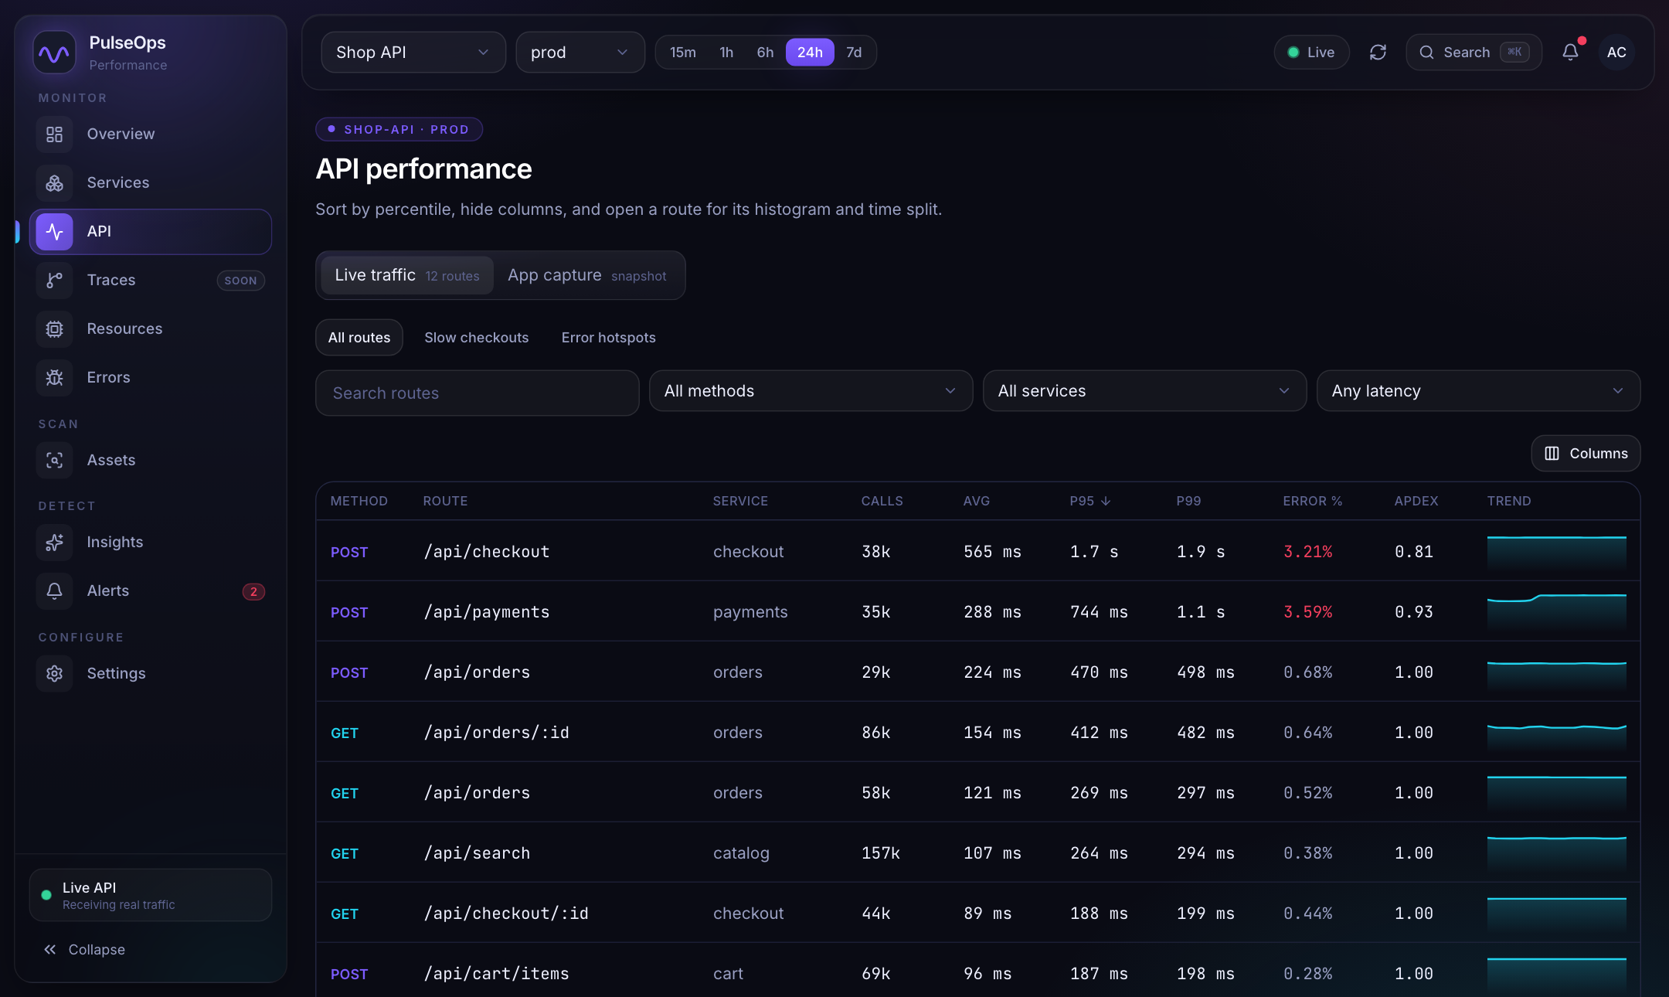
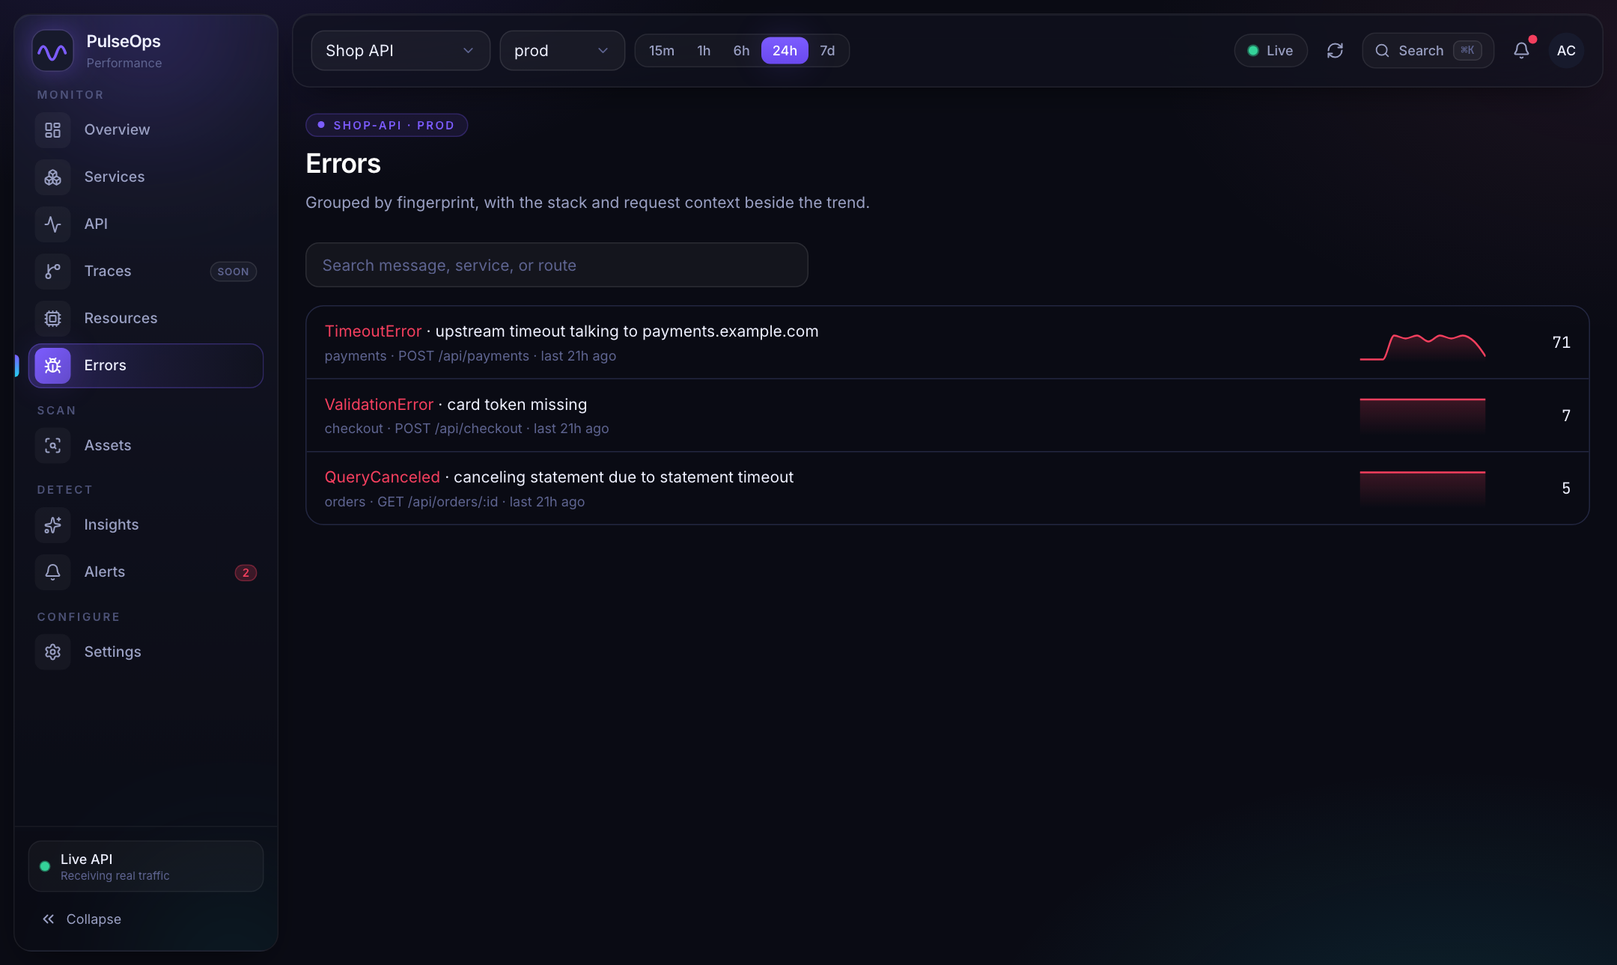
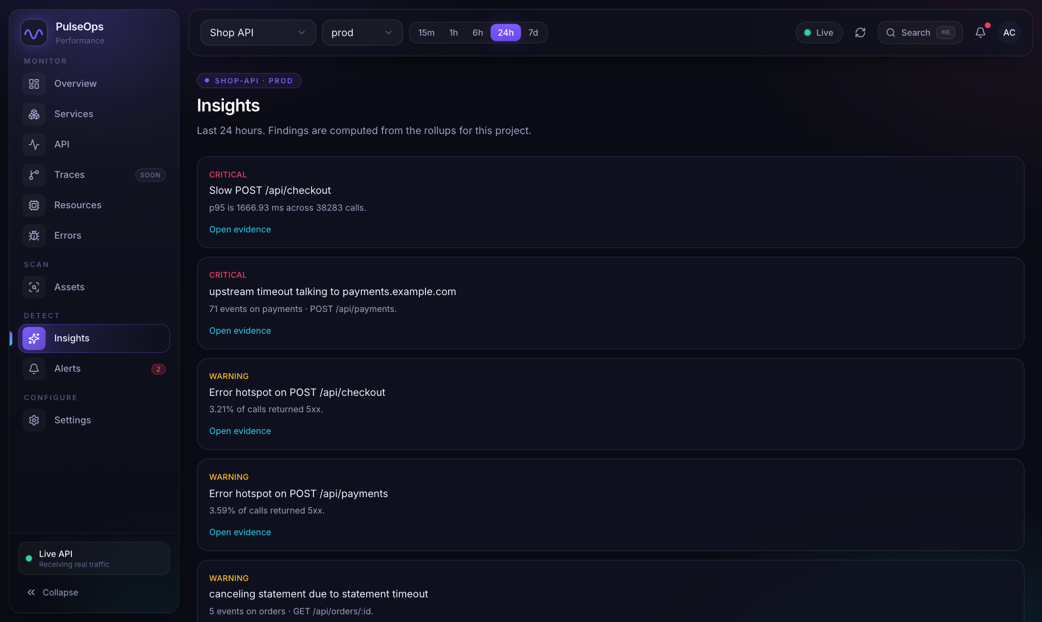
SHOP API (SEEDED DEMO DATA)
Step 1: Sign in and look at the demo project
What each page answers
Services: health, latency and error rate per service
API: every route with calls, average, p95, p99, errors, Apdex
Errors: grouped by fingerprint, with a trend
Insights: slow routes and error hotspots ranked by severity
PulseOps proof of concept
Notes:
This is the seeded Shop API project, so the pages are full of data. Sign in with demo@pulseops.dev. Use it to show what a finished report looks like before creating a new project.

Slide 6
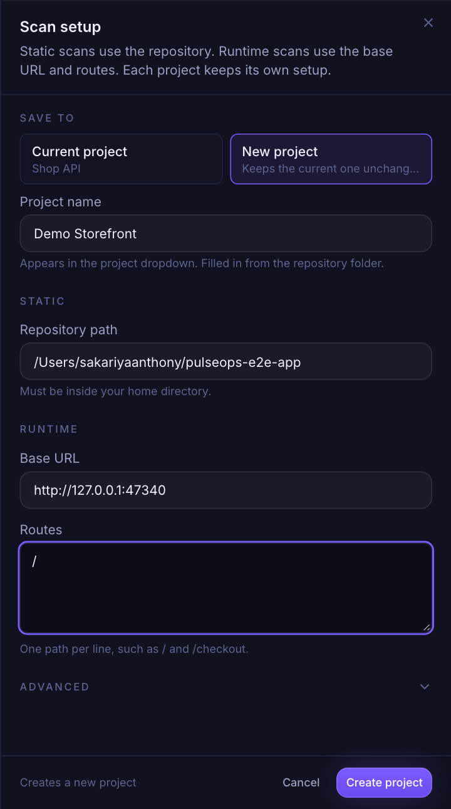
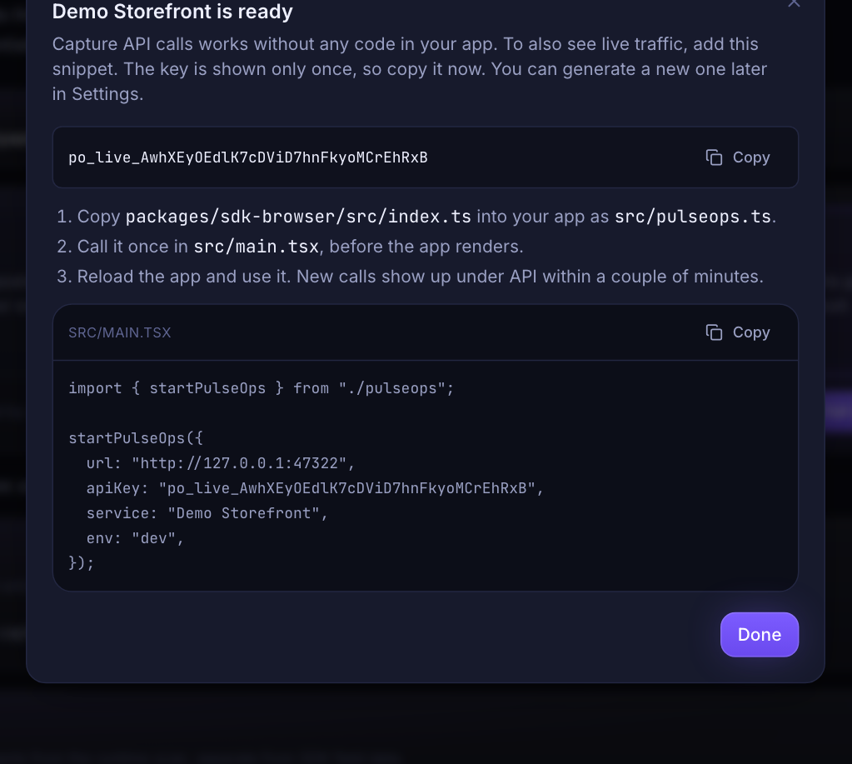
ASSETS, EDIT SETUP, NEW PROJECT
Step 2: Create one project for the app
Create once, then everything hangs off it
Name, repository path, base URL and routes are saved with the project
The key and SDK snippet appear once, ready to copy. Skipping is fine
A name that already exists is refused, so one app stays one entry
PulseOps proof of concept
Notes:
Fill the form live. The project name comes from the repo folder. After Create, the dialog shows the one-time key and a snippet that already has the service name filled in. Mention that creating a second project with the same name is refused with a clear message.

Slide 7
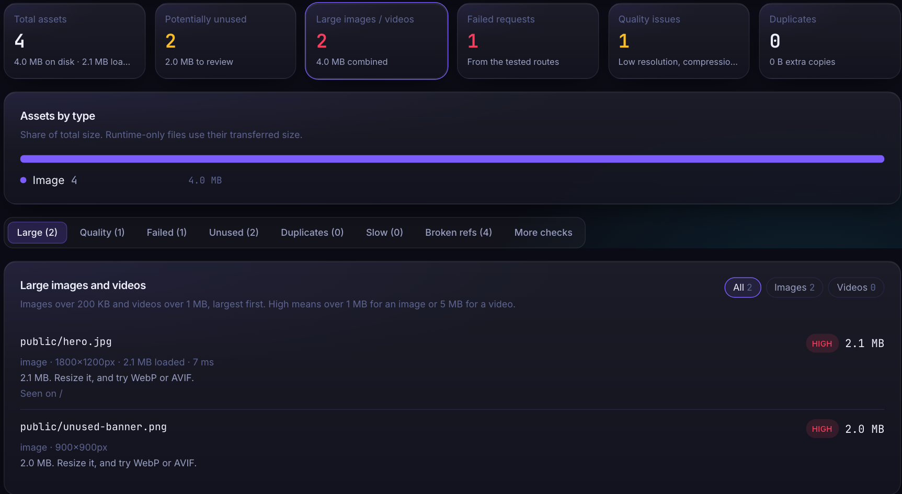
ASSETS, FULL SCAN
Step 3: Scan the assets
What the scan found
Reads the repository and opens the routes in Chromium
Compares what the code references with what the browser loaded
Files neither saw are marked potentially unused, not deleted
4
2
2
1
assets found
unused, 2.0 MB
large images, 4.0 MB
failed request
PulseOps proof of concept
Notes:
The demo app has a 2.1 MB hero image, a 2.0 MB banner nothing uses, and a missing promo image. The scan flags each of these and suggests resizing or converting to WebP or AVIF.

Slide 8
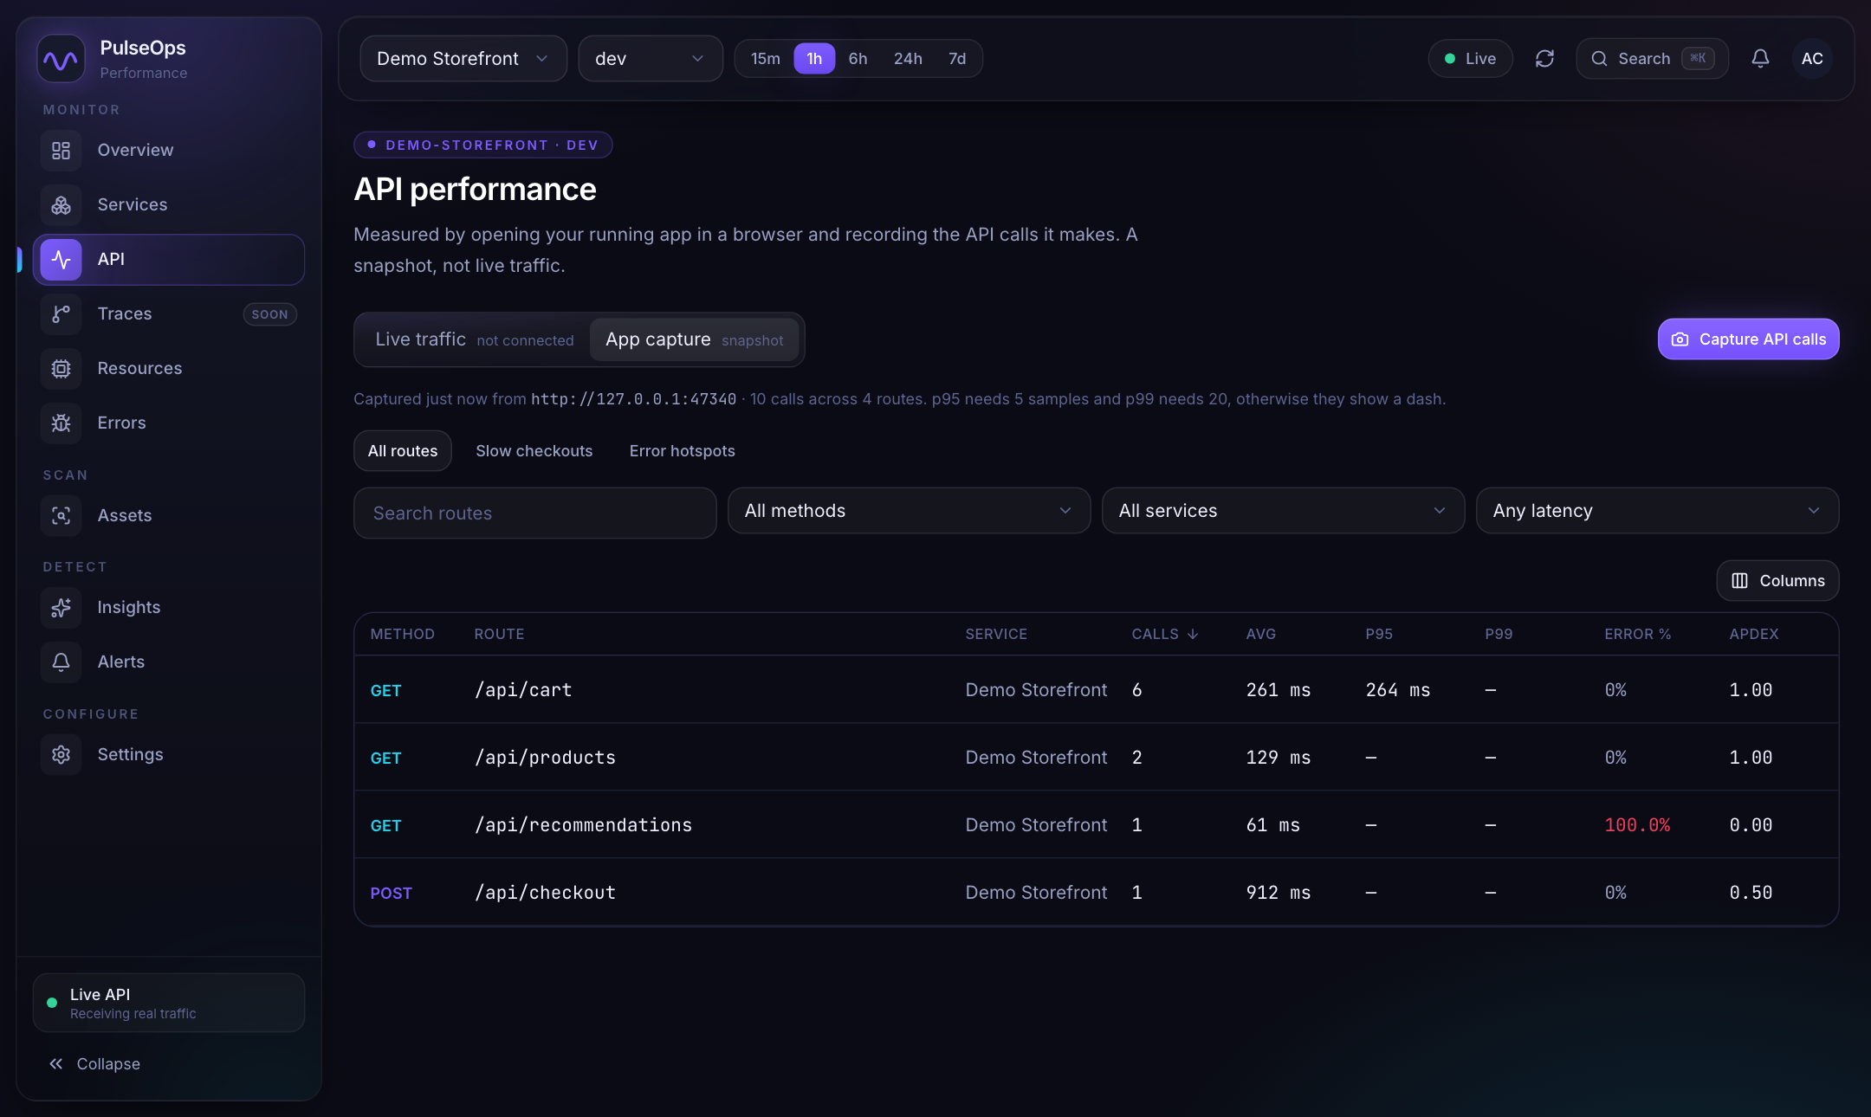
API, APP CAPTURE
Step 4: Capture API calls without touching the app
How the capture works
Press Capture API calls. PulseOps opens the app and records every API call it makes
Per route: calls, average, p95, p99, error rate and Apdex
p95 needs 5 samples and p99 needs 20, otherwise a dash
A snapshot of that run, labelled as such
The app must already be running at the base URL.
PulseOps proof of concept
Notes:
This is the new button. In this run, /api/recommendations returned 500 so it shows 100% errors, and /api/checkout took about 0.9 s so its Apdex is 0.50. If the app is not running, the page says: Is your app running at the base URL? Start it and try again.

Slide 9
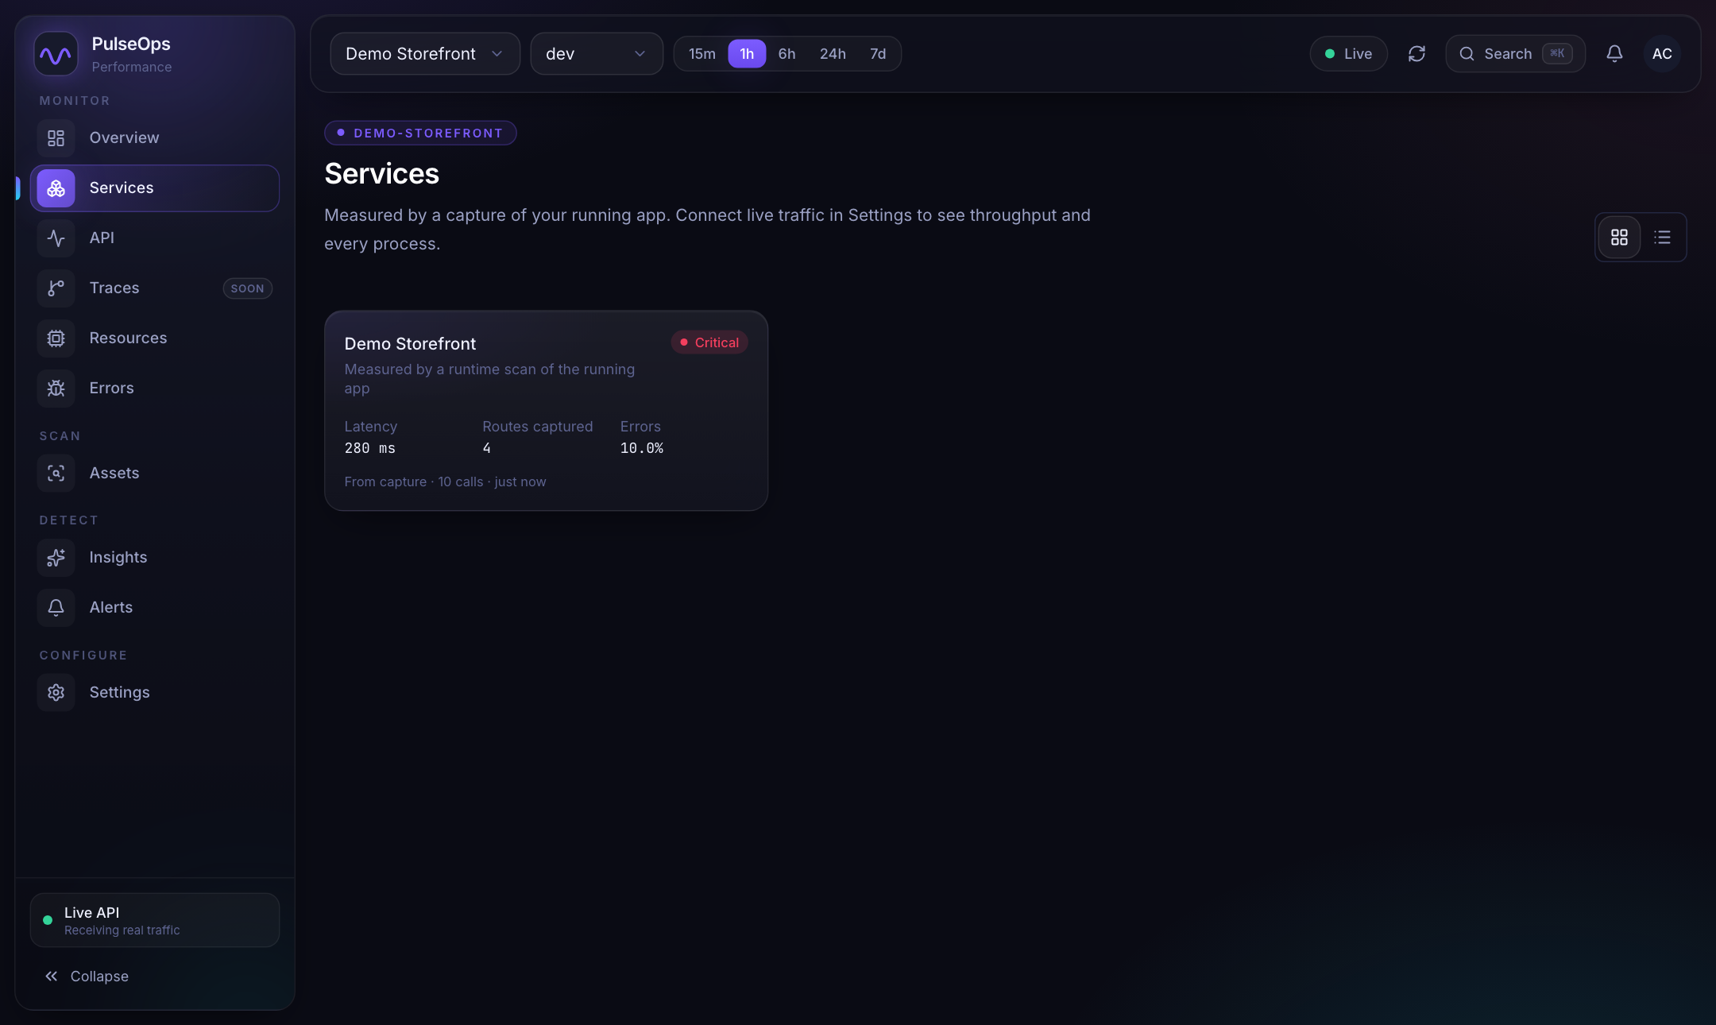
SERVICES
Step 5: One service card for the project
Built from the same capture
One card per app, named after the project
Latency is weighted by calls on routes with samples
Health: critical at 5% errors or more, degraded at 1% errors or latency over 800 ms
Clicking the card opens the API page on the capture
280 ms
4
10%
latency
routes captured
errors
PulseOps proof of concept
Notes:
With no live telemetry, the Services page falls back to a single card from the latest capture. Once live traffic arrives, the real per-process cards replace it.

Slide 10
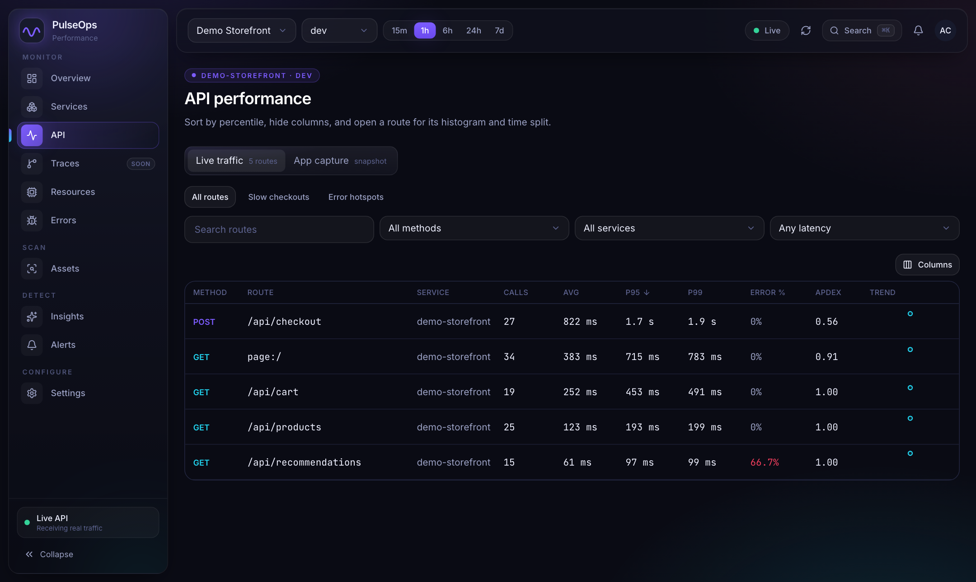
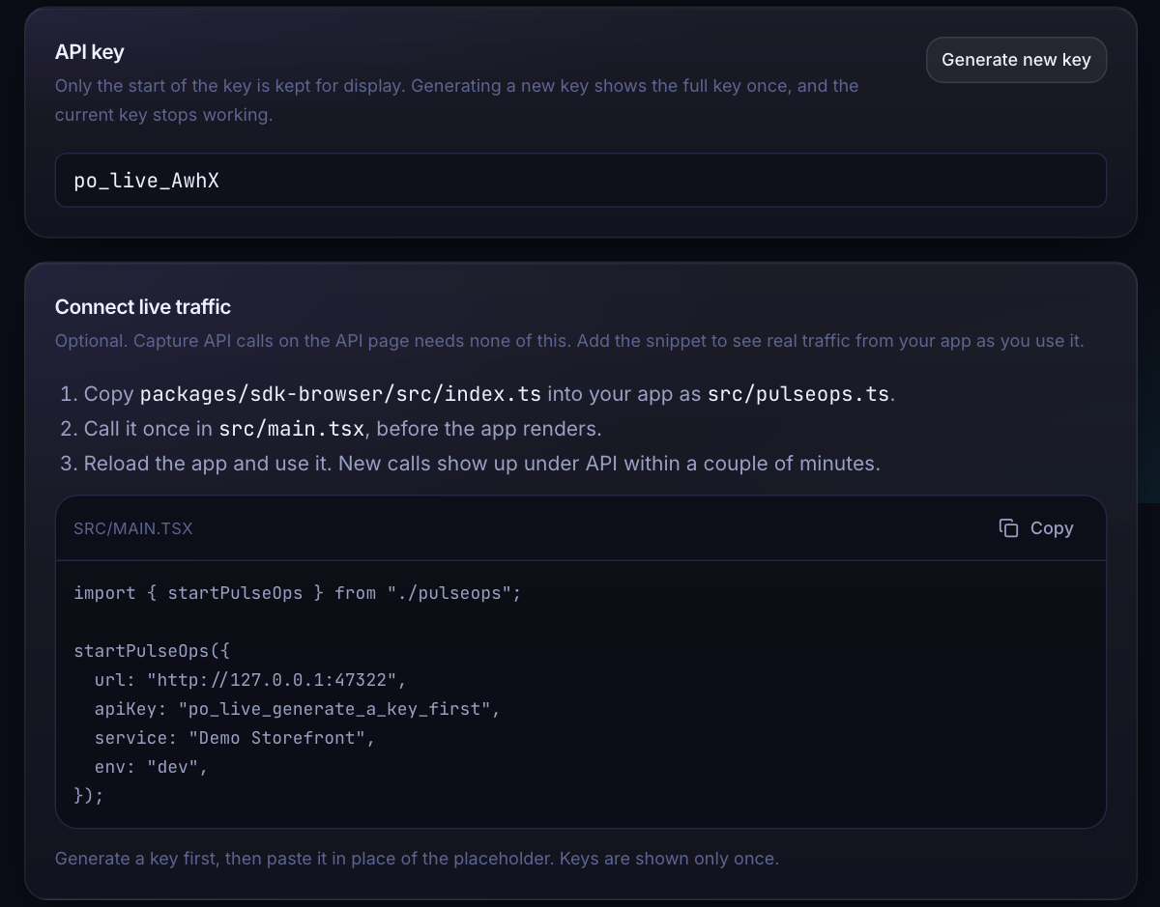
OPTIONAL, SAME PROJECT
Step 6: Add live traffic when you are ready
Demo traffic here was posted to the ingest endpoint in the SDK's format. The demo app has no SDK embedded.
Settings shows the snippet with the service name filled in. Generate new key shows the full key once
Generating a key stops the old one, so apps using it get rejected
The API page now defaults to Live traffic, with a trend per route
PulseOps proof of concept
Notes:
Be upfront that the live rows come from a script posting to the same ingest endpoint the SDK uses, because the demo app does not embed the SDK. In a real app you paste the snippet into main.tsx and traffic arrives within a few seconds.

Slide 11
RESULTS
What was shown, and what is left
Demonstrated
Limits and next steps
One project holds the asset scan, API view, Services and live traffic
Asset scan finds unused, oversized and broken files
API calls captured from a running app with no code changes
Real key reveal and rotation; the old key stops working
Duplicate project names are refused
Private and local addresses stay blocked during scans
The app must be started by you; the scan does not launch it
A capture is one scripted visit, not live traffic
Percentiles need enough samples (5 for p95, 20 for p99)
Traces, team, retention and notification settings are not configured yet
Next: scheduled captures and an opt-in way to start the app
PulseOps proof of concept
Notes:
Close on honesty: it works end to end, and the limits are known. Starting the app automatically is deliberately left out because running commands from the dashboard is a security decision.

Slide 12
SETUP
Run the demo yourself
Before you present
# 1. databases (pulseops-source/infra)
docker compose up -d timescaledb redis
# 2. API (pulseops-source/apps/api)
. .venv/bin/activate
python -m app
# 3. dashboard (pulseops-source/apps/web)
npm run dev
# open http://127.0.0.1:47321
# demo@pulseops.dev / pulseops-demo
Start the app you will scan so it answers at the base URL
Keep its repository inside your home folder
Install the scanner libraries once; SCAN.md has the commands
Restart the API after code changes
PulseOps proof of concept
Notes:
SCAN.md in the repository has the full steps, including installing Playwright and Chromium for the scanner.

