Slide 1

TRAFFIC CONTROL SYSTEM USING FUZZY LOGIC

Slide 2
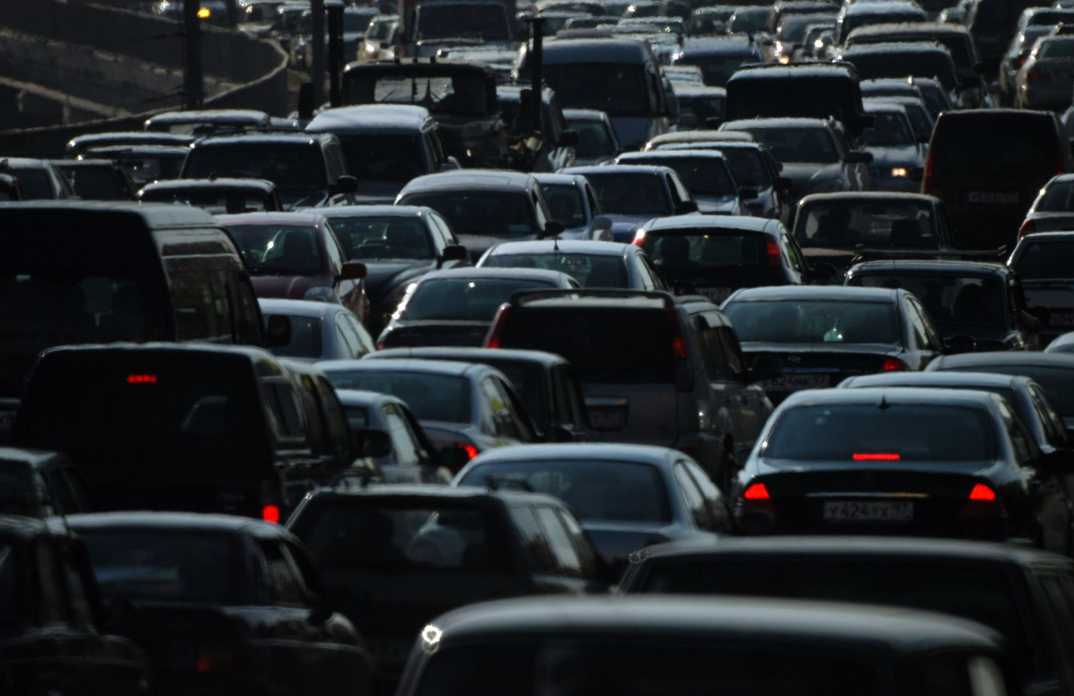
PROBLEM STATEMENT:
Traffic congestion is one of the crucial aspect of the urban planning.
However , with the rapid increase of traffic (both public and personal transport); these days there are a lot of traffic congestion problems.

Slide 3
One of the alternative and potential solutions can be fuzzy logic-based traffic lights control system.
1) What is fuzzy logic ?
A method of reasoning that resembles human reasoning.
2) Why we used fuzzy logic ?
The approach of fuzzy logic imitates the way decision making in humans that involves all intermediate possibilities between digital values YES and NO
Proposed
Solution

Slide 4
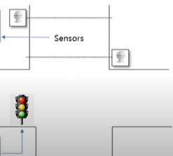
How fuzzy logic works for traffic lights?
Counter
*Queue
*Arrival
State Machine
Fuzzy Logic Controller
Traffic Lights Interface

Slide 5
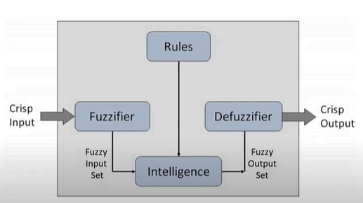
IN DETAIL WORKING OF FUZZY LOGIC CONTROL

Slide 6
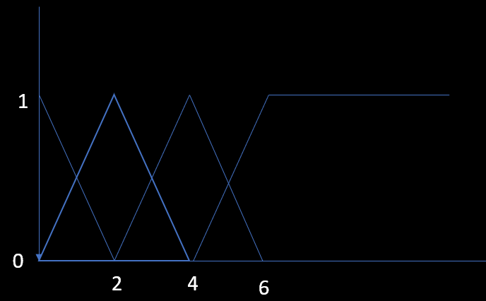
Fuzzification Process
Input Variables
Arrival --------→ {Few , Small , Medium , Many}
Queue ---------→ {Zero , Short ,Medium , Long}
For both Vertical and Horizontal Lanes
Membership functions
Input Fuzzy Variable-1
Arrival
Input Fuzzy Variable-2
Queue
Few S Med Many
Zero Sho Med Long
No of cars
No of cars

Slide 7
• Rules
IF Arrival is FEW AND Queue is Zero THEN Extension is Zero
IF Arrival is FEW AND Queue is Short THEN Extension is Zero
IF Arrival is FEW AND Queue is Medium THEN Extension is Zero
IF Arrival is FEW AND Queue is Large THEN Extension is Zero
• IF Arrival is Few AND Queue is Very Small THEN Extension is Short IF Arrival is Few AND Queue is Small THEN Extension is Short
IF Arrival is Few AND Queue is Medium THEN Extension is Zero IF Arrival is Few AND Queue is Large THEN Extension is Zero
IF Arrival is Many AND Queue is Very Small THEN Extension is Medium
IF Arrival is Many AND Queue is Small THEN Extension is Medium IF Arrival is Many AND Queue is Medium THEN Extension is Short
IF Arrival is Many AND Queue is Large THEN Extension is Zero IF Arrival is Too Many AND Queue is Very Small THEN Extension is Longer
. IF Arrival is Too Many AND Queue is Small THEN Extension is Medium
+IF Arrival is Too Many AND Queue is Medium THEN Extension is Medium IF Arrival is Too Many AND Queue is Large THEN Extension is Longer
INTELLIGENCE PROCESS

Slide 8
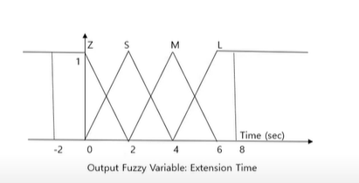
DEFUZZIFICATION PROCESS
Extension Time:

