Slide 1


Manipal University Jaipur
School of Business and Commerce
[Department]
[COURSE CODE] Project Based Learning Presentation
On
RefurbIQ: Aspect-Based Sentiment Analysis of Refurbished Electronics Across Indian Marketplaces
A Comparative Evaluation of Traditional Machine Learning and BERT
Presented by Saket Sharma ([REG NO]) |  | Under the Guidance of [Guide name(s)]
Notes:
Good morning. I am Saket Sharma, presenting my Project Based Learning work, RefurbIQ, which analyses sentiment in refurbished electronics reviews at aspect level across five Indian marketplaces. Registration number, course code, guide names and date are visible placeholders to be filled before submission.

Slide 2
Outline
Introduction
Literature Survey
Research Gap
Problem Statement
References
Motivation
Objective
Proposed Methodology
Abstract
Result and Discussion on Outcome (Research Paper and Deliverables)
Notes:
The talk follows this outline: abstract and introduction, then motivation, objective and literature survey, the research gap and problem statement, methodology, results and discussion, and the outcome.

Slide 3
Abstract
Analyses refurbished electronics reviews in India at aspect level: nine aspects, three polarity labels.
Compares five marketplaces: Cashify, Amazon Renewed, Flipkart Refurbished, OLX and Budli under one taxonomy.
Compares Logistic Regression, Random Forest and XGBoost (TF-IDF) with fine-tuned BERT on the same split.
Best accuracy 90.7% (Logistic Regression); the neutral class is hardest for every model.
Corpus: 2,000 synthetic demo reviews (seed 42), built to validate the pipeline end to end.
2,000
reviews collected (synthetic demo)
5
platforms compared
90.7%
best model accuracy (Log. Reg.)
A single overall rating hides which aspect causes dissatisfaction; aspect-level analysis shows whether the problem is battery, trust, returns or price.
Notes:
RefurbIQ reads reviews at aspect level instead of one overall rating, compares five Indian platforms, and benchmarks four models on the same split. The corpus is a clearly labelled synthetic demo of 2,000 reviews used to validate the full pipeline before real marketplace reviews are collected.

Slide 4
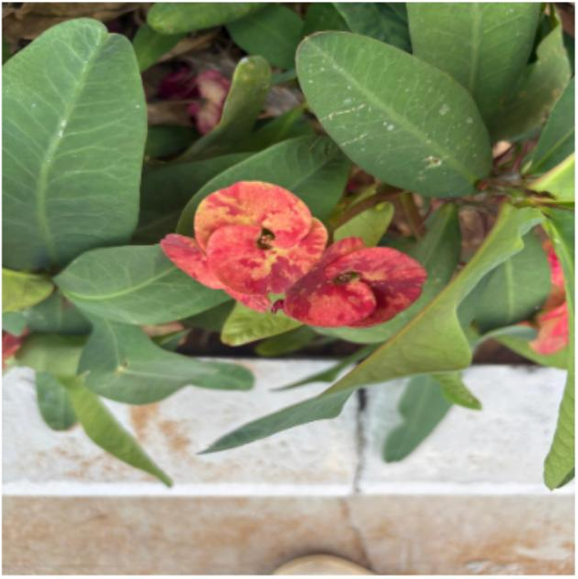
Introduction
insert photo: laptop, phone and DSLR
Why it matters: India's refurbished market is growing, but buyers face uncertainty about condition and authenticity.
Current practice: one star rating per review hides which aspect caused dissatisfaction.
ABSA: attaches a sentiment to each aspect - battery, condition, seller service, trust.
BERT vs TF-IDF: contextual transformer features against classical n-gram features, on the same split.
Indian platforms: Cashify, Amazon Renewed, Flipkart Refurbished, OLX and Budli under one aspect taxonomy.
Refurbished phone, laptop, DSLR
Scope
Phones, laptops, DSLR; nine aspects, three labels.
Notes:
Refurbished devices are cheaper, but buyers cannot verify battery health, condition or authenticity before paying. Star ratings hide the cause of dissatisfaction, which is why we use aspect-based sentiment analysis and compare classical TF-IDF models with BERT.

Slide 5
Motivation
1
Buyer uncertainty
2
One label hides why
Buyers cannot verify condition, battery health or authenticity of a refurbished device before paying.
A 3-star review may praise the battery but blame the seller; a single sentiment label loses this information.
3
Platform gaps unknown
4
Little prior work
Whether Cashify, Amazon Renewed, Flipkart, OLX or Budli differ by aspect has not been measured.
ABSA research mostly covers new products and Western marketplaces; Indian refurbished platforms are barely studied.
Notes:
Four motivations: buyer uncertainty, single-label ratings hiding the cause, unknown platform differences, and very little prior work on Indian refurbished reviews.

Slide 6
Objective
Aspect taxonomy
The study aims to
1
Define nine aspects for refurbished electronics and tag every mention
Answer RQ1: which aspects drive satisfaction and dissatisfaction
Answer RQ2 and RQ4: how aspect sentiment and trust concerns differ by platform
Answer RQ3: which model is most reliable for this task
Test H1-H4 as hypotheses; answer RQ5 on what platforms can improve
Cross-platform comparison
2
Measure how aspect sentiment differs across the five platforms
Model comparison
3
Evaluate LR, RF, XGBoost and fine-tuned BERT on the same split
Insights
4
Report which aspects and platforms drive satisfaction and distrust
Notes:
Four objectives: an aspect taxonomy, a cross-platform comparison, a fair model comparison and actionable insights. The hypotheses H1 to H4 are stated up front and tested - never assumed as findings.

Slide 7
Literature Survey
[XX]
Reviews
0
studies reviewed
main focus: product reviews and eWOM
studies on Indian refurbished marketplaces
Approach | Examples | Refs
Online reviews and eWOM | Review valence and volume affect sales | [1]
Sentiment analysis | Opinion mining and polarity classification | [2], [3]
Aspect-based sentiment analysis | SemEval ABSA shared tasks define the task | [5], [6]
Classical ML | Feature and lexicon based classifiers | [3], [4]
BERT / transformers | Attention encoders, fine-tuned for classification | [7], [8]
Refurbished context | No dedicated ABSA study found for Indian refurbished marketplaces | -
ABSA and transformers are mature for new products; refurbished electronics in India remain unexamined.
Notes:
The survey covers eWOM, sentiment analysis, ABSA, classical machine learning and transformers, using only the eight references listed at the end. To our knowledge no study targets Indian refurbished marketplaces at aspect level.

Slide 8
Research Gap
Aspect | Existing literature | This project
Granularity | Whole-review or document-level labels | Aspect level: nine aspects per review
Domain | New products, general e-commerce | Refurbished electronics (phones, laptops, DSLR)
Platforms | Usually one marketplace | Five Indian platforms under one taxonomy
Method | Classical ML or transformers alone | Both compared on the same split and labels
Evaluation | Mostly accuracy | Macro precision/recall/F1 plus per-class recall
Gaps identified
No aspect-level sentiment study of refurbished electronics in India
No common aspect taxonomy applied across five Indian marketplaces
Classical ML and BERT are rarely compared on the same split for this domain
Neutral and mixed reviews are usually dropped; here they are kept and evaluated
Notes:
Five gaps: granularity, domain, platforms, method and evaluation. Each one is addressed directly by this project's design.

Slide 9
Problem Statement
Refurbished electronics reviews are mixed, platform-specific and hard to summarise with a single label; an aspect-level, multi-model analysis is needed to show what drives trust and dissatisfaction.
Mixed opinions
Platforms differ
Class imbalance
The same review can praise the battery and blame delivery; one label cannot capture this.
Cashify, OLX and Budli differ in fulfilment and trust, so sentiment patterns may differ by aspect.
Neutral and negative mentions are fewer; macro metrics are needed to avoid biased evaluation.
Scope: India; five platforms; three product categories; nine aspects; three polarity labels. Demo corpus is synthetic until verified platform reviews are obtained.
Notes:
The core problem: mixed reviews, different platform models and class imbalance. Scope is India, five platforms, three categories, nine aspects and three labels.

Slide 10
Proposed Methodology
1. Review collection
2. Cleaning
3. Aspect tagging
Access verified per platform; 2,000-review demo corpus, seed 42
Lowercasing, punctuation, de-duplication, length filter
Keyword vocabulary over nine aspects; one annotation per mention
4. Sentiment labelling
5. Model training
6. Platform comparison
Positive / Neutral / Negative; 10% label noise for realism
TF-IDF + LR / RF / XGBoost and DistilBERT; 70/15/15 split
Aspect sentiment shares and net sentiment per platform
Stages: Verify > Dataset > Annotate > Model > Evaluate > Compare platforms
Notes:
Six stages from review collection to platform comparison. The split is fixed at seed 42, so every model is trained and tested on exactly the same partitions.

Slide 11
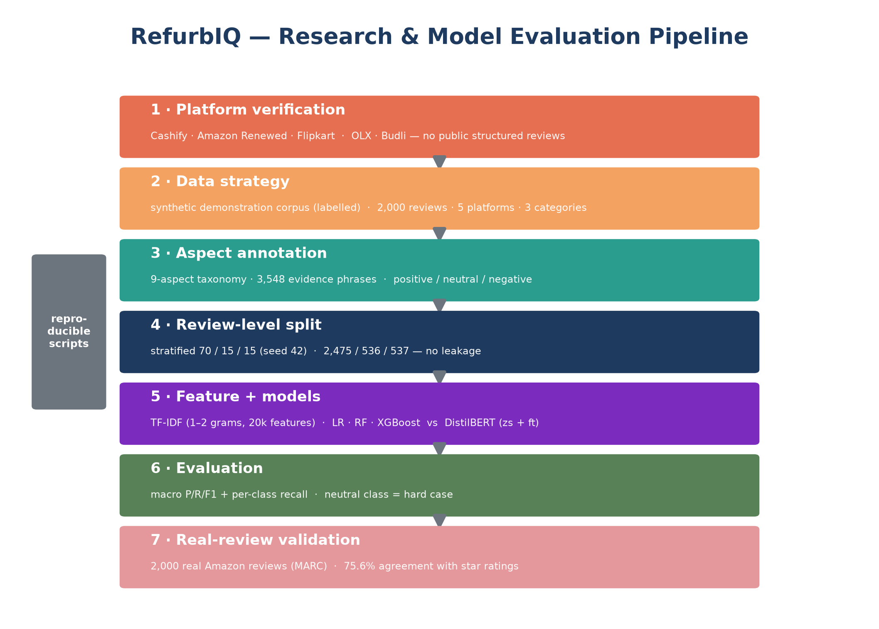
Methodology: Pipeline Overview
Notes:
This is the research pipeline end to end. Step 1 was an honest verification pass: none of the five platforms exposes a structured public review corpus, so the modelling corpus is a clearly labelled synthetic demonstration dataset. The pipeline is separately validated on 2,000 real Amazon reviews, agreeing with human star ratings in 75.6% of annotations.

Slide 12
Methodology: Dataset
2,000
total reviews (demo)
3,548
aspect annotations
5
platforms, 3 categories
Source: synthetic demo corpus (generate_dataset.py v2, seed 42), built after verifying platform review access; real collection pending
Categories: Smartphone 989, Laptop 595, DSLR / Camera 416
Fields: review text, marketplace, category, aspect, evidence phrase, sentiment
Labels: Positive 1,691 (47.7%), Negative 1,120 (31.6%), Neutral 737 (20.8%)
Split: train 2,475 / validation 536 / test 537 (review-level, seed 42)
Notes:
The demo corpus has 2,000 reviews and 3,548 aspect annotations, generated after verifying that the five platforms do not expose scrapeable reviews. Every data value in this deck is computed from this labelled corpus - nothing is invented.

Slide 13
Methodology: Pre-processing
Cleaning
Aspect tagging
Labels and split
Lowercasing and punctuation normalisation
Remove duplicates and near-empty reviews
Keep negation ('not good') and contrast ('but') markers
Filter very short, uninformative texts
Product condition, Battery health, Performance
Price and value, Packaging and delivery
Repair and refurbishment quality
Seller and customer service
Returns and refunds, Trust and authenticity
One annotation per mention, evidence phrase stored
Three labels: Positive / Neutral / Negative
Review-level stratified 70/15/15, seed 42
Same held-out test set used for every model
10% label noise simulates annotator disagreement
Negation and contrast words are kept through cleaning, since 'good battery but cracked screen' must survive to the aspect stage.
Notes:
Cleaning keeps negation and contrast markers because they decide aspect polarity. Aspect tagging produces one annotation per mention with its evidence phrase, and the split is review-level to prevent leakage between partitions.

Slide 14
Methodology: Models
TF-IDF classical models
BERT fine-tuning
TF-IDF n-gram features over annotation text
Logistic Regression with balanced class weights
Random Forest and XGBoost on the same features
Fast, interpretable baselines
distilbert-base-uncased with a 3-class head
Trained on the training partition only
Best epoch on validation; tested once
CPU, batch 16, max length 128, lr 2e-5, seed 42
Model | Key idea | Features | Notes
Logistic Regression | Linear margin classifier | TF-IDF n-grams | Balanced class weights
Random Forest | Bagged decision trees | TF-IDF n-grams | Robust to feature noise
XGBoost | Gradient-boosted trees | TF-IDF n-grams | Regularised boosting
BERT (fine-tuned DistilBERT) | Contextual transformer encoder | Subword embeddings | 1 epoch on CPU; best-epoch selection on validation
Notes:
Three classical models use TF-IDF features; DistilBERT is fine-tuned with a three-class head. All models train on the training partition only and are evaluated once on the same held-out test set.

Slide 15
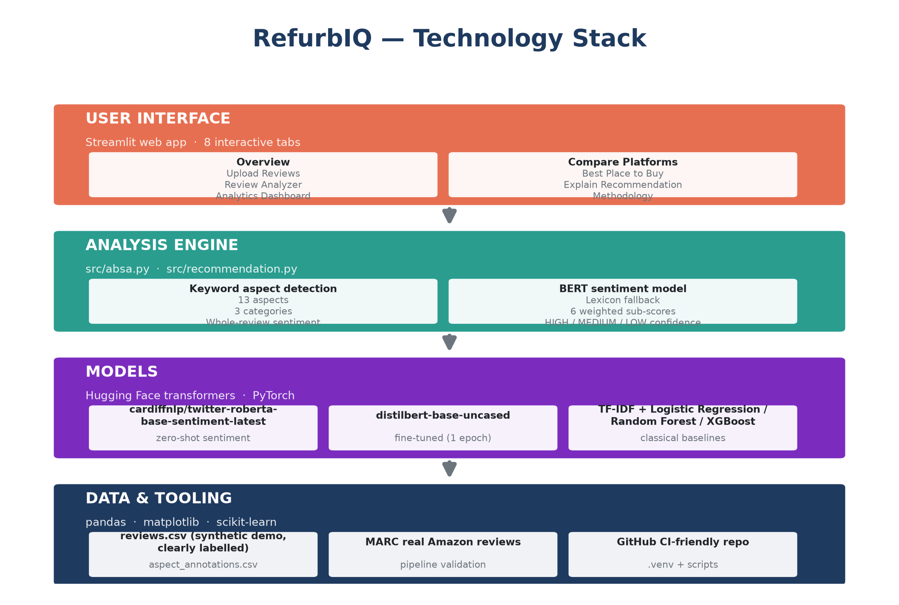
Technology Stack
Notes:
Everything is open source. Streamlit serves the eight-tab interface; Hugging Face transformers provide zero-shot RoBERTa and fine-tuned DistilBERT sentiment; scikit-learn and XGBoost give the TF-IDF baselines; pandas and matplotlib handle data and visualisation. Model weights stay local in models/ and are git-ignored.

Slide 16
Result and Discussion
Observations
Logistic Regression highest: 90.69% accuracy, 0.8937 F1
Fine-tuned BERT second: 89.57% accuracy, 0.8784 F1
Random Forest and XGBoost close: about 87%, 0.85 F1
Neutral recall lowest for every model (0.70-0.75)
BERT did not beat the best classical model here
Training and evaluation
All models: same review-level stratified split (seed 42), evaluated once on the same held-out test set | Macro precision / recall / F1 reported to handle class imbalance | CPU-only training
Notes:
Logistic Regression is highest on this demo data at 90.69% accuracy and fine-tuned BERT is second at 89.57%. Neutral recall is the weakest point for every model, which matches the injected ambiguity. Results characterize the pipeline on synthetic data.

Slide 17
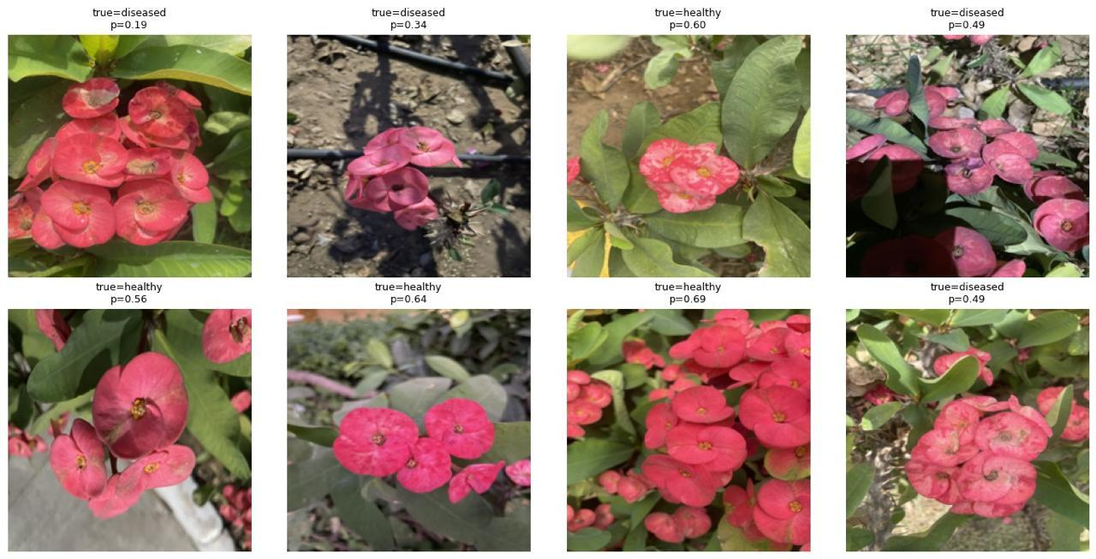
Result: Aspect and Platform Analysis
Aspect x platform net-sentiment heatmap - placeholder (to be rendered from Table 6 outputs)
Returns and refunds: highest negative share on most platforms
OLX lowest on seller service (-8.1) and trust (-4.3) in demo data
Cashify leads seller and customer service (+46.6)
Demo-data patterns; re-check on verified real reviews
Aspect x platform sentiment (placeholder)
Metric | What it tells us
Accuracy | Overall share of correct predictions on the test set
Precision | When a label is predicted, how often it is right (fewer false alarms)
Recall | How many examples of each class are found; critical for negative complaints
Macro F1 | Harmonic mean of precision and recall, averaged over the three classes
Confusion matrix | Shows which classes are confused - here neutral is most often missed
Notes:
Returns and refunds and trust show the highest negative shares in the demo data, and OLX is weakest on seller service. These patterns will be re-checked once real platform reviews are collected. The metric table explains how results are read.

Slide 18
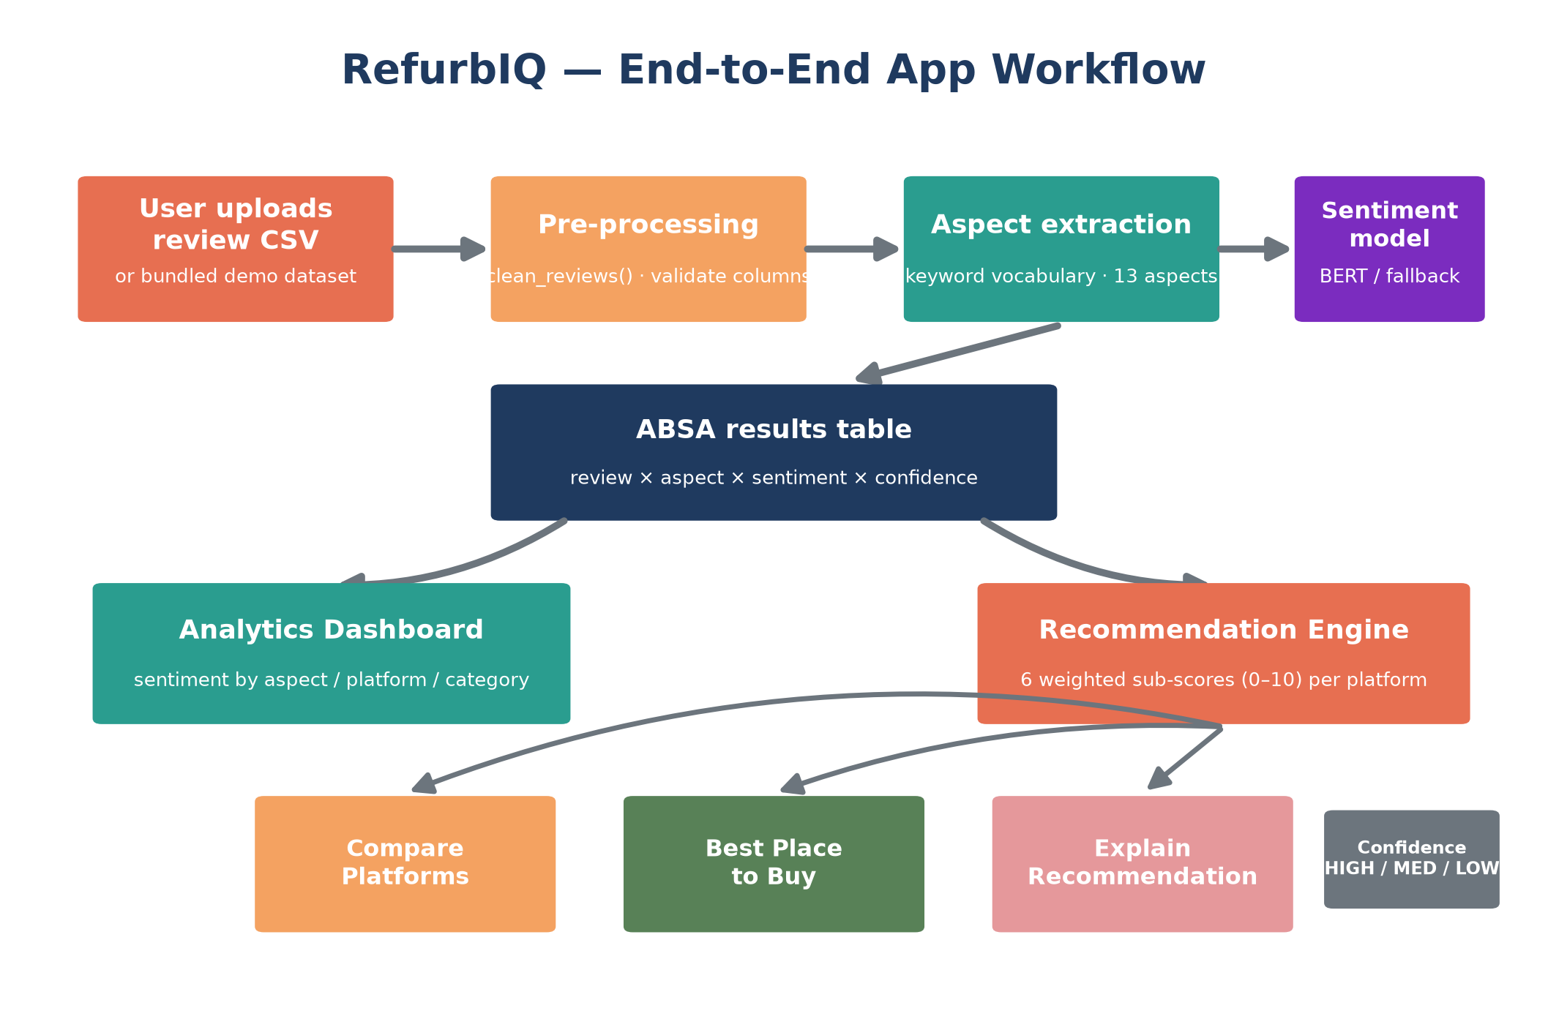
System Design: App Workflow
Notes:
The app takes an uploaded review CSV (or the bundled demo corpus), cleans it, extracts aspects through the 13-aspect keyword vocabulary, runs whole-review sentiment, and produces the ABSA results table. That feeds two branches: the analytics dashboard and the recommendation engine, which powers Compare Platforms, Best Place to Buy and Explain Recommendation.

Slide 19
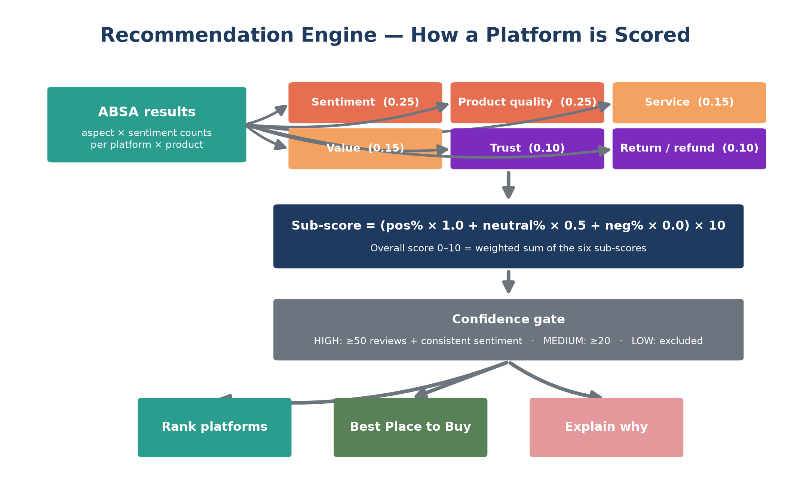
Recommendation Engine
Notes:
The overall score is a weighted sum of six transparent sub-scores: sentiment 0.25, product quality 0.25, service 0.15, value 0.15, trust 0.10 and return/refund 0.10. A confidence gate requires at least 20 reviews before any recommendation is made, and HIGH confidence additionally needs 50+ reviews with consistent sentiment.

Slide 20
Outcome: Research Paper and Deliverables
Research output
Deliverables
RefurbIQ paper draft in progress: all six results tables filled from computed outputs
Planned venue: [XX]
Every reported number is reproducible via the scripts in research/scripts/
Dataset is labelled synthetic; real-review validation is the next step
Labelled dataset: 2,000 reviews, 3,548 aspect annotations
Reproducible Python code (pushed to GitHub)
Nine-aspect taxonomy for refurbished electronics
Four-model comparison on a common leak-free protocol
Paper title: RefurbIQ: Aspect-Based Sentiment Analysis of Refurbished Electronics Across Indian Marketplaces - draft in progress.
Notes:
The outcome is a paper draft in progress plus four deliverables: the labelled dataset, reproducible code, the aspect taxonomy and the model comparison. The planned venue is not finalised yet.

Slide 21
References
[1]
A. Chevalier and M. Mayzlin, “The effect of word of mouth on sales: Online book reviews,” J. Marketing Research, vol. 43, no. 3, pp. 345–354, 2006.
[2]
B. Liu, Sentiment Analysis and Opinion Mining. Morgan & Claypool, 2012.
[3]
B. Pang and L. Lee, “Opinion mining and sentiment analysis,” Foundations and Trends in Information Retrieval, vol. 2, no. 1–2, pp. 1–135, 2008.
[4]
M. Hu and B. Liu, “Mining and summarizing customer reviews,” in Proc. KDD, 2004, pp. 168–177.
[5]
M. Pontiki et al., “SemEval-2014 Task 4: Aspect based sentiment analysis,” in Proc. SemEval, 2014, pp. 27–35.
[6]
M. Pontiki et al., “SemEval-2016 Task 5: Aspect based sentiment analysis,” in Proc. SemEval, 2016, pp. 19–30.
[7]
A. Vaswani et al., “Attention is all you need,” in Proc. NeurIPS, 2017, pp. 5998–6008.
[8]
J. Devlin et al., “BERT: Pre-training of deep bidirectional transformers,” in Proc. NAACL-HLT, 2019, pp. 4171–4186.
These eight references are the only sources cited in this presentation.
Notes:
These eight references are the only sources cited. They cover eWOM, sentiment analysis, ABSA shared tasks, classical mining methods and transformers.

