Slide 1

N E T F L I X C O N T E N T A N A L Y T I C S
Exploring the Netflix Catalog
A capstone project on the Netflix global catalog — 5,837 titles, 72 countries, cleaned in Excel and visualized in Power BI.
PRESENTED BY
Saket Aman
Sourish Mukherjee
Data Cleaning: Microsoft Excel | Dashboarding: Power BI

Slide 2
PROJECT OBJECTIVE
Why We Built This
Understand the Catalog
1
Break down 5,837 Netflix titles by genre, type, rating and revenue to see what actually makes up the platform.
Track Content Health
2
Monitor what's Available, Leaving Soon or Removed — and whether quality plays a role in what gets pulled.
Reveal Global Reach
3
Map production countries to show how far beyond the US Netflix's content engine really runs.
Turn Data into a Tool
4
Package everything into a single interactive Power BI dashboard that answers questions in seconds, not spreadsheets.

Slide 3
HOW WE BUILT IT
Our Pipeline: Excel to Power BI
01
02
03
04
Raw Dataset
Excel Cleaning
Power BI Modeling
Interactive Dashboard
Netflix catalog export — 5,837 rows x 15 fields: titles, cast, country, ratings, revenue, availability.
›
Fixed nulls in director/cast/country, standardized dates, split multi-value fields, parsed duration into minutes & seasons.
›
Built measures (Avg Revenue, Avg Rating), relationships and DAX calculations on top of the cleaned table.
›
Assembled KPI cards, genre/country breakdowns, director rankings and a year-over-year trend view.

Slide 4
DATASET SNAPSHOT
What We Were Working With
5,837
72
14
TOTAL TITLES
COUNTRIES REPRESENTED
CONTENT GENRES
1925–2026
3,939 / 1,898
6.51
RELEASE YEAR SPAN
MOVIES / TV SHOWS
AVG. IMDB RATING

Slide 5
INSIGHT 01
Movies Dominate the Catalog
67.5%
of titles are Movies (3,939) — more than double the TV Show count.
32.5%
are TV Shows (1,898), skewing heavily toward single-season releases.
Why it matters
Acquisition and licensing strategy should weight movie decisions more heavily — they drive both catalog volume and revenue.

Slide 6
INSIGHT 02
Niche Genres Earn More Per Title

Slide 7
INSIGHT 03
Ratings Are Remarkably Even Across Genres
Sports (5.90) is the one clear outlier — every other genre clusters within half a point of the 6.51 catalog average.

Slide 8
INSIGHT 04
A Global Catalog, US-Anchored
72
countries contribute at least one title to the catalog.
41%
of titles originate in the United States — the largest single source.
India + UK
form a strong secondary hub, together outpacing every other country combined outside the US.

Slide 9
INSIGHT 05
Acquisitions Surged 2015–2019
From 74 titles added in 2015 to 1,843 in 2019 — a 24x jump, tracking Netflix's global content-investment ramp-up. (2020–2026 records are sparse in this extract and excluded here for a clean read.)

Slide 10
INSIGHT 06
1 in 5 Titles Has Left — or Is Leaving
81.8%
of the catalog (4,855 titles) is currently Available.
18.2%
has already left or is scheduled to — 724 Removed, 358 Leaving Soon.
Not a quality issue
Removed titles average 6.57 and Leaving Soon titles average 6.60 — both above the platform average. Churn tracks licensing, not ratings.

Slide 11
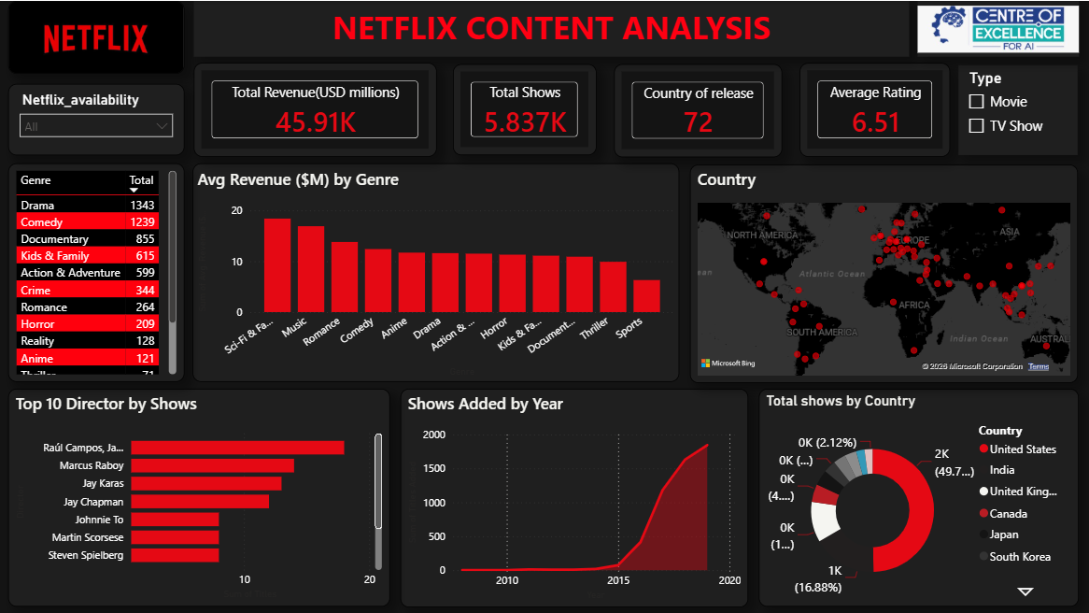
THE LIVE DASHBOARD
Everything, on One Screen
Dashboard screenshot to be added here
Built entirely in Power BI — KPI cards, genre/revenue chart, director ranking, year trend and country breakdown, all cross-filtered live.

Slide 12
THANK YOU
Questions & Discussion
Saket Aman · Sourish Mukherjee
Netflix Content Analytics — Excel + Power BI

