Slide 1




Student Result Analyzer Dashboard
Interactive Academic Performance Analysis using Microsoft Excel
Ramtanay Chakraborty & Saket Aman
Author

Slide 2





Problem Statement
The Challenge of Educational Data
Schools continually collect large volumes of student academic data. However, relying on manual analysis makes it exceptionally difficult to:
Identify top-performing students efficiently.
Compare individual student performance holistically.
Understand complex grade distributions.
Track historical pass and fail rates accurately.
Compare outcomes across different academic streams.
Generate rapid, on-demand administrative reports.
Manual Analysis Problems
Excel Dashboard Solutions

Slide 3









Project Objectives
Analyze Performance
Interactive Dashboard
Dynamic Reports
Deeply analyze student academic performance using structured data modeling.
Build a fully interactive dashboard for intuitive, click-driven data exploration.
Create dynamic report generation capabilities to automate standard academic reviews.
Compare Grades
Identify Performers
Visualize Averages
Facilitate macro and micro comparisons of grades across subjects and demographics.
Instantly identify top academic performers overall and within specific streams.
Provide clear, visual subject-wise performance benchmarks and averages.

Slide 4






Dataset Overview & Cleaning
Dataset Columns
Data Cleaning Process
Student ID
Total Marks
Remove duplicates: Ensure unique student records.
Student Name
Average
Correct formatting: Standardize text and numbers.
Gender
Position
Handle missing values: Impute or clean blank entries.
Stream
Grade
Validate marks: Ensure numeric consistency.
Section
Attendance
Calculate metrics: Auto-calculate Total and Average.
Subject Marks
Remark
Assign logic: Conditionally assign Grades based on logic.
Raw Data
Data Cleaning
Pivot Tables
Dashboard

Slide 5
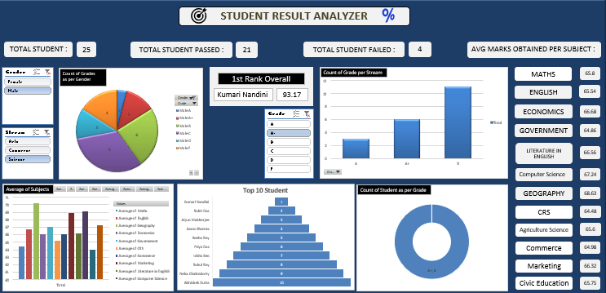

Interactive Dashboard
Key Performance Indicators
Total Students, Passed, and Failed Counts
1st Rank Overall Student Spotlight
Average Marks Obtained per Subject Summary
Visual Analytics
Doughnut/Pie: Grade Distribution by Gender & Overall
Column Charts: Grade Count by Stream & Subject Averages
Funnel Chart: Top 10 Performing Students
Interactive Controls
Slicers for Gender, Stream, and Grade filtering
Built-in navigation buttons (Raw Data, Clean Data, Report Card)
Interaction: Slicers update every Pivot Table and Pivot Chart dynamically, granting instantaneous data insights.

Slide 6
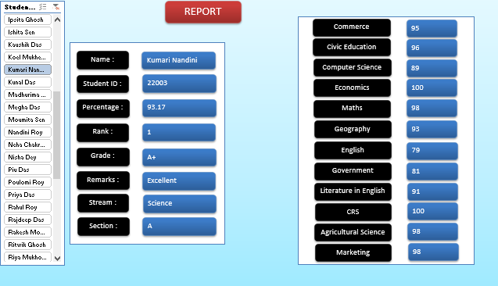
Dynamic Report Card Module
Automated Student Profiles
The Report Card module serves as a deep dive into individual student performance, generated completely autonomously via dashboard interactions.
Dynamic Selection: Students are selected instantly using a connected slicer UI.
Comprehensive Display: Automatically retrieves Name, ID, Percentage, Rank, Grade, Remarks, Stream, and Section.
Subject Breakdown: Displays exact scores for all enrolled subjects side-by-side.

Slide 7
















Tools & Technologies

Slide 8






Key Findings & Insights
50
80%
20%
Kumari N.
TOTAL STUDENTS ANALYZED
OVERALL PASS RATE
OVERALL FAIL RATE
OVERALL TOP RANK
Performance Analytics
Business Value
Subject Averages: Clear disparities identified in subject mastery (e.g., Mathematics vs. English).
Decision Making: Helps administrators identify underperforming streams instantly to allocate educational resources effectively.
Grade Distribution: Visualization reveals the primary concentration of academic results within standard curves.
Reward Systems: Effortlessly extracts the Top 10 performing students for scholarship or recognition programs.
Demographic Trends: Gender-wise grade analysis exposes varying academic strengths and weaknesses.
Efficiency: Replaces hours of manual filtering with instant, click-based interactive reporting.

Slide 9













Professional Skills Demonstrated

Slide 10


Conclusion
This project successfully transforms raw, unstructured student academic data into highly meaningful, actionable business intelligence insights.
Key Benefits
THANK YOU
Highly Interactive & Easy to Use
Fast, Automated Reporting
Saket Aman
&
Ramtanay Chakraborty
Dynamic Filtering Capabilities
Professional, Clean Visualization
Future Scope
Integration with Power Query & Power Pivot
ASPIRING DATA ANALYST
Migration to Power BI Dashboards
Automated PDF Report Card Generation
Implementing Predictive Analytics Models

