Slide 1

School of Computer Science and Engineering
RoadSense: Road Infrastructure
Monitoring Using Vibration Analysis
B.Tech (Honours) - Computer Science
Review 1
Internal
Project Guide / Mentor:
Prof. Chidhananda R S
Assistant Professor
School of Computer Science and Engineering
RV University, Bangalore
Team Members
1RUA24CSE0395 - Saket M

Slide 2
Contents
Title and Problem Definition
Aim and Objectives
Introduction & Scope
Literature Survey
Requirement Specification
Proposed Methodology
Implementation (Weeks 1–4)
Results & Screenshots
Future Work
Conclusion
References

Slide 3
Title and Problem Definition
Title: RoadSense — Road Infrastructure Monitoring Using Vibration Analysis
India has 6M+ km of roads; potholes cause thousands of accidents annually.
Manual road surveys are expensive, slow, and subjective — engineers walk the roads by hand.
No affordable, automated system exists that uses smartphone vibrations to detect and map potholes.
Goal: Use the accelerometer and gyroscope already inside every smartphone to detect road defects automatically.

Slide 4
Aim and Objectives
Aim: Design an affordable, automated road-condition monitoring system using smartphone inertial sensors.
Obj 1: Build a Progressive Web App (PWA) to record accelerometer, gyroscope, and GPS data simultaneously while riding.
Obj 2: Develop a custom web-based data labeling tool for annotating time-series sensor CSVs.
Obj 3: Collect real-world ride data on Bangalore roads and create a labeled ground-truth dataset.
Obj 4: Establish a spike-detection algorithm using Z-axis acceleration thresholds.
Obj 5: Visualize detected road anomalies on an interactive geographic map.

Slide 5
Introduction & Scope
Road surface degradation is a critical public safety hazard in India.
Smartphones contain powerful inertial measurement units (accelerometers + gyroscopes) that can sense road vibrations.
When a vehicle hits a pothole, the Z-axis acceleration spikes sharply — this is the core signal we exploit.
Scope: Mount a smartphone on a two-wheeler, record sensor data during rides, and automatically flag anomalies.
Weeks 1–4 focused on building the data collection app and the labeling tool to create training datasets.

Slide 6
Literature Survey
Eriksson et al. (2008) — "Pothole Patrol": Used taxi-mounted smartphone accelerometers. Achieved 80–90% recall but high false-positive rate from speed bumps.
Mednis et al. (2011) — Defined Z-axis threshold-based anomaly detection on Android phones. Limitation: Fixed thresholds fail at varying vehicle speeds.
Perttunen et al. (2011) — Used machine learning on accelerometer features for road classification. Limitation: Required extensive manual feature engineering.
Tai et al. (2010) — Proposed adaptive threshold using vehicle speed profiles. Limitation: Tested only on cars, not two-wheelers.
Research Gap: No existing system provides an end-to-end pipeline from data collection → labeling → detection → map visualization using just a smartphone.

Slide 7
Requirement Specification
Hardware: Any Android smartphone with accelerometer, gyroscope, and GPS. A two-wheeler vehicle for data collection.
Software: HTML5, CSS3, JavaScript (Vanilla), Python 3.13.
Libraries: Chart.js (interactive graphing), Papa Parse (CSV parsing), Leaflet.js (map rendering).
Data Format: CSV files with columns for timestamp, accel_x, accel_y, accel_z, gyro_x, gyro_y, gyro_z, latitude, longitude, speed.
Deployment: GitHub Pages (zero-cost static hosting for the PWA and map).

Slide 8
Proposed Methodology
Stage 1 — Data Collection: PWA records accelerometer, gyroscope, GPS, and speed at ~100 Hz while riding.
Stage 2 — Data Labeling: Upload the CSV to the custom labeling tool. Visually identify Z-axis spikes and annotate them as "Pothole" or "Speed Breaker".
Stage 3 — Anomaly Detection: Apply threshold-based spike detection on the Z-axis acceleration data. Flag readings where |accel_z| exceeds a configurable sensitivity threshold.
Stage 4 — Map Visualization: Plot all flagged GPS coordinates on an interactive Leaflet.js map, color-coded by severity (green = smooth, yellow = degraded, red = terrible).
Stage 5 — Export: Generate labeled CSV files with the annotation column for downstream ML training.

Slide 9
Implementation Timeline (Weeks 1–4)
Week 1: Research and planning. Studied existing pothole detection literature. Set up the development environment.
Week 2: Built the RoadSense PWA — records accelerometer, gyroscope, GPS, and speed data simultaneously with a "Start Ride" button.
Week 3: Developed the custom Labeling Tool web app — drag-and-drop CSV upload, interactive Chart.js graph, region selection, and CSV export with labels.
Week 4: Conducted initial test rides on Bangalore roads. Collected and labeled 5 ride datasets (~22,000 data points). Identified key challenges (speed bumps vs potholes).

Slide 10
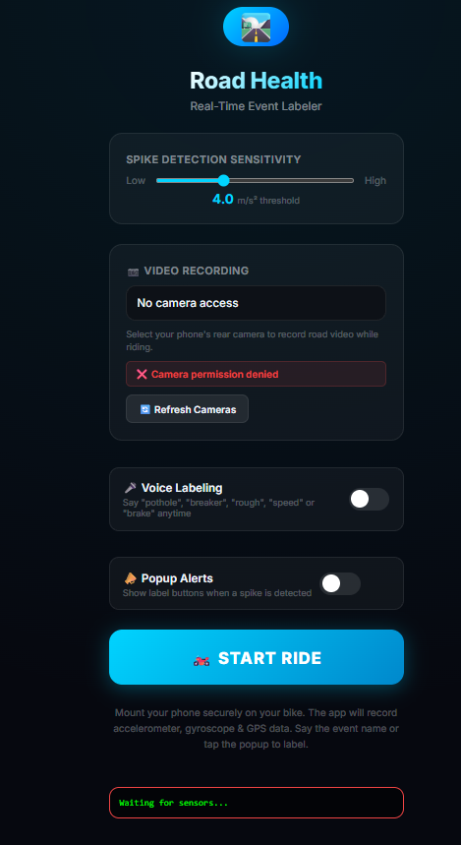
Fig 1: RoadSense Data Collection App
The RoadSense PWA running on a smartphone.
Features: Configurable spike detection sensitivity (threshold slider), voice labeling, popup alerts for real-time event marking.
The app records accelerometer, gyroscope, GPS coordinates, and vehicle speed simultaneously at ~100 Hz.
Data is exported as a raw CSV file for offline analysis.

Slide 11
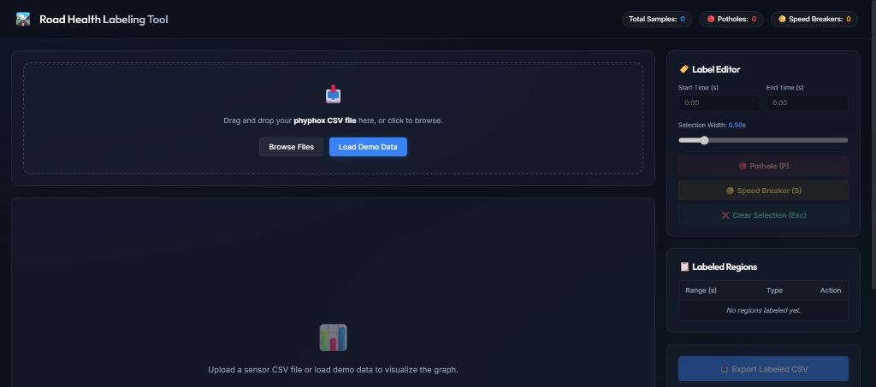
Fig 2: Labeling Tool — CSV Upload Interface
The custom-built Labeling Tool web application.
Users drag and drop a sensor CSV file or load demo data to visualize the acceleration graph.
Right panel: Label Editor with Pothole (P) and Speed Breaker (S) buttons, selection width slider, and labeled regions list.

Slide 12
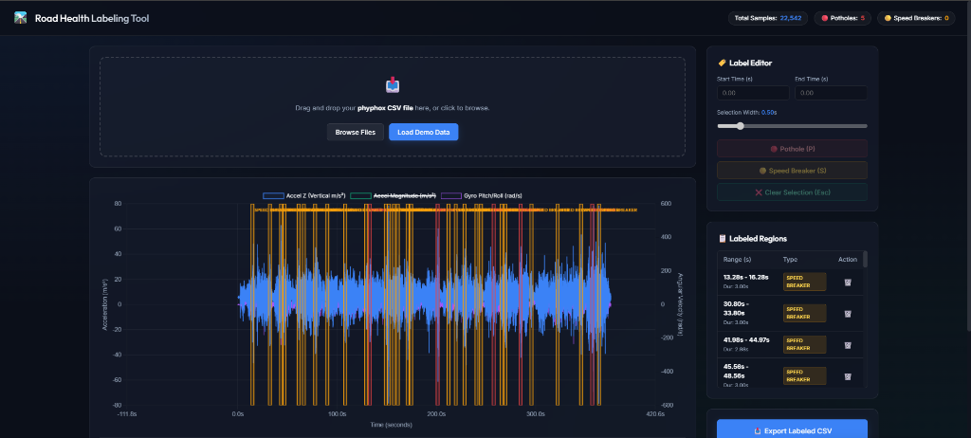
Fig 3: Labeling Tool — Annotated Ride Data
A real ride dataset (22,542 samples) loaded into the labeling tool.
Blue line: Z-axis acceleration (vertical jolts). Orange line: Acceleration magnitude. Cyan line: Gyroscope pitch/roll.
Red/yellow highlighted regions: Manually labeled speed breakers. The tool maps these annotations back to exact timestamps.
Labeled CSV is exported for ground-truth dataset creation.

Slide 13
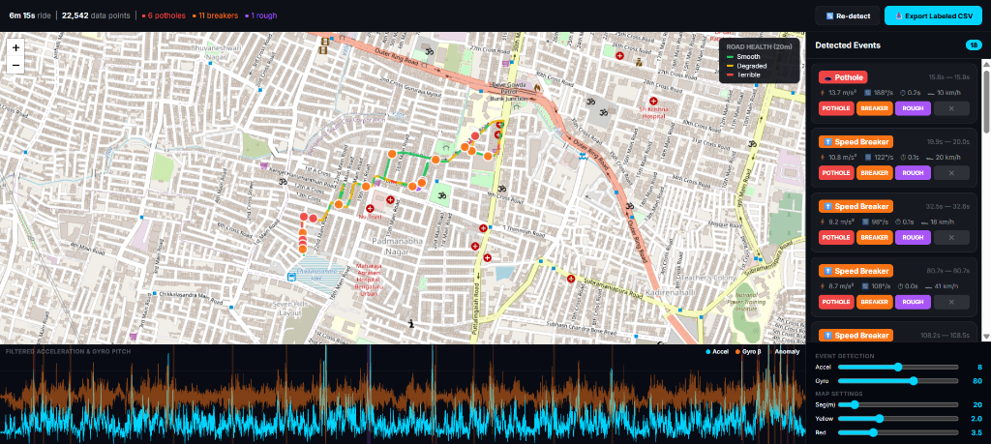
Fig 4: Interactive Road Health Map
Detected events plotted on a Leaflet.js map of Bangalore.
Road segments are color-coded: Green = Smooth, Yellow = Degraded, Red = Terrible.
Right panel: List of all detected events (6 potholes, 11 speed breakers, 1 rough patch) with their acceleration and speed values.
Bottom panel: Filtered acceleration and gyroscope waveform for the full ride with anomaly markers.

Slide 14
Future Work
Develop a machine learning model trained on the labeled datasets to automatically classify road anomalies.
Build a vehicle speed calibration profile so that detection thresholds adapt to different speeds.
Integrate camera-based visual detection to cross-verify sensor data (multi-sensor fusion).
Add auto-spike detection to the labeling tool to reduce manual annotation effort.
Deploy a public-facing road health dashboard for municipal authorities.

Slide 15
References
[1] J. Eriksson et al., "The Pothole Patrol: Using a Mobile Sensor Network for Road Surface Monitoring," ACM MobiSys, 2008.
[2] A. Mednis et al., "Real-time pothole detection using Android smartphones with accelerometers," IEEE DCOSS, 2011.
[3] M. Perttunen et al., "Distributed road surface condition monitoring using mobile phones," IEEE Pervasive, 2011.
[4] Y.-C. Tai et al., "Automatic road anomaly detection using smart mobile device," IEEE WASA, 2010.
[5] Chart.js — Open Source HTML5 Charts. https://www.chartjs.org/
[6] Papa Parse — CSV Parser for JavaScript. https://www.papaparse.com/
[7] Leaflet.js — Interactive Maps. https://leafletjs.com/

Slide 16
Thank You

