Slide 1
RoadSense: Week 1 to 4 Progress
Data Labeling Foundation
Saket M

Slide 5
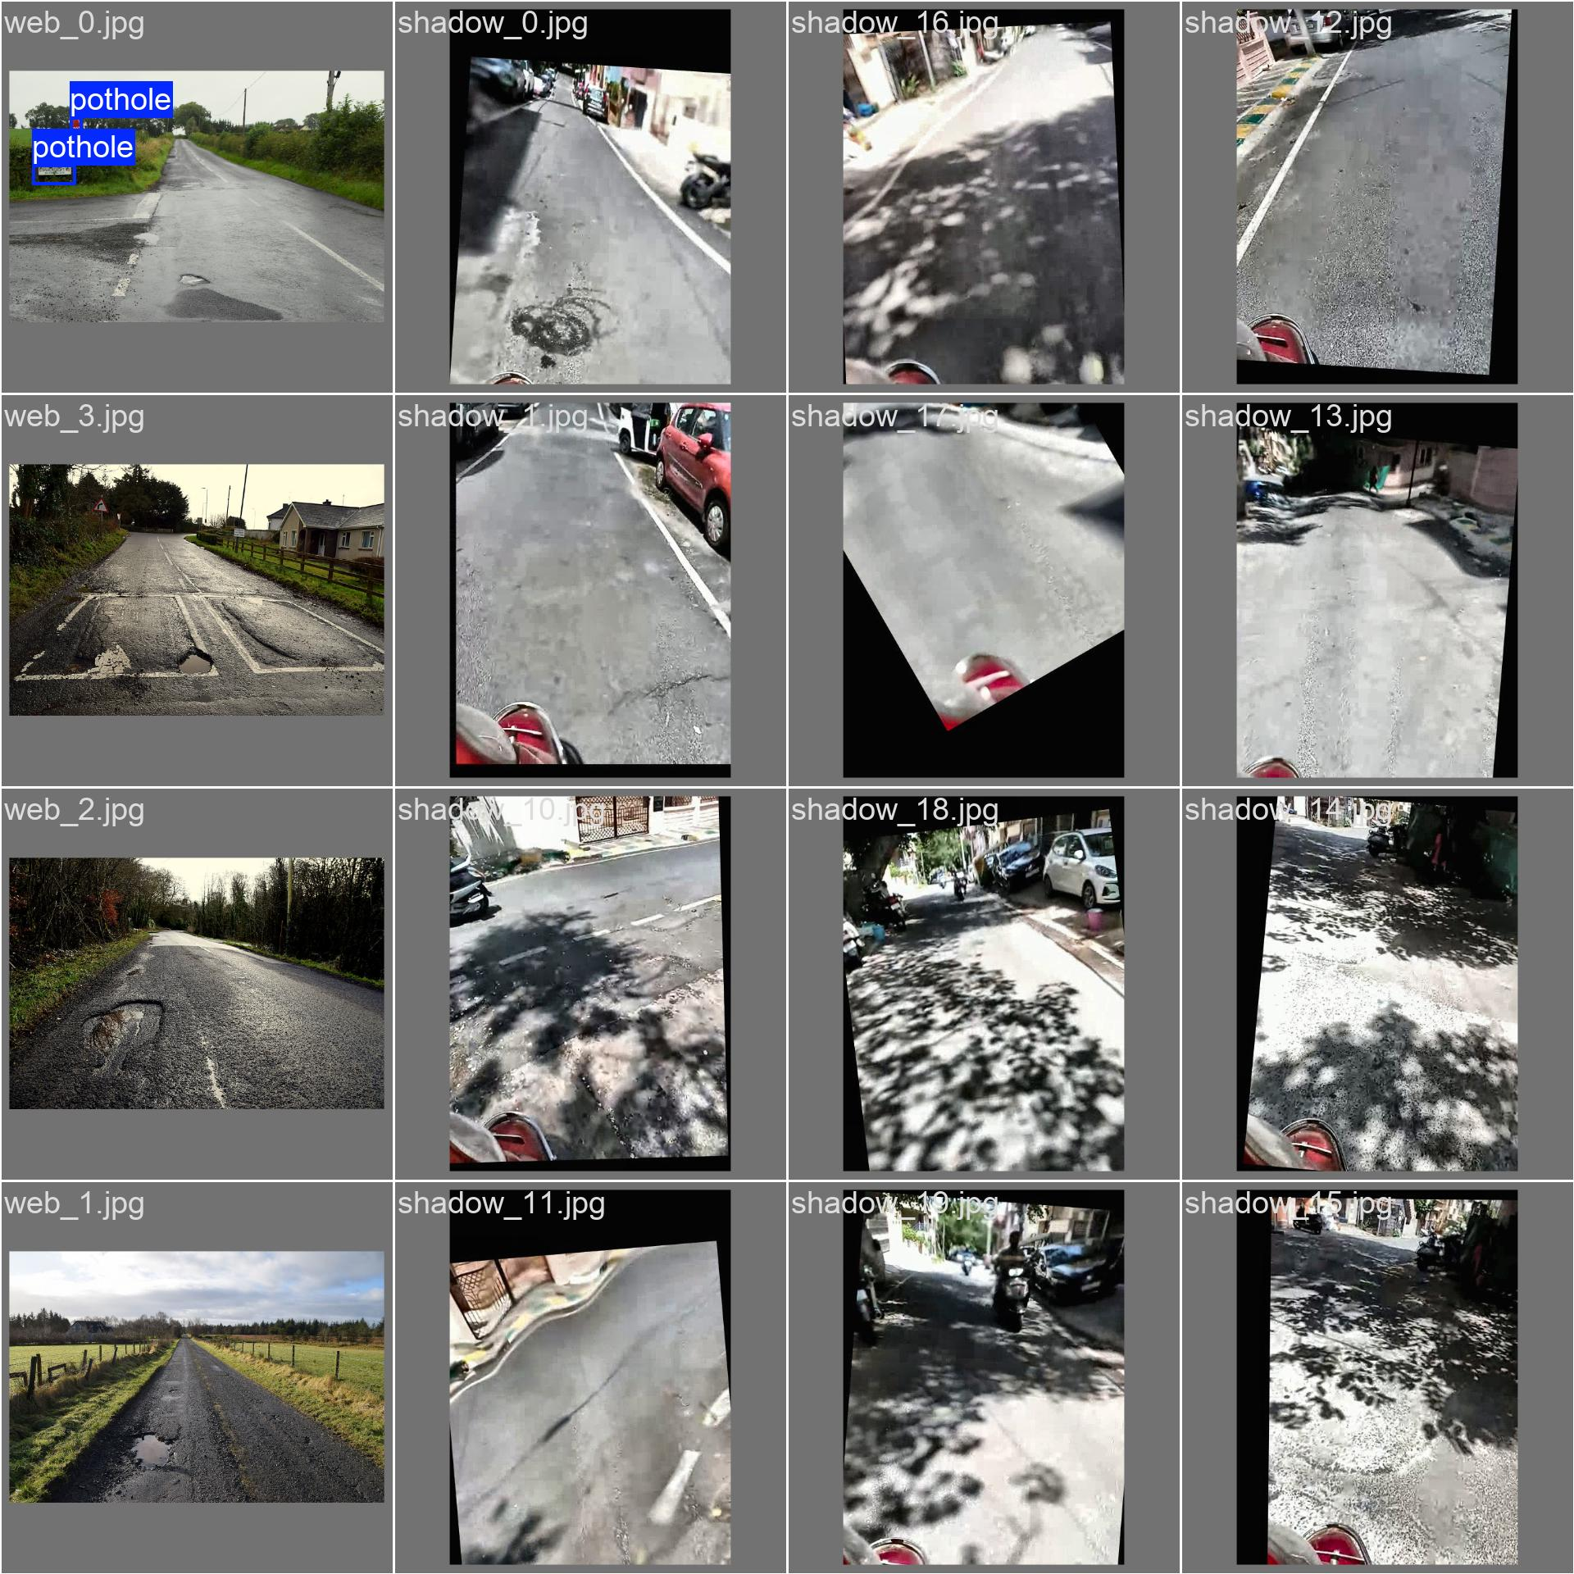
Visual Data Labeling (Bounding Boxes)

