Slide 1
RoadSense: Week 1 to 4 Progress
Building the Foundation & Custom Labeling Tools
Saket M

Slide 2
Week 1 to 4: The Goal
Objective: Establish a robust pipeline for collecting and labeling raw sensor data.
  Challenges faced:
    Raw accelerometer and gyroscope data from smartphones is noisy.
    Existing labeling tools (like CVAT or LabelImg) are designed for images, not 1D time-series sensor data.
    We needed a custom solution to visually map Z-axis jolts to physical potholes.

Slide 3
Technologies Used
Frontend Technologies:
  Vanilla HTML5, CSS3, and JavaScript
  Glassmorphism UI design for a premium, distraction-free dark mode
Data Visualization & Processing:
  Chart.js: For rendering high-performance interactive graphs of the Z-axis acceleration.
  Papa Parse: For rapid, client-side parsing of large CSV files.

Slide 4
What We Did: Custom Sensor Labeling Tool
Developed a web-based application to annotate time-series CSVs.
  Interactive Charting: Users can drag and zoom over the acceleration timeline.
  Region Selection: Highlight a section of the graph and label it as 'Pothole' or 'Speed Breaker'.
  Export functionality: The tool maps the labeled regions back to the exact timestamps and exports a new annotated CSV.
  Undo/Redo system and keyboard shortcuts for rapid workflow.

Slide 5
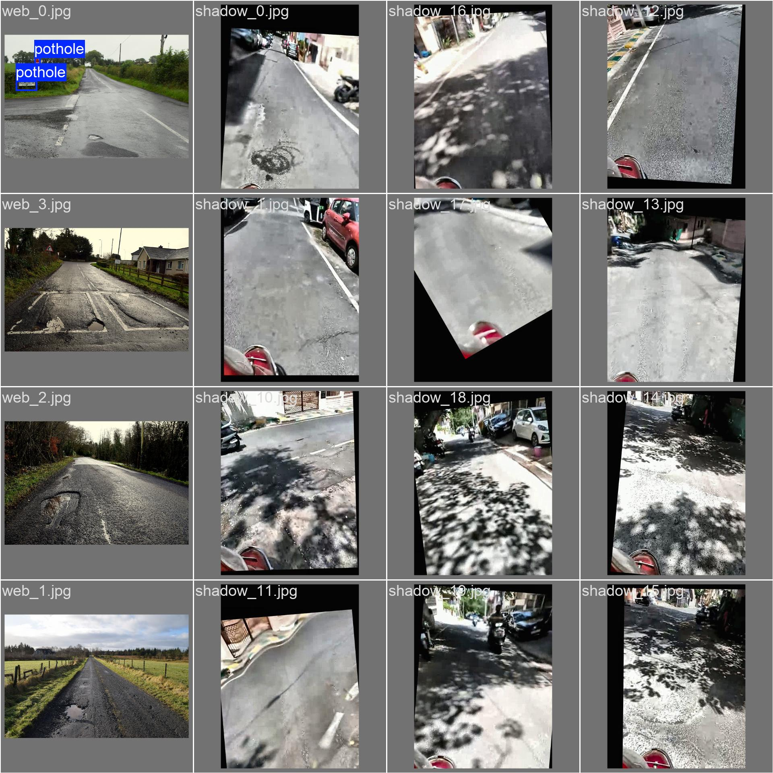
Visual Data Labeling (Bounding Boxes)

Slide 6
Future Improvements (Aimed at Week 4)
Tool Enhancements:
  Implement LocalStorage auto-saving to prevent data loss on browser refresh.
  Data decimation for rendering massive 30-minute ride files without lag.
  Add 'Auto-Spike Detection' to automatically highlight regions where Z-axis > 12 m/s².
Project Evolution:
  Transition from sensor-only detection to Multi-Sensor Fusion (Camera + YOLOv8 + Accelerometer).

